Slide 1
Lab1 – Understand NN and Training Process
Advisor：Tsai, Chia-Chi
TA：賴姿伶

Slide 2
Outline
Lab1 tasks
Google Colab
How NN works
MNIST dataset

Slide 3
Outline
Lab1 tasks
Google Colab
How NN works
MNIST dataset

Slide 4
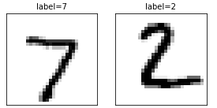
1. Lab1 tasks
Implement the following layers as a python function ( both forward and backward propagation )
Inner-product layer (10%)
Activation layer (Sigmoid or Rectified) (10%)
Softmax layer (10%)
Implement training and testing process
Included cross-validation (5%)
Use cross-entropy as loss function (5%)
Build neural network to solve the MNIST classification problem
At least one hidden layer neural network (cannot use convolutional layer) (10%)
Accuracy must > 90%
Print test and val accuracy. Plot epoch-train accuracy, epoch-val accuracy, epoch-train loss, epoch-val loss (10%)
Report (40%)

Slide 5
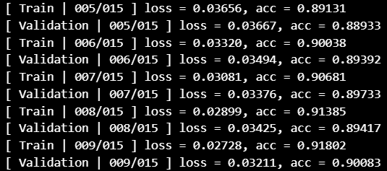
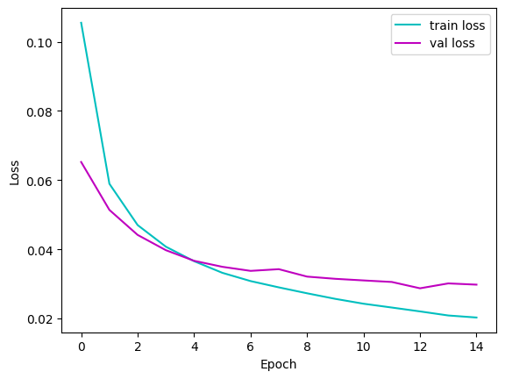
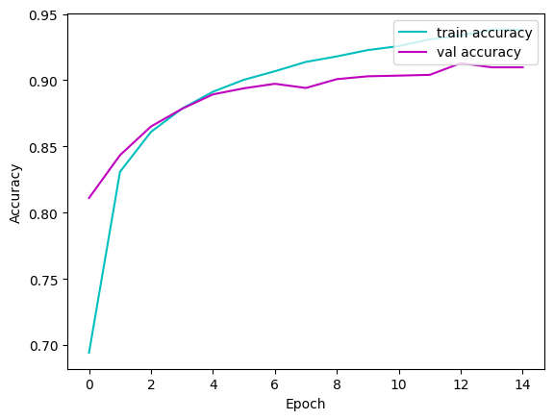
Display your result
Print val accuracy of each epoch.
Plot epoch-accuracy and epoch-loss.
Print test accuracy.

Slide 6
Outline
Lab1 tasks
Google Colab
How NN works
MNIST dataset

Slide 7
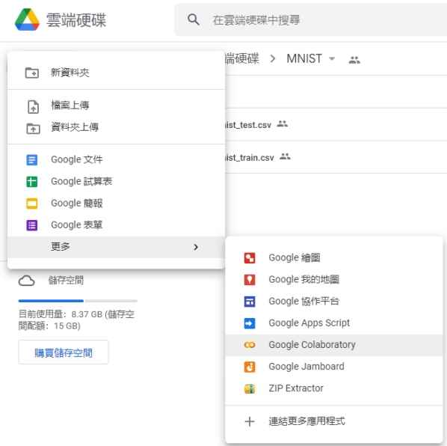
2. Google Colab
Go to Google Drive and Create a Google Colaboratory file
Notes:
Q: 問老師這樣比喻正不正確?

Slide 8
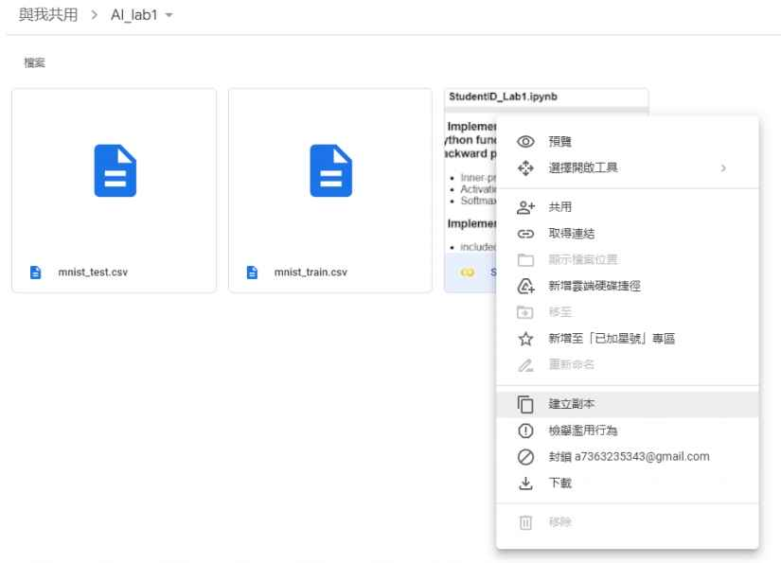
2. Google Colab
於sample code點選”在雲端硬碟中儲存副本”
Notes:
Q: 問老師這樣比喻正不正確?

Slide 9
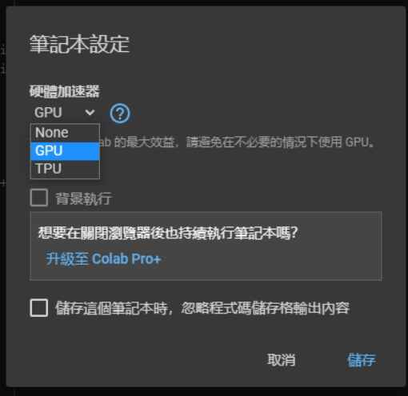
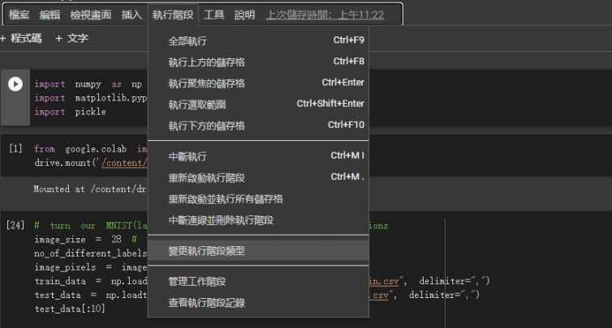
2. Google Colab
Choose GPU as runtime (Default : CPU)
Notes:
Q: 問老師這樣比喻正不正確?

Slide 10
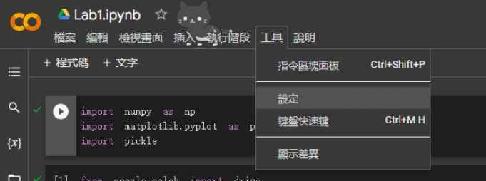
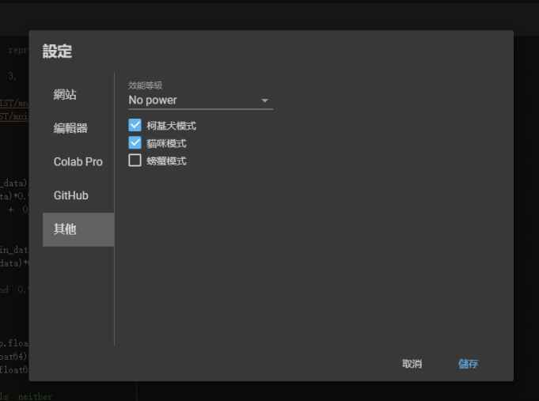
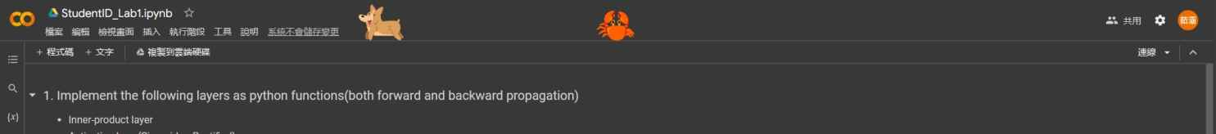
2. Google Colab
Choose a pet
Notes:
Q: 問老師這樣比喻正不正確?

Slide 11
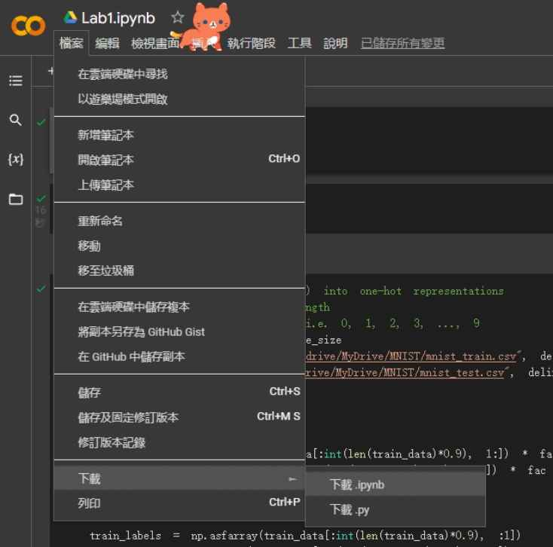
2. Google Colab
Save as ipynb
Notes:
Q: 問老師這樣比喻正不正確?

Slide 12
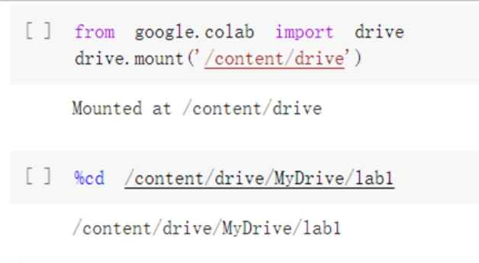
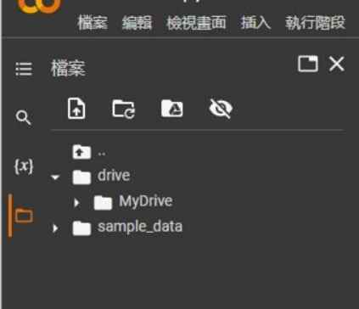
2. Google Colab
連結到雲端資料夾並設定當前路徑
Notes:
Q: 問老師這樣比喻正不正確?

Slide 13
Outline
Lab1 tasks
Google Colab
How NN works
MNIST dataset

Slide 14
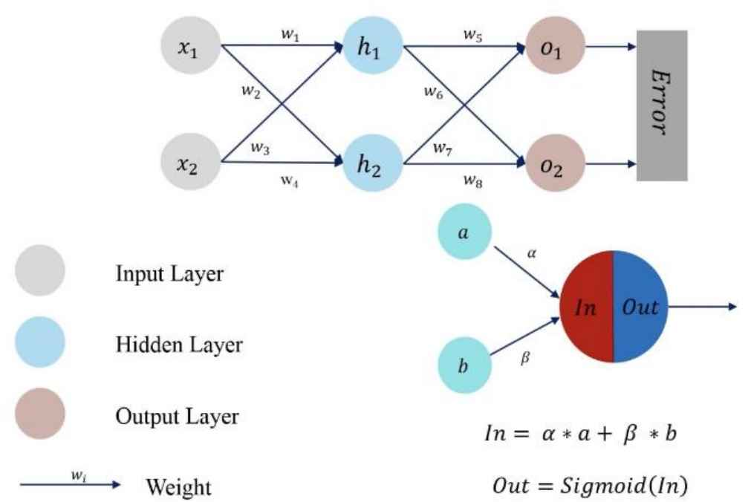
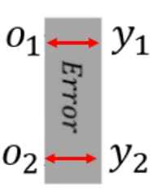
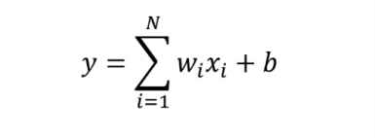
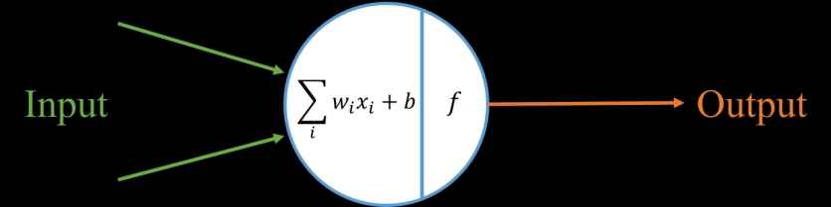



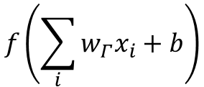

NN training
𝑓 𝑖𝑠 𝑎𝑐𝑡𝑖𝑣𝑎𝑡𝑖𝑜𝑛 𝑓𝑢𝑛𝑐𝑡𝑖𝑜𝑛
𝑓(𝑥) = 𝑆𝑖𝑔𝑚𝑜𝑖𝑑(𝑥)
In
Out
$$x_{1}$$
$$w_{1}$$
$$f\left(\sum_{i}{w_{Γ}x_{i}}+b\right)$$
Input
output
$$w_{2}$$
$$x_{2}$$
Lab 1 use Softmax as the output layer
Notes:
Q: 問老師這樣比喻正不正確?

Slide 15
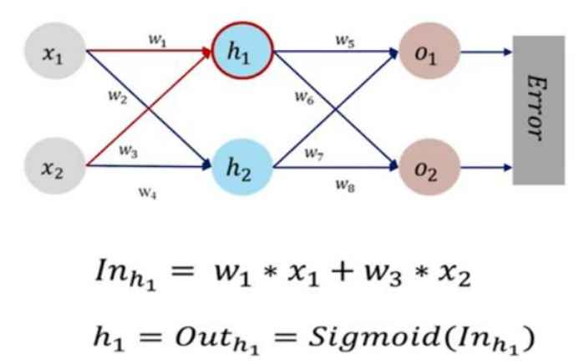
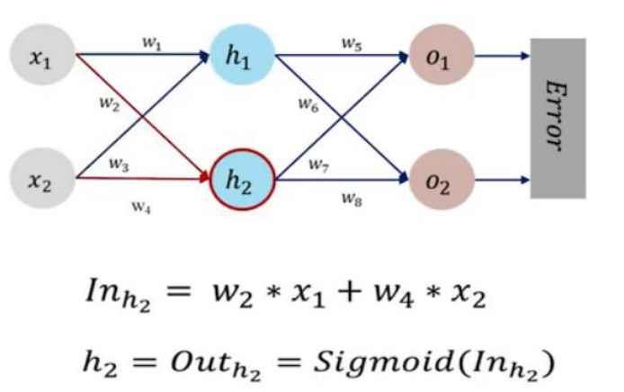
NN training – forward propagation
Notes:
Q: 問老師這樣比喻正不正確?

Slide 16
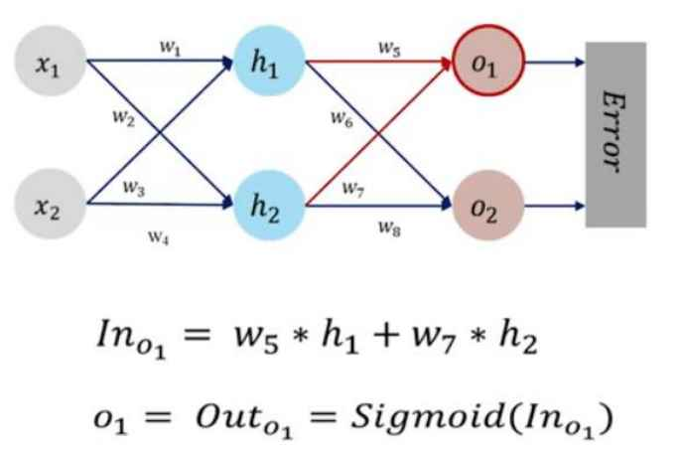
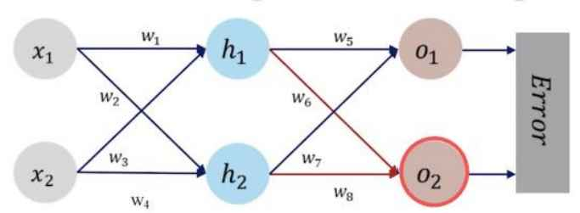
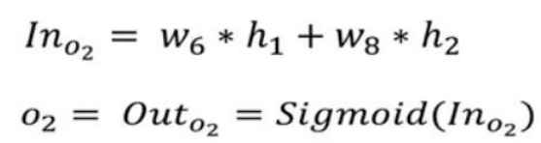
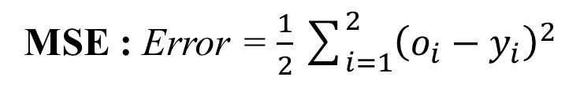
NN training – forward propagation
MSE : Error = $\frac{1}{2}\sum_{i=1}^{2}{{\left(o_{i}−y_{i}\right)}^{2}}$
Notes:
Q: 問老師這樣比喻正不正確?

Slide 17
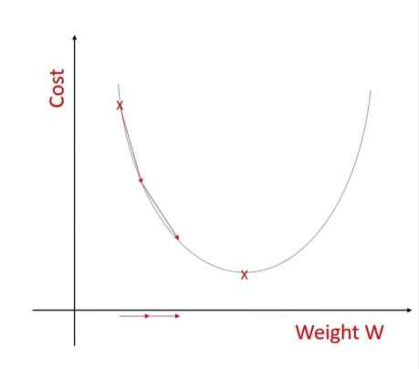
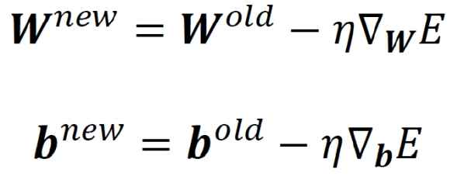
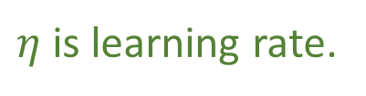
Gradient Descent
Calculate the gradient of the loss function with respect to the weights, and adjust the weights along the gradient direction to reduce the loss.
In the neural networks, there are only the inner-product layers have weights to be optimized.
Using gradient descent to optimize parameters in inner-product layers.
$η$ is learning rate.

Slide 18
Gradient Descent
Learning rate determines the step size.
If the learning rate is too large, there will often be instability and easily to miss the best result.
If the learning rate is too small, more iterations are needed to reach the minimum value.
Learning rate = 0.9
Learning rate = 0.1

Slide 19
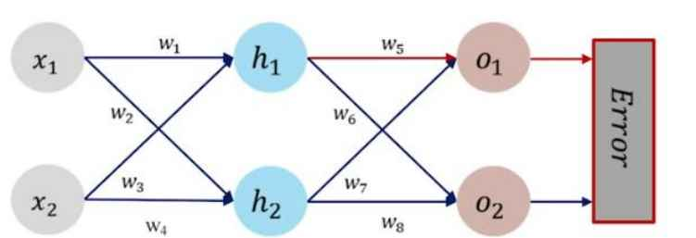

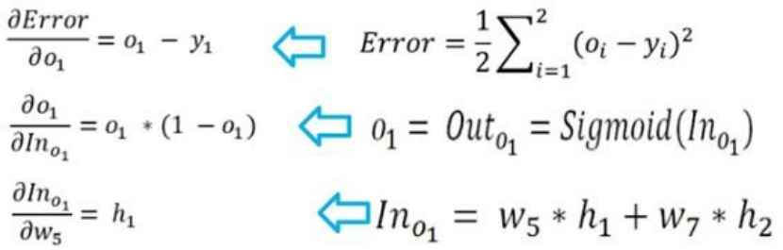



NN training – backward propagation
$$w_{5}$$
$$w_{8}$$
計算 到 的梯度(誤差對每個權重的變化)
(以 為例)
$$w_{5}$$

Slide 20
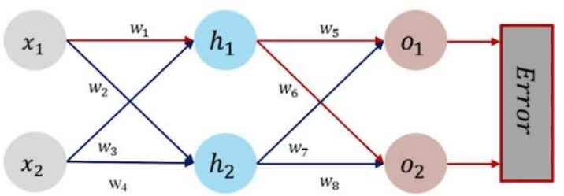
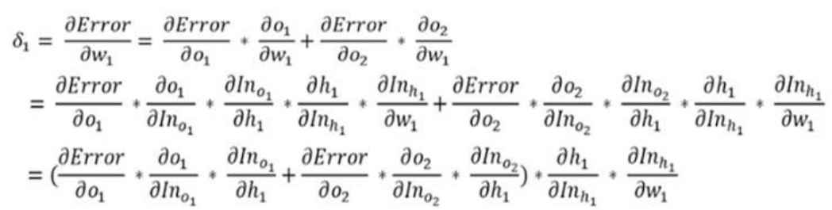



NN training – backward propagation
$$w_{1}$$
$$w_{4}$$
計算 到 的梯度(誤差對每個權重的變化)
(以 為例)
$$w_{1}$$

Slide 21
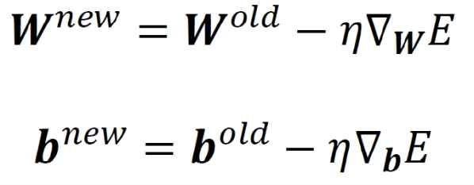

NN training – backward propagation
更新權重
$δ_{1}$ $\sim δ_{8}$

Slide 22
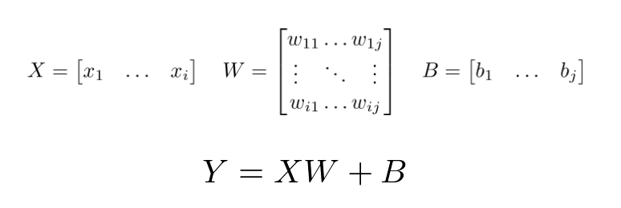
Inner-product layer
Forward propagation
# i : the number of input neurons
# j : the number of output neurons

Slide 23



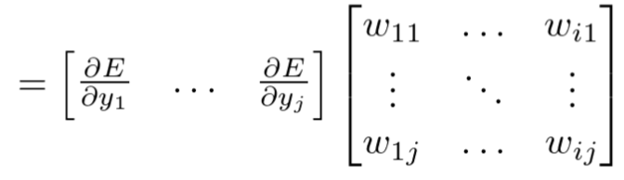





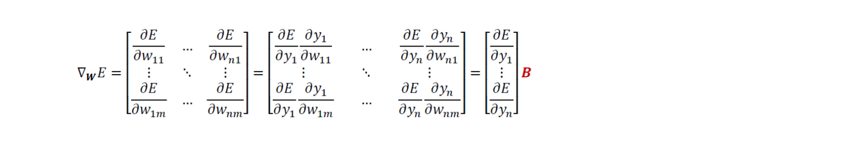
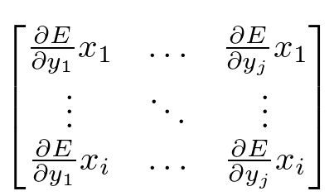
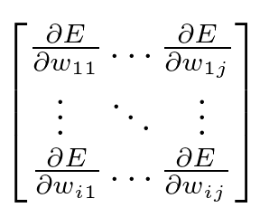













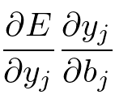




Inner-product layer
Backward propagation
$$Y=XW+B$$
A
$$\frac{∂E}{∂X}=\frac{∂E}{∂Y}\frac{∂Y}{∂X}=\frac{∂E}{∂Y}W$$
B
$$\frac{∂E}{∂W}=\frac{∂E}{∂Y}\frac{∂Y}{∂W}=X\frac{∂E}{∂Y}$$
$$\frac{∂E}{∂B}=\frac{∂E}{∂Y}\frac{∂Y}{∂B}=\frac{∂E}{∂Y}1$$
C
Please find the matrices A, B and C

Slide 24
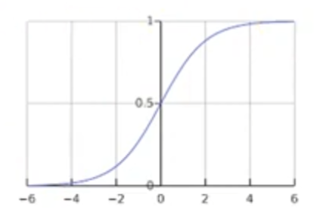
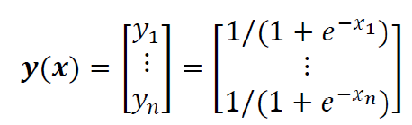
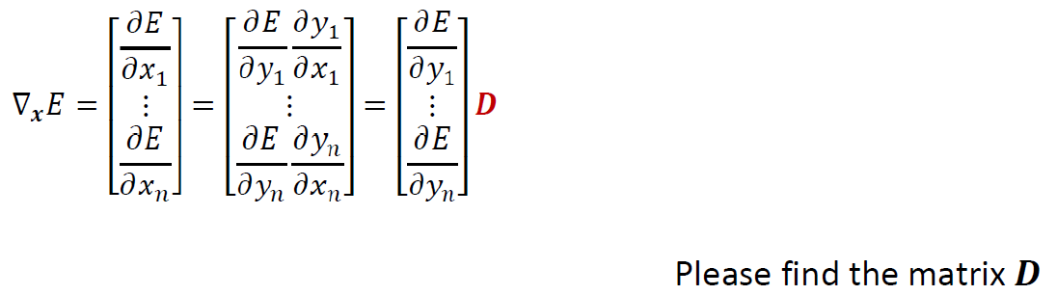
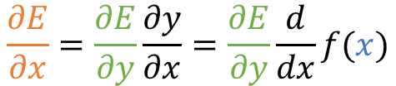

Activation layer- Sigmoid function
Forward propagation
Backward propagation
$$\frac{∂E}{∂x}=\frac{∂E}{∂y}\frac{∂y}{∂x}=\frac{∂E}{∂y}\frac{d}{dx}f(x)$$
$$D$$

Slide 25
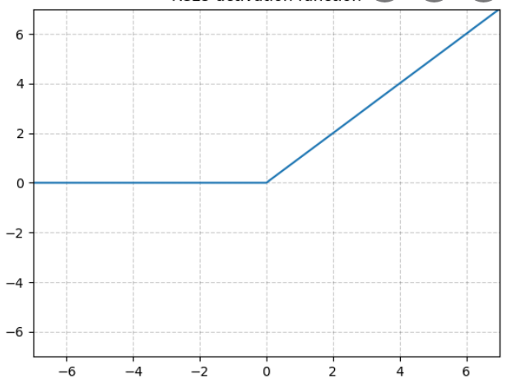
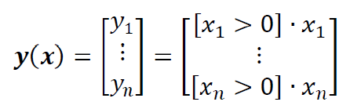
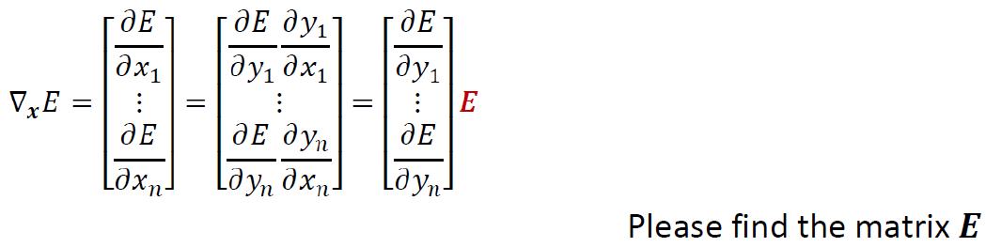

Activation layer- Rectified function
Forward propagation
Backward propagation
$$\frac{∂E}{∂x}=\frac{∂E}{∂y}\frac{∂y}{∂x}=\frac{∂E}{∂y}\frac{d}{dx}f(x)$$
$$E$$

Slide 26
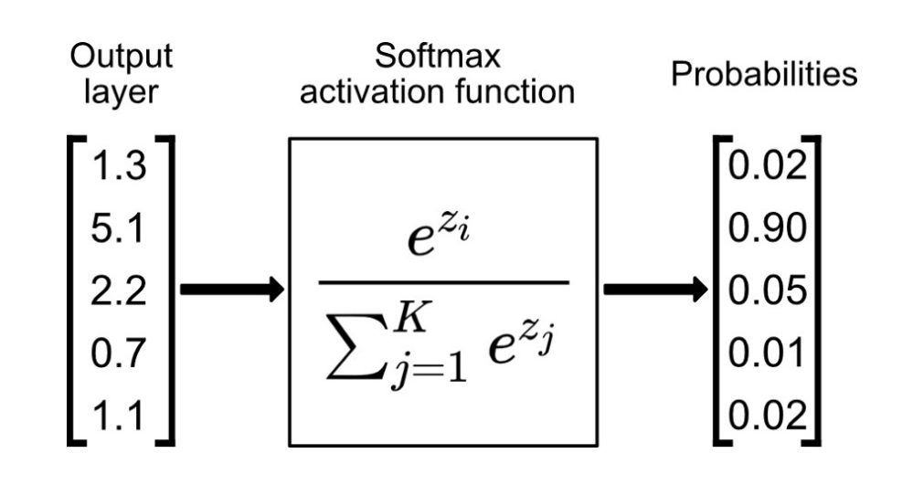
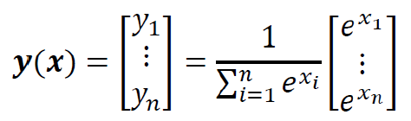
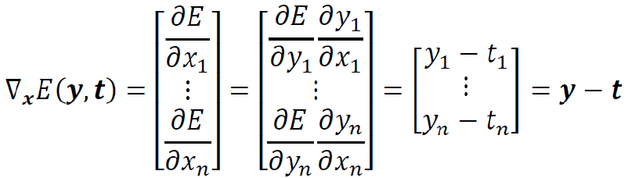
Softmax layer
Forward propagation
Backward propagation

Slide 27
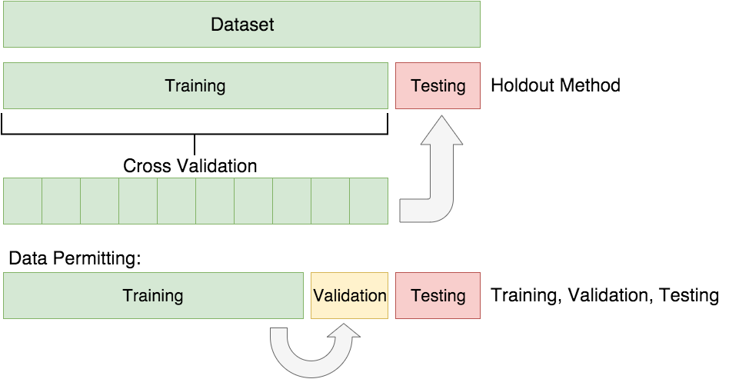
Cross validation

Slide 28
Outline
Lab1 tasks
Google Colab
How NN works
MNIST dataset

Slide 29

MNIST Dataset
MNIST dataset is a large dataset of handwritten digits
Train: 60000 images (28*28 pixels) + one label for each image
train_images[60000][784] : consist of 60000 images
train_labels[60000] : consist of 60000 labels
Test: 10000 images (28*28 pixels) + one label for each image
test_images[10000][784] : consist of 10000 images
test_labels[10000] : consist of 10000 labels

Slide 30



原始 Dataset
How to load ubyte?

Slide 31


Coding Dataset
mnist_train.csv & mnist_test.csv
讀寫容易，數據可以表格化展示
pixel information
label

Slide 32


One-hot encoding
easy to show predicted probability of each label

Slide 33
Upload to moodle
學號_lab1.zip
學號_lab1.ipynb
IPython notenook 須包含程式碼跟結果
學號_lab1.pdf
說明如何實作各個layer
用自己的話說明forward / backward如何進行
截圖並說明各項結果(包含accuracy和loss圖表(plot)的結果)
實作過程中遇到的困難及你後來是如何解決的(optional)

Slide 34
Thanks for your listening
Advisor：Tsai, Chia-Chi
雲端連結:
https://drive.google.com/drive/folders/1iaHWh042C6TRjOw4ybh6udM9JtHeQO3u?usp=sharing

