Slide 1
Acoustics of Speech and Linear Prediction Modeling
EE6641 Analysis and Synthesis of Audio Signals
Yi-Wen Liu
Updated Nov. 24, 2015

Slide 2
Agenda
Acoustics
Impedance, reflectance, multi-tube modeling
Linear prediction (LP)
Relation to acoustics
LP and spectral analysis
Least-square formulation
Formants: resonant peaks
LP and speech synthesis
LP and speech recognition

Slide 3
Acoustics: the impedance concept
Canonical acoustic variables are
Acoustic pressure P(x,t)
Volume velocity U(x,t)
Z = P/U is the characteristic impedance
(and, how about Q = PU?)
Based on continuity and Newton’s law, Z = ρc/A
ρ: Density of air
c: Speed of sound (~340 m/s or 1 ft/ms)
A: Cross-section area

Slide 4
More on Z = ρc/A
The characteristic impedance is frequency-independent (?!)
This formula does not consider
Dissipative loss
Friction 摩擦力
Viscosity 黏滯性
Propagation modes
Turbulence 紊流
Other nonlinear effects

Slide 5
Continuity, impedance mismatch, and acoustic reflectance
Now consider acoustic wave propagation through the boundary between two tubes
Due to impedance mismatch, a portion of the wave is reflected and a portion crosses the boundary
P₁⁺
P₂⁺
P₁⁻

Slide 6
Acoustic pressure reflectance and transmittance
Reflectance R can be defined as P₁⁻/P₁⁺
Based on continuity, we can show that
r₁₂ = (Z₁-Z₂)/(Z₁+Z₂)
T = 1-r is called the transmittance
P₁⁺
P₂⁺
P₁⁻

Slide 7
Two-port formulation
7
Now consider reflected waves as a linear combination of left- and right- going incident waves
use volume velocity U as the input-output variable
we have:
U₁⁺
U₂⁺
U₂⁻
U₁⁻

Slide 8
Signal-flow graph
1+r
u₁⁺[n]
u₂⁺[n]
-r
r
u₁⁻[n]
u₂⁻[n]
1-r
U₁⁺
U₂⁺
U₂⁻
U₁⁻

Slide 9
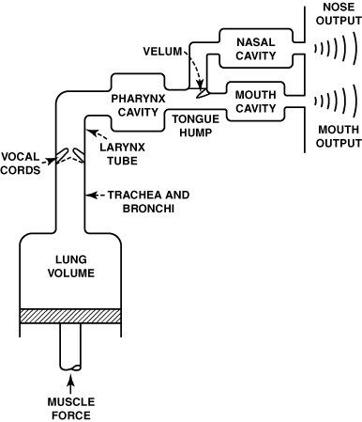
The multi-tube model of the vocal tract
r_{ij} : reflectances
. . .
r₁₂
r₂₃
r_{N-1,N}
Z₁
Z₂
Z_{N}
Z_{i}: char. impedances
This part changes its
shape when producing
speech
http://cobweb.ecn.purdue.edu/~ee649/notes/figures/vocal_schematic.gif

Slide 10
Signal flow of the multi-tube model
. . .
r₁₂
r₂₃
r_{N-1,N}
Z₁
Z₂
Z_{N}
1+r₁₂
u₂⁺[n]
1+r₂₃
u₃⁺[n]
u₁⁺[n]
τ₂
τ₃
and so on…
-r₁₂
r₁₂
-r₂₃
r₂₃
u₁⁻[n]
τ₂
τ₃
u₃⁻[n]
1-r₁₂
u₂⁻[n]
1-r₂₃

Slide 11
Source modeling
1+r₁₂
u₂⁺[n]
1+r₂₃
u₃⁺[n]
u₁⁺[n]
τ₂
τ₃
and so on…
-r₁₂
r₁₂
-r₂₃
r₂₃
u₁⁻[n]
τ₂
τ₃
u₃⁻[n]
1-r₁₂
u₂⁻[n]
1-r₂₃
Source impedance:
(1+r_{G})/2
u₁⁺[n]
1+r₁₂
u₂⁺[n]
τ₁
Source Reflectance:
u_{G}[n]
volume
velocity
at glottis
…
r_{G}
-r₁₂
r₁₂
τ₁
τ₂
1-r₁₂

Slide 12
Load modeling
1+r_{N}
1+r_{N-1}
u_{N}⁺[n]
τ_{Ν}
…
-r_{N-1,N}
r_{N-1,N}
-r_{N}
τ_{Ν}
1-r_{N-1,N}
Frequency-dependence analysis:
Frequency decrease
=> Z_{r} approaches 0 => r_{N} approaches 1,
which means output acoustic pressure approaches 0.
Frequency increases
=> r_{N} approaches a constant.
Load impedance due to radiation from lips:
Load reflectance:

Slide 13
The entire multi-tube model with source and load
. . .
r₁₂
r₂₃
r_{N-1,N}
Z₁
Z₂
Z_{N}
(1+r_{G})/2
1+r₁₂
…
1+r_{N-1}
1+r_{N}
τ₁
τ₂
τ_{Ν}
u_{in}[n]
volume
velocity
at glottis
u_{out}[n]
Radiation from lips
r_{G}
-r_{N-1,N}
r_{N-1,N}
-r₁₂
r₁₂
τ₁
τ₂
…
τ_{Ν}
-r_{N}
1-r₁₂
1-r_{N-1,N}

Slide 14
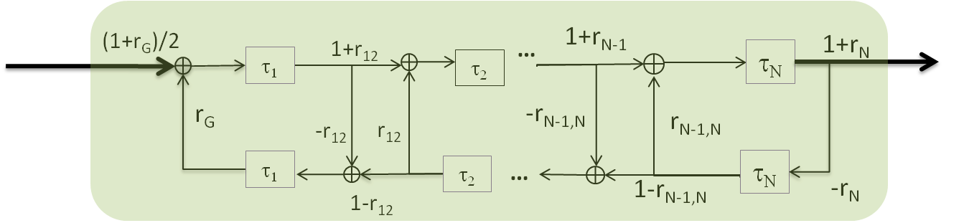
Linear prediction: Vocal tract as an all-pole IIR filter
e[n]
glottal source;
excitation
x[n]
output
We can write x[n] in terms of e[n]:
This equation is called a linear prediction model
P is the order of prediction
a_{k}’s are the linear prediction coefficients

Slide 15
Speech analysis and synthesis based on LP
Analysis:
record x[n]
estimate a_{k}’s that gives best prediction of x[n]
Best prediction is formulated as a least-square problem*
Synthesis: Create e[n], synthesize x[n] in real-time.
Reflectances and LP coefficients are related via the Levinson-Durbin recursive formula.
glottal source;
excitation
e[n]
output
x[n]

Slide 16
LP analysis: a least-square formulation
Can be formulated as a matrix
inverse problem:
Find {a_{k}}, k = 1, 2, …, P
so as to minimize the sum of square of prediction error e[n], defined as below,
K
b
a
x[1] x[2] … … x[P]
x[2] x[3] … … x[P+1]
.
.
.
x[L] x[L+1] … x[P+L]
x[P+1]
x[P+2]
.
.
.
x[P+L]
a₁
a₂
.
.
.
a_{P}
≈
Solution:
a = (K^{T}K)⁻¹(K^{T}b)

Slide 17
A least-square solver: MATLAB lpc() function
LPC Linear Predictor Coefficients.
A = LPC(X,N) finds the coefficients,
A=[ 1 A(2) ... A(N+1) ], of an Nth order forward linear predictor.
Xp(n) = -A(2)*X(n-1) - A(3)*X(n-2) - ... - A(N+1)*X(n-N)
such that the sum of the squares of the errors
err(n) = X(n) - Xp(n)
is minimized.

Slide 18
Remarks on least-square prediction
The resulting prediction error e[n] is spectrally maximally flat
The prediction “whitens” the signal
Makes sense, for the white noise is uncorrelated from sample to sample, which makes it impossible to predict further.
In practice, because of spectral roll-off, one needs to pre-emphasize* before LP analysis.

Slide 19
Pre-emphasis and de-emphasis
FIR pre-emphasis
Linear Prediction
Analysis
y[n]
x[n]
e[n]: estimated source
find {a₁, … a_{P}}
x[n] = y[n] – 0.95 y[n-1]
Multi-tube synthesis
IIR De-emphasis
e[n]
x[n]
y[n]
y[n] = 0.95 y[n-1] + x[n]

Slide 20
Source-filter separation
Find {a₁,..a_{P}} such that energy of e[n] is minimized.
Turns out that such e[n] will be maximally spectrally flat.
This provides a source-filter separation:
{a₁,..a_{P}}: vocal-tract filter
e[n]: glottal source = {voiced, unvoiced}
When voiced, use pulse train
When unvoiced, use white noise
Noise generator
e[n]
All-pole filter {a₁,..a_{P}}
s[n]
Glottal
source
Speech signal
Pulse-train generator
Vocal tract

Slide 21
More on LP
Speech synthesis: By replacing e[n] with a template, speech compression achieves <8k bits/s.
Codebook excited linear prediction (CELP)
key technology for voice over internet and wireless networks.
Speech recognition: From {a₁,..a_{P}}, we can estimate
Vocal tract constriction
Frequency-envelope; formant structure.
e[n]
All-pole filter {a₁,..a_{P}}
s[n]
Glottal
source
Speech signal
Vocal tract

Slide 22
LP finds an all-pole filter that provides spectral smoothing
x[n]
e[n]
All-pole filter {a₁,..a_{P}}
x[n]
Glottal
source
e[n]
X(ω)
E(ω)
Adapted from Rabiner & Juang, p. 108.

Slide 23
Formant frequencies and speech production
f1
f2
f3
The formant filter
2000
f2-f1
300
i (heed)
300
front
back
u (loose)
ɪ (hid)
high
ʊ (look)
f1
Articulation
space
ɛ (head)
ɔ (law)
(had)
900 Hz
low
ɑ (lot)

Slide 24
References
王小川: 語音訊號處理(三版, 2009) 全華出版社
S. Vaseghi (2007). Multimedia signal processing: theory and applications in speech, music, and communications. London: Wiley.
T. Quatieri (2001). Discrete-time speech signal processing: principles and practice. Prentice-Hall.
L. Rabiner and B.-H. Juang. (1993). Fundamentals of speech recognition. Prentice-Hall.

