Slide 1
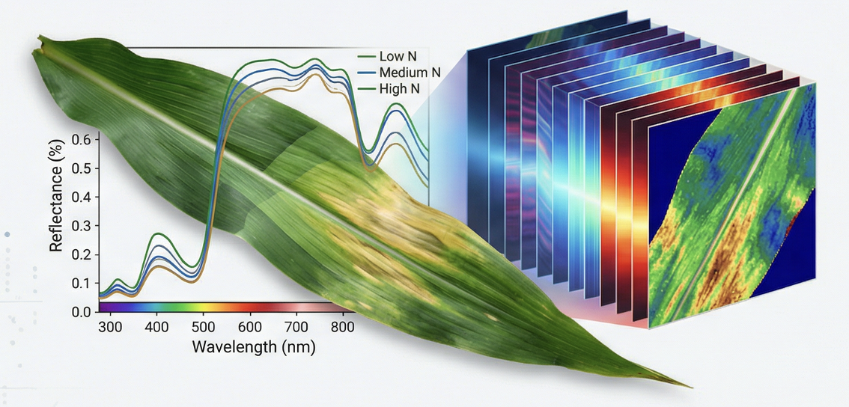
Hyperspectral Imaging for Nitrogen
Status Classification in Corn Leaves
A Multi-Scale Analysis Combining Spectral Indices,
Machine Learning, and Anatomical Segmentation
Jingbo Yue
Sourav Mohapatra

Slide 2
Contents
INTRODUCTION
OBJECTIVES
MATERIALS AND METHODS
RESULTS AND DISCUSSION
KEY FINDINGS
CONCLUSIONS

Slide 3
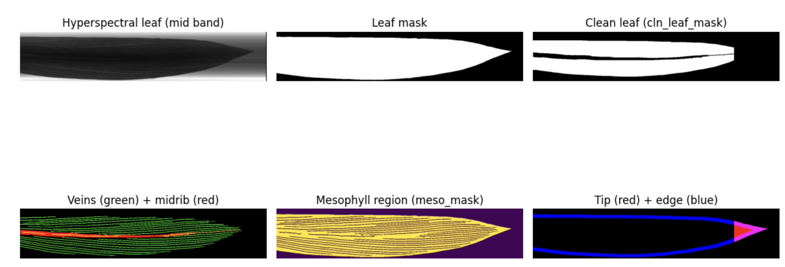
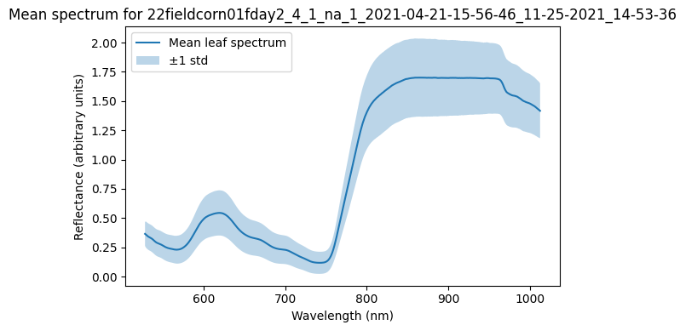
Introduction
Nitrogen is a key nutrient controlling corn growth, chlorophyll formation, and canopy reflectance.
Traditional nitrogen assessment (visual scouting, tissue sampling) is subjective, slow, and often detects stress too late.
Hyperspectral imaging offers a non-destructive, pixel-level view of leaf physiology across hundreds of wavelengths.
Our dataset captures reflectance across 364 spectral bands (≈400–1000 nm), enabling fine-grained analysis of nitrogen stress signatures.
Problem Statement:
“Given hyperspectral images of corn leaves under N1 (low N) and N2 (high N) conditions:
  Can we reliably distinguish N1 vs N2?
  Where on the leaf are spectral / nitrogen differences most pronounced?”
Notes:
“Corn productivity depends strongly on Nitrogen availability—it directly affects chlorophyll formation and therefore how plants absorb and reflect light.
Traditionally, Nitrogen is assessed visually or through destructive tissue sampling, which is slow, subjective, and usually detects stress too late.
In our study, we leverage hyperspectral imaging, which captures reflectance at 364 different wavelengths per pixel. This gives us a non-destructive, high-resolution way to detect Nitrogen stress much earlier than human observation.
The main questions we focus on are:
1. Can hyperspectral data reliably distinguish low-nitrogen (N1) from high-nitrogen (N2) leaves?
2. Where on the leaf are Nitrogen-driven spectral differences the most pronounced?
Answering these leads to more precise nutrient monitoring and ultimately higher crop efficiency.”

Slide 4
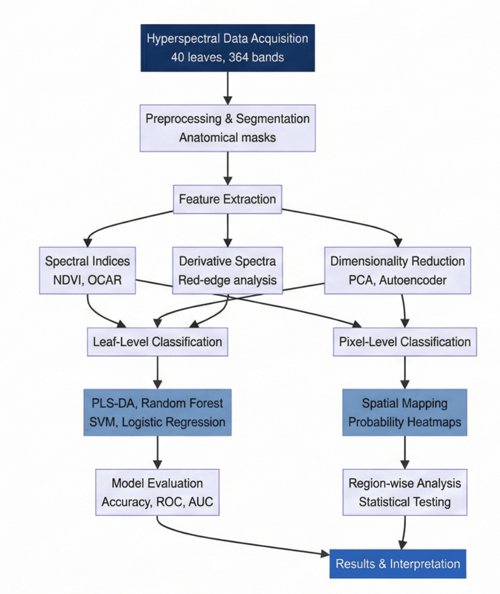
Workflow

Slide 5
Objectives
Develop reliable nitrogen-classification models
Distinguish N1 (low N) and N2 (high N) treatments using full-leaf and pixel-level hyperspectral features.
Validate a multi-scale hyperspectral analysis framework
Compare leaf-level spectra, vegetation indices, PCA features, pixel-level classifiers, and autoencoder embeddings.
Identify key spectral biomarkers of nitrogen stress
Determine the wavelengths, indices (NDVI, OCAR), and spectral derivatives most sensitive to nitrogen variation.
Quantify anatomical region-specific responses
Evaluate how veins, midrib, mesophyll, edges, and tips differ in spectral and nitrogen-probability behaviour.
Benchmark classical indices vs machine-learning models
Compare NDVI/OCAR with logistic regression, SVM, random forest, PLS-DA, and PCA-based classifiers.
Notes:
Our objectives span multiple scales — from whole-leaf summaries to pixel-level physiological patterns.
First, we aim to build nitrogen-classification models distinguishing N1 vs N2.
We validate a multi-scale pipeline, combining spectral indices, PCA, pixel-level classification, and anatomical segmentation.
We identify key spectral biomarkers, especially in red and red-edge regions.
We quantify region-specific responses across veins, mesophyll, tips, and edges.
Finally, we benchmark simple index-based models against machine learning models such as SVM and logistic regression.
This layered approach helps us understand both accuracy and the underlying plant physiology.”

Slide 6
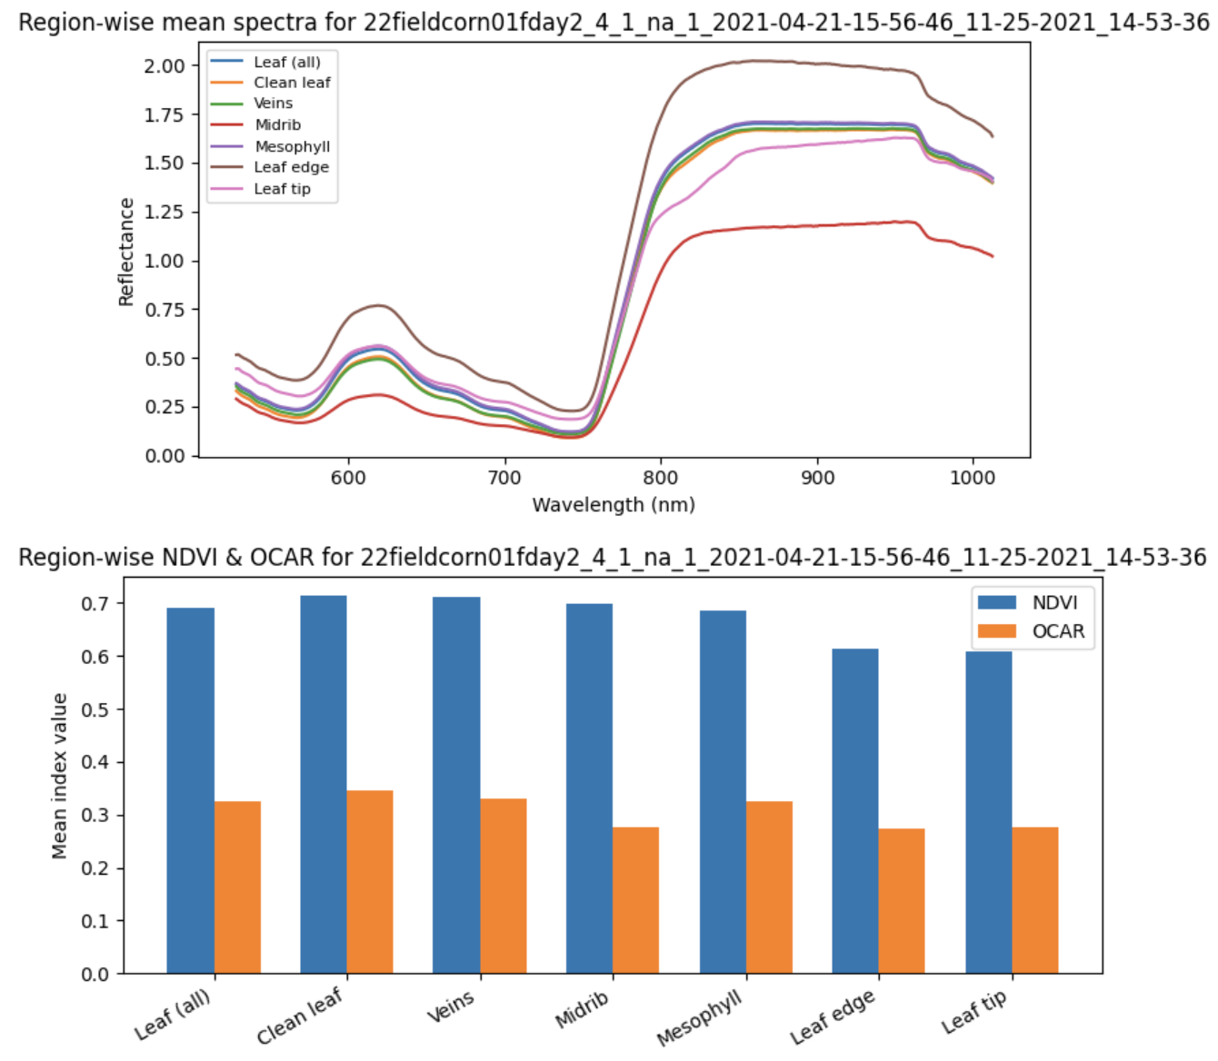
Materials and Methods
Dataset: 40 hyperspectral corn leaf images
(224 × 1111 pixels × 364 spectral bands, 400–1000 nm).
Treatments: N1 (Low Nitrogen) vs. N2 (High Nitrogen), 20 leaves each.
Segmentation: 7 anatomical region masks
– Leaf (whole leaf)
– Clean leaf
– Veins
– Midrib
– Mesophyll
– Leaf edge
– Leaf tip
Vegetation Indices:
– NDVI (NIR–Red / NIR+Red)
– OCAR (R700 – R670 / R700), chlorophyll-sensitive.
Pixel-level modelling:
PCA compression → Logistic Regression classifier for P(N2).
Notes:
We worked 20 low-N and 20 high-N leaves.
We captured visible, red-edge, and near-infrared regions where nitrogen affects reflectance. The highest reflectance we can clearly see is the leaf edge; the lowest reflectance is the midrib.
We applied anatomical segmentation to isolate clean leaf, veins, midrib, mesophyll, leaf tip, and edge since Nitrogen stress may appear in some tissues before others.
We computed two Nitrogen-sensitive vegetation indices:
NDVI — based on red vs NIR reflectance
OCAR — focused on red-edge behavior
Then, for modeling:
• At leaf level → we used average features per leaf
• At pixel level → we applied PCA compression and logistic regression to produce spatial nitrogen maps
This allows us to compare global vs localized nitrogen effects.”

Slide 7
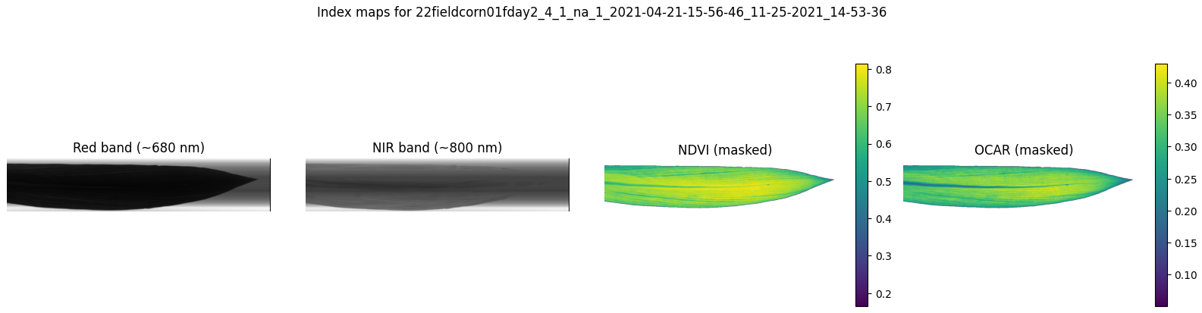
We evaluate two nitrogen-sensitive vegetation indices:
NDVI = (NIR − Red) / (NIR + Red)
OCAR = (R700 − R670) / R700
(exact formula)
Goal:
→ Compare index-based binary classification vs. ground truth labels (N1 / N2)
→ Determine if indices alone can separate nitrogen treatments
Notes:
Here is the specific formula we used to compute NDVI and OCAR.
We apply the leaf mask so only the leaf is shown in color.
We can already see spatial variation:
• The middle area of the leaf has higher NDVI and OCAR values.
• The leaf tip and edges show lower values.
These patterns are consistent with nitrogen levels — healthy tissue usually has higher chlorophyll and higher reflectance in NIR.
This tells us that spectral indices can capture nitrogen-related stress within a leaf, not just an overall leaf value.

Slide 8
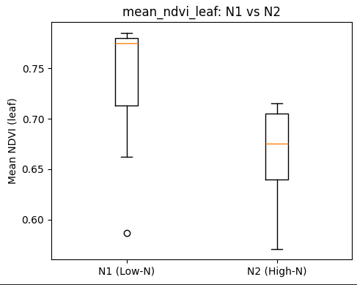
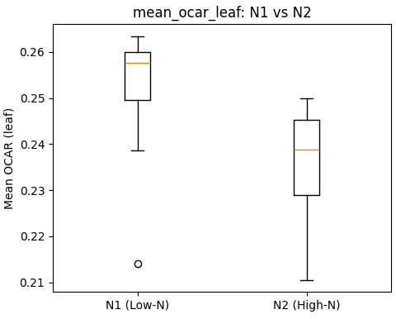
Results and Discussion
Both NDVI and OCAR show statistically significant differences between N1 (low-N)
and N2 (high-N) treatments at the whole-leaf level (p < 0.0001).
High nitrogen increases chlorophyll concentration, resulting in stronger red-band
absorption and therefore lower NDVI values for N2 leaves.
→ Vegetation indices can detect nitrogen-related changes,
but pixel-level variability indicates the need for more powerful
🔜 multivariate machine learning models.
mean_ndvi_leaf: N1 vs N2
t = +4.972, p = 0.0000
mean_ocar_leaf: N1 vs N2
t = +4.837, p = 0.0000
Notes:
We can see both indices clearly separate N1 and N2 leaves statistically.
High nitrogen increases chlorophyll, causing greater absorption in red wavelengths → which results in lower NDVI for N2 leaves.
OCAR shows a similar trend — both indices have p-values < 0.0001, meaning the differences are highly significant.
However, we also observe large pixel-to-pixel variability inside a single leaf → averaging it may hide early stress signals.
So, while index-based detection works well for broad differences, it motivates us to go further with machine learning and spatial analysis.

Slide 9
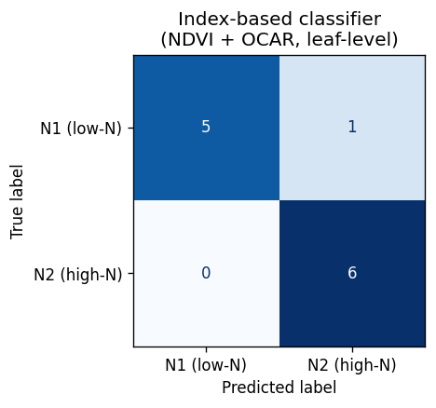
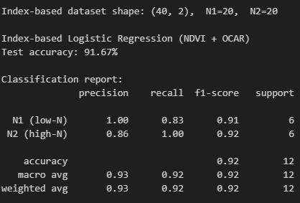
Index-based Classifier
Using only NDVI and OCAR at the leaf level, a simple classifier already achieved 92% accuracy in separating low-N (N1) and high-N (N2) leaves. This confirms that nitrogen differences are clearly detectable in spectral indices.
Next, we move beyond leaf-level averages to pixel-level machine learning models and P(N2) spatial maps for finer nitrogen stress detection.
Notes:
Here we only used the NDVI and OCAR, at the leaf level.
We use 70% for training and 30% for testing. With just two features, logistic regression already achieved 92% accuracy.
From the confusion matrix, we can see that there is only one misclassified leaf.
This means nitrogen stress already affects leaf reflectance strongly, so indices work well.
However, this method assumes the whole leaf is the same.
In reality, Nitrogen stress often starts locally as we mentioned previously, for example at leaf edges or tips.
So next, Sourav will move forward to other machine learning models and spatial P(N2) maps, “the probability maps showing where high nitrogen areas appear on the leaf”,
to detect those fine-scale nitrogen patterns more accurately.

Slide 10
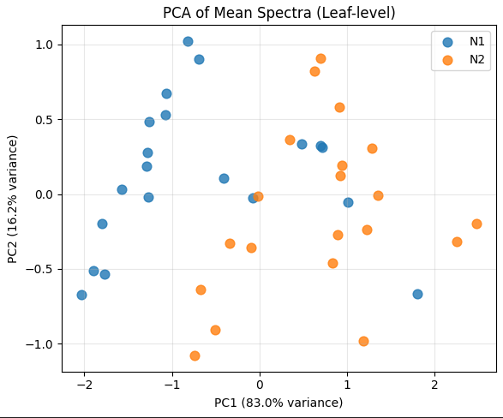
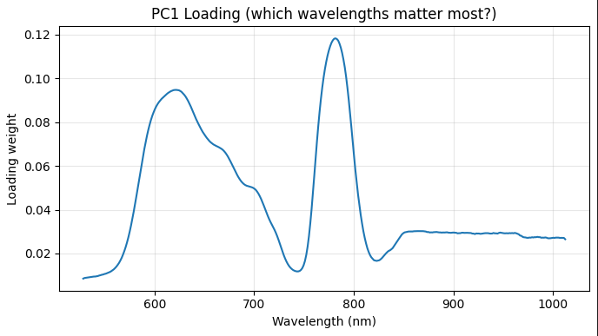
Leaf-Level PCA of Mean Spectra
Input: mean reflectance spectrum per leaf (masked leaf pixels).
PCA with 3 components on matrix of shape (n_leaves, n_bands).
PC1–PC2 scores colored by nitrogen treatment (N1 vs N2).
PC1 loading highlights key wavelength regions (red and red-edge bands).
Spectra matrix shape: (40, 364)
PCA explained variance (%):
PC1=83.0%, PC2=16.2%, PC3=0.6%
Notes:
Input Data
“We start by computing the mean spectrum of all leaf pixels after segmentation.
This gives us a matrix of 40 leaves by 364 spectral bands. So instead of analyzing hundreds of thousands of pixels, we summarize each leaf into a single reflectance curve.”
PCA Results
“We then run PCA with 3 components. The explained variance tells us a lot:
PC1 alone explains about 83% of the variation in the leaf spectra, PC2 explains around 16%, and PC3 is negligible. This means that almost all of the meaningful spectral variability across leaves is captured by just the first two components.”
Separation of Treatments
N1 leaves tend to cluster toward lower PC1 values, and N2 leaves toward higher PC1.
This suggests that nitrogen status has a strong influence on the overall spectral shape.
Which Wavelengths Matter?
“The PC1 loading plot helps us interpret what spectral regions contribute most.
We see strong peaks in the red and red-edge regions, around 680–750 nm. physiological expectations:- nitrogen affects chlorophyll content, and chlorophyll strongly absorbs in the red and transitions sharply in the red-edge region.

Slide 11
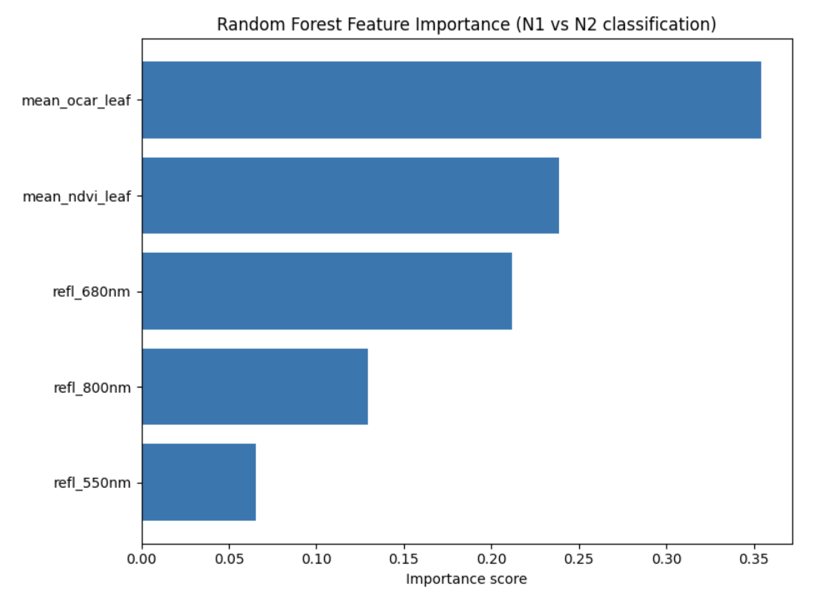
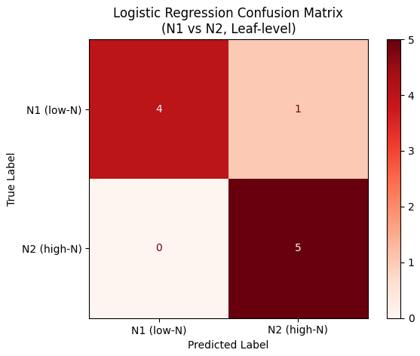
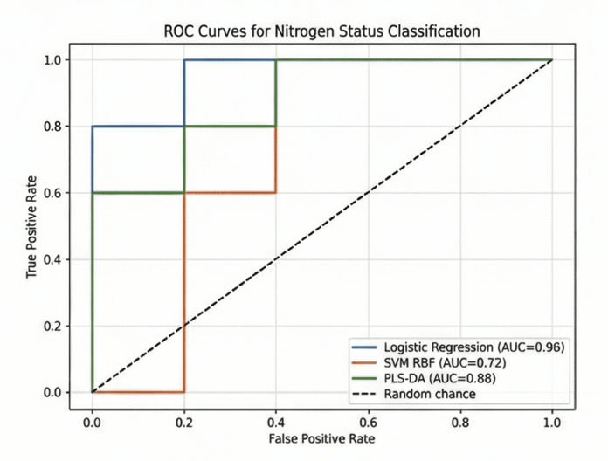
Leaf-Level ML model Comparison
Features used:
mean_NDVI_leaf
mean_OCAR_leaf
refl(550 nm), refl(680 nm), refl(800 nm)
Models evaluated with 5-fold CV:
Logistic Regression → 0.80 ± 0.06
SVM (RBF) → 0.85 ± 0.09 (best CV mean)
Random Forest → 0.80 ± 0.13
PLS-DA → 0.70% test, 0.80% CV
ROC-AUC values:
LogReg: 0.96
PLS-DA: 0.88
SVM: 0.72
All models separate N conditions well, with SVM showing highest CV accuracy and Logistic Regression delivering best AUC.
Notes:
“This slide summarizes our leaf-level machine learning models for distinguishing N1 and N2 nitrogen treatments based on simple spectral features.”
Features Used
“We used five interpretable leaf-level features extracted from the hyperspectral data:
mean NDVI,
mean OCAR,
reflectance at 550 nm,
680 nm,
and 800 nm.
These indices and bands represent chlorophyll absorption, red-edge response, and visible reflectance—so they're physiologically meaningful and lightweight for modeling.”
Across these, SVM achieved the highest mean CV accuracy at 0.85 ± 0.09, indicating strong separation capability even with low-dimensional feature inputs.”
“Logistic Regression and Random Forest performed comparably, around 0.80.”
“PLS-DA, performed slightly lower with ~0.70 test accuracy.”
ROC-AUC Analysis
“Logistic Regression delivered the best ROC-AUC score of 0.96, outperforming even SVM in terms of ranking ability.
PLS-DA achieved an AUC of 0.88, while SVM showed a lower AUC of 0.72, likely due to overfitting on such a small dataset.”
Interpretability: Feature Importance
“Random Forest feature importance indicates that OCAR and NDVI are the strongest predictors, followed by reflectance at 680 nm—consistent with chlorophyll sensitivity and red-edge behavior.
Confusion Matrix Insight
“For Logistic Regression, the confusion matrix shows only one misclassified leaf out of ten in this fold,
Key Takeaway
“Overall, all models correctly distinguish nitrogen treatments using just five leaf-level features.
SVM provides the highest CV accuracy, while Logistic Regression gives the strongest AUC

Slide 12
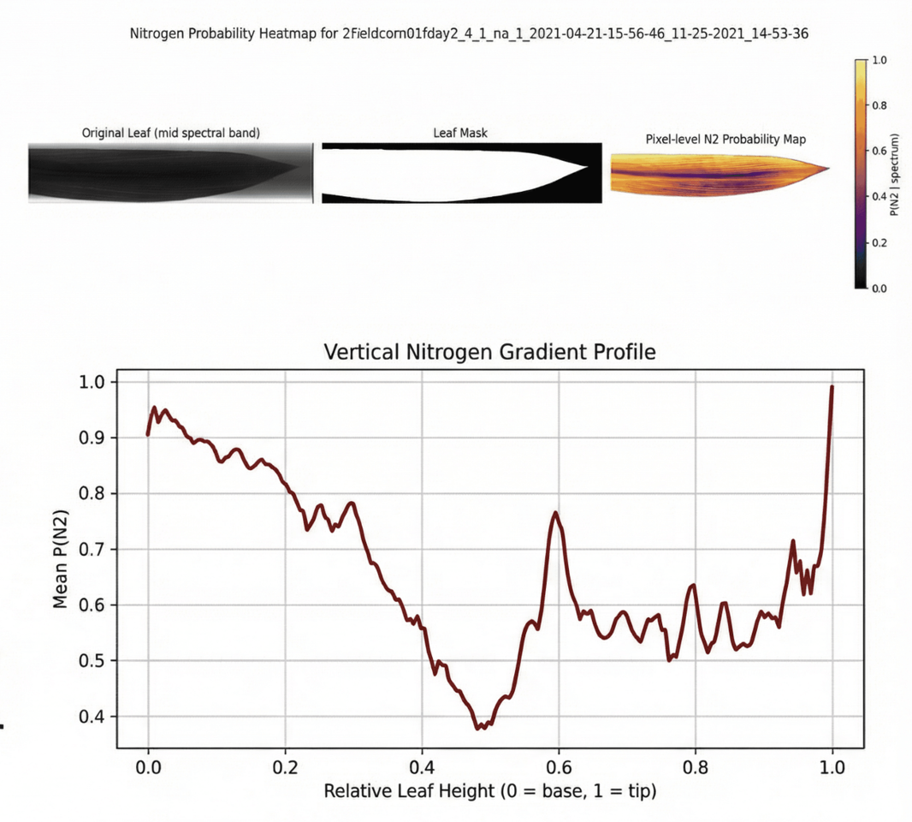
Pixel Level Analysis
Pixel-Level Accuracy
  A Logistic Regression classifier trained on PCA-compressed pixel spectra achieves ~88% accuracy in distinguishing N1 vs N2 at the pixel level.
Spatial Heterogeneity
  Pixel-wise nitrogen probability heatmaps reveal strong within-leaf variation, highlighting zones with consistently higher or lower predicted N status.
Vertical Gradient
  Quantitative profiling shows a systematic decline in nitrogen probability from the leaf base to the tip, indicating a clear vertical physiological gradient.
Anatomical Patterns
  Veins and midrib regions exhibit spectral signatures that differ noticeably from the mesophyll, confirming tissue-specific nitrogen responses.
Notes:
“This slide shows how nitrogen differences appear at the pixel level of the hyperspectral images.
using PCA-compressed pixel spectra, a logistic regression classifier achieves around 88% accuracy in separating N1 vs N2 pixels. This confirms that even individual pixels have strong nitrogen signals.
the pixel-level probability heatmap on the top right shows how nitrogen predictions vary across a single leaf. Warmer colors indicate higher nitrogen probability. You can see clear spatial heterogeneity—some regions are consistently higher while others are lower within the same leaf.
The second figure, the vertical nitrogen gradient plot, shows how nitrogen probability changes from the leaf base to the tip. There is a systematic decline, meaning the base tends to have higher nitrogen than the tip. This aligns with known physiological nitrogen transport patterns.

Slide 13
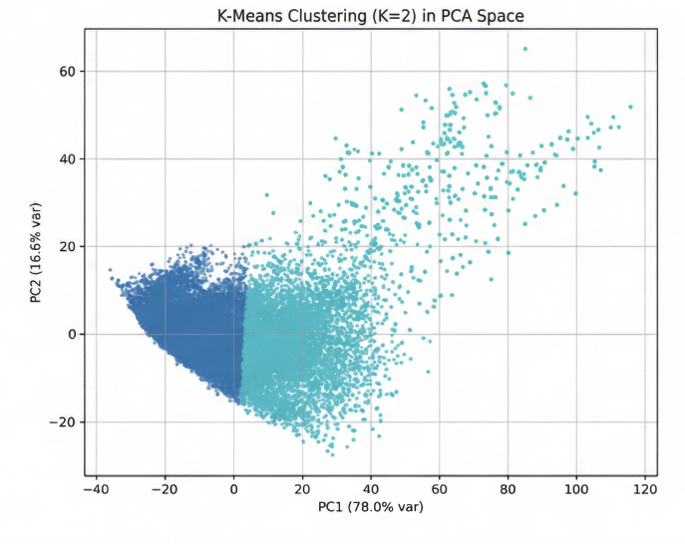
Unsupervised Clustering
Notes:
PCA Scatter Plot + K-Means (K=2)
“This scatter plot shows every pixel from the entire dataset after reducing its 364-band spectrum to the first two principal components.
PC1 alone explains 78% of the spectral variation; PC2 adds another ~17%.
When we run K-Means with K=2, we see two very distinct pixel populations.
The left cluster (dark blue) contains pixels with lower PC1 values, typically representing mesophyll regions or stressed/low-N zones.
The right cluster (cyan) contains pixels with higher PC1 values, often corresponding to veins, midrib, or nitrogen-rich tissue.
The important point is:
Even without nitrogen labels, the pixels naturally separate into two major spectral groups.
This means nitrogen status and anatomical structure are inherently encoded in the hyperspectral signatures.”

Slide 14
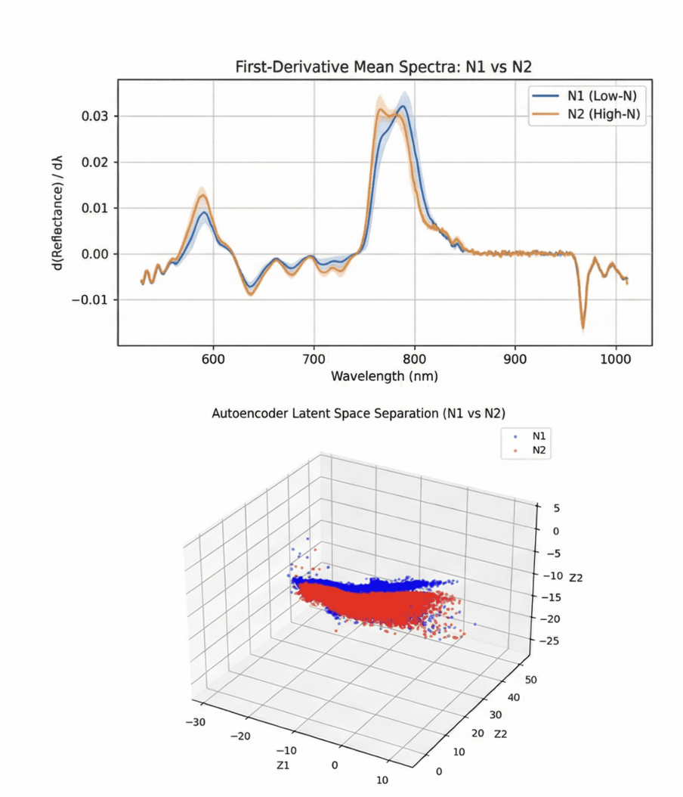
Key Findings
Multi-Scale Success: Nitrogen treatments were successfully separated at both leaf-level and pixel-level analysis.
Spectral Sensitivity: The red-edge region (≈680–750 nm) emerged as the most responsive spectral zone to nitrogen status.
Spatial Heterogeneity: Pixel-level probability maps exposed within-leaf gradients invisible in average reflectance.
Tissue Specificity: Mesophyll and vein tissues showed distinctly different spectral responses, indicating localized physiological effects.
Unsupervised Validation: Clustering and autoencoder embeddings independently revealed separable spectral signatures for N1 vs. N2 without using labels.
Notes:
We found that nitrogen treatments were separable at multiple scales. Both leaf-level and pixel-level analyses clearly distinguished N1 from N2.
The top-right plot shows the first-derivative mean spectra for N1 and N2. The biggest separation occurs in the red-edge region (around 700–750 nm). This tells us that this wavelength range is the most sensitive indicator of nitrogen status.
The bottom-right 3D plot shows the autoencoder latent space. Even though the model was trained without labels, we still see two partially separated clusters for N1 and N2. That means nitrogen stress produces spectral differences strong enough to be captured by an unsupervised model.

Slide 15
Conclusions
Pixel-level classification achieved ~88% accuracy in distinguishing N1 (low-N) vs N2 (high-N) treatments, demonstrating strong nitrogen separability directly from hyperspectral spectra.
Leaf-level nitrogen scores clearly separated treatments, with mean (P(N2)) significantly higher for N2 leaves than N1 leaves (p < 0.01), confirming robustness at aggregated scales.
Red-edge wavelengths (≈680–750 nm) showed the strongest treatment differences, with first-derivative spectra revealing a distinct N-response peak near ~720–740 nm.
Vertical gradient analysis showed a consistent decline in nitrogen probability from base → tip, with up to 20–30% lower (P(N2)) at the tip regions—capturing fine-scale physiological gradients.
Anatomical region analysis revealed tissue specificity, where mesophyll had significantly lower NDVI and N2 probability compared to veins and midrib (p < 0.05), indicating spatially localized nitrogen effects.
Unsupervised clustering (K=3) recovered clear spectral zones that aligned with anatomical structures and showed higher uniformity in N2 leaves but fragmented, heterogeneous clusters in N1 leaves, validating stress signatures even without labels.
Notes:
Our analysis shows that hyperspectral imaging can clearly separate nitrogen treatments at both leaf and pixel scales. The pixel model reached ~88% accuracy, and leaf-level nitrogen scores were significantly higher for N2. The red-edge region (680–750 nm) was the strongest nitrogen indicator. We also found a consistent base-to-tip nitrogen decline. Unsupervised clustering independently revealed treatment differences, meeting the project’s goal of confirming nitrogen-driven spectral structure using both supervised and unsupervised methods.

Slide 16
Thank you...

