Slide 1
Host
Send, Recv
HCI Transport
Serial
H4
H5
初始化脚本
Chipset 层
BCM
CSR
nRF

Slide 2
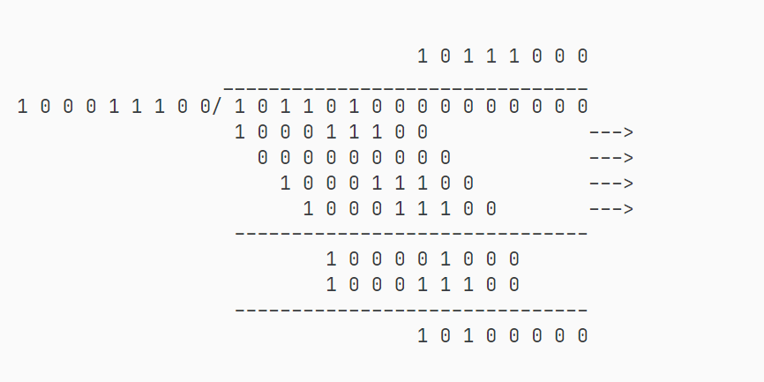

Slide 3
0
0
0
0
0
0

