Slide 1

MVC Architecture
Model
View
Controller

Slide 2







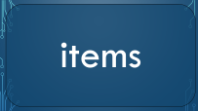
Model

Slide 3
collisions

Slide 4
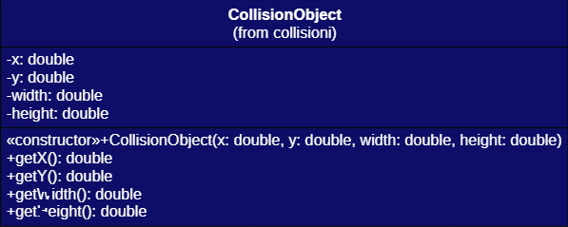
Collisions

Slide 5
entity

Slide 6




InteractionActionEntity
Builder pattern

Slide 7
Entity

Slide 8
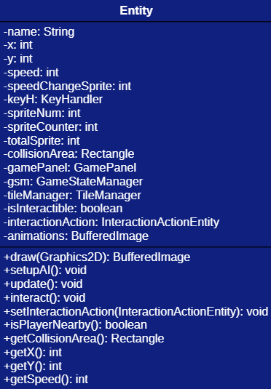
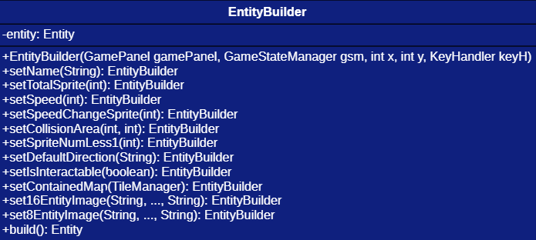
Entity & EntityBuilder

Slide 9
Player

Slide 10
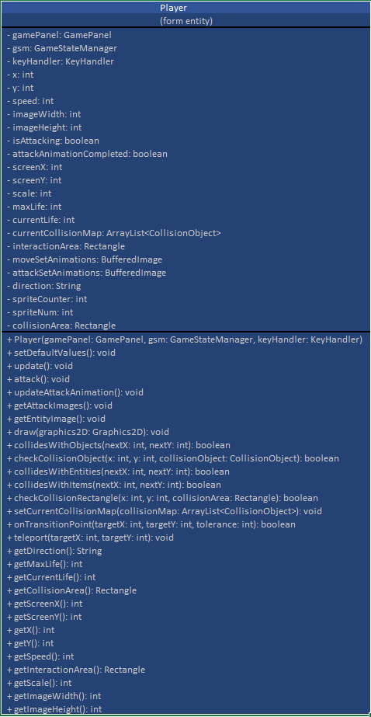
Player

Slide 11
NpcCreator

Slide 12
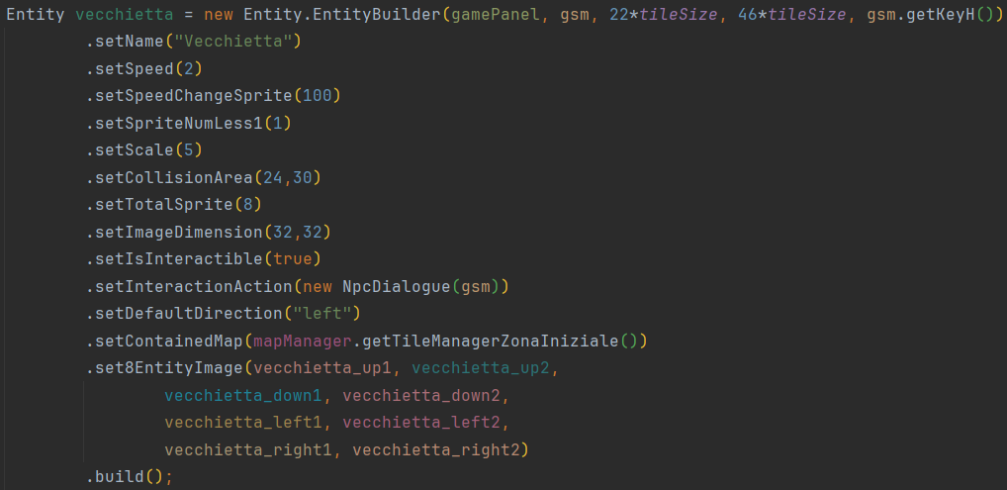
NpcCreator

Slide 13
NpcDialogue

Slide 14
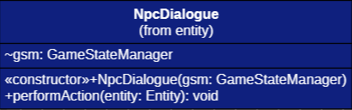
NpcDialogue

Slide 15
hud

Slide 16

hud

Slide 17
OBJ_Heart

Slide 18
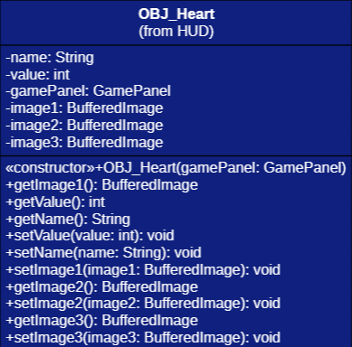
OBJ_Heart

Slide 19
items

Slide 20
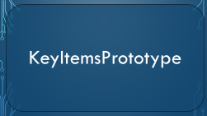


Prototype
InteractionActionItems
Prototype pattern

Slide 21
KeyItemsPrototype

Slide 22
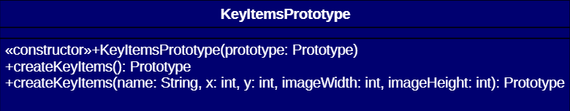
KeyItemsPrototype

Slide 23
KeyItems

Slide 24
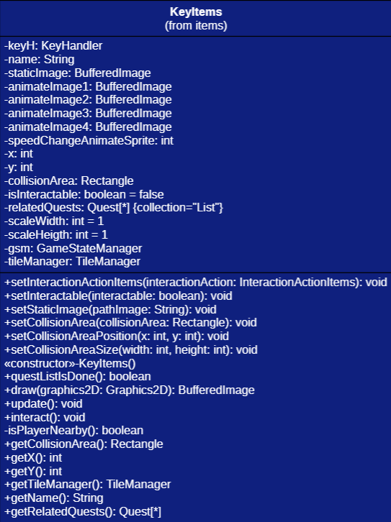
KeyItems

Slide 25
ObjectCreator

Slide 26
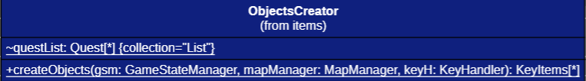
ObjectCreator

Slide 27
quests

Slide 28



quests

Slide 29
Quest

Slide 30
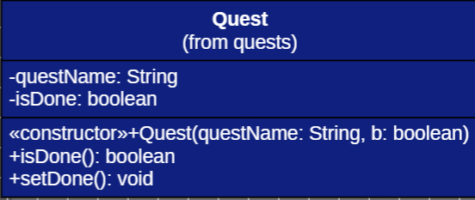
Quest

Slide 31
QuestInitializer

Slide 32
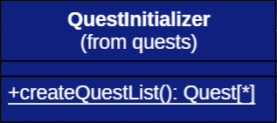
QuestInitializer

Slide 33
tile

Slide 34


tile

Slide 35
TileManager

Slide 36
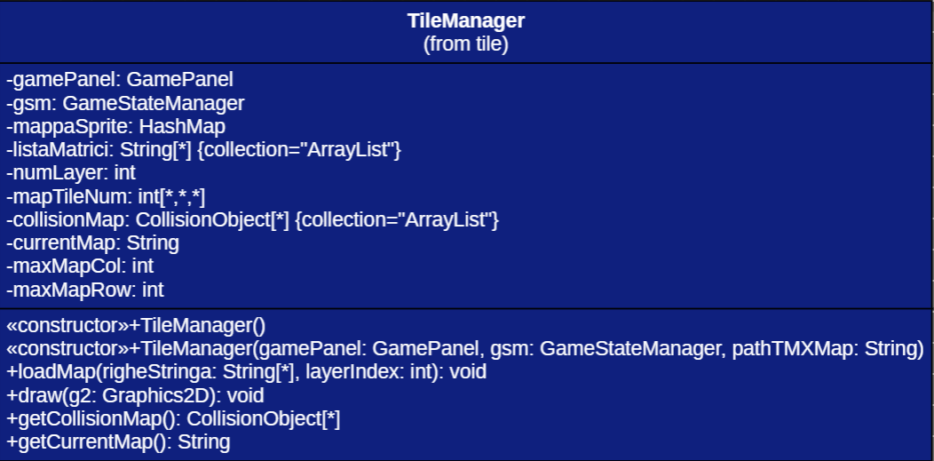
TileManager

Slide 37
MapManager

Slide 38
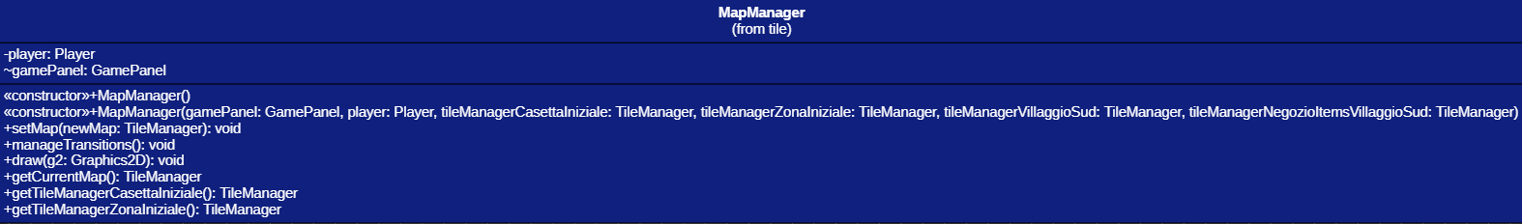
MapManager

Slide 39
gameState

Slide 40





gameState
GameState
State Pattern

Slide 41
DialogueState

Slide 42
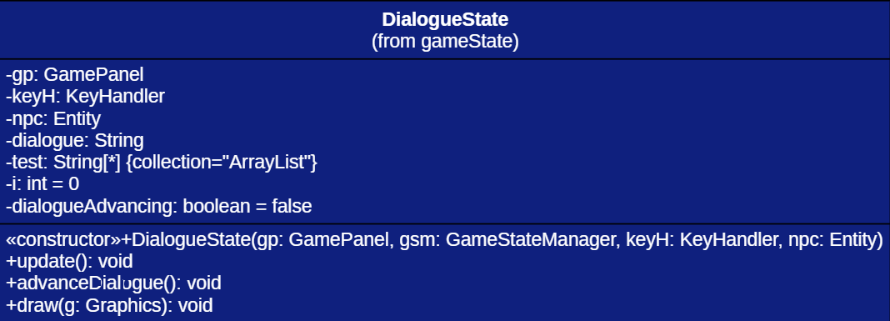
DialogueState

Slide 43
GameStateManager

Slide 44
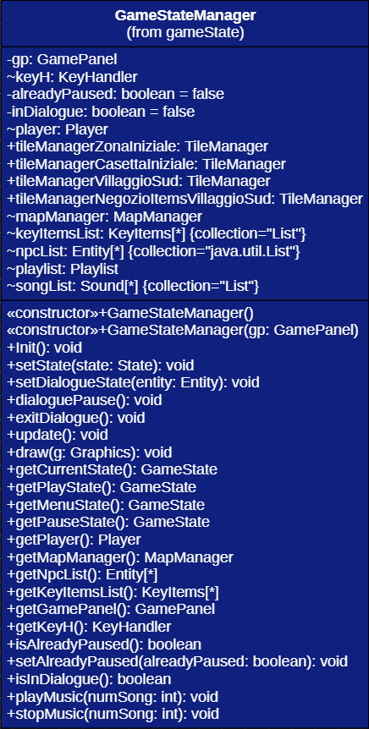
GameStateManager

Slide 45
MenuState

Slide 46
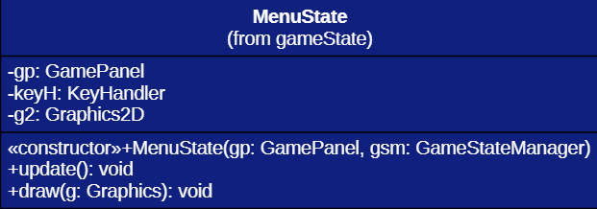
MenuState

Slide 47
PauseState

Slide 48
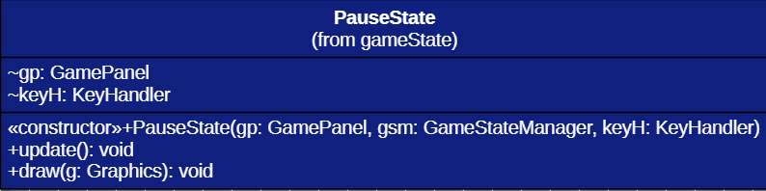
PauseState

Slide 49
PlayState

Slide 50
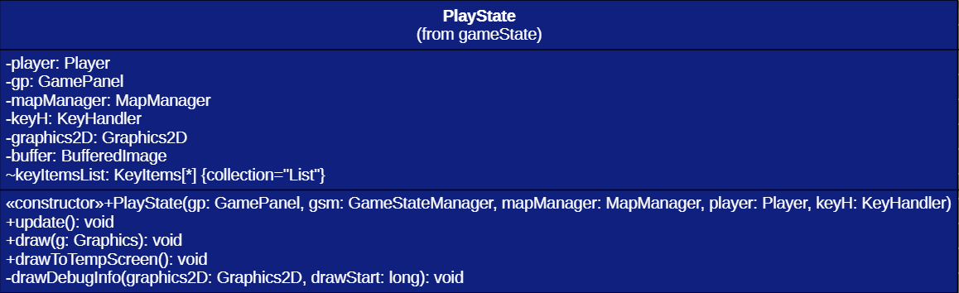
PlayState

Slide 51
toolTMX

Slide 52

toolTMX

Slide 53
TMXReader

Slide 54
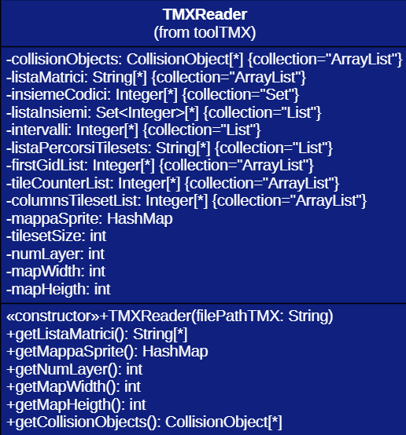
TMXReader

Slide 55
sound

Slide 56


sound

Slide 57
Playlist

Slide 58
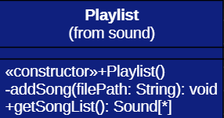
Playlist

Slide 59
Sound

Slide 60
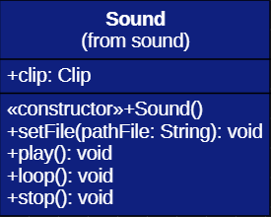
Sound

Slide 61



View

Slide 62
GamePanel

Slide 63
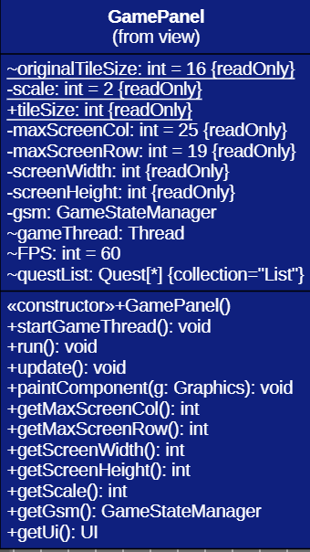
GamePanel

Slide 64
UI

Slide 65
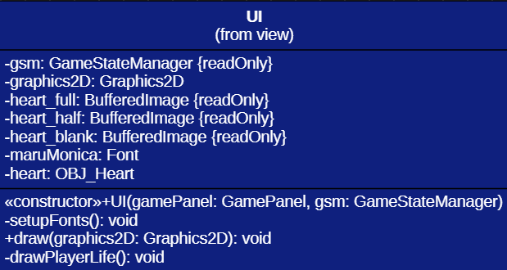
UI

Slide 66
UtilityTool

Slide 67
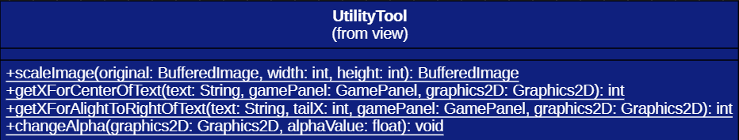
UtilityTool

Slide 68


Controller

Slide 69
KeyHandler

Slide 70
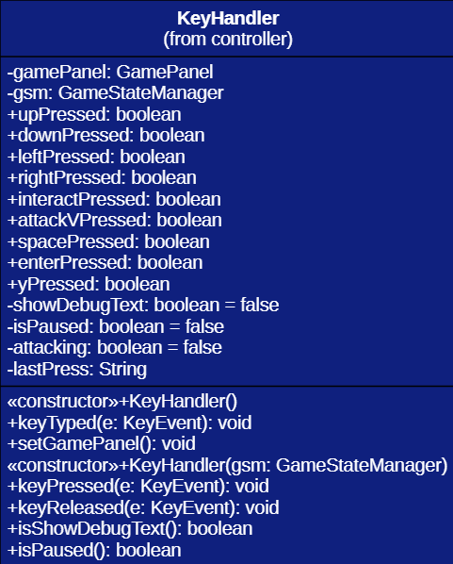
KeyHandler

Slide 71
MouseHandler

Slide 72
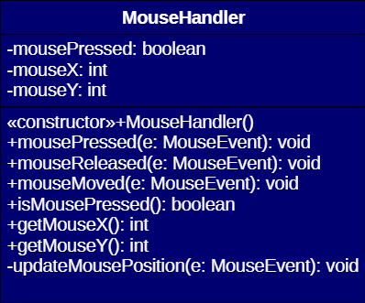
MouseHandler

