Slide 1

MVC Architecture
Model
View
Controller

Slide 2


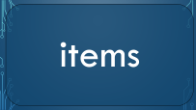





Model
toolTMX

Slide 3
collisions

Slide 4
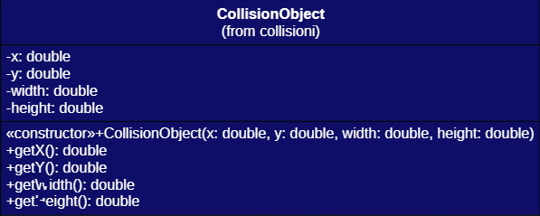
Collisions

Slide 5
entity

Slide 6




InteractionActionEntity

Slide 7
Entity

Slide 8
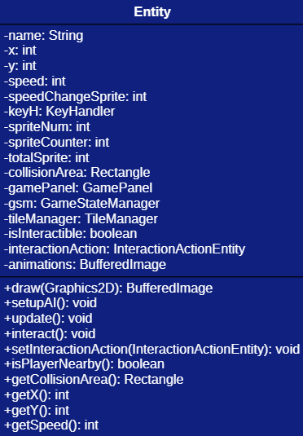
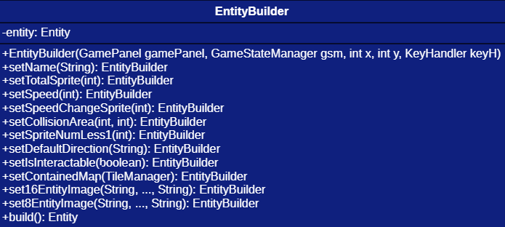
Entity & EntityBuilder

Slide 9
Player

Slide 10
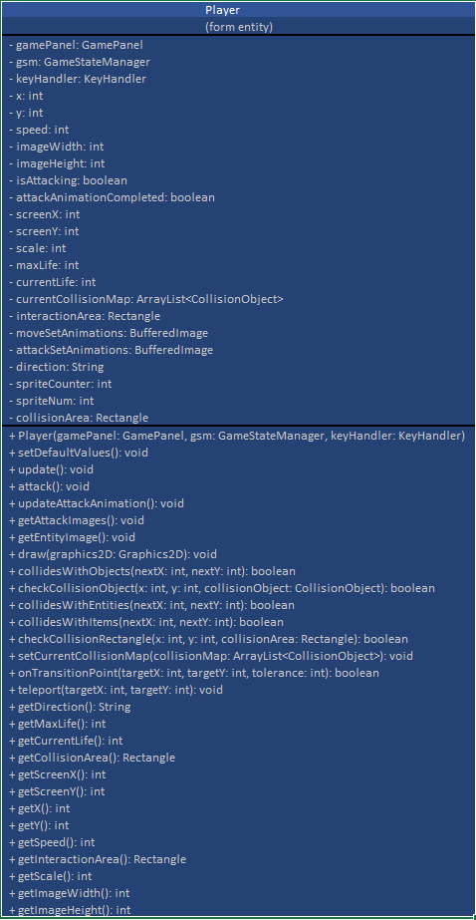
Player

Slide 11
NpcCreator

Slide 12
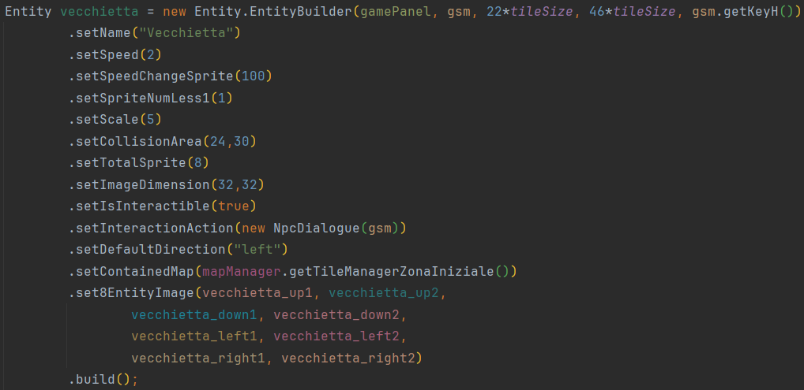
NpcCreator

Slide 13
NpcDialogue

Slide 14
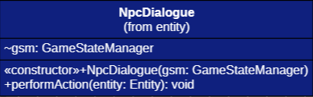
NpcDialogue

Slide 15
hud

Slide 16

hud
Entity.Player

Slide 17
OBJ_Heart

Slide 18
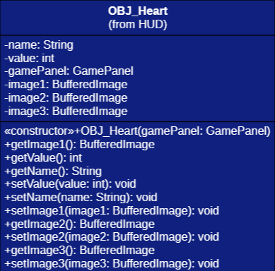
OBJ_Heart

Slide 19
items

Slide 20


InteractionActionItems

Slide 21
KeyItems

Slide 22
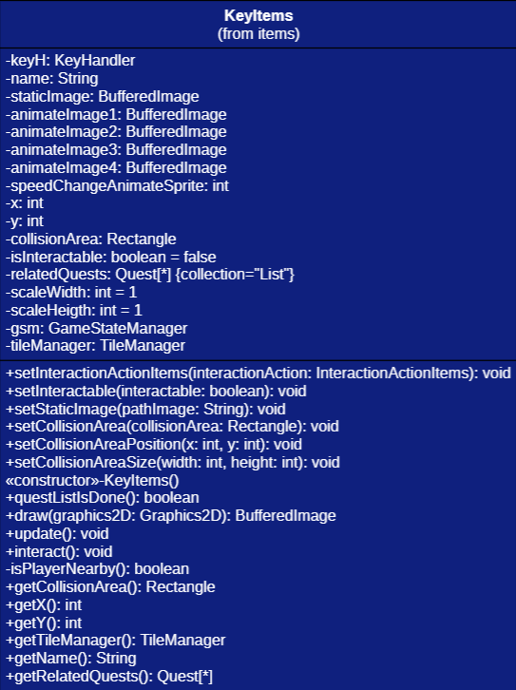
KeyItems

Slide 23
ObjectCreator

Slide 24
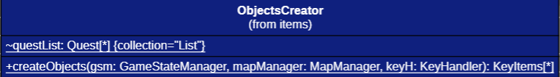
ObjectCreator

Slide 25
quests

Slide 26


quests

Slide 27
Quest

Slide 28
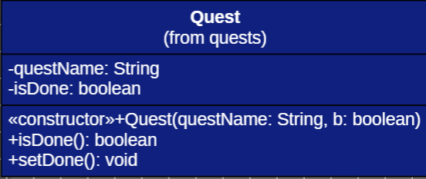
Quest

Slide 29
QuestInitializer

Slide 30
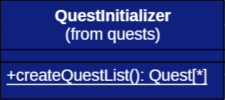
QuestInitializer

Slide 31
tile

Slide 32


tile

Slide 33
TileManager

Slide 34
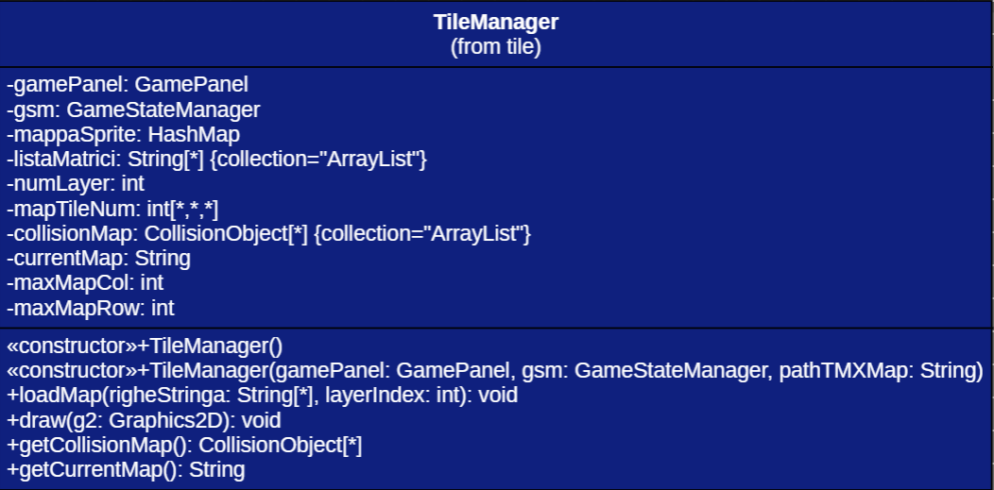
TileManager

Slide 35
MapManager

Slide 36
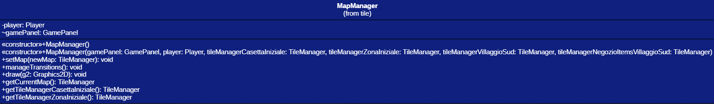
MapManager

Slide 37
gameState

Slide 38





gameState
GameState

Slide 39
DialogueState

Slide 40
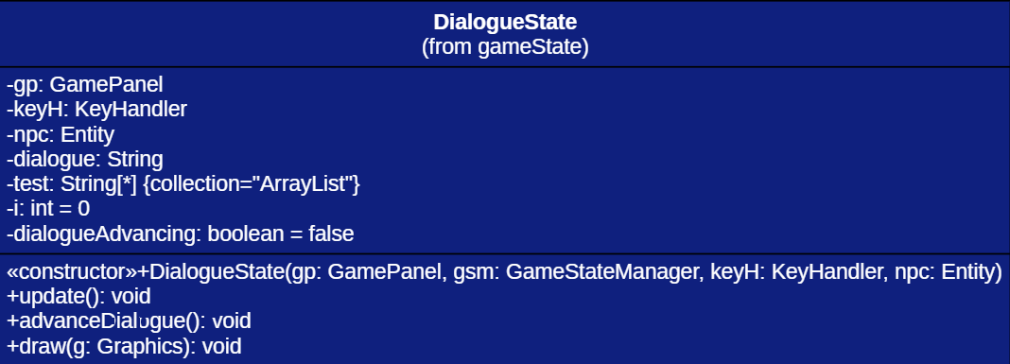
DialogueState

Slide 41
GameStateManager

Slide 42
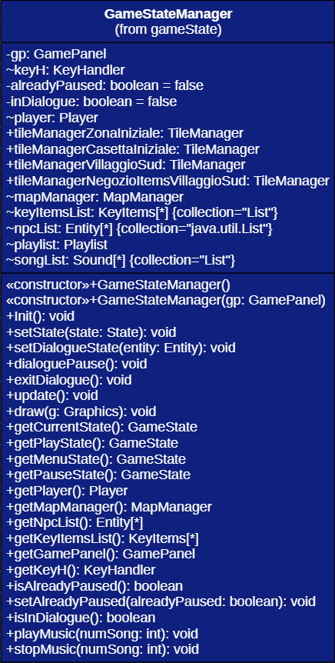
GameStateManager

Slide 43
MenuState

Slide 44
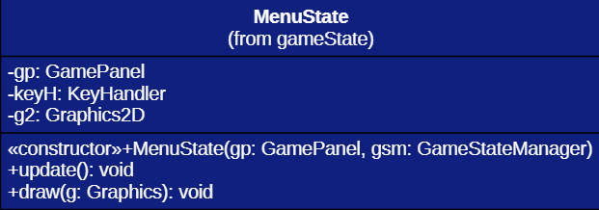
MenuState

Slide 45
PauseState

Slide 46
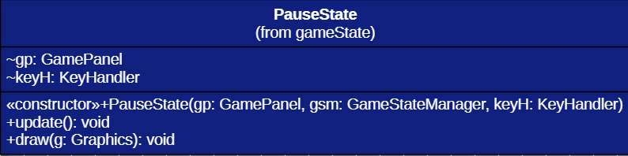
PauseState

Slide 47
PlayState

Slide 48
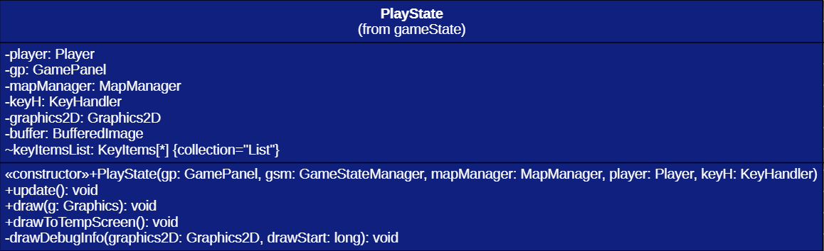
PlayState

Slide 49
toolTMX

Slide 50

toolTMX

Slide 51
TMXReader

Slide 52
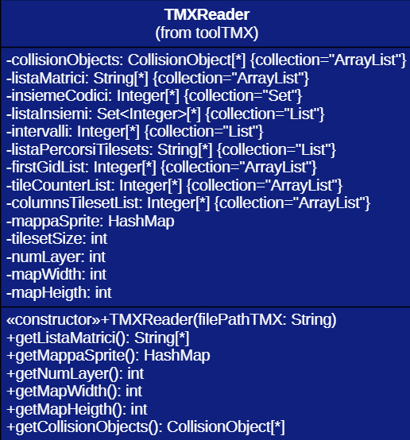
TMXReader

Slide 53
sound

Slide 54


sound

Slide 55
Playlist

Slide 56
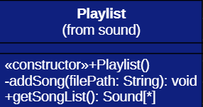
Playlist

Slide 57
Sound

Slide 58
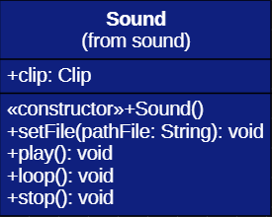
Sound

Slide 59



View

Slide 60
GamePanel

Slide 61
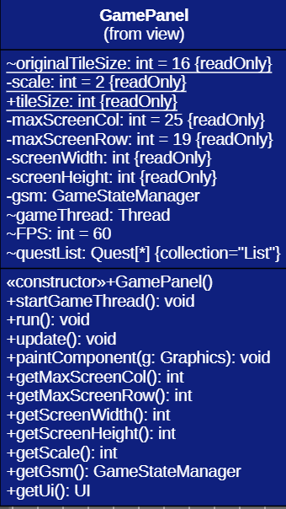
GamePanel

Slide 62
UI

Slide 63
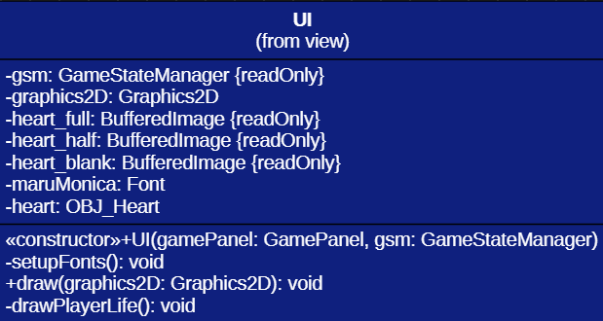
UI

Slide 64
UtilityTool

Slide 65
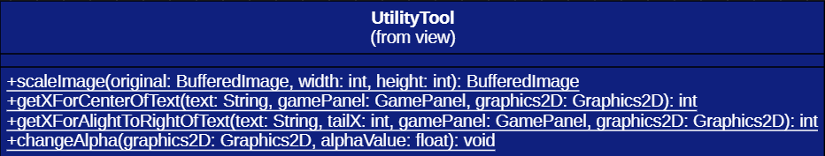
UtilityTool

Slide 66

Controller

Slide 67
KeyHandler

Slide 68
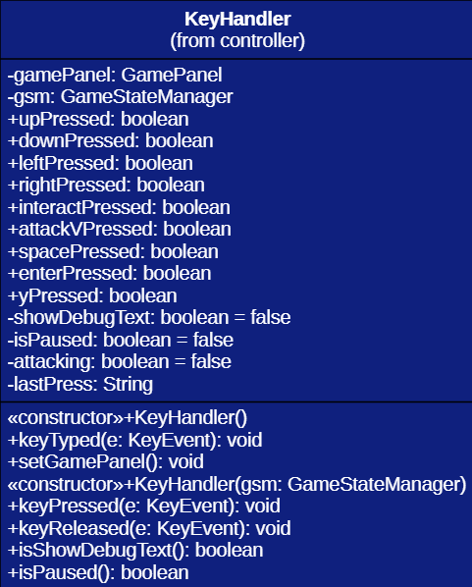
KeyHandler

