Slide 1
PALMY Manual
Giacomo Mastroddi
16.06.2023

Slide 2
Folder Structure

Slide 3
Folders
Calibrations: Contains the codes to calibrate the sensors that need it. Example: The IR camera needs to be positioned at the right height.
Data: At every process stop, the sensor data are saved here.
Documentation: Contains this manual and reports.
Generators: Contains GIF and Image generators for both Thermero and IR data.
GIFs: Contains the GIFs generated.
Images: Contains the Images generated.
Tests: Contains the codes to check the functioning of the single sensors, chips and actuators.

Slide 4
Main and Classes
Classes contain all the code to construct objects:
Actuator: Fan, Cooler, and Heater.
Chip: Multiplexer and Analog-to-Digital Converter.
Controller: To control the system.
LCD: To print values on the screen.
Saver: To save relevant information of the process.
Sensor: Clock, Temperature & Relative Humidity, CO2, NH3, Flow, IR camera, Thermero, and Scale
Main contains the code that brings all these objects together.

Slide 5
Run Experiment

Slide 6
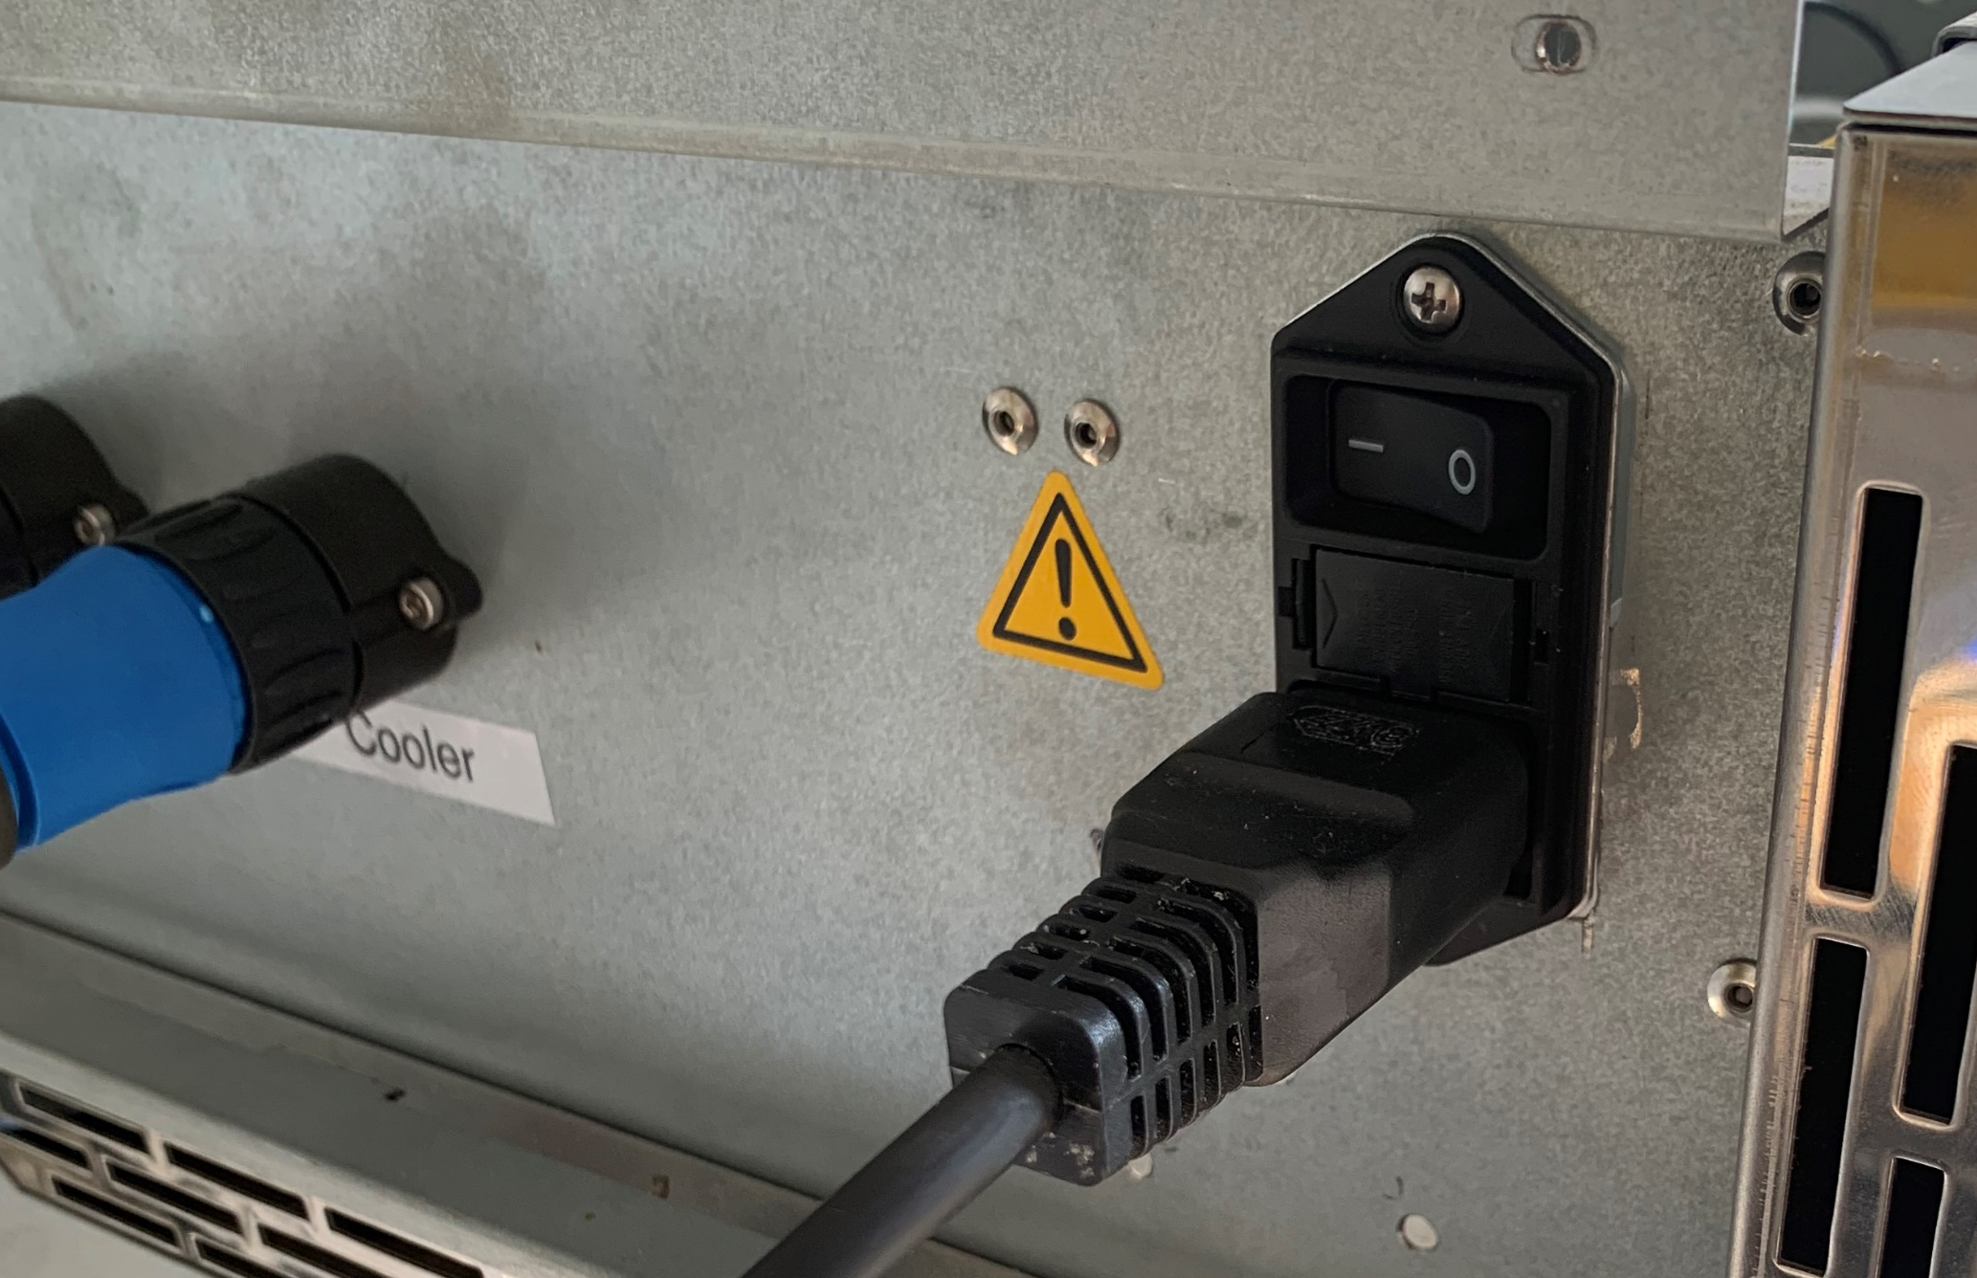
Power and Cables
Check that the cables of the sensors are connected.
Turn on the power.
Wait for the screen to show the desktop of the Raspberry Pi.

Slide 7
Process
Open «PALMY» folder (Double-Click).
Open «Main.py» on Thonny (Double-Click or Open With).
Run the code (Press F5 or the green play button).
Answer the questions on the screen until the process is started.
To stop the process press CTRL + C. Do NOT press the red stop button! The data won’t be saved and the Heater and Cooler will continue to run.

Slide 8
Errors
All the sensors can encounter error. Normally, by moving the cables, re-running the program, or turn off and turn on PALMY they will work again.

Slide 9
NH3out and NH3in
The NH3 at the outlet shows some hardware problems and is for this reason not set up. At line 92 you can see «NH3out = None»
You can use the same idea to manually deactivate some sensors. Example: If you do not want the Flow sensor, you can type «Flow = None» after line 83.

Slide 10
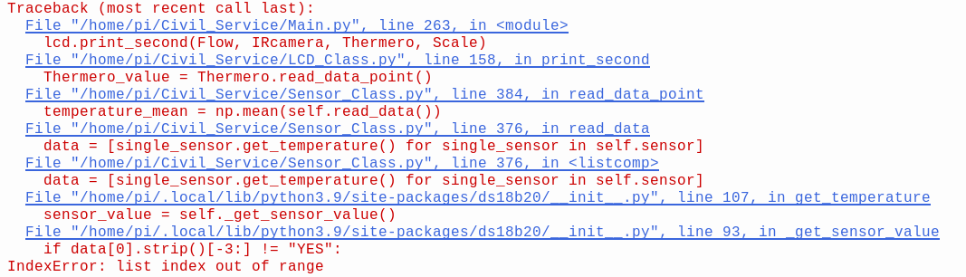
Thermero
The Thermero sometimes encounters an error that can halt the process. The occurrence of this error remains unclear and unpredictable. To allow the 20 sensors to communicate effectively with the Raspberry Pi, a time sleep between sensor readings has been implemented, providing them with ample time.

Slide 11
Save GIFs
From Thermero and IR camera Data

Slide 12
Save GIF
After the data csv files are saved into the «Data» folder, you can follow these steps to create a GIF:
Open «Generators» folder.
Open «csv2gif.py».
Run the code.
Select the data file of interest by navigating the pop-up window. NB: The data are saved in the «Data» folder.
Change Slide %

Slide 13
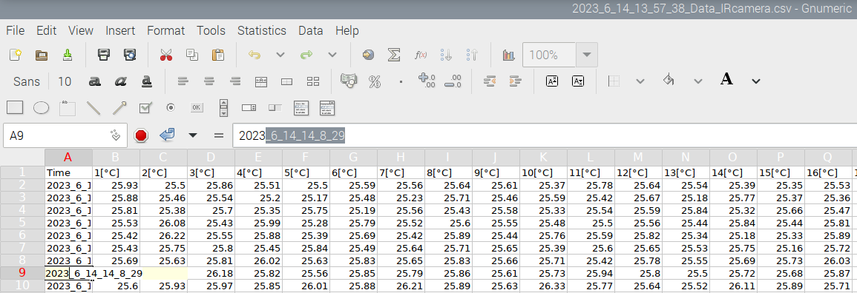
Save GIF
Enter the time ranges. To simplify this procedure, you can open the data file of interest with Gnumeric and copy and paste the value of the «Time» column (the first one on the left).
Enter the file name without extension (.gif will be automatically generated). The file is now saved in the «GIFs» folder.

Slide 14
Save Images
From Thermero and IR camera Data

Slide 15
Save Image
After the data csv files are saved into the «Data» folder, you can follow these steps to create an Image:
Open «Generators» folder.
Open «csv2png.py».
Run the code.
Select the data file of interest by navigating the pop-up window. NB: The data are saved in the «Data» folder.
Change Slide %

Slide 16
Save Image
Enter the time of the image. To simplify this procedure, you can open the data file of interest with Gnumeric and copy and paste the value of the «Time» column (the first one on the left).
Enter the file name without extension (.png will be automatically generated). The file is now saved in the «Images» folder.

