Slide 1
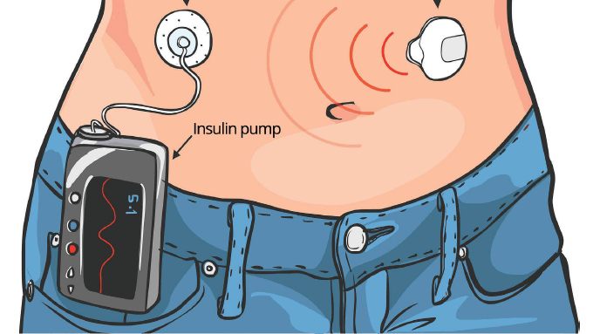

Artificial Pancreas Controllers
Giacomo Mastroddi - InsulinCo
https://www.umassmed.edu/dcoe/diabetes-education/pumps_and_cgm/

Slide 2
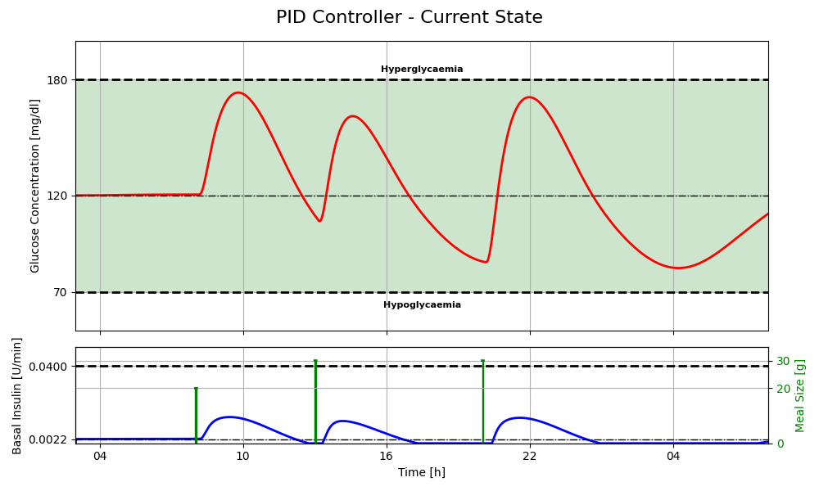



Current State – PID
Meal intakes
The current scenario involves a breakfast with 20 grams of carbohydrates, and lunch and dinner with 30 grams each.
Behaviour
Tracking: Ensures that the insulin and glucose level are maintained at the steady-state reference values.
Reactive action: Insulin injections are administered only after detecting a deviation from the reference glucose level.
Safety: With these small meal intakes, administering insulin after the glucose level rises keeps the patient’s glucose within the safe range.
No saturation: The response is moderate, preventing the insulin pump from reaching its upper limit of 0.04 U/min.
1.
3.
2.
4.
1.
Conclusion
The PID controller shows zero steady-state error.
The reactive action guarantees a safe operation with these meal intakes, although not considering delay.
Tuning parameters are tailored to every specific patient.
All icons are taken from Flaticon

Slide 3
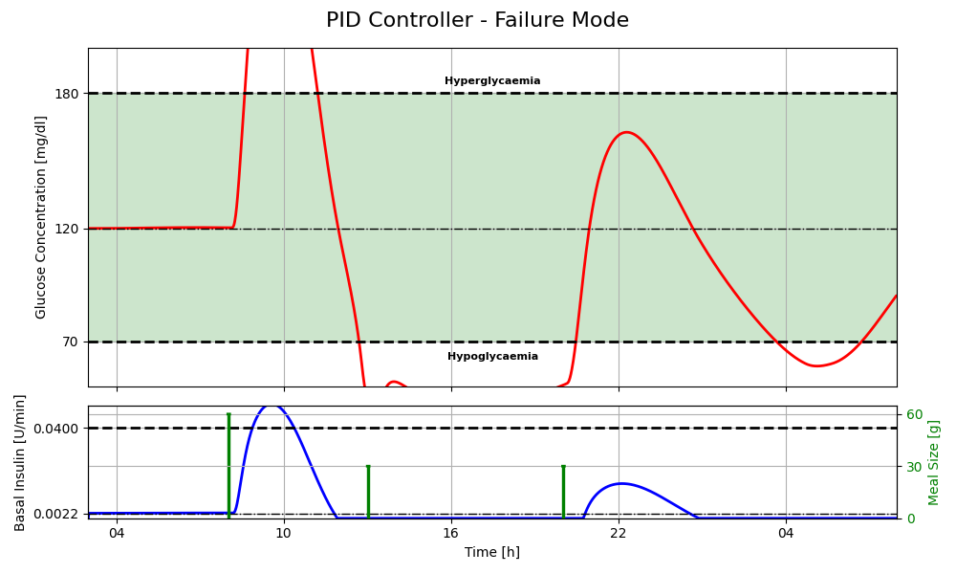


Failure Mode – PID
2. 3.
Meal intakes
A severe failure scenario occurs when the patient consumes 60 grams of carbohydrates at breakfast and 30 grams at lunch and dinner.
Limitations of current PID controller
Insulin effect delay: The insulin's effect on the measured glucose concentration is delayed and not accounted for (the blue curve increases only after the green curve).
Constraints: The controller cannot safely satisfy constraints under these conditions.
Risk of extremes: Both hyperglycemia and hypoglycemia are possible outcomes.
Injection capacity: The maximum injection capability of the insulin pump is not met, leading to insufficient insulin delivery in real life.
2. 3.
4.
1.
Conclusion
Prolonged violation of glucose limits can lead to hospitalization or even death of the patient.
A controller with predictive capabilities and the ability to satisfy constraints is essential.

Slide 4
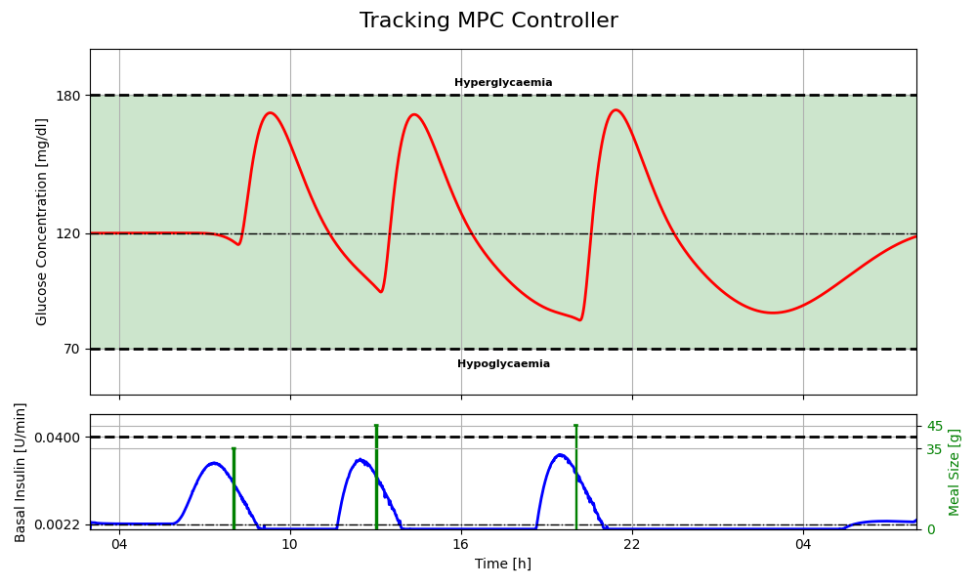
Tracking MPC
Meal intakes
The default meal values are 35 grams for breakfast and 45 grams for lunch and dinner.
Model-based controller
The recommended controller type is a tracking Model Predictive Control (MPC).
Controller motivation
Tracking: Ensures that the insulin and glucose level are maintained at the steady-state reference values of 0.0022 U/min and 120 mg/dL.
Predictive and receding horizon: Anticipates meals and mitigates model mismatches, resulting in safer behavior.
Constraints: Naturally integrates glucose and pump limits into the control formulation, enhancing safety and performance.
1.
2.
1.
Conclusion
Meal prediction and anticipation of insulin injections counterbalance the increase in glucose concentration.
Constraints are safely respected, ensuring optimal control and patient safety.
Tuning parameters are tailored to every specific patient.

Slide 5
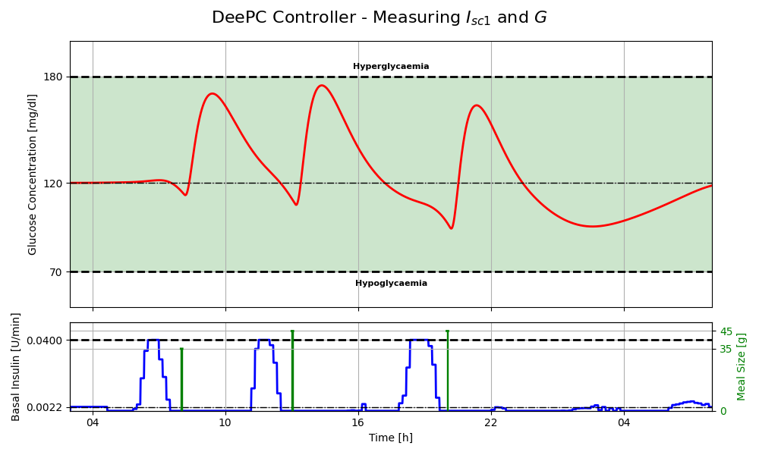
Regularized Tracking DeePC
Meal intakes
The default meal values are the same as before.
Data-driven controller
The recommended controller type is a regularized tracking Data-enabled Predictive Control (DeePC).
Controller motivation
Regularized: Minimizes linear-nonlinear mismatches and ensures accurate prediction of the outputs.
Tracking, constraints and receding horizon: Like the MPC, it anticipates meals, consider constraints and mitigates mismatches, promoting safer behavior.
Direct control: Eliminates the need for an identification step by directly using collected patient data for prediction and control.
Conclusion
Meal prediction and anticipation of insulin injections counterbalance the increase in glucose concentration.
Constraints are safely respected, ensuring optimal control and patient safety.
Tuning parameters are tailored to every specific patient.

Slide 6
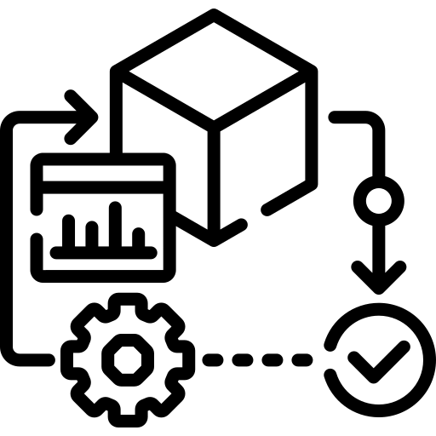
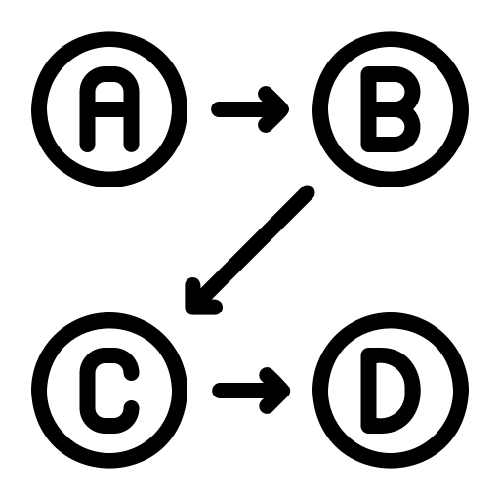

Plan for Deployment
Requirements
Safety: The system must be safe at all times, meaning stability and robustness must be met.
Feasibility: The controller must consistently produce feasible insulin actuation values.
Personalized tuning: Parameters must be customized for each individual patient.
For MPC also ReplayBG model parameters.
For DeePC also high-quality and sufficient data.
Low power consumption: The optimization calculation must be as efficient as possible.
Trade-offs
Data vs. safety: Balancing the need for data that covers a wide glucose concentration range with the requirement to safely obtain these values.
Precision/accuracy vs. computational effort
Long prediction horizon: Using a longer prediction horizon for better future estimates.
Low discretization step: Employing a low discretization step for finer control.
Frequent optimization: Often solving optimization problems to maintain accuracy.
Technical steps
Based on insights presented by Simone Del Favero, an expert in artificial pancreas controllers, the necessary steps for deployment are:
Controller evaluation: Use the ReplayBG simulator as alternative to animal testing to ensure that the controllers perform as expected for many different scenarios.
Hardware integration: Embed the controller into hardware equipped with a clear interface for flawless operation.
Human trials: Proceed with evaluations in controlled environments on human subjects to ensure safety and performance in real-world scenarios.
Specific for the tracking MPC
Specific for the regularized tracking DeePC

Slide 7
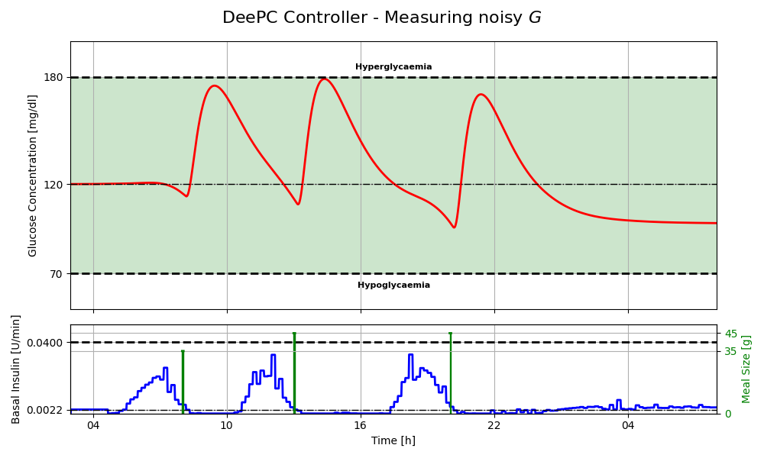
Regularized Tracking DeePC – Bonus
Requirements and merits
In real-world applications, only glucose concentration can be effectively measured. Therefore, the regularized tracking DeePC proposed earlier is modified to rely solely on this value. Additionally, this data is corrupted by noise, reflecting practical scenarios.
Trade-offs
Data vs tuning: The precision of the controller is highly dependent on the quality, quantity and glucose concentration range of the available data.
State information: Relying on only one of the nine states of the model reduces the number of tuning parameters but increases the challenge of achieving a reliable and precise controller.
Conclusion
The presence of significant noise can cause tracking problems for the controller since it relies on data.
This controller is more applicable in real-world scenarios as it only requires data from the patient.
Tuning parameters are tailored to every specific patient.

Slide 8
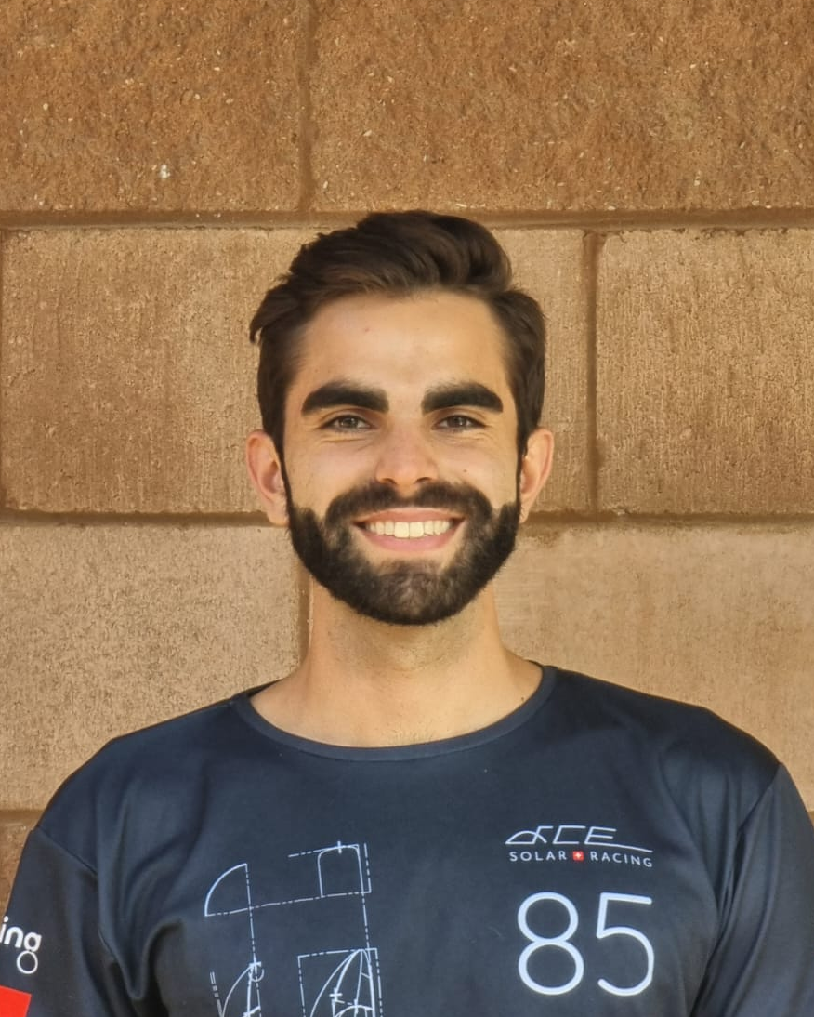

Giacomo Mastroddi
giacomma@ethz.ch
19-914-449

