Slide 1
Where Denver Demands Yoga

Slide 2
Background and Business value
A close friend has confessed that he wants to open a yoga studio.
We recently went to Denver and he fell in love with it. Hence, the analysis will take place there.
We’ll be attempting to cluster similar neighborhoods to determine which types of neighborhoods typically contain yoga studios.
Every brick and mortar style business has a demand for appropriate real estate.

Slide 3
Data Acquisition and cleaning
The list of neighborhoods and coordinates were extracted from Wikipedia and the venue data were obtained using the Foursquare API.
Neighborhoods without Wikipedia pages, and the airport were removed from the dataset.
The closest 100 venues within 1,000 meters were selected using the computed Euclidean distance for each neighborhood.

Slide 4
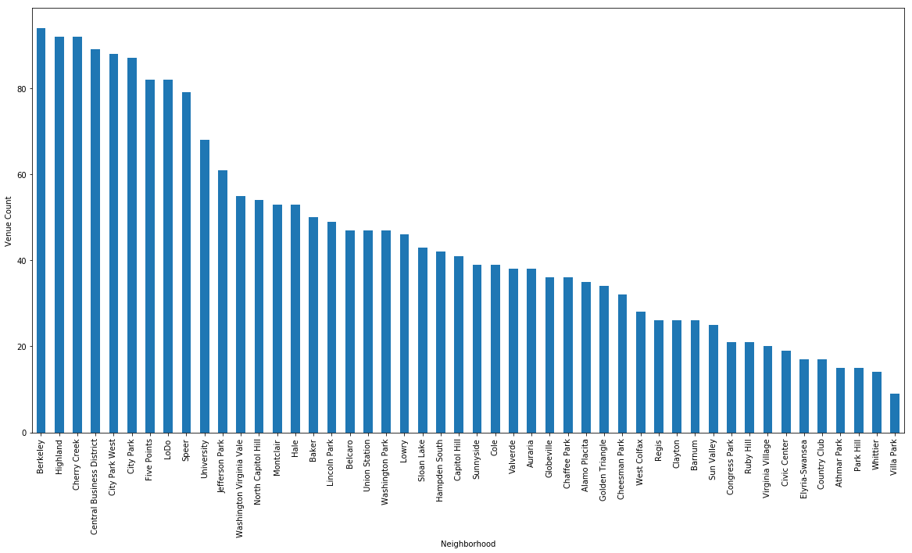
Neighborhood Descriptive Statistics
There are 48 neighborhoods left after the cleaning.
The mean number of venues is 45 with a standard deviation of 24.
The neighborhoods without a sufficient number of venues will be determined while clustering.

Slide 5
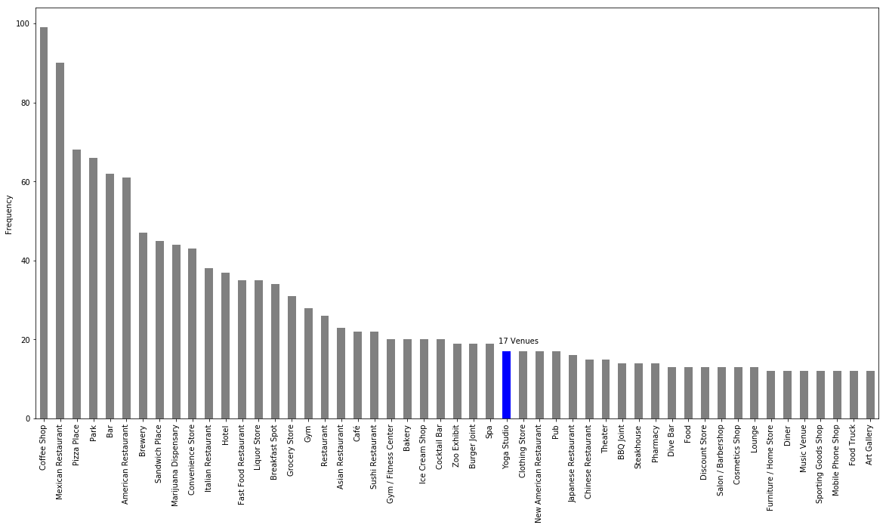
Venue Descriptive Statistics
There are 48 neighborhoods left after the cleaning.
The mean number of venues is 45 with a standard deviation of 24.
The neighborhoods without a sufficient number of venues will be determined while clustering.

Slide 6
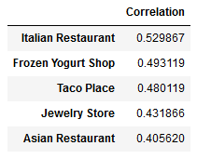
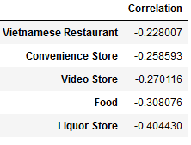
Correlations to Yoga
Correlations may provide a method of validating our clusters later on. We hope to see the positively correlated categories clustered with the yoga studios and vice versa for the negatively correlated categories.
Also, it’s fun to observe some of these such as the liquor store. Yogis clearly don’t drink much.

Slide 7
Preprocessing
To standardize, venue category frequencies were converted to proportions of their respective neighborhoods.
Since there were only 17 yoga studios, it is unlikely that k-means will produce clusters that are influenced by yoga. To remedy this, we multiply there proportion by a constant to increase their weights.

Slide 8
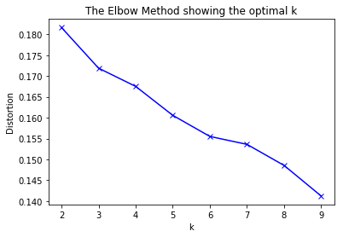
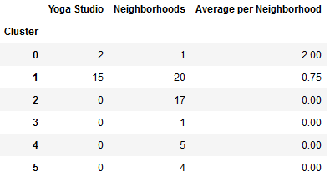
Clustering
The first clustering did not yield a definite value for k as indicated by the distortion curve.
To progress, we’ll use six clusters and observe the results. As we see, all the yoga studios were clustered together as desired, but the clusters are not evenly split. We’ll remove the outlying clusters and check if that helps at all.

Slide 9
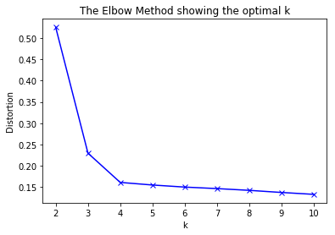
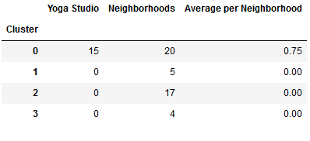
Clustering
Unfortunately, removing the outlier neighborhoods did not help to even out the cluster sizes.
However, we do see a much better distortion curve and only two choices for potential k-values. On the right, you can see the four clusters that were the same as the first clustering.

Slide 10
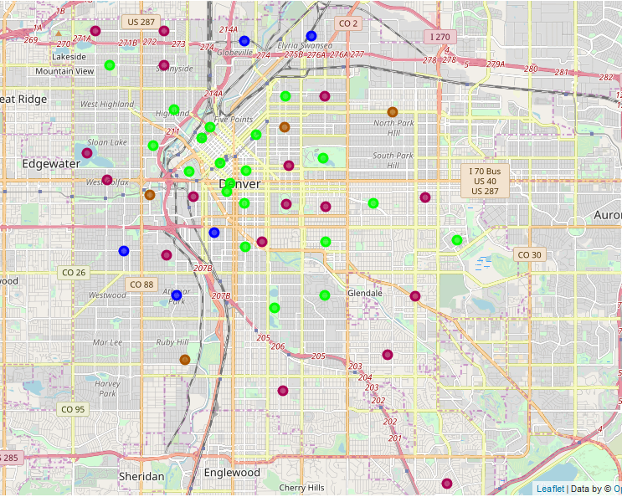
Results
Ideally, we would have clusters that are closer in size, but at least this clustering weeds out the neighborhoods that are not suitable for a yoga studio.
The green circles represent cluster 0 which we see contains all the yoga studios. Let’s take a closer look at the neighborhoods within that cluster that don’t already have a yoga studio in them.

Slide 11
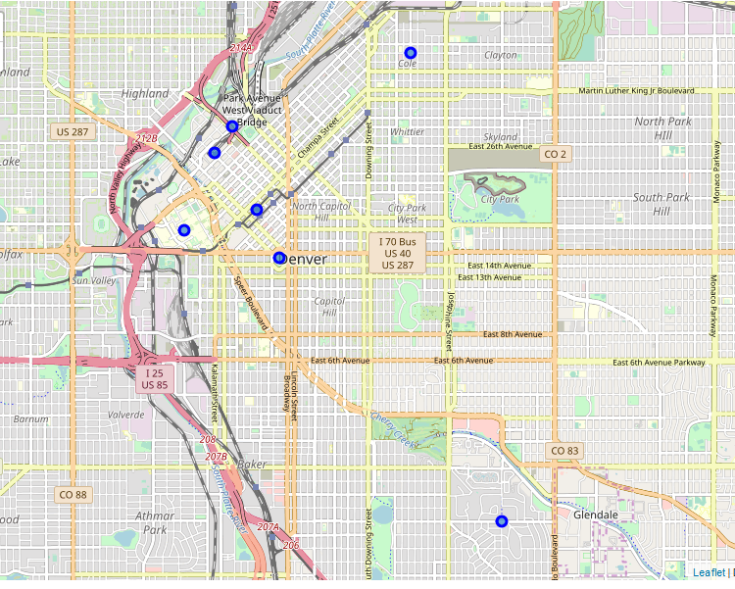
Results
Most of the relevant neighborhoods are in the heart of Denver. This is likely due to the high rent and yoga studios are not suited to bring in the kind of revenue required for downtown real estate. Luckily, we see two locations that are not downtown.

Slide 12
Conclusion
There are not very many yoga studios compared to other venue types in Denver, so there may not be significant demand.
We see that yoga studios have difficulty surviving downtown even though the downtown neighborhoods are like other neighborhoods that have yoga studios.
There are only two neighborhoods, Belcaro and Lowry, that were clustered with the yoga neighborhoods that aren’t downtown as well.
Surveying would help to answer the question as to whether there is demand, but the analysis certainly helped to narrow the search.

