Slide 1
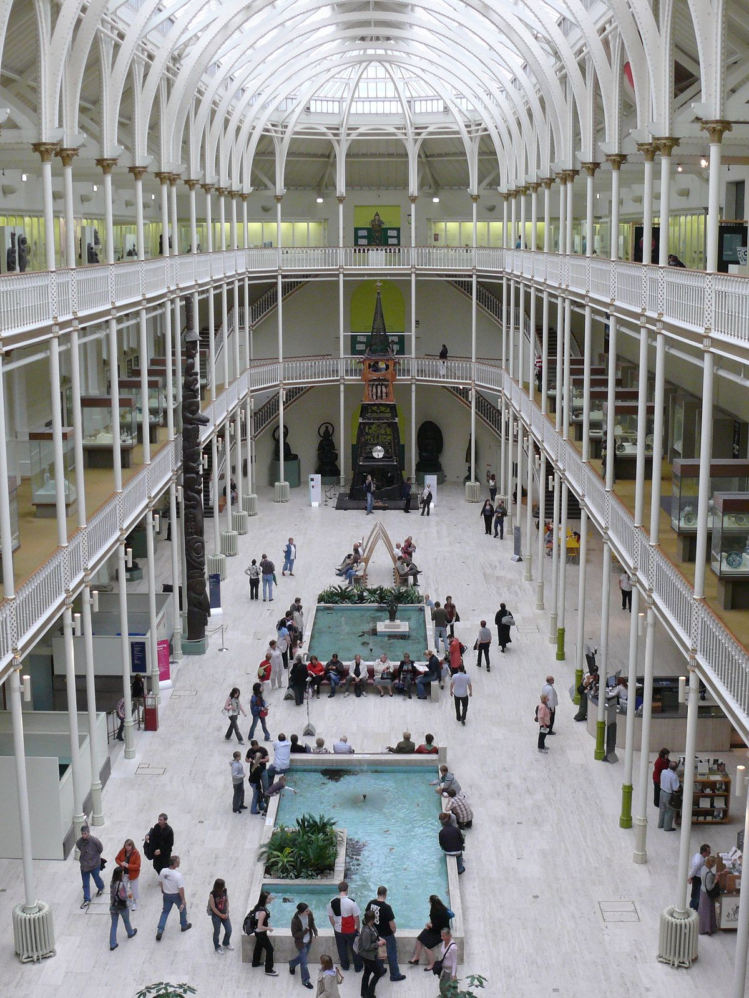
Virtual Tour Application
National Museum of Scotland
Group 29

Slide 2
Project Scope
Virtual Guide for the National Museum of Scotland
Provide a personalised tour/experience dependent on the visitors interests.
Group Members
Alice McConnell
Maja Heltowska
Jack Millar
Sam McGhie
Bailey Watts
James Vincent

Slide 3
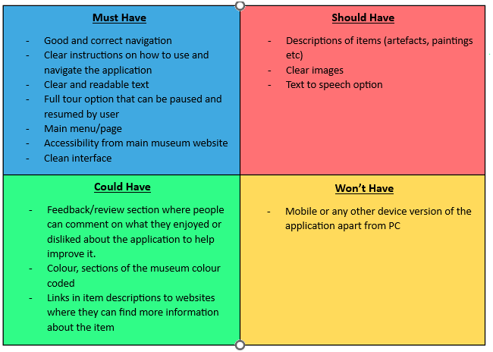
MoSCoW

Slide 4
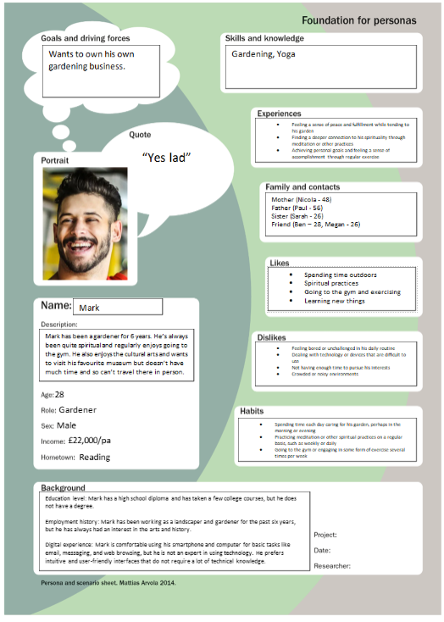
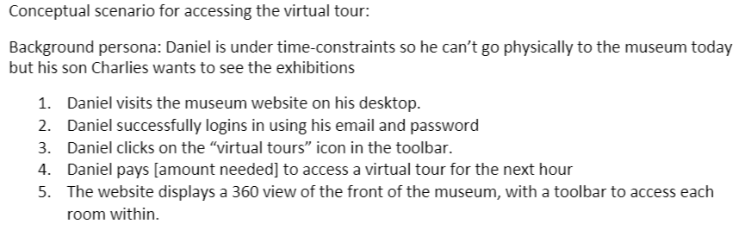
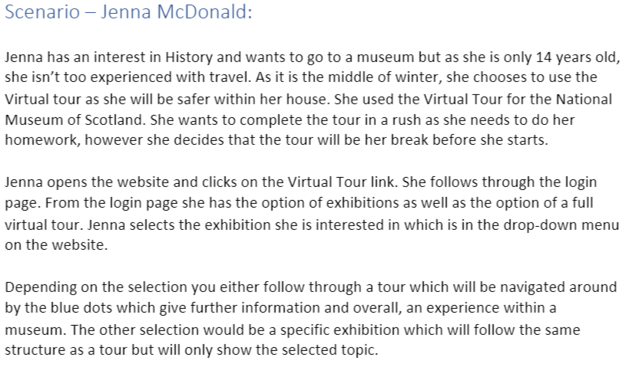
Personas
Usage Scenarios

Slide 5


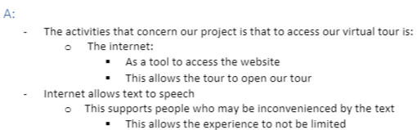
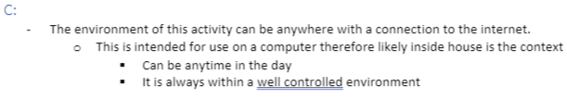

PACT analysis
Key points

Slide 6
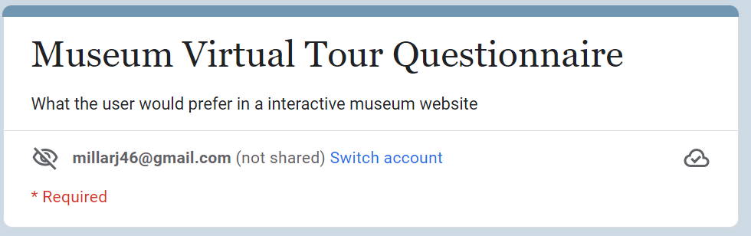
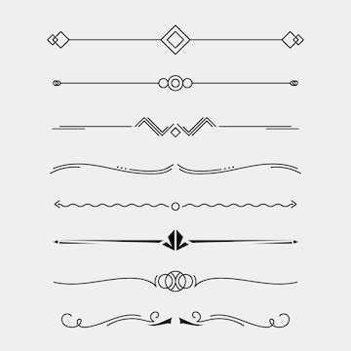
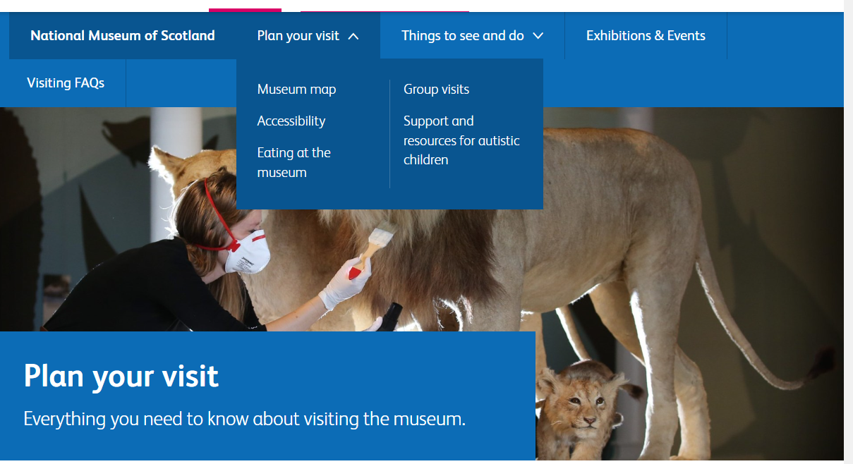
Data Gathering Techniques
Questionnaire
Online Research
We explored the National Museum of Scotland's website to determine colour schemes and take photos for our prototype.
70% of people surveyed would be interested in a Virtual Tour
89% of people have a laptop/desktop to access the virtual tour
78% of people are currently between the ages of 18 and 21

Slide 7
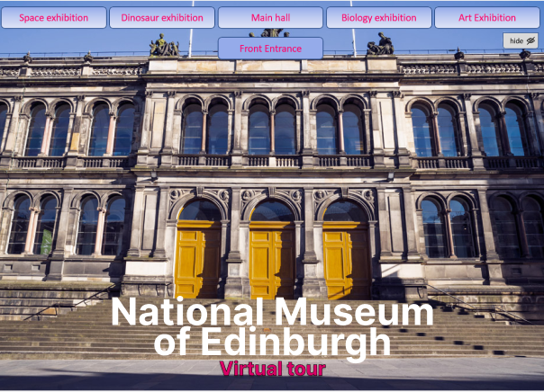
High Fidelity Prototype
1/2
Camera is fixed for the homepage
Home Page
Selected button will be opaque, the rest will be slightly transparent
Hide button - to hide the top row of buttons
Name of Museum

Slide 8
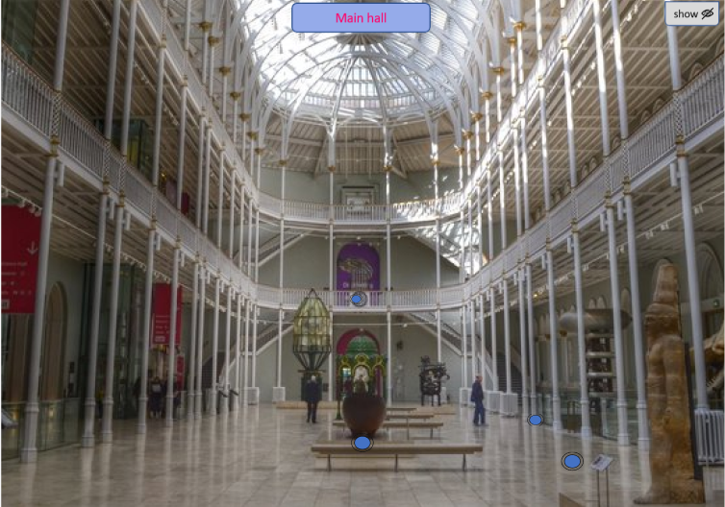
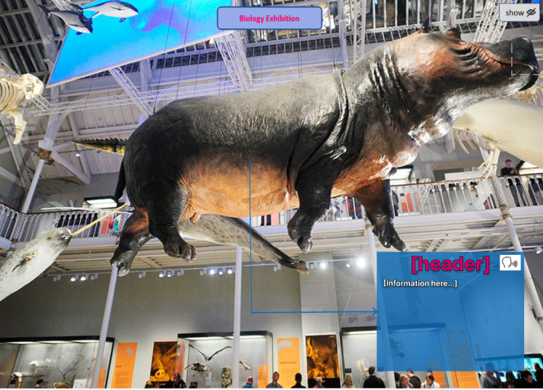
High Fidelity Prototype
2/2
Freeview
Freeview (detailed look at display)
Camera can rotate 360°
Clicking on each circle will move the camera to that position,
Information box to show more details on nearby display

Slide 9
Participation-based
Evaluation
“buttons on front page blend into the sky”
“it’s a good early version with implications that features will be added in the future”
“the textbox that displays information could be bigger”
feedback/criticism
“Red on blue is not a good contrast”
“Add arrows on the floor to show where ur moving too”

Slide 10
Conclusion based on findings
We need to rethink our colour scheme for some text/buttons
Make the camera icons to move the camera to more obvious to the user
Make text more bold

Slide 11
The End…

