Slide 1




Post-Brexit Data Protection In The UK
22 November 2022 – Jack Featherstone

Slide 2
ABSTRACT
On the 31st of January 2020, the UK formally left the EU after 47 years of membership. The EU is the world's largest trading bloc and the UK’s largest trading partner.
As we approach the third anniversary of Brexit, I thought it was an ideal time to recap post-Brexit GDPR compliance requirements. There have been several developments since the UK left the EU.
This guidance is aimed at UK businesses who receive data from or have offices in the EU and European Economic Area (EEA).
2

Slide 3
INTRODUCTION
Research on data protection law has never been so challenging, it is constantly evolving, discussion about their need and their future as well as on their gaps and limitations appear to be forever intensifying requiring continuous strong commitment.
The UK leaving the EU brought a particularly hectic period for privacy and data protection law scholars and practitioners. Staying up to date is vital to keep an eye on a whole range of thoughts. A challenging but fascinating venture.
The goal of this dissertation is to help readers not only obtain new knowledge on specific aspects of the current policy and legal framework but to also use this information to answer the question
'Following the outcome of the historic Brexit Is divergence likely either in the immediate or in the long term ?'.
This dissertation brings together a brief history of data protection laws, how the UK data protection framework evolved and explain why the UK has, for the time being, decided not to diverge from the EU protection law.
3

Slide 4
Brief History of GDPR in the UK
The relationship between data protection and privacy needed to be dethatched. Early data protection was seen as a sub-set of privacy interests. Gradually however, the EU started to engage in the field of data protection and adopted a different take on data protection.
The Data Protection Directive (DPD) was introduced in 1995. The directive aimed to protect the rights and freedoms of persons with respect to the processing of personal data by laying down the key criteria for making processing lawful e.g., transparency and legitimate purpose. Each of the 27 EU member states separately implemented the directive into its own national law.
The Data Protection Act (DPA) 1998 was an act of Parliament that enacted the EU data protection Directive in the UK.
As the directives requirements were separately implemented by each country, data protection laws and regulations varied slightly among countries which resulted in a lack of uniformity of data subjects right across the EU. The DPD also did not provide legal protection from EU personal data processing from outside the EU
In the 1970’s the Right to Privacy was thought to be unfit for the ‘modern’ challenges of large automated data processing (databases). Figure 1
The Right to Privacy was aimed at protecting the private rights of citizens by giving them a right to control over their data.
At the time data processing often did not handle private or sensitive data but public and non-sensitive data. Secondly, privacy doctrines emphasized the right of the data subject having a unilateral role in deciding the nature and extent of their self-disclosure.
As data processing at the time did not deal with private and sensitive data, data subjects had no or substantially less personal interest in controlling this information that governments could use to help develop social and economic policies. The right to control by the data subject was felt unreasonable, so the focus of data protection principles shifted on the fairness and reasonableness of data processing rather than granting a right to control.
The relationship between data protection and privacy needed to be dethatched. Early data protection was seen as a sub-set of privacy interests. Gradually however, the EU started to engage in the field of data protection and adopted a different take on data protection.
4

Slide 5

To overcome The DPD’s shortcomings, in 2016 the EU adopted the General Data Protection Regulation (GDPR) replacing the DPD which came into force from 25 May 2018. The GDPR has Extraterritorial scope which means personal data of EU citizens is safeguarded even if it’s transferred outside the EU borders. The regulation applies to all companies both EU-based and non-EU based.
First database to use Structured Query Language
The Data Protection Act (DPA) 2018 is the UK’s implementation of GDPR which replaced The DPA 1998 .
On the 31/01/2020 the UK left the EU, although there was a transition period (31/01/2020 – 31/12/2020) where the UK remained a member of the single market where GDPR would continue to apply. The transition period was designed to provide time for negotiations between the UK and EU's future relationship.​
5

Slide 6
Data Protection During The Transition Period
The transition period was the period (1/2/2020 - 31/12/2020) in which the UK was no longer a member of the EU but remained a member of the single market. During that time, it will continue to be subject to EU rules. The transition period was intended to provide time for the UK and EU to sort out their future relationship.
The UK government knew that GDPR would supersede The EU Data Protection Directive and be applicable in all EU member states including the UK, from the 25th of May 2018 (GDPR start date) until the end of the transition period.
Failure to comply fully with GDPR would have left the UK in breach of its member state obligations, which could have left to a disruption in its dataflows if the commission prohibited transfers from EU member states to the UK.
It therefore enacted the DPA 2018 up until the end of the transition period for two interrelated reasons, the first of which was economic necessity.
Secondly, since no-one expected that the UK would leave the EU, so no alternative was ready to 'roll out'. The easiest option, therefore, was to maintain the status quo until it had evaluated the merits of diverging from the GDPR which was hailed as the catalyst for a new global digital gold standard of data protection.​
The GDPR would continue to have extra-territorial application to UK data controllers offering goods or services to individuals or monitoring the behavior of individuals in EEA countries, thereby necessitating ongoing compliance with the GDPR. Divergence before then would merely have increased the compliance burden of data controllers and been an unwelcome business cost.
6

Slide 7
The Adequacy Decision
An adequacy decision is a formal decision made by the EU which recognises that another country offers comparable protection of personal data to that of the EU.
After the Transition period, the UK had left the EU, to prevent potentially ending significant data-sharing deals with the EU, the free and unconditional flow of data from the EU to the UK became contingent on a positive adequacy decision from the EU Commission.
On the 28/06/22, the EU Commission announced it had adopted adequacy decisions for the UK.
In its press release, the Commission highlighted that the UK's data protection system continues to be based on the same rules that were applicable when the UK was a Member State of the EU and that the UK had fully incorporated the principles, rights and obligations of the GDPR post-Brexit legal system.
This means Personal data can now flow freely from the EU to the UK.
​
7

Slide 8
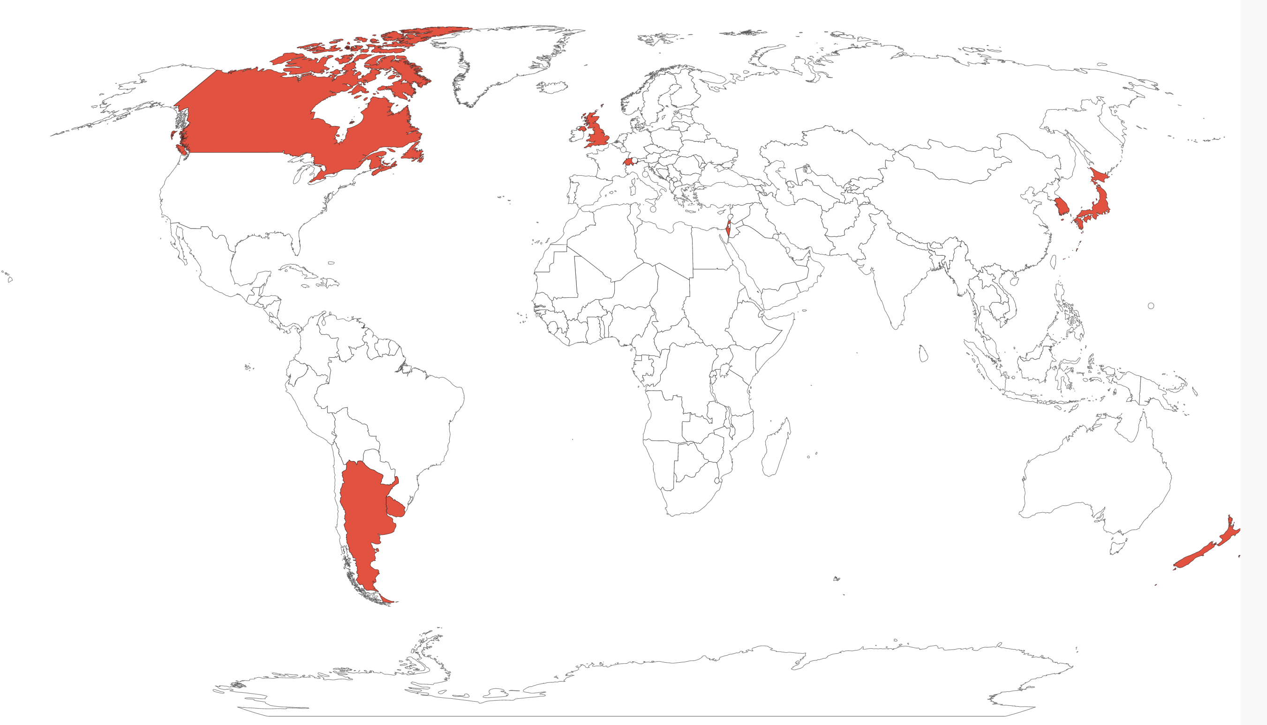
Countries with EU Adequacy Decisions
8

Slide 9
The Brussels Effect
As alluded to in the previous section, the UK government did not have an agreed vision regarding data protection, when it triggered Article 50 to leave the EU.
One might have expected the UK government to immediately declare an intention to maintain compliance with EU data protection laws given that this would ensure that the UK provides an essentially equivalent level of protection and increase the likelihood of securing and thereafter retaining an adequacy decision to facilitate personal data-enabled services exports from the EU to the UK – they were worth approximately £42bn (€47bn) whilst exports from the UK to the EU were worth £85bn (€96bn) in 2018.
However, there were calls for Brexit to be used as an opportunity to diverge from the EU standard by those who viewed the GDPR standards as being too high and contended that lower, less onerous standards would give the UK leverage when engaging in trade deals with other countries.
There was in fact was little appetite in the business sector for wholescale divergence from the EU data protection standard.
Business representatives made an implicit mention of the Brussels effect, that is, the regulatory ‘race to the top’ whereby the most stringent standard has an appeal to companies operating across multiple regulatory environments as it makes global production and exports easier.
If you are running a global operation, you will want to have consistent processes across your businesses. What we are seeing is that global firms based outside of the EU are taking the GDPR as the norm for their business and are building their processes around it, so, for very large companies, there is no desire to diverge from the GDPR—the opposite, because they worry about falling between the gaps. '
Business representatives were also cognizant of the trade power of the EU, three-quarters of the UK's cross border data flows are with EU countries. They were aware that the UK will have to do very much in partnership with EU rather than simply striking out.
The EU is able, through its ‘trade power,’ to ‘export’ its laws and standards to other countries by offering improved access to its large and valuable market in return for legal compliance.
Multinational corporations are obliged to comply with the GDPR to gain access to the EU market, and as these multinational companies prefer to deal with as few legislative frameworks as possible, they promote through compliance with it, the GDPR as the global regulatory standard, not least to avoid the additional costs of compliance with multiple rules and to gain the economies of scale achieved by promoting compliance with the GDPR. Consequently, trade and market forces were drivers of the UK’s continued compliance with EU data protection law, post Brexit.
​

Slide 10
Post-Transition Data Protection In The UK
Given the need for close alignment with the GDPR to initially secure an adequacy decision, and to maximize the likelihood of renewal of an adequacy decision in due course, it should come as no surprise that the UK data protection law is in essence a copy of the GDPR.
The transition period ended on 31 December 2020 and EU law ceased to apply directly.
Secondary legislation passed under the EU Withdrawal Act – then amended the EU GDPR to create a domestic data protection law: the UK GDPR.
The UK GDPR is very similar to the EU GDPR, so organizations that comply with the latter are likely to be in compliance with the former.
As for transfers of personal data outside the UK they are only permissible if an adequacy decision or appropriate safeguard is in place
The UK has recognized all EU member states as providing an adequate level of data protection for the purposes of the UK GDPR
These steps offer certainty and continuity of data flows in the short term, but in recognition of the UK’s ‘reclaimed’ regulatory autonomy, power is conferred on the UK Secretary of State for Digital, Culture, Media and Sport (DCMS) to conduct its own adequacy assessments in respect of transfers outside the UK.
Little information is available on the criteria the UK intends to use to assess adequacy.
The UK government has said that it is prioritizing adequacy decisions for Australia, Colombia, Dubai, South Korea, Singapore and the US.
It lists Brazil, India, Indonesia and Kenya as longer-term priorities.
.
10

Slide 11
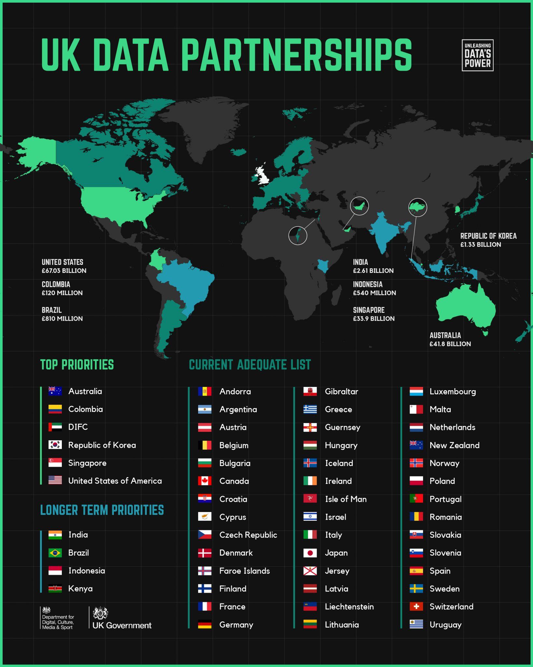
The UK's Adequacy Decisions
11

Slide 12
Continued Alignment Vs Divergence
A statement made by Boris Johnson when in precedency ‘The UK will in future develop separate and independent policies in areas such as [...] data protection.’
Likewise, the UK’s Secretary of State for Digital, Culture, Media and Sport Oliver Dowden MP observed that:
'The EU doesn’t hold the monopoly on data protection. So, having come a long way in learning how to manage data risks, the UK is going to start making more of the opportunities.'
Comments of this nature have fuelled speculation that the UK will seek to forge its own data protection path.
A confidential draft seen by the Financial Times found that smaller businesses were particularly affected by the costs of compliance with the General Data Protection Regulation (GDPR).
A lack of clarity over how the rules relate to emerging technologies has meant regulators have struggled to apply them in fields such as artificial intelligence, blockchain and the internet of things which makes it impossible to properly use or even develop these technologies – AI needs access to data for training purposes, yet the vast majority of data is being stored outside the EU, which risks making it impossible for us to be competitive in any form of digital innovation, undermining our future economic prosperity.
​
The changes are intended to support the Government’s growth agenda by reducing regulatory burdens and simplifying compliance for data controllers. At the same time they are also intended to protect data privacy and help prevent loss from cyber attacks and data breaches.
One proposal suggests replacing the UK GDPR with a new ‘framework for data protection’ that would inter alia reduce reliance on consent by placing greater emphasis ‘on the legitimacy of data processing’.
The new regime will move away from a “one size fits all” approach and be less onerous in particular for some smaller organisations and businesses.
Evidently, Brexit has added to the complexity of the global data protection landscape.
It has not achieved its long-awaited objective of freeing UK data protection law from the bridles of EU law. The UK legal framework is inexorably put in a position of dependence.
The UK government’s announcement that it ‘intends to expand the list of adequate destinations in line with our global ambitions and commitment to high standards of data protection’.
This statement will be welcomed by those who were calling for Brexit to be used as an opportunity to diverge from the EU standard as mentioned previously or those seeking evidence of the UK reclaiming its sovereignty and boldly seeking to forge new or stronger trade links with countries beyond the EU.
12

Slide 13
However it is important to note that the UK’s own adequacy status (i.e., adequacy decision facilitating EEA-UK personal data transfers), could be imperilled if the UK were to make a finding of adequacy in respect of countries that the EU has not found adequate and allow such adequacy regulations to be used as a ‘back door’ for onward transfers of data from EEA countries that would breach GDPR requirements.
Likewise, although the UK can, as a sovereign third country, revise the UK GDPR and DPA 2018, significant divergence could jeopardise the EU-UK adequacy decision and/or impede its renewal. The power to diverge is therefore best described as illusory.
The compliance burden for multinationals has increased. Multi-nationals operating in both jurisdictions (UK GDPR and EU GDPR) will effectively be subject to two regimes need to appoint a representative in each jurisdiction. Relatedly, a data breach that has a multi-country dimension may be exposed to two sets of penalties, in respect of incidents that breach both UK and EU data protection law.
As acknowledged by the Commission, SMEs should be offered additional support e.g., templates, hotlines, and appropriate training to help them understand and meet their GDPR obligations
As for the GDPR impeding innovation, it must be noted that the GDPR does contain lots of ‘white spaces’ including wide exemptions for research which, if properly developed, will support the UK’s world-leading research. If the initial ‘teething problems’ regarding support for SMEs can be overcome, and guidance to how UK-based data controllers and processors can and should interpret the derogations and ‘white spaces’ in the GDPR, then multi-national data controllers are unlikely to call for the UK government to significantly diverge from the GDPR if it continues.​
both UK and EU data protection law.​
​
Significant UK divergence from the GDPR would not necessarily be an appropriate response given that customers increasingly value high levels of data protection, and multi-national companies operating in both the EU and UK are likely to promote continued compliance with the GDPR than a multiplicity of different standards. ​
​
But, in my view calls for divergence from the EU standard are not likely to be loud or pressing for as long as the EU remains an important trading partner of the UK, and multi-nationals operating on a global basis support compliance with the EU standard. ​
​
​
​
13

Slide 14
CONCLUSION
This chapter opened by arguing that UK’s departure from the EU would serve as an acid test not only of the EU’s influence as a trade power and global regulator in general, but more specifically, whether the GDPR has any realistic prospect of becoming the ‘global digital gold, standard of data protection’.
Despite negotiations the parties did eventually agree and the UK retained the GDPR in domestic law and applied for an EU adequacy decision under the GDPR framework, so in that respect the GDPR adequacy framework can be considered a success. Not only that, but the extra-territorial provisions and mutual adequacy obligations in both the UK GDPR and GDPR have created the conditions for synergy and continued alignment between the two data protection frameworks, with the benchmark of protection being the high standard set in the GDPR, at least for so long as each want to facilitate ‘free flows’ of data to the other.
Whilst Brexiteers are likely to be disappointed at this outcome given their vociferous calls to restore complete sovereignty, data protection advocates will extol the UK’s continued compliance with the GDPR as early evidence of the influence of the GDPR and its effectiveness in in ensuring high standards of data protection in third countries around the world.
Having said that, continued compliance by the UK with the GDPR should not be taken for granted. Rather, it must remain fit for purpose. Accordingly, the EU should not ignore the concerns raised that it hampers innovation and competitiveness. If such concerns are not addressed trade and market forces could act as drivers for divergence from EU data protection law in the longer term. If that were to occur then the EU may not realize its goal of the GDPR becoming the ‘global digital gold, standard of data protection’.
In sum, EU data protection advocates have rightly framed the UK’s continued compliance with the GDPR as early evidence of the potential for the EU to set the standard of data protection laws and encouraging harmonization on a global basis, but its longer-term future is not so certain as the GDPR could lose influence over time if it is not fit for purpose. Hence, the UK has left the EU but not EU data protection law behind, for now, at least.
14

Slide 15
REFERENCES
A. Bendiek and M. Römer, M. (2019) 21(1) ‘Externalizing Europe: the global effects of
European data protection’ (2019)
Anu Bradford, The Brussels Effect: How the European Union Rules the World
Federation of Small Businesses, ‘Manifesto European Elections 2014’ (February 2014).
Daniel Castro, ‘Brexit Allows UK to Unshackle Itself from EU’s Cumbersome Data Protection Rules’ (Centre for Data Innovation, 20 July 2016) https://www.datainnovation.org/2016/07/brexit
-allows-uk-to-unshackle-itself-from-eus-cumbersome-data-protection-rules/ accessed 19 April 2021.
Anu Bradford, ‘The Brussels effect,’ (2012) NW U Law Rev, 107(1), 1–68, 9.
Estimated by the UK government’s Department for Digital, Culture, Media and Sport by applying the UN definition of digitally deliverable services (DDS) to UK Office for National Statistics data; cited in DCMS, Explanatory Framework for Adequacy Discussions, Section A: Cover Note, 13 March 2020
House of Lords, European Union Committee, ‘Brexit: the EU data protection package,’ 3rd Report
of Session 2017–19 – published 18 July 2017 – HL Paper 7, para 128.
Statement made by Oliver Patel, Head of Inbound Data Flows, Department for Digital, Culture, Media and Sport (DCMS) at Commercial data transfers between UK and EU and the adequacy decision, Cross DPN Online Workshop, 22 April 2021.
Joseph Menn, ‘Exclusive: Facebook to move UK users to California terms, avoiding EU privacy rule, (Reuters, US Legal News, 15 December 2020), https://www.theguardian.com/technology/2020/ dec/15/facebook-move-uk-users-california-eu-privacy-laws
PM Statement, UK / EU relations: Written statement – HCWS86, 3 February 2020.
Oliver Dowden, ‘New approach to data is a great opportunity for the UK post-Brexit’ (Financial
Times 27 February 2021), https://www.ft.com/content/ac1cbaef-d8bf-49b4-b11d-1fcc96dde0e1 accessed 19 April 2021.
European Commission, Communication from The Commission To The European Parliament And The Council, Data protection as a pillar of citizens’ empowerment and the EU’s approach to the digital transition – two years of application of the General Data Protection Regulation, COM (2020) 264 final, Brussels, 24.6.2020 https://eur-lex.europa.eu/legal-content/EN/TXT/HTML/?uri=CELEX:DC0264& from=EN accessed 19 April 2021.
Javier Espinoza, “EU must overhaul flagship data protection laws, says a ‘father’ of policy,” (Financial Times, 3 March 2021).
Axel Voss, ‘How to bring GDPR into the digital age,’ (Politico, 25 March 2021) https://www .politico.eu/article/gdpr-reform-digital-innovation/ accessed 19 April 2021.
15

