Slide 1
PROJECT STARTER
A structured harness for AI-assisted development using Claude Code
Stack-agnostic · MIT License · github.com/jackrich78/project-starter

Slide 2
THE PROBLEM
Every session starts from zero
"You spend an hour getting Claude to understand your project. Tomorrow, it's forgotten everything."
"You ask it to add a feature and it breaks three things — it lost track of what it already built."
"Every session feels like day one. Nothing compounds."
Claude Code can do anything — but without structure, every session is improvised. Even with 1M tokens, agent performance degrades over long sessions. The real question: how do you build something reusable and reliable that ships quality without starting over?
You get fast prototypes but fragile systems. Speed without compounding.

Slide 3
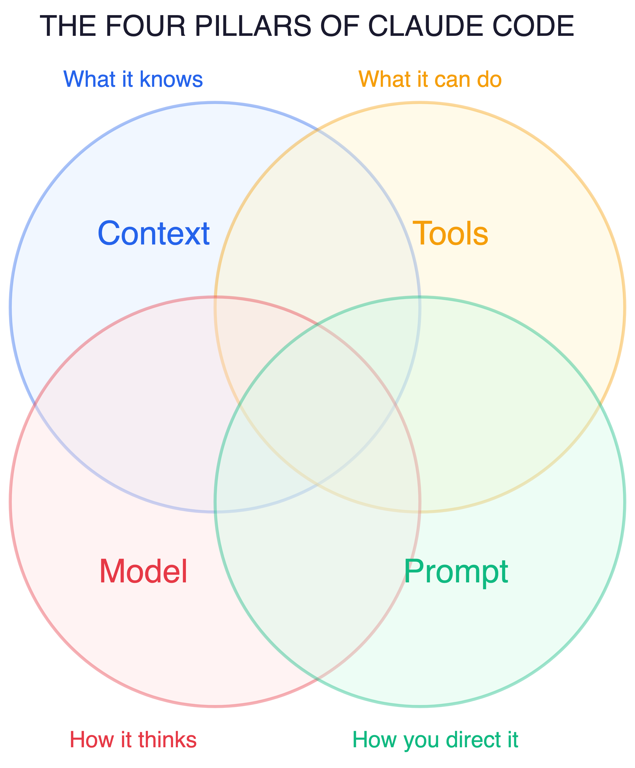
WHAT IS CLAUDE CODE?
An AI coding agent you can structure
An AI agent that reads, writes, and runs code in your terminal. Four things determine how well it works:
Context — what it knows about your project
Tools — what it can do (read, write, search, run)
Model — how it thinks and reasons
Prompt — how you direct it (CLAUDE.md, commands)
Built-in: /help, /clear, /compact, /model, /config, /permissions
This template structures all four pillars. The intersection is where quality happens.

Slide 4
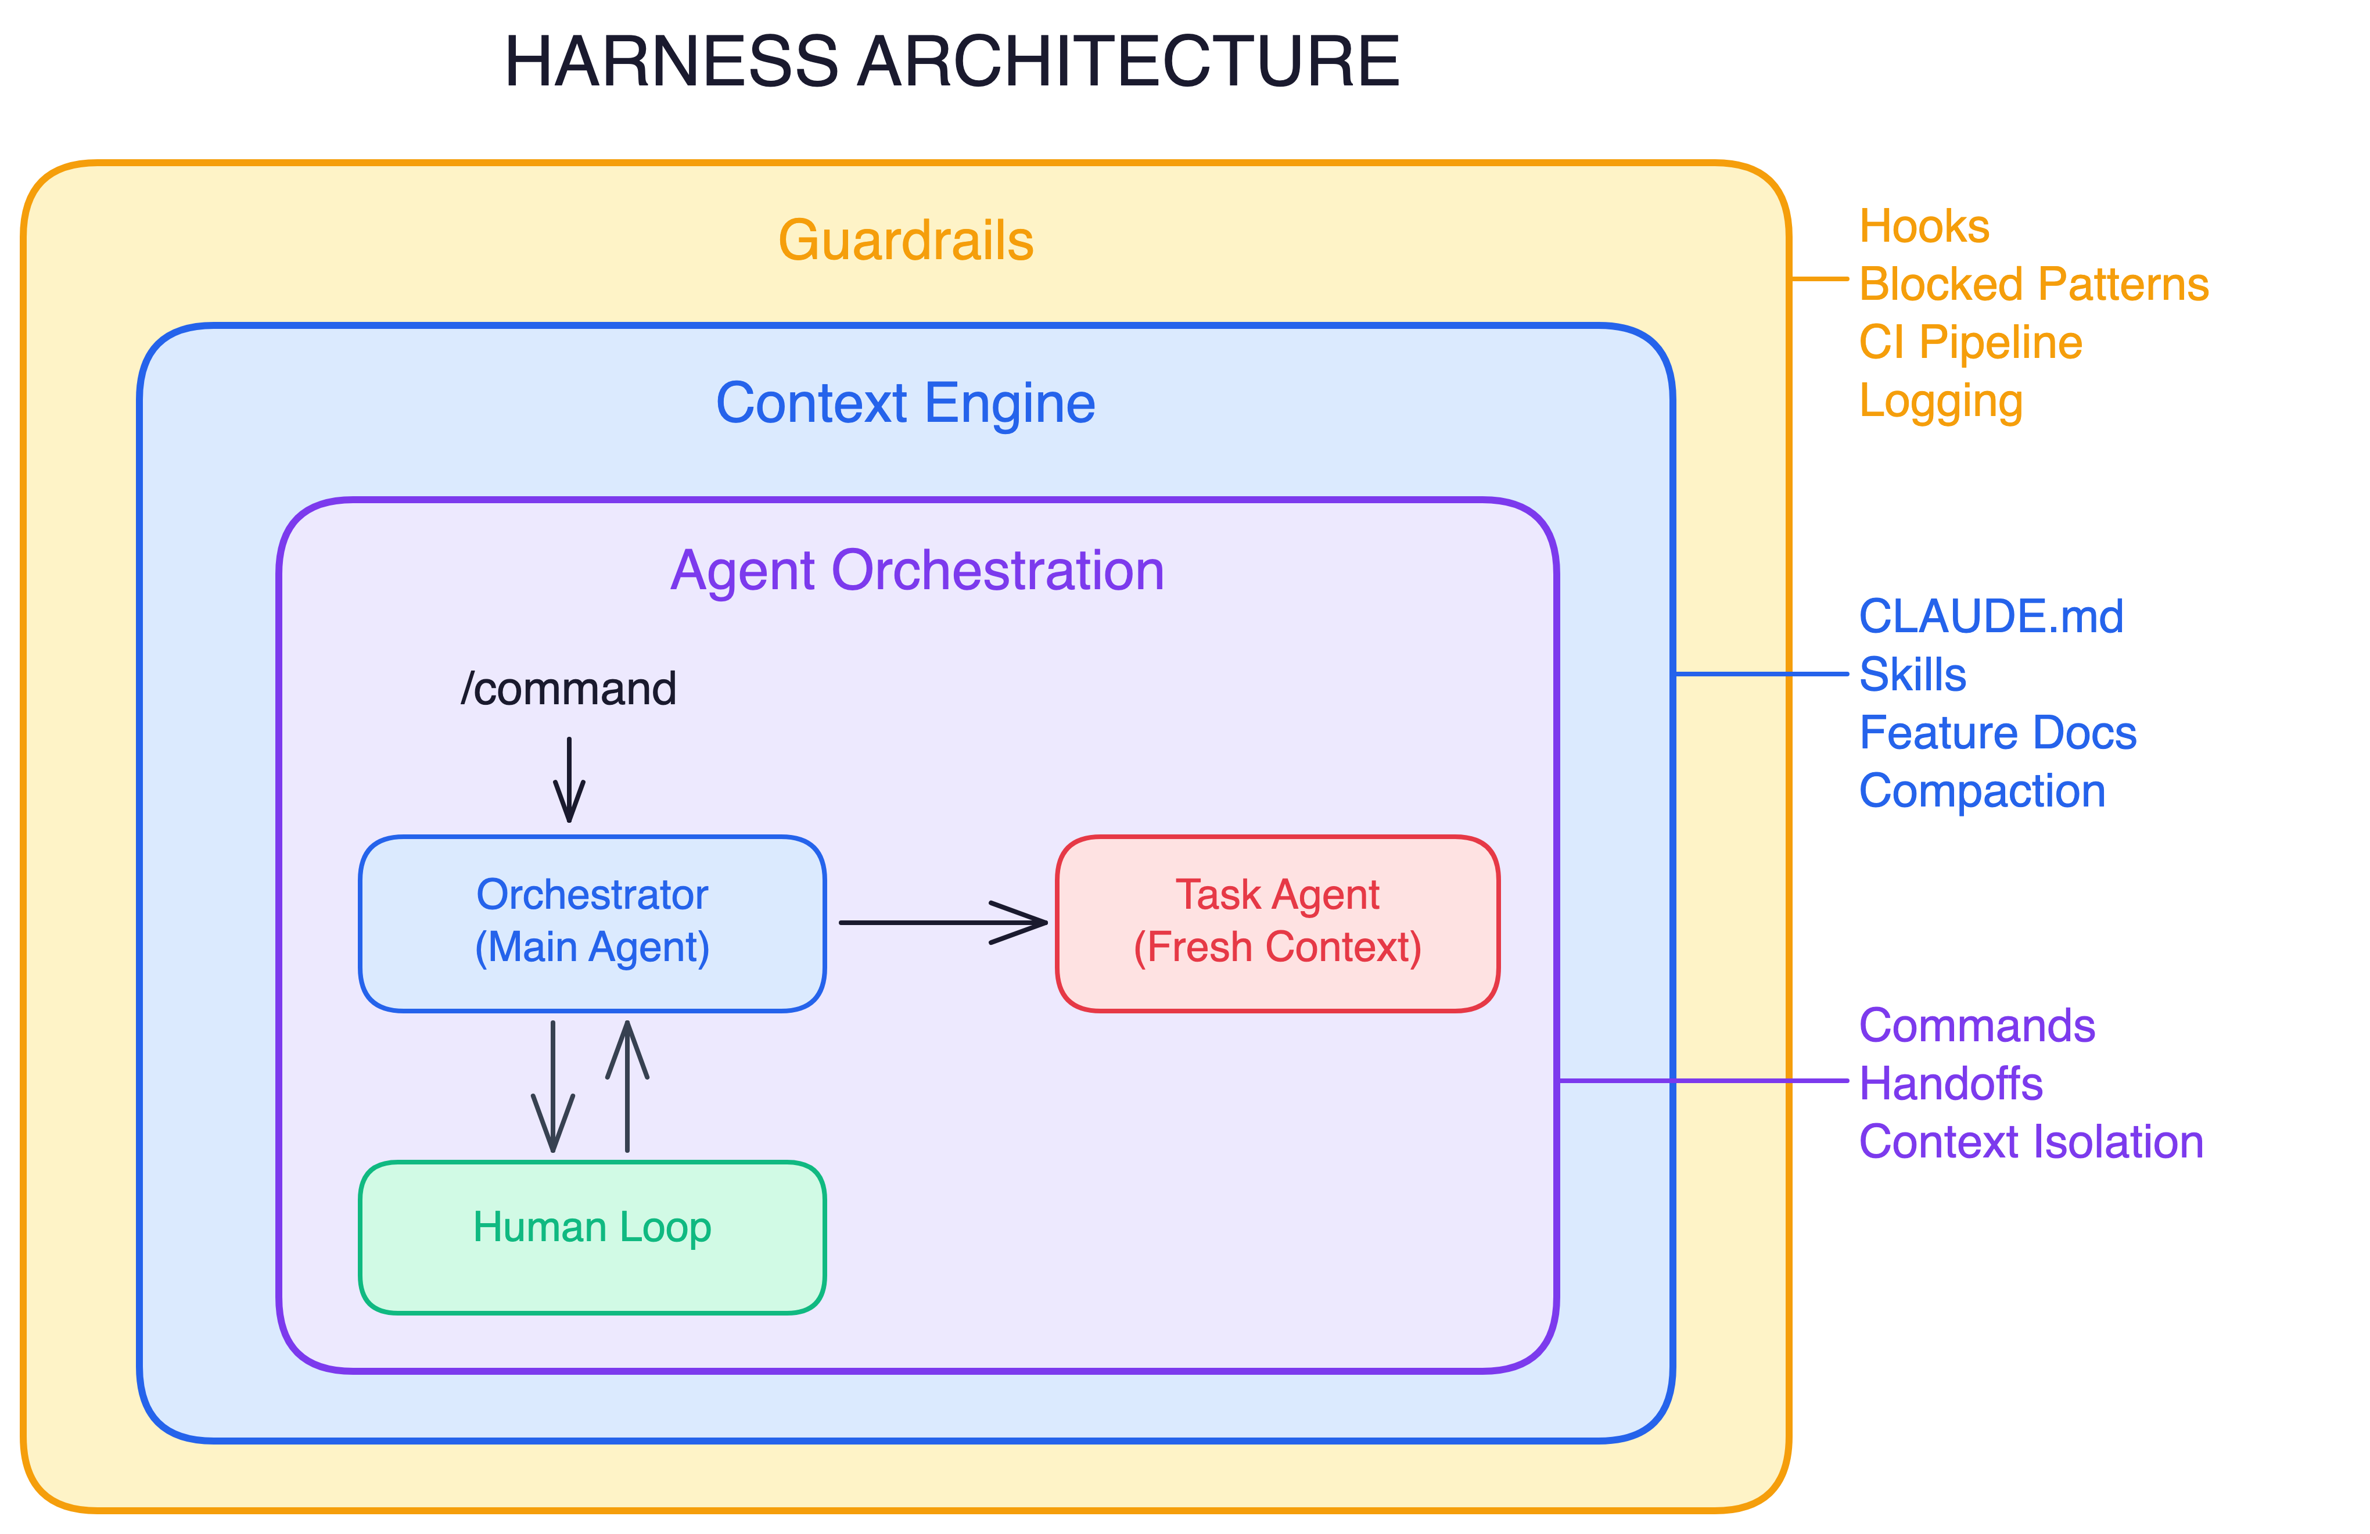
THE SOLUTION
A workflow template, not a framework
WHAT YOU CAN INFLUENCE
HOW PROJECT STARTER LAYERS IT
Fork it, customize it, start building. Knowledge compounds with every feature you ship.
14
12
17
commands
agents
skills

Slide 5
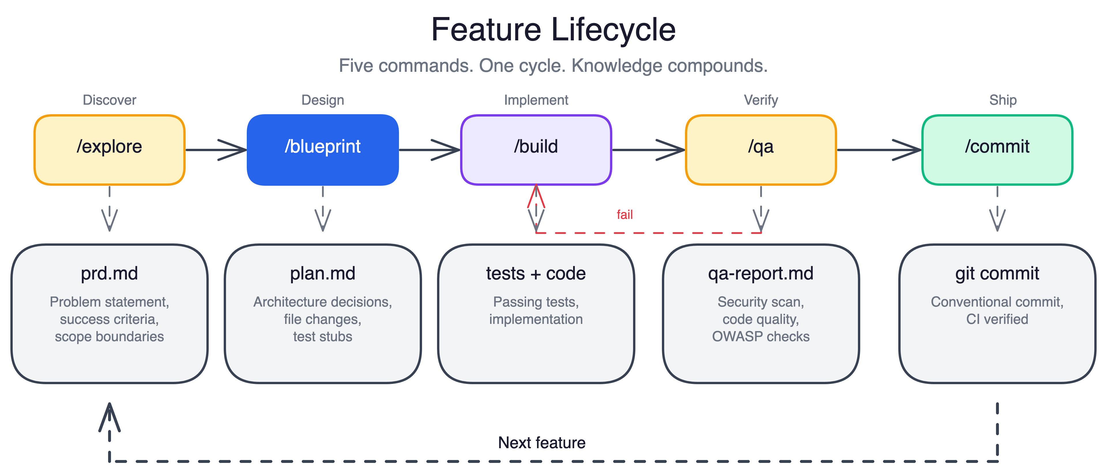
THE WORKFLOW LOOP
Five commands form a repeatable loop
/explore → /blueprint → /build → /qa → /commit. Each command produces an artifact the next one reads. The loop writes to your knowledge base — it's not fire-and-forget.

Slide 6
DURABLE ARTIFACTS
Each command writes durable artifacts
docs/features/FEAT-001_health-check/
prd.md ← /explore
plan.md ← /blueprint
handover.md ← /handover
qa-report.md ← /qa
test/ ← /build
src/ ← /build
git commit ← /commit
prd.md
Problem statement, success criteria, scope. Claude reads this to start every subsequent command.
plan.md
Implementation steps, architecture decisions, test stubs. The implementation contract.
handover.md
What was done, decisions made, what's next. Token-budgeted under 1,500 tokens.
qa-report.md
SAST results plus OWASP checklist. APPROVED / NEEDS_FIXES / BLOCKED verdict gates the commit.

Slide 7
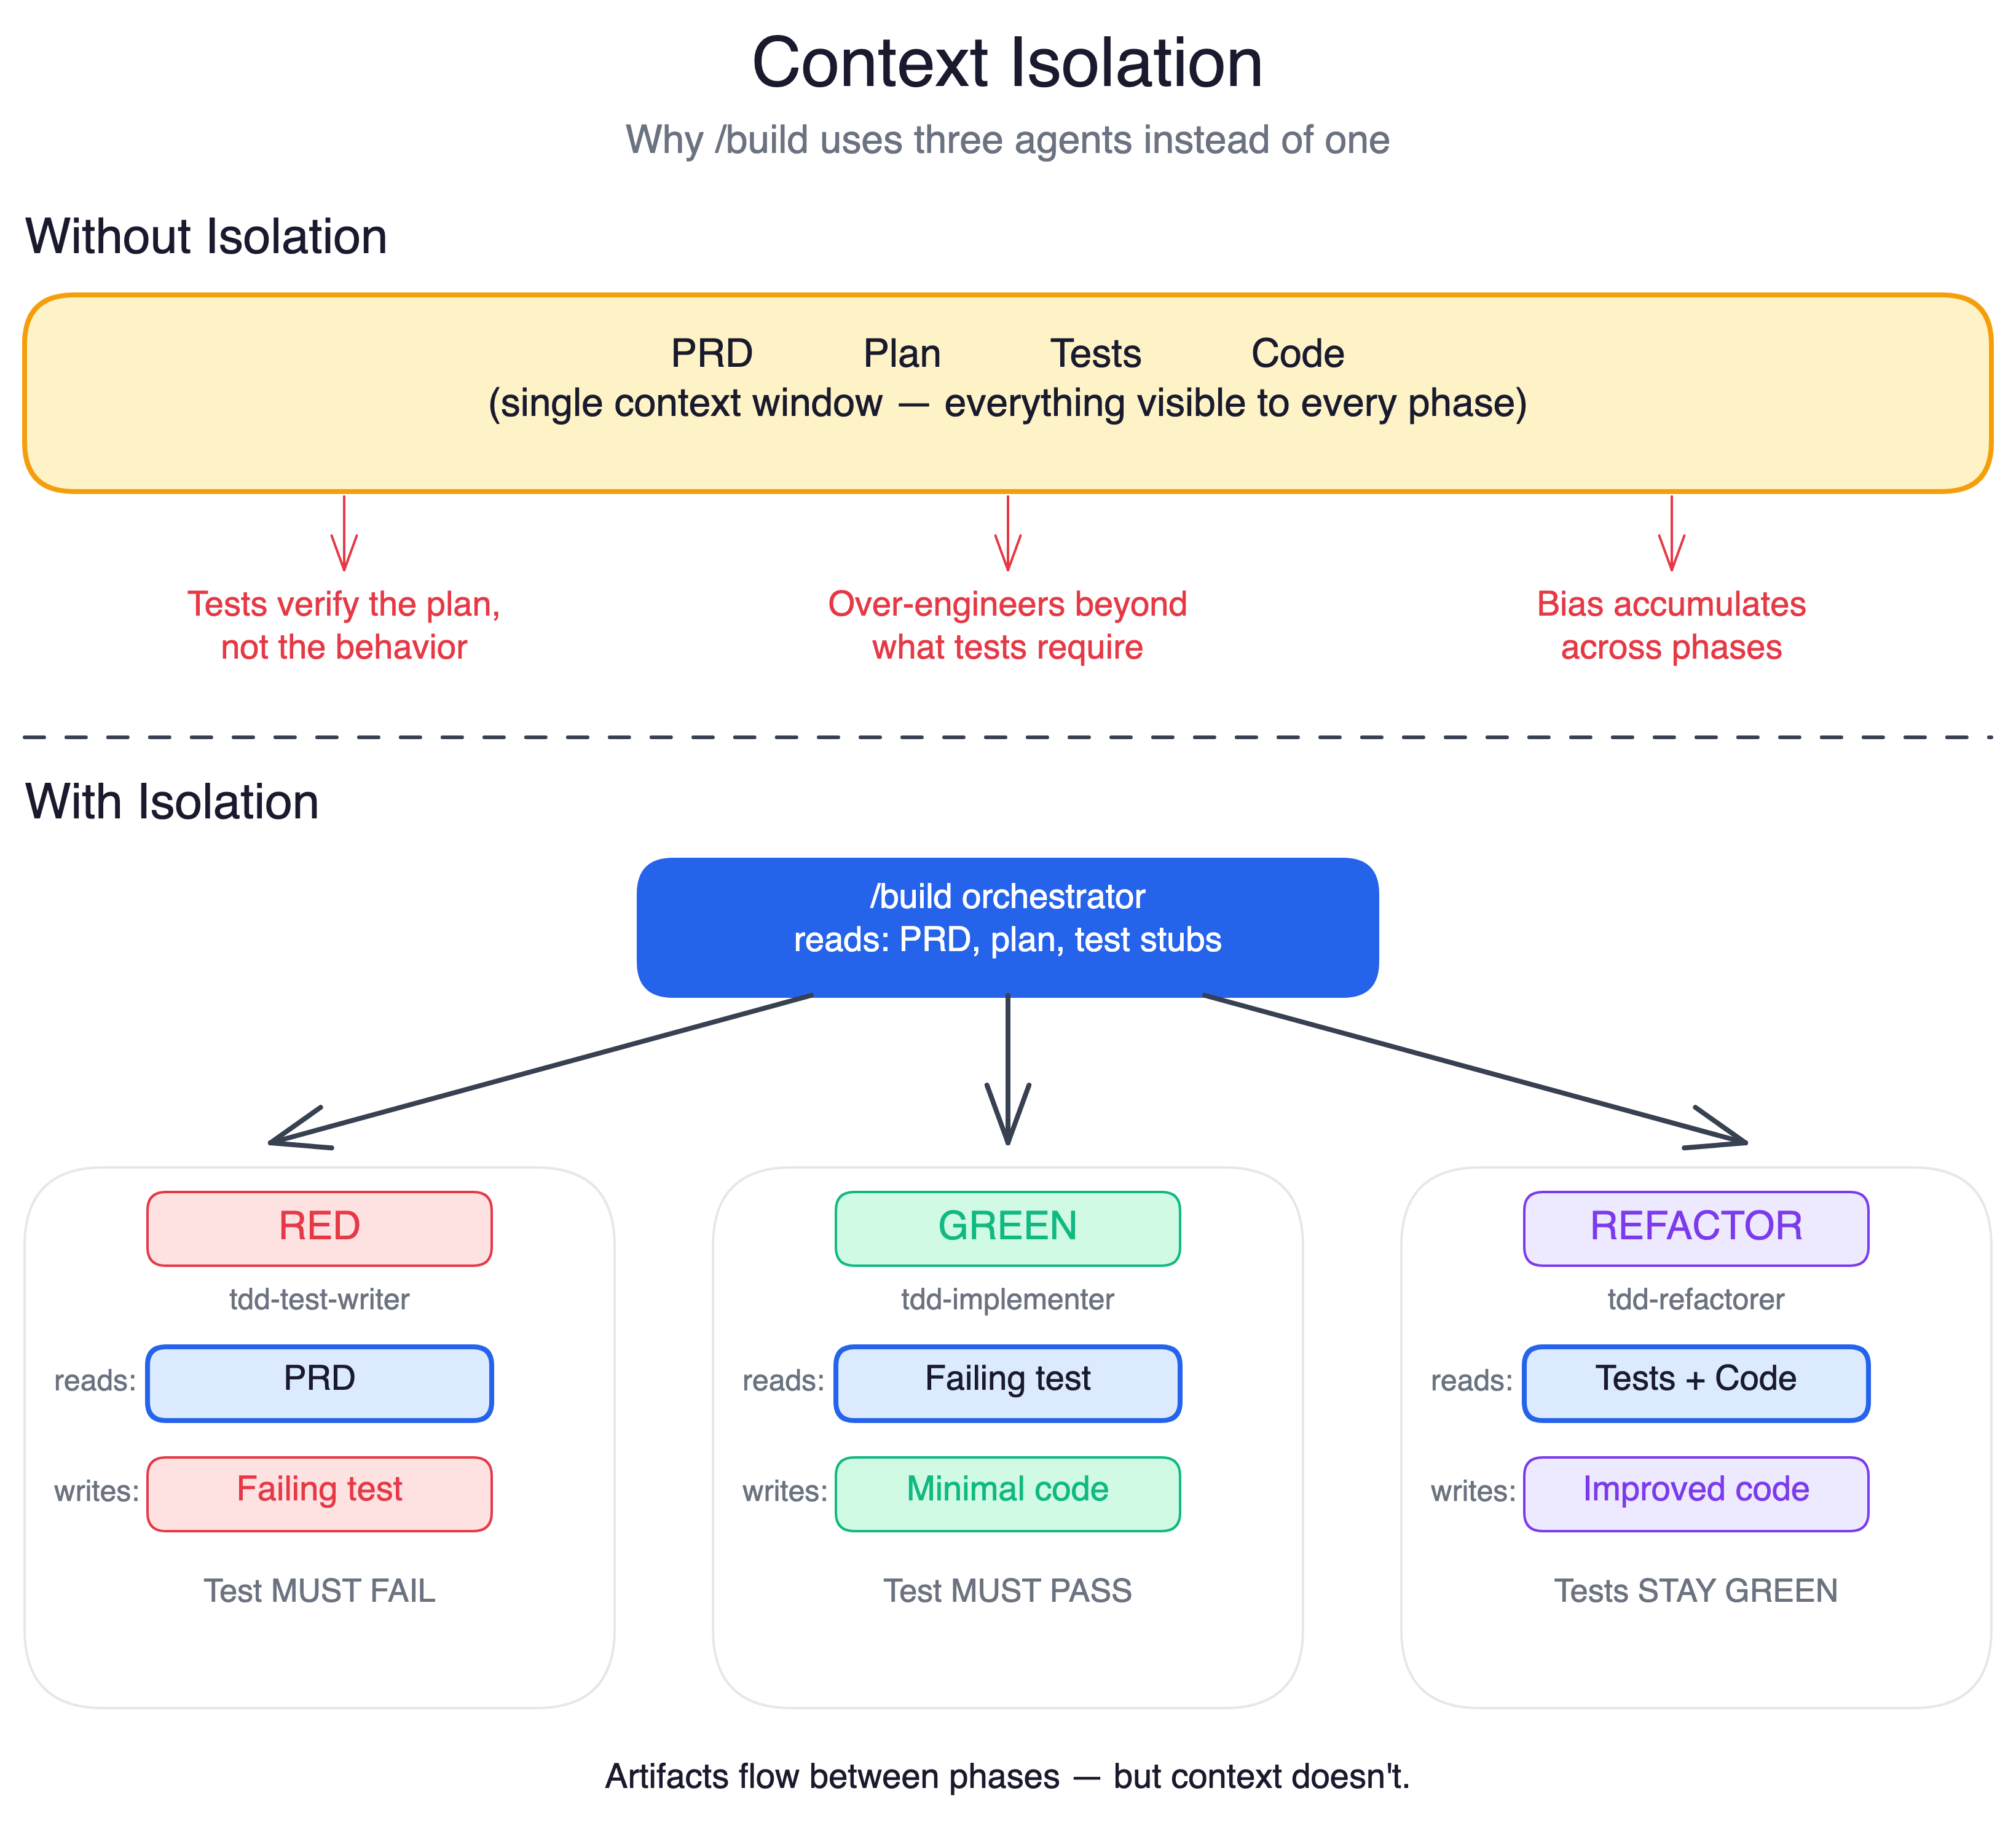
CONTEXT ISOLATION
Isolation prevents agents from biasing each other
Test writer sees: PRD only
Writes tests against stated behavior. If the plan is wrong, the tests still test the right thing.
Implementer sees: Failing tests only
Writes the minimum code to make tests pass. Can't over-engineer what it can't see.
Refactorer sees: Tests + code
Improves structure without changing behavior. Green tests are the constraint.
Artifacts flow between phases — but context doesn't. The absence of connections IS the architecture.

Slide 8
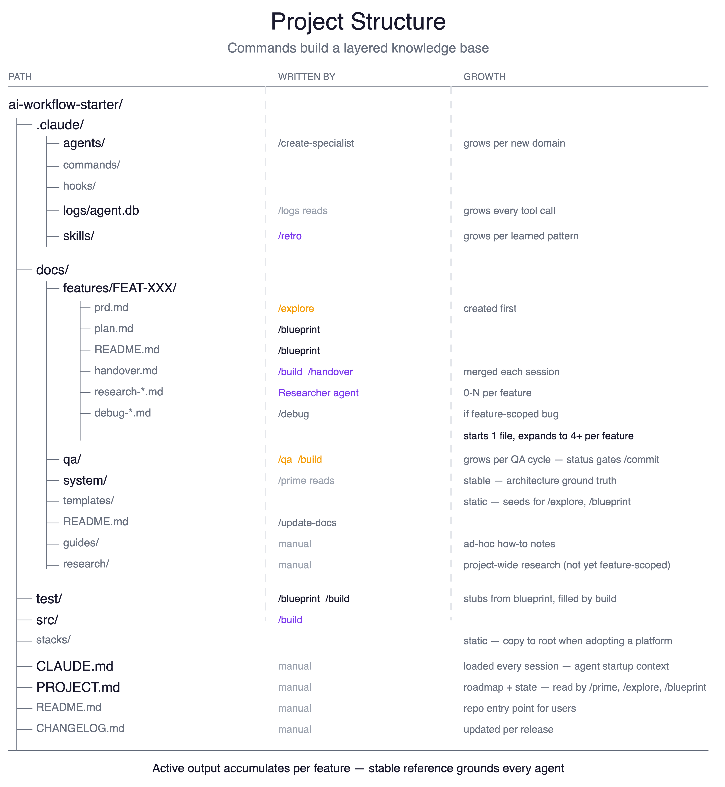
THE KNOWLEDGE BASE
Every session builds on the last
Feature docs (docs/features/)
PRD, plan, handover, and QA report per feature. Nothing is thrown away. Feature 12 benefits from everything written in features 1–11.
Skills (.claude/skills/)
Cross-cutting patterns extracted by /retro after each feature. A debugging approach from FEAT-003 is available in FEAT-012.
Session continuity
/handover writes a token-budgeted summary before you stop. /prime loads it at session start. Each merge prunes stale context — handovers get sharper over time.

Slide 9
WHAT IT LOOKS LIKE
A typical session, from setup to commit
Four commands, four artifacts, one green CI run:
$ /setup docs/research/my-project-notes.md
→ configures PROJECT.md, CLAUDE.md, and initial docs
→ installs stack scaffolding if specified
$ /explore add a health check endpoint
→ asks 3 clarifying questions
→ creates docs/features/FEAT-001_health-check/prd.md
$ /build FEAT-001
→ RED: tdd-test-writer writes failing tests (sees PRD only)
→ GREEN: tdd-implementer writes minimal code (sees tests only)
→ REFACTOR + QA: clean up → 15 SAST rules + OWASP → APPROVED
$ /commit
→ QA gate passes → conventional commit → CI passes in 12s

Slide 10
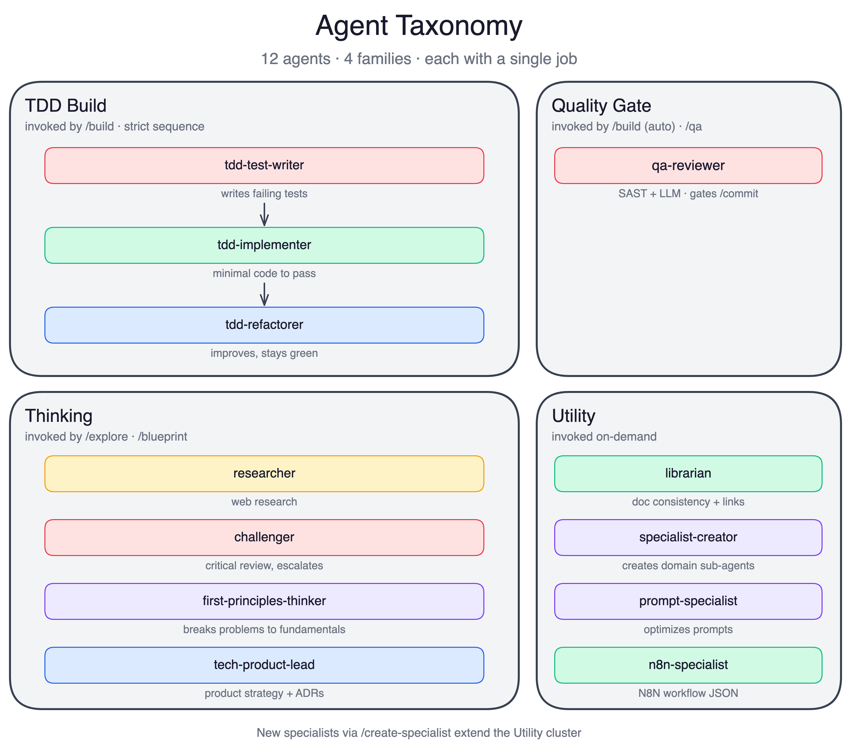
AGENTS AS SPECIALISTS
12 specialists — each with one job
TDD Build (3 agents)
Run the RED-GREEN-REFACTOR cycle. Each in an isolated 200k-token context.
Quality Gate (1 agent)
qa-reviewer: SAST plus OWASP review with fresh context every time. No bias from the build session.
Thinking (4 agents)
researcher, challenger, first-principles-thinker, product-engineering-lead. Research and critique before code is written.
Utility (4 agents)
specialist-creator, prompt-specialist, librarian, n8n-specialist. Extend the harness, maintain docs, build integrations.

Slide 11
COMMANDS REFERENCE
14 commands — start with the six in bold
PRIMARY
SECONDARY
/setup [docs]
/debug [issue]
Configure project, generate initial docs from source material
6-phase systematic bug investigation
/explore [topic]
/handover
Interview-driven feature spec → structured PRD with success criteria
Token-budgeted session summary (under 1,500 tokens)
/prime [mode]
/blueprint FEAT-XXX
Load context at session start (think, build, review)
Reads codebase, validates assumptions, drafts implementation steps
/retro
/build FEAT-XXX
Extract patterns → reusable skills
TDD with 3 isolated agents + QA reviewer → tested, reviewed code
/logs
/qa [target]
Query SQLite audit trail
Semgrep SAST + OWASP review → APPROVED / NEEDS_FIXES / BLOCKED
/create-specialist [lib]
Generate domain-expert agent for any library
/commit
QA gate → conventional commit → push → verify CI passes
/update-docs
Validate cross-references across docs
/demo
Guided walkthrough of the full workflow

Slide 12
SKILLS REFERENCE
17 skills — reusable decision guides
Modular guides bundled with context, templates, and references. Commands import them automatically. /retro crystallizes new ones after each feature.
DEVELOPMENT (5)
CONTENT & VISUAL (8)
TECHNICAL (3)
debug
brand-guidelines
mcp-builder
6-phase bug investigation
Colors, typography, visual style
Build MCP servers for APIs
spike
diagram / excalidraw-diagram
slack-block-kit
Time-boxed validation
Mermaid + Excalidraw visuals
Slack message builder
tdd-red-green-refactor
icon
youtube-transcript-extract
TDD orchestration
Lucide icons to branded PNGs
Video transcript extraction
test-strategy
docx / md-to-doc
META (1)
Test type decision guide
Document creation + MD conversion
ci-validation
pptx / pdf
skill-creator
CI pipeline checks
Presentations + PDF manipulation
Guide for creating new skills

Slide 13
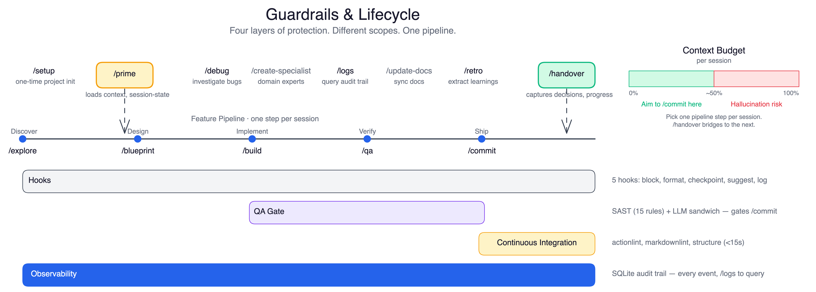
GUARDRAILS
Four protection layers throughout the lifecycle
Runtime hooks (5 hooks, 30 patterns)
QA gate (15 SAST rules, OWASP)
Block destructive commands before execution. Log every tool call to SQLite.
Clean-context reviewer after every /build. APPROVED verdict gates /commit.
CI pipeline (under 15 seconds)
Observability
YAML syntax, markdown lint, structure checks on every push. /commit waits for green.
SQLite audit trail. /logs to query. /debug for systematic root cause investigation.
Built-in observability: session logging to SQLite, agent tracing via /logs, CI/CD hooks — see docs for details.

Slide 14
THE COMPOUNDING ADVANTAGE
The longer you use it, the better the context
Feature Docs
Skills
Session Continuity
Every /explore, /blueprint, /build, and /commit writes to docs/features/FEAT-XXX/. The PRD, plan, handover, and QA report persist across sessions. Feature 12 benefits from everything written in features 1–11.
After each feature, /retro extracts patterns into .claude/skills/. A debugging approach from FEAT-003. A validation pattern from FEAT-007. Each skill is auto-imported when relevant commands run.
/handover captures state in under 1,500 tokens — what was done, decisions made, what's next. /prime loads it at session start. Each merge prunes stale context. Handovers get sharper over time, not longer.

Slide 15
GETTING STARTED
Up and running in 15 minutes
Step 1 — Clone the template
git clone https://github.com/jackrich78/project-starter.git my-project
Or use "Use this template" on GitHub to create a copy under your account
Step 2 — Install and test
npm install && npm test
All 10 scaffold tests should pass before you continue
Step 3 — Open in Claude Code
claude .
Claude Code reads CLAUDE.md automatically and loads project context
Step 4 — Run /setup to configure your project
/setup docs/research/my-project-notes.md
Configures PROJECT.md, CLAUDE.md, and generates initial docs from your source material
Step 5 — Start your first feature
/explore your first feature idea
Explore interviews you and creates the first PRD — the pipeline begins
Run npm test first — all 10 scaffold tests should pass before you start.

Slide 16
WORKING WITH CLAUDE
Steer Claude in the moment — five intent modes
Slow down and reason deeply
Stop — don't fill gaps
Verify before moving on
Before complex decisions, architecture, or debugging
When Claude seems confident without reading the file
After implementation, to catch self-introduced errors
Challenge the approach
Control scope and output
Stress-testing a plan before committing to a direction
Preventing scope creep, verbosity, or silent reference changes
All phrases are situational — you combine them. "Think ultra hard, do not assume, validate your work" before a risky refactor. See Claude Code best practices: code.claude.com/docs

Slide 17
LEARN MORE
Documentation and community
Getting Started
Skills Reference
docs/guides/getting-started.md
docs/system/skills-reference.md
Architecture
Observability
docs/system/architecture.md
docs/system/observability.md
Commands Reference
CI/CD Workflow
docs/system/commands-reference.md
docs/system/cicd-workflow.md
github.com/jackrich78/project-starter
MIT License · Issues welcome · PRs encouraged

