Slide 1
Project Starter
A structured harness for AI-assisted development using Claude Code
Stack-agnostic · MIT License · github.com/jackrich78/project-starter

Slide 2
THE PROBLEM
AI sessions are fast but chaotic
Context lost between sessions
Decisions live only in chat
Claude forgets everything. Every session re-explains the project from scratch.
Architecture choices disappear when the chat history is gone. Nothing persists.
Every session starts from scratch
Agents bias each other's work
Sessions don't build on each other. Nothing compounds. Progress resets each time.
An implementer reading the PRD over-engineers. Seeing only tests keeps it honest.
The result: each session is as chaotic as the first. The AI gets no smarter about your project.

Slide 3
THE SOLUTION
A workflow template, not a framework
WHAT IT IS
WHAT YOU GET
Commands, agent definitions, and hooks that live inside Claude Code
Stack-agnostic — works with any language or framework
A knowledge base that grows with every feature you ship
/explore — interview-driven feature spec, never blank page
/build — TDD with 3 context-isolated agents plus QA gate
Session continuity — /handover and /prime, under 1,500 tokens
12 agents with defined responsibilities
16 skills that accumulate via /retro
Security guardrails: 15 SAST rules, 30 blocked patterns, CI verification
WHAT IT ISN'T
An npm package, framework, or standalone CLI
Something you install — you clone it and it runs inside Claude Code

Slide 4
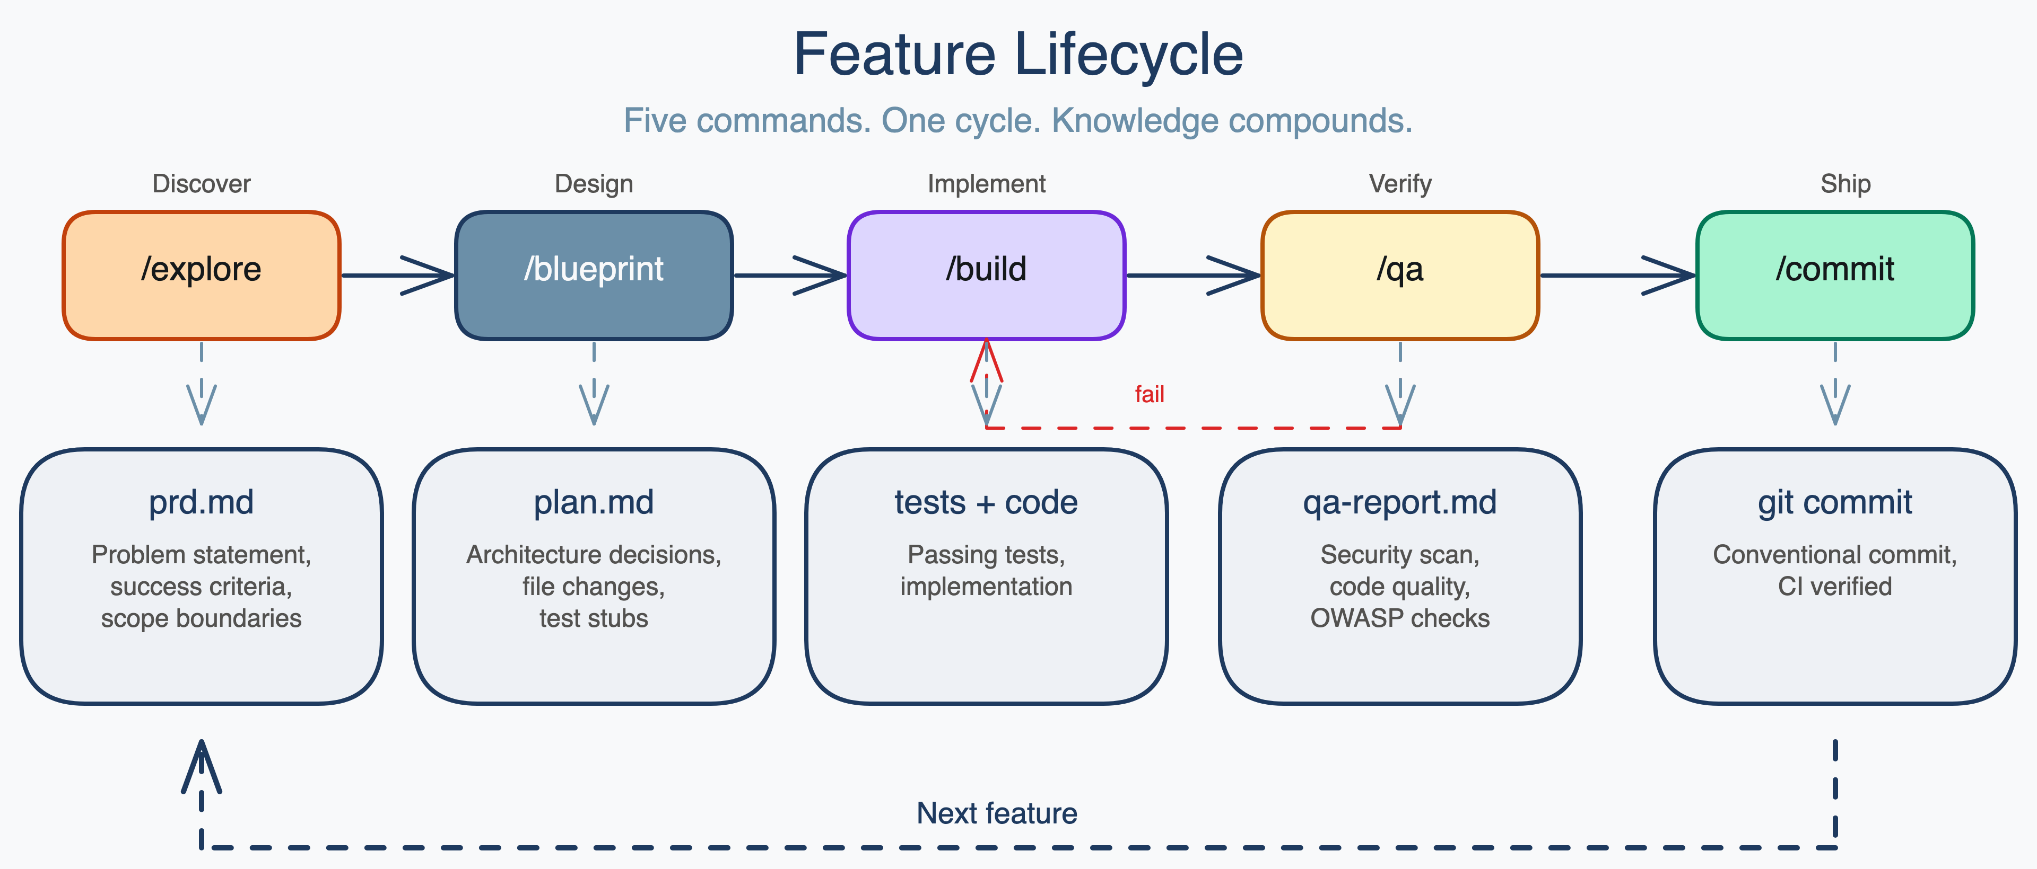
CONCEPT 1: THE WORKFLOW LOOP
Five commands form a repeatable loop
/explore → /blueprint → /build → /qa → /commit. Each command produces an artifact the next one reads. The loop writes to your knowledge base — it's not fire-and-forget.

Slide 5
CONCEPT 1: THE WORKFLOW LOOP
Each command writes durable artifacts
docs/features/FEAT-001_health-check/
prd.md ← /explore
plan.md ← /blueprint
handover.md ← /handover
qa-report.md ← /qa
test/ ← /build
src/ ← /build
git commit ← /commit
prd.md
Problem statement, success criteria, scope. Claude reads this to start every subsequent command.
plan.md
Implementation steps, architecture decisions, test stubs. The implementation contract.
handover.md
What was done, decisions made, what's next. Token-budgeted under 1,500 tokens.
qa-report.md
SAST results plus OWASP checklist. APPROVED / NEEDS_FIXES / BLOCKED verdict gates the commit.

Slide 6
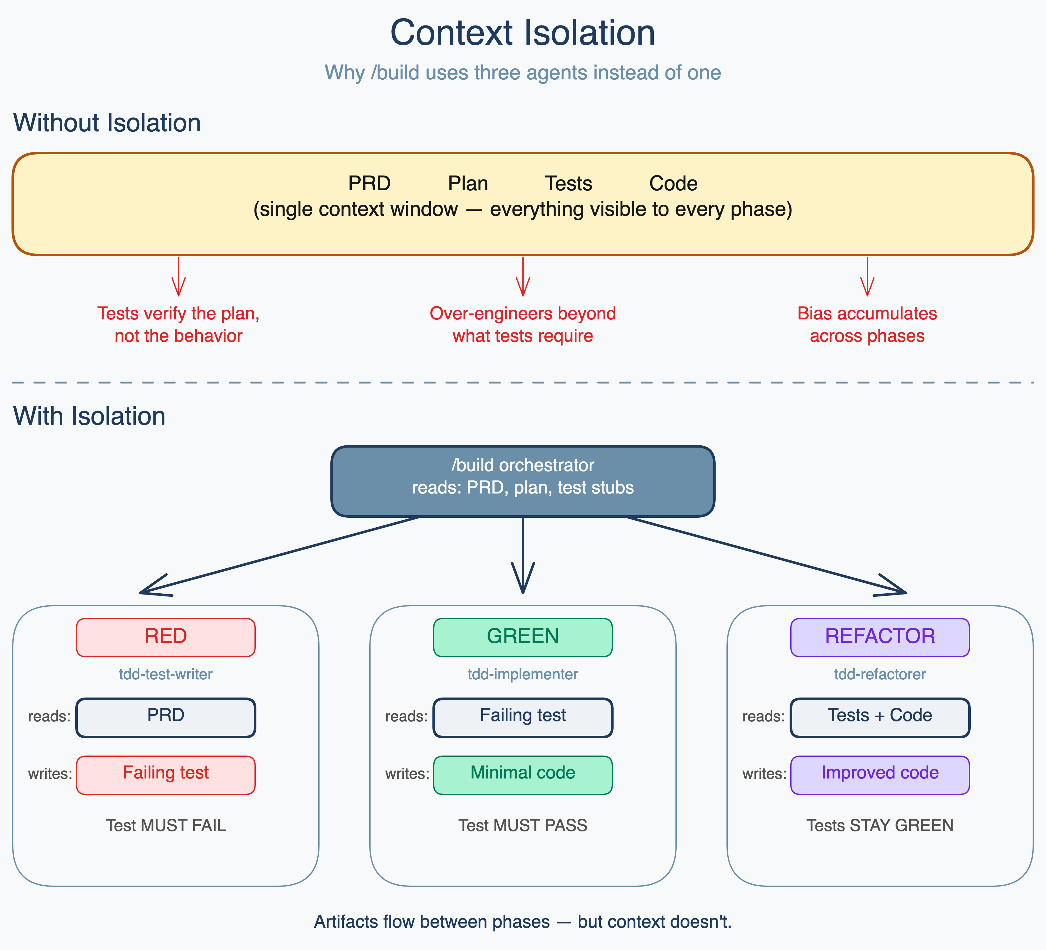
CONCEPT 2: CONTEXT ISOLATION
Isolation prevents agents from biasing each other
Test writer sees: PRD only
Writes tests against stated behavior. If the plan is wrong, the tests still test the right thing.
Implementer sees: Failing tests only
Writes the minimum code to make tests pass. Can't over-engineer what it can't see.
Refactorer sees: Tests + code
Improves structure without changing behavior. Green tests are the constraint.
Artifacts flow between phases — but context doesn't. The absence of connections IS the architecture.

Slide 7
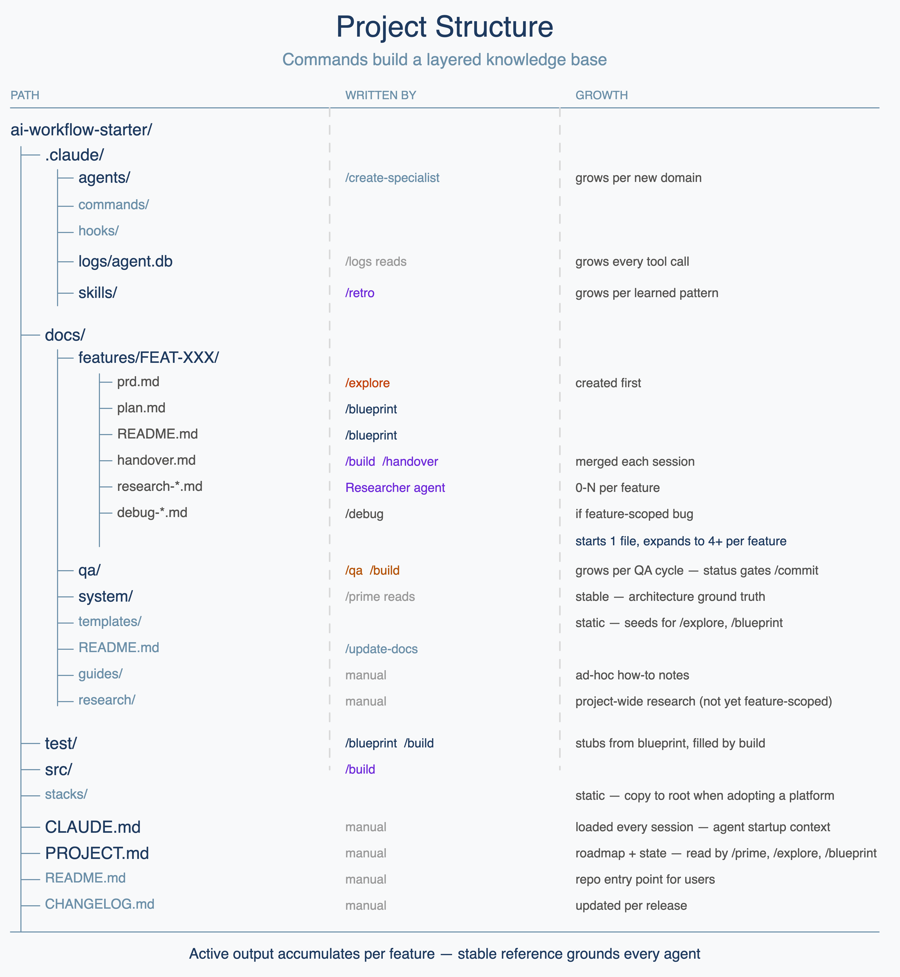
CONCEPT 3: THE KNOWLEDGE BASE
Every session builds on the last
Feature docs (docs/features/)
PRD, plan, handover, and QA report per feature. Nothing is thrown away. Feature 12 benefits from everything written in features 1–11.
Skills (.claude/skills/)
Cross-cutting patterns extracted by /retro after each feature. A debugging approach from FEAT-003 is available in FEAT-012.
Session continuity
/handover writes a token-budgeted summary before you stop. /prime loads it at session start. Each merge prunes stale context — handovers get sharper over time.

Slide 8
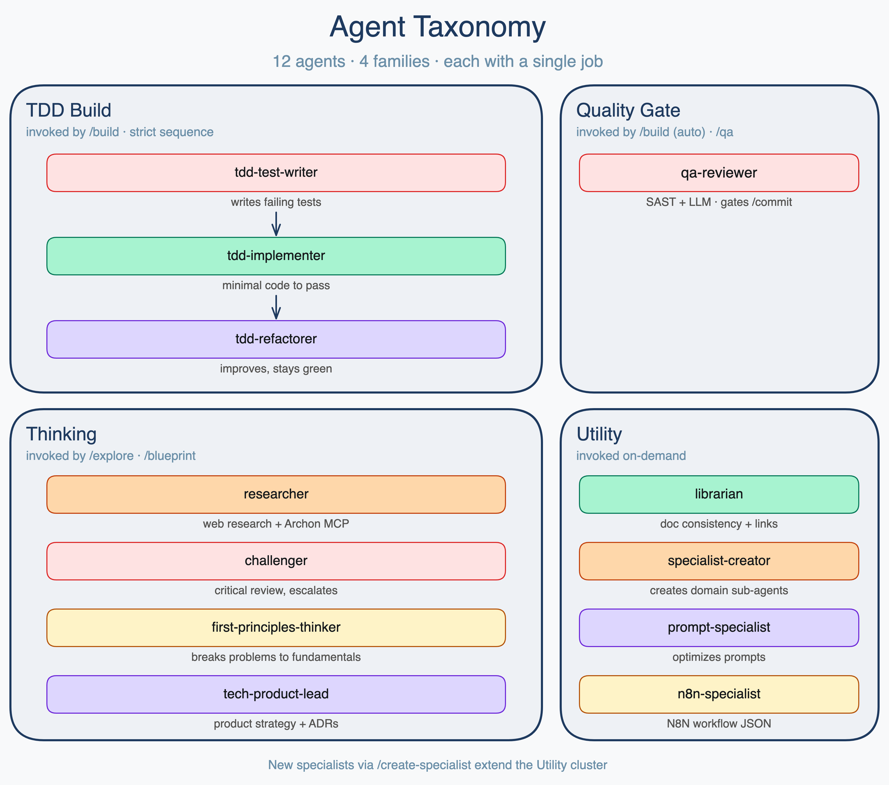
CONCEPT 4: AGENTS AS SPECIALISTS
12 specialists — each with one job
TDD Build (3 agents)
Run the RED-GREEN-REFACTOR cycle. Each in an isolated 200k-token context.
Quality Gate (1 agent)
qa-reviewer: SAST plus OWASP review with fresh context every time. No bias from the build session.
Thinking (4 agents)
researcher, challenger, first-principles-thinker, product-engineering-lead. Research and critique before code is written.
Utility (4 agents)
specialist-creator, prompt-specialist, librarian, n8n-specialist. Extend the harness, maintain docs, build integrations.

Slide 9
CONCEPT 5: WHAT IT LOOKS LIKE
A typical session, from idea to commit
Three commands, three artifacts, one green CI run:
$ /explore add a health check endpoint
→ asks 3 clarifying questions
→ creates docs/features/FEAT-001_health-check/prd.md
$ /build FEAT-001
→ RED: tdd-test-writer writes failing tests (sees PRD only)
→ GREEN: tdd-implementer writes minimal code (sees tests only)
→ REFACTOR: tdd-refactorer cleans up (sees tests + implementation)
→ QA: 15 SAST rules + OWASP → APPROVED
$ /commit
→ QA gate passes → conventional commit → CI passes in 12s

Slide 10
REFERENCE: COMMANDS
Discovery and Build commands
DISCOVERY
/explore [topic]
Interviews you about the problem, researches the space, produces a structured PRD with success criteria.
Use when: you have an idea but don't know what "done" looks like.
/blueprint FEAT-XXX
Reads the actual codebase, validates assumptions, drafts implementation steps, runs Challenger review.
Use when: PRD is approved and before writing code.
BUILD
/build FEAT-XXX
TDD with 3 isolated subagents plus QA reviewer. Produces tested, reviewed code.
Use when: blueprint plan is approved.
/debug [issue]
6-phase investigation: classify, root cause, fix, regression test, verify, document.
Use when: something is broken and needs systematic investigation.

Slide 11
REFERENCE: COMMANDS
Quality and Session commands
QUALITY
SESSION
/qa [target]
/prime [mode] [FEAT]
Two-layer review: Semgrep SAST (15 rules) then LLM OWASP pass. Verdict: APPROVED / NEEDS_FIXES / BLOCKED.
Load context at session start. Mode shapes mindset: think, build, review.
/handover
/commit
Token-budgeted session summary (under 1,500 tokens). Auto-loaded by next /prime.
Checks QA gate, stages files, conventional commit format, pushes, verifies CI passes.
/retro
Extracts recurring patterns → reusable skills in .claude/skills/.
MAINTENANCE
/logs
/update-docs
Queries SQLite audit trail. Filters: recent, tools, sessions.
Validates cross-references, flags broken links across the docs system.
/spike [topic]
/create-specialist [lib]
Time-boxed technical validation (2–8h) before committing to an approach.
Generates a domain-expert agent for any library (Supabase, Stripe, etc.).
/test
Run the project test suite and report results.

Slide 12
REFERENCE: SKILLS
Skills are reusable decision guides
Modular guides bundled with context, templates, and references. Commands import them automatically. /retro crystallizes new ones after each feature.
DEVELOPMENT WORKFLOW
CONTENT & VISUAL
debug
linkedin-carousel — Branded PPTX carousel (4:5 portrait)
Structured 6-phase bug investigation
linkedin-post — Post caption with brand voice and CTA
linkedin-script — 60–90s video script with timing cues
spike
diagram — Brand-themed diagrams from Mermaid syntax
Time-boxed technical validation (2–8h)
icon — Lucide icons rendered to branded PNGs
docx — Document creation with tracked changes support
tdd-red-green-refactor
md-to-doc — Markdown to formatted .docx for Google Docs
TDD orchestration with isolated subagents
TECHNICAL
test-strategy
pptx — Create and edit PowerPoint presentations
Decision guide for test type and pyramid level
mcp-builder — Build MCP servers for external API integration
pdf — PDF manipulation, extraction, and form filling
excalidraw-diagram — Visual diagrams as Excalidraw JSON
UTILITIES
skill-creator — Guide for creating or updating skills

Slide 13
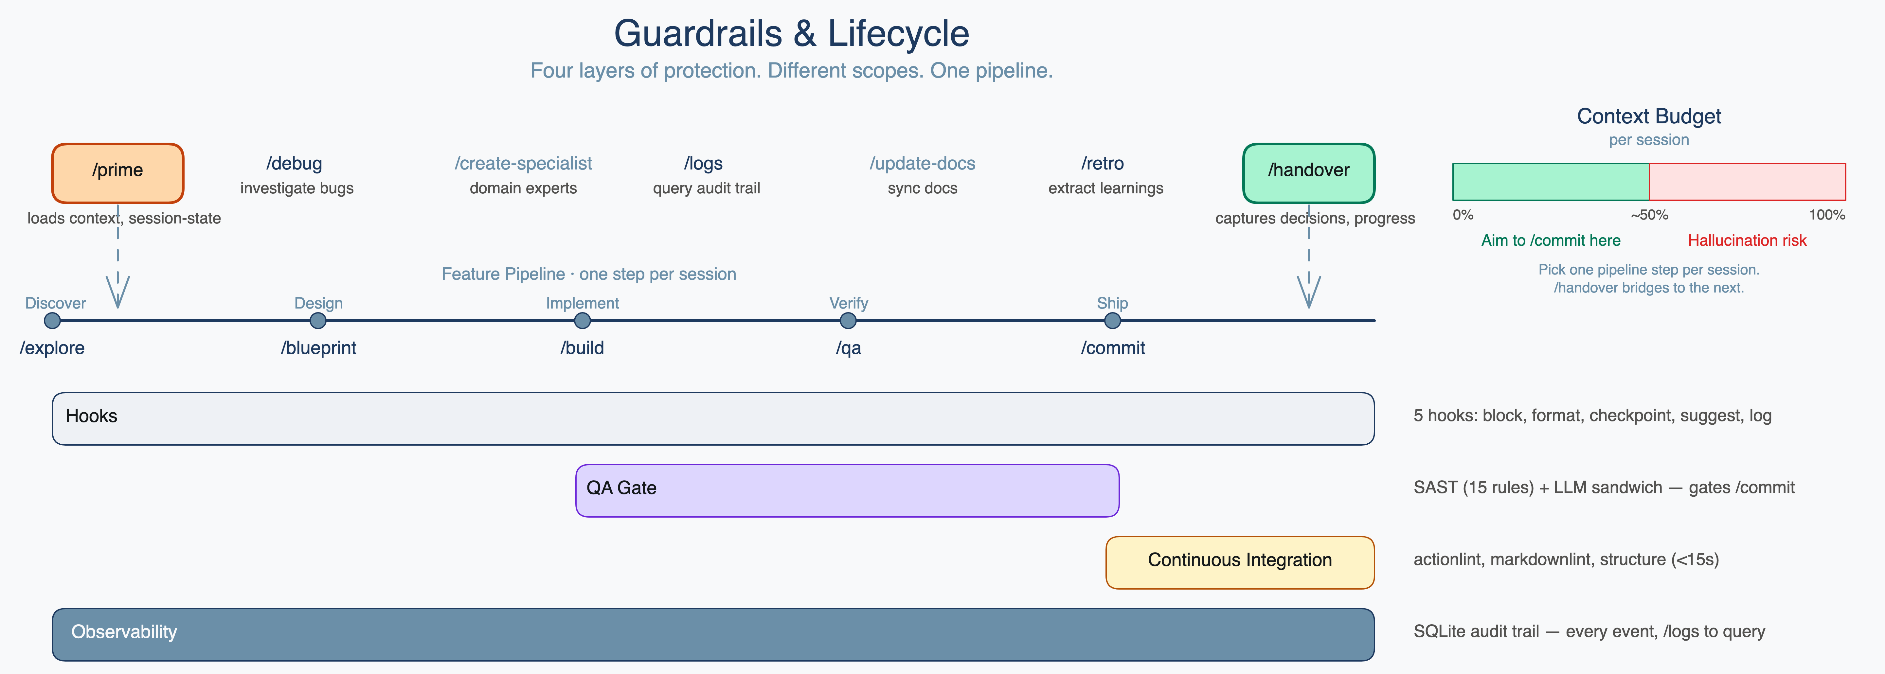
CONCEPT 6: GUARDRAILS
Four protection layers throughout the lifecycle
Runtime hooks (5 hooks, 30 patterns)
QA gate (15 SAST rules, OWASP)
Block destructive commands before execution. Log every tool call to SQLite.
Clean-context reviewer after every /build. APPROVED verdict gates /commit.
CI pipeline (under 15 seconds)
Observability
YAML syntax, markdown lint, structure checks on every push. /commit waits for green.
SQLite audit trail. /logs to query. /debug for systematic root cause investigation.

Slide 14
THE COMPOUNDING ADVANTAGE
The longer you use it, the better the context
Feature Docs
Skills
Session Continuity
Every /explore, /blueprint, /build, and /commit writes to docs/features/FEAT-XXX/. The PRD, plan, handover, and QA report persist across sessions. Feature 12 benefits from everything written in features 1–11.
After each feature, /retro extracts patterns into .claude/skills/. A debugging approach from FEAT-003. A validation pattern from FEAT-007. Each skill is auto-imported when relevant commands run.
/handover captures state in under 1,500 tokens — what was done, decisions made, what's next. /prime loads it at session start. Each merge prunes stale context. Handovers get sharper over time, not longer.

Slide 15
GETTING STARTED
Up and running in 15 minutes
Step 1 — Clone the template
git clone https://github.com/jackrich78/project-starter.git my-project
Or use "Use this template" on GitHub to create a copy under your account
Step 2 — Install test dependencies
npm install && npm test
All 10 scaffold tests should pass before you continue
Step 3 — Open in Claude Code
claude .
Claude Code reads CLAUDE.md automatically and loads project context
Step 4 — Configure your project in Claude Code
"Help me update CLAUDE.md and PROJECT.md for my project. I'm building [your description]."
CLAUDE.md loads at the start of every session — accurate context here shapes every response Claude will ever give you
Step 5 — Load context and start your first feature
/prime think then /explore your first feature idea
prime loads the project context; explore interviews you and creates the first PRD
Run npm test first — all 10 scaffold tests should pass before you start.

Slide 16
WORKING WITH CLAUDE
Steer Claude in the moment — five intent modes
Slow down & reason deeply
Stop — don't fill gaps
Verify before moving on
When Claude seems confident without reading the file
After implementation, to catch self-introduced errors
Before complex decisions, architecture, or debugging
Challenge the approach
Control scope & output
Stress-testing a plan before committing to a direction
Preventing scope creep, verbosity, or silent reference changes
All phrases are situational — you combine them. "Think ultra hard, do not assume, validate your work" before a risky refactor. "Tell me succinctly" after a wall of explanation.

Slide 17
LEARN MORE
Documentation and community
Getting Started
Skills Reference
docs/system/getting-started.md
docs/system/skills-reference.md
Architecture
Observability
docs/system/architecture.md
docs/system/observability.md
Commands Reference
CI/CD Workflow
docs/system/commands-reference.md
docs/system/cicd-workflow.md
github.com/jackrich78/project-starter
MIT License · Issues welcome · PRs encouraged

