Slide 1
4-bit Nanoprocessor
Design, Implementation & Demonstration
CS1050 Computer Organization and Digital Design | University of Moratuwa

Slide 2
Presentation Agenda
01
Task Overview & Purpose
02
Instruction Set Architecture
03
Architecture & Signal Flow
04
Component Deep Dive
05
Resource Utilisation
06
Additional Features
07
Board Demo & Conclusion
08
Problems faced and Future Developments

Slide 3
01
Task Overview & Purpose

Slide 4
What is the Task?
Design and implement a 4-bit nanoprocessor in VHDL
Deploy and verify on Digilent BASYS3 (Artix-7 FPGA)
Execute a hardcoded program: calculate sum of 1 + 2 + 3
Store final answer in R7, display on LEDs and 7-segment display
Lab Task Program
MOVI R7, 1 -- R7 = 1
MOVI R5, 2 -- R5 = 2
MOVI R4, 3 -- R4 = 3
ADD R7, R5 -- R7 = 3
ADD R7, R4 -- R7 = 6 ✓
Final Result: R7 = 6 (1+2+3 = 6)
Displayed on LD0–LD3 and 7-segment display
Why? Understand how a CPU fetches, decodes and executes at the gate level — making abstract computer architecture completely visible.

Slide 5
02
Instruction Set Architecture

Slide 6
Instruction Set — 12-bit Word, 4 Instructions
Instruction | Opcode [11:10] | Format | Operation
MOVI R, d | 10 | 10 RRR 000 dddd | R ← d (immediate load)
ADD Ra, Rb | 00 | 00 RaRaRa RbRbRb 0000 | Ra ← Ra + Rb
NEG R | 01 | 01 RRR 0000000 | R ← −R (2's complement via 0−R)
JZR R, d | 11 | 11 RRR 0000 ddd | If R=0 → PC←d else PC←PC+1
R0 = 0 always
No HALT
JZR R0, addr
Hardwired zero register
enables NEG without
a separate negation circuit
PC wraps after address 7
Program loops continuously
Reset button restarts it
Since R0=0 always
this acts as unconditional
jump — built-in for free

Slide 7
03
Architecture & Signal Flow

Slide 8
Fetch → Decode → Execute Cycle
FETCH
DECODE
EXECUTE
PC UPDATE
PC holds address → ROM outputs 12-bit instruction onto Ins_Bus
Instruction Decoder reads opcode[11:10] → generates all control signals
Datapath routes data through MUXes → ALU computes → register written
3-bit Adder computes PC+1 → MUX selects PC+1 or jump address → PC loads
Traced Signal Flow — ADD R7, R5 (instruction: 001111010000)
PC=011 → ROM → Ins_Bus=001111010000 → Decoder: opcode=00 (ADD)
Reg_en=111 Reg_Sel_A=111(R7) Reg_Sel_B=101(R5) Load_sel=0 Add_Sub_Sel=0
MuxA→R7=0001 MuxB→R5=0010 ALU: 0001+0010=0011 MUX4→0011→RegBank
Adder3bit: 011+1=100 MUX3(Jump=0)→100 PC loads 100 Next: ADD R7,R4

Slide 9
Bus Architecture — Simplifying Interconnects
Three bus widths connect all components:
12-bit
Instruction Bus
Without buses: 8 regs × 4 bits × 2 MUXes = 64 individual wires
With 4-bit data bus: 8 STD_LOGIC_VECTOR(3 downto 0) signals
Reduces wiring complexity drastically
Makes VHDL top-level readable and maintainable
Ins_Bus — ROM → Decoder
Why Buses?
4-bit
Data Bus
Data_bus0..7 — Reg Bank → MUXes → ALU → Reg Bank
3-bit
Address Bus
Mem_Bus — PC → ROM address
3-bit
PC Next Bus
Count_Mux_to_PC — MUX_3 → Program Counter D

Slide 10
04
Component Deep Dive

Slide 11
All Components at a Glance
HA / FA
Adder_3_Bit
Add_Sub_Unit
Building blocks for all adders
Increments PC by 1 each cycle
4-bit add/subtract with flags using two’s complement.
Decoder_3_to_8
Reg / Register_Bank
Program_Counter
One-hot enable for register select
8 × 4-bit registers, R0 hardwired 0
3-bit PC with synchronous reset
Program_ROM
Instruction_Decoder
MUX_8_way_4_Bit
8 × 12-bit hardcoded instruction store
Generates all control signals from opcode
Selects ALU operands from registers (×2)
MUX_2_way_4_Bit
MUX_2_way_3_Bit
LUT_16_7 / Slow_Clk
ALU result vs immediate value → Writing register bank
PC+1 vs jump address → select the next program counter
7-seg display driver / clock divider

Slide 12
Instruction Decoder — Brain of the Processor
The Instruction Decoder translates a 12-bit binary instruction into every control signal in the system.
MOVI (10)
ADD (00)
NEG (01)
JZR (11)
Reg_en ← inst[9:7]
Reg_en ← inst[9:7]
Reg_en ← inst[9:7]
Reg_Sel_A ← inst[9:7]
Load_sel ← '1'
Load_sel ← '0'
Load_sel ← '0'
Jump_address ← inst[2:0]
Imd_Val ← inst[3:0]
Reg_Sel_A ← inst[9:7]
Reg_Sel_A ← "000" (R0=0)
Reg_Check_Jmp ← Mux_A_out
→ MUX passes immediate
Reg_Sel_B ← inst[6:4]
Add_Sub_Sel ← '1'
If Mux_A_out=0000:
to register, bypasses ALU
→ MUX passes ALU result
→ ALU: 0 − R = −R
Jump_flag ← '1'

Slide 13
Key Components — Implementation Highlights
Add/Subtract Unit — 2's Complement Trick
Slow Clock — count(1) vs count(25)
B_eff(i) <= B(i) XOR Sel;
carry(0) <= Sel;
-- Sel=0: A+B (addition)
-- Sel=1: A+NOT(B)+1 = A-B
count(1) → period = 40 ns → simulation
count(25) → period = 671 ms → BASYS3 board
Bit N toggles at 100 MHz ÷ 2^(N+1)
Program ROM — Hardcoded Instructions
MUX Optimisation — case-when
ROM_DATA : rom_type := (
0=>"101110000001", -- MOVI R7,1
3=>"001111010000", -- ADD R7,R5
4=>"001111000000", -- ADD R7,R4
);
if-elsif → priority encoder → cascaded logic → slower
case-when → balanced MUX tree → fewer LUT levels → faster
with-select for 2-way MUXes → zero latch risk
Result: MUX_8_way reduces to 1 LUT level

Slide 14
RTL Synthesis Workflow & XDC Constraints
1. Elaboration
2. RTL Opt.
3. Tech Map
4. Place & Route
5. Bitstream
Parse VHDL hierarchy,
resolve port connections
Simplify logic,
remove dead signals
Map gates to LUT4/
LUT6/FDRE/CARRY4
Assign physical
locations & routing
Generate .bit file
for FPGA programming
XDC Constraints File
Port | Pin | Board
Clk | W5 | 100 MHz oscillator
Reset | U18 | btnC — centre button
R7[0..3] | U16,E19,U19,V19 | LD0–LD3
Zero | V14 | LD14
Overflow | V3 | LD15
Seg7[0..6] | W7–U7 | 7-seg segments
Anode[0..3] | U2,U4,V4,W4 | Digit selects
set_property PACKAGE_PIN W5 [get_ports Clk]
set_property IOSTANDARD LVCMOS33 [get_ports Clk]
create_clock -period 10.00 [get_ports Clk]
set_property PACKAGE_PIN U18 [get_ports Reset]
set_property PACKAGE_PIN U16 [get_ports {R7[0]}]

Slide 15
05
Resource Utilisation

Slide 16
Resource Utilisation — xc7a35tcpg236-1 (BASYS3)
20
41
7
0
Slice LUTs
Flip-Flops
CARRY4
Block RAM / DSP
of 20,800 (0.10% of FPGA resource)
FDRE (0.10% of FPGA resource)
Dedicated carry chains for Fast addition operations.
Design is small & fully LUT-based
LUT Breakdown
41 FDREs Explained
Type | Count | Purpose
LUT1 | 1 | Single-input (buffer/invert)
LUT2 | 1 | OR for carry logic
LUT3 | 6 | 3-input MUX, adder terms
LUT4 | 13 | MUX, decoder, ALU (largest group)
LUT5 | 5 | 5-input MUX selections
LUT6 | 5 | 7-seg encoding, register bank
26 — Slow_Clk 26-bit counter
12 — Registers R4, R5, R7 only (3×4)
3 — Program Counter (3-bit)
= 41 total
Vivado automatically removed unused registers such as R1,R2,R3 and R6. This optimization is called Dead logic elimination.

Slide 17
Resource Minimisation — Measures Taken
case-when vs if-elsif in MUX
with-select in 2-way MUXes
1
2
Balanced MUX tree instead of priority encoder → reduces LUT levels from 3 to 1 for 8-way MUX
This is faster and uses fewer logic levels.
We used the-select. If we used a process block, the tool may create a latch by mistake→ synthesises to minimum 1 LUT per output bit
Shared w1 in Full Adder
R0 hardwired = 0 (NEG trick)
3
4
A XOR B computed once, reused for Sum and carry. With out this the tool make two separate XOR gates → saves 1 XOR gate per FA × 7 FA instances = 7 gates saved
NEG uses 0−R via existing subtractor → no separate negation circuit → saves ~4 LUTs
to_integer indexing in Decoder
Vivado dead logic elimination
5
6
Single indexed assignment → Vivado infers minimal AND-gate structure → fewer inputs than 8-branch case
R1,R2,R3,R6 never written → automatically removed → saved 4×4=16 flip-flops without any manual work

Slide 18
06
Additional Features

Slide 19
Four Additional Features — Advanced Nanoprocessor
Feature 01: Comparator
LEDs: LD6 / LD7 / LD8
Feature 02: 4-bit Multiplier
LEDs: LD12–LD15 (full result)
Compares two 4-bit ALU inputs every cycle → raises Equal, LessThan, or GreaterThan flag. Only one LED on at a time. Demo: ADD with inputs 5 & 2 → LD8 (Greater) lights.
Computes full product of two 4-bit operands. 4-bit result on LD0–LD03. Overflow flag when upper 4 bits ≠ 0. Demo: 3×3=9 (1001) on display and LEDs.
Feature 03: Parity Generator
LEDs: LD9 (Even) / LD10 (Odd)
Feature 04: Magnitude Detector
LEDs: LD11 / LD12 / LD13
4-input XOR chain on R7 → Even or Odd parity flag. Always opposite. Demo: R7=9 (1001) → 2 ones → Even. R7=7 (0111) → 3 ones → Odd. Visible LED switch.
Classifies R7: Is_Zero (=0), Is_Small (1–7), Is_Large (8–15). Exactly one active. Demo: Reset→LD11, R7=3→LD12, R7=9→LD13 (dramatic switch). R7=7→LD12 again.

Slide 20
Advanced Demo Program — All 4 Features Visible
Addr | Assembly | R7 After | Feature Demonstrated
0 | MOVI R7, 3 | 3 | Setup
1 | MOVI R2, 3 | 3 | Setup
2 | MUL R7, R2 | 9 (1001) | Feature 2: 3×3=9 LD12-LD15 lit 7-seg shows 9
3 | MOVI R3, 5 | 9 | Setup
4 | MOVI R4, 2 | 9 | Setup
5 | ADD R3, R4 | 9 (R7 unchanged) | Feature 1: inputs 5>2 → LD8 (Greater) lights
6 | NEG R7 | 7 (0111) | Feature 3: parity Even→Odd Feature 4: Large→Small
7 | JZR R0, 0 | loops | R0=0 always → always jumps back — unconditional loop

Slide 21
07
Board Demo & Conclusion

Slide 22
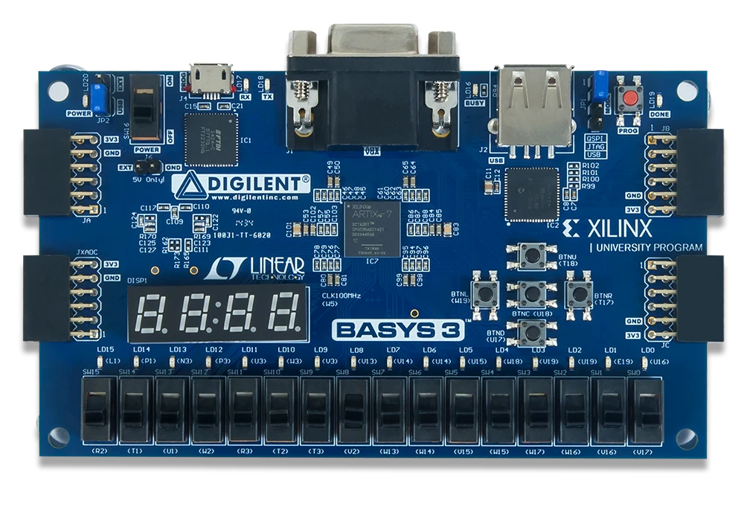
BASYS3 Board - Basic Nanoprocessor
Reset
Overflow
7 Segment Display
Register Values
Zero

Slide 23
BASYS3 Board - Advanced Nanoprocessor
Even Parity
Odd Parity
Greater Than
Less Than
Equal
Mult - Overflow
Reset
Large
Small
Zero
Zero
Overflow
Register Values

Slide 24
BASYS3 Board Demo — Basic Nanoprocessor
LED Output Map
LD0-3
LD14
LD15
7-Seg
btnC
R7 result (binary)
Zero flag
Overflow flag
R7 in hex
RESET
Instruction Step | R7 | Display | LEDs | Note
Power On / Release Reset | 0 | 0 | All off | Program starts automatically
MOVI R7, 1 | 1 = 0001 | 1 | LD0 ON | ~0.67s with count(25)
MOVI R5, 2 + MOVI R4, 3 | 1 | 1 | LD0 ON | R5,R4 loaded, R7 unchanged
ADD R7, R5 | 3 = 0011 | 3 | LD0,LD1 ON | 1+2=3
ADD R7, R4 ← FINAL | 6 = 0110 | 6 | LD1,LD2 ON | 3+3=6 = 1+2+3
Press btnC (Reset) | 0 = 0000 | 0 | All off | Restarts from address 0

Slide 25
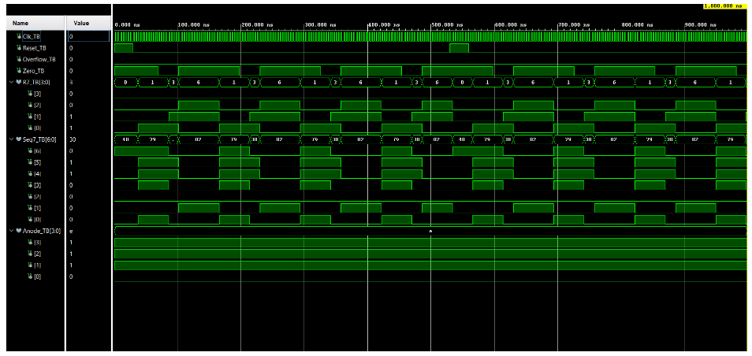
Simulation

Slide 26
08
Problems Faced and Future Developments

Slide 27
Problems faced
Problem | Solution
Incorrect Load_sel logic in the instruction decoder caused R7 to remain at 0 because MOVI routed ALU output instead of the immediate value. | Corrected the decoder logic: MOVI uses Load_sel <= '1' and ADD/NEG use Load_sel <= '0', allowing R7 to update correctly.
The slow clock divider used count(25), producing a ~671 ms clock period, so no instruction executed during short simulations. | Changed the divider to count(1) for simulation (~40 ns clock period) and reverted to count(25) for FPGA implementation.

Slide 28
Future Developments
Dual port for comparator
Larger Program ROM with variable Programs
The current Program ROM is a fixed 8-address memory hardcoded in VHDL. A future development would replace it with a larger ROM (for example 64 or 256 addresses using a 6-bit or 8-bit program counter) and allow the program to be loaded via the UART serial interface of the BASYS3 board. This would mean programs could be written in assembly, assembled to binary on a PC, and uploaded to the nanoprocessor without needing to regenerate and re-flash the FPGA bitstream. This is a significant step toward making the processor genuinely programmable rather than fixed-function.
Currently the 7-segment display is hardwired to Register R7 only. This means during a comparison operation, only one operand can be shown on the display at a time. A future improvement would be to implement a dual-digit 7-segment multiplexed display where the left digit shows operand A (Mux_A_out) and the right digit shows operand B (Mux_B_out) simultaneously. This requires extending the LUT_16_7 component to support all four anode digits with time-multiplexed switching using a fast sub-clock, and adding a display mode selector controlled by the instruction type. This would make the comparator feature fully self-explanatory on the board without needing to explain which register holds which value.

Slide 29
Key Things
✓
4-bit Processor
Executes MOVI, ADD, NEG, JZR — sum 1+2+3=6 stored in R7 and displayed on board
✓
Modular VHDL Design
Each component developed, tested, and simulated independently before integration
✓
Resource Optimisation
20 LUTs, 41 FDREs — case-when, with-select, dead logic elimination and gate sharing
✓
Extended Instruction Set
Comparator, Multiplier, Parity Generator, Magnitude Detector added as extra features
✓
FPGA Deployment
Synthesis → Implementation → Bitstream → BASYS3 board verified and demonstrated

Slide 30
Members and Contributions
Team Member | Contribution
Jayasekara J.P.D.N.R. | Designed the Instruction Decoder and generated all control signals including register enable, MUX selection, ALU operation control, and jump logic. Implemented the Program Counter, 3-bit adder (PC+1), and Program ROM for instruction storage and execution control.
Jackson J.W. | Designed all multiplexers including 8-way 4-bit MUX, 2-way 4-bit MUX, and 2-way 3-bit MUX. Developed 4-bit, 3-bit, and 12-bit bus structures. Managed data routing between registers, ALU, and immediate values ensuring correct system data flow.
Isaiyalan K. | Designed and implemented the 4-bit Add/Subtract Unit, including 2’s complement logic for subtraction and NEG operations. Handled overflow detection and supported testing of ADD and NEG instructions.
Jathursanan S. | Implemented an 8 × 4-bit register bank (R0–R7) with R0 hardwired to zero. Designed the 3-to-8 decoder for register selection, register enable logic, and reset functionality. Ensured correct data storage and retrieval across the system.
Together | The nanoprocessor was developed as a fully integrated system combining arithmetic logic, data storage, data routing, and control units. Each module was independently designed and then integrated to form a working 4-bit processor capable of executing a small instruction set. Extensive teamwork was involved in debugging and verification using simulation and hardware testing on the BASYS 3 board. The final system successfully executed instructions such as MOV and ADD, with outputs displayed via LEDs and a 7-segment display. The project improved understanding of processor architecture, modular design, and hardware-software integration.

Slide 31
Thank You
Group 19 — CS1050 Computer Organization and Digital Design
University of Moratuwa | Department of Computer Science and Engineering

