Slide 1

BLAST
PRO
Task 2
Xploma / INSY7315 Work Integrated Learning
Nicholas Farquhar · Zain Labuschagne
Matthew Jackson · Jaco Smit
Ethan Chipps · Jarred Blamire

Slide 2
01 / CLIENT BRIEF
Why BlastPro exists
THE PROBLEM
THE SOLUTION
Xploma designs blasts using spreadsheets, reference books and manual calculations.
One system for project planning, saved calculations, warnings and field observations.
Past projects become easier to find, review and audit.
BLASTPRO / INSY7315 TASK 2
02

Slide 3
02 / CLIENT WORKFLOW
Business process today
01
02
03
04
05
06
07
Client request
Site survey
Design and quotation
Permit application
Drilling and charging
Blast execution
Post-blast inspection
01
Manual calculations take time and can introduce errors.
02
Projects are planned from scratch with little reuse of past results.
03
Scattered records make later review and auditing difficult.
BLASTPRO / INSY7315 TASK 2
03

Slide 4
03 / PRODUCT SCOPE
Web design and Android field work
WEB + API
ANDROID
Create a company and sign in
Manage Blasters, products and prices
Create and find projects
Design holes and save drafts
Calculate totals, PPV and flyrock
Review results and warnings
Sign in to an existing account
Open or create shared projects
Add project notes and comments
Attach photos from the field
View the same project on the web
Calculation and account creation stay on the web.
BLASTPRO / INSY7315 TASK 2
04

Slide 5
04 / ARCHITECTURE
One API connects every surface
Web browser
MVC pages + cookie session
→
BlastPro API
SQL Server
→
JWT · Identity · business rules
EF Core · migrations
Android app
→
Kotlin + account sign-in
MVC calls the API; the database is accessed through the API.
BLASTPRO / INSY7315 TASK 2
05

Slide 6
05 / TECHNOLOGY STACK
Implementation tools and purpose
FRONT END
ASP.NET Core MVC
Razor views, cookies, HTTPS API calls
BACK END
ASP.NET Core API
Identity, JWT, business rules, Swagger in Development
DATABASE
SQL Server + EF Core
LocalDB for development; Azure SQL for the live system
MOBILE
Kotlin + Android Studio
Projects, notes, comments and photos
TESTING
BlastPro.Tests
Unit, integration and end-to-end tests
TOOLS
Visual Studio + GitHub
Local run, source control and review
BLASTPRO / INSY7315 TASK 2
06

Slide 7
06 / USER ROLES
Company and project boundaries
MAIN COMPANY USER
BLASTER
Created with a new company
Manages company details and products
Creates, edits, deactivates and reactivates Blasters
Accesses company projects
Created by a Main Company User
Works with own projects only
Can edit permitted profile details
Company has at most five active Blasters
The API enforces role, company, owner and account-state rules on every request.
BLASTPRO / INSY7315 TASK 2
07

Slide 8
07 / WEB JOURNEY
Four stages from project to report
01
Dashboard
Find or create a project
02
Pattern design
Enter bench, site, hole and product data
03
Results
Save calculations and inspect warnings
04
Report
Review saved result and print
The live demo follows this same route.
BLASTPRO / INSY7315 TASK 2
08

Slide 9
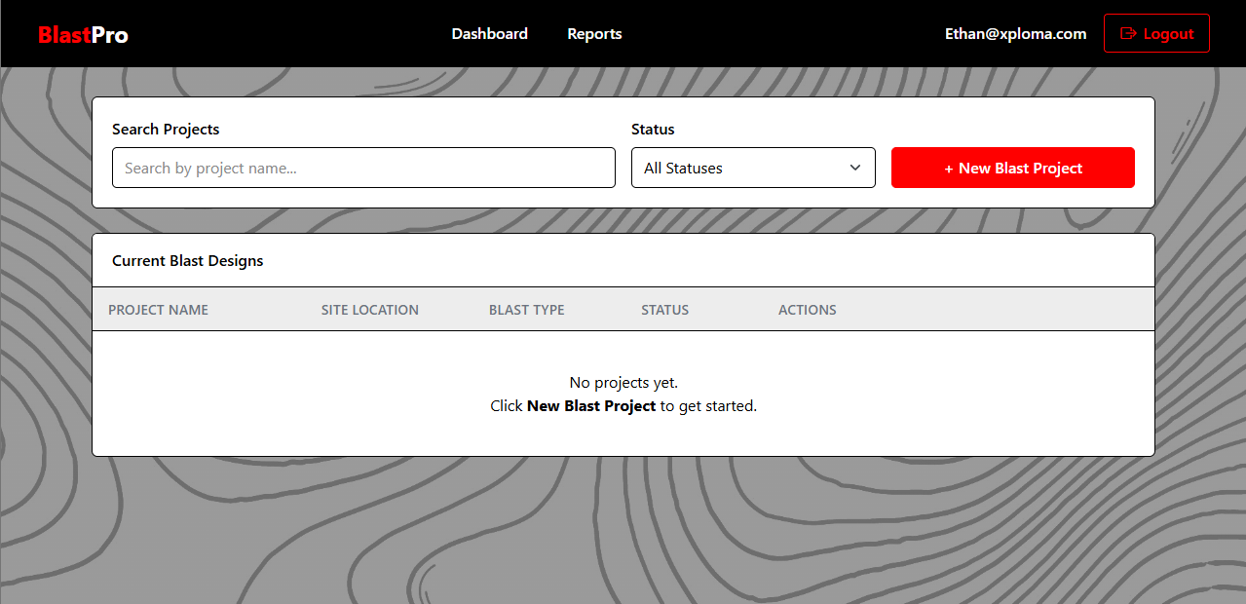
08 / WEB APPLICATION
Project dashboard
Find
Search by project name.
Filter
Select project status.
Create
Start a new design.
Screenshot from the teammate draft; the live demo uses the hosted app.
BLASTPRO / INSY7315 TASK 2
09

Slide 10
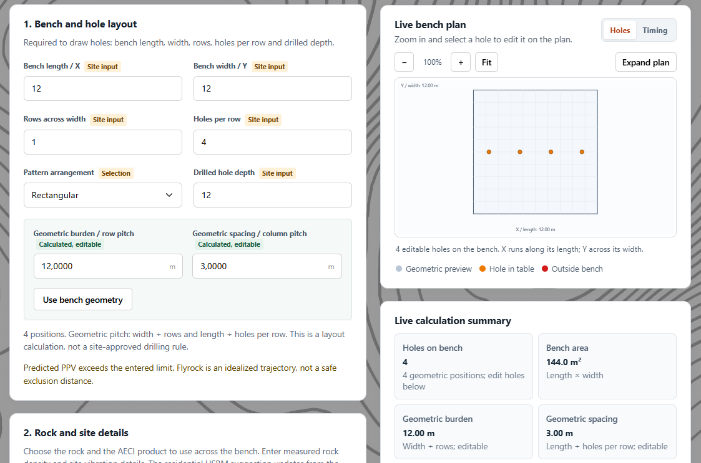
09 / PATTERN DESIGN
Bench, hole and site inputs
01
Bench length, width, rows and holes per row
02
Rock type, density, burden and spacing
03
Vibration threshold and AECI product
04
Hole coordinates, depth and charge
Save as a draft or calculate after review.
BLASTPRO / INSY7315 TASK 2
10

Slide 11
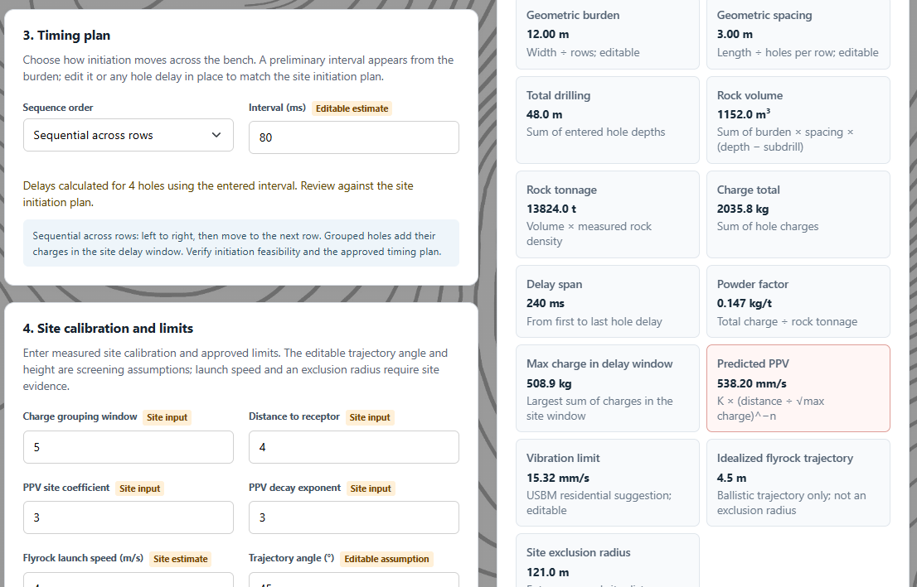
10 / PATTERN DESIGN
Timing, calibration and editable holes
01
Set delay sequence and interval
02
Enter charge grouping window and receptor distance
03
Review PPV calibration and exclusion limit
04
Edit a hole row for site-specific values
The live summary updates before saving a result.
BLASTPRO / INSY7315 TASK 2
11

Slide 12
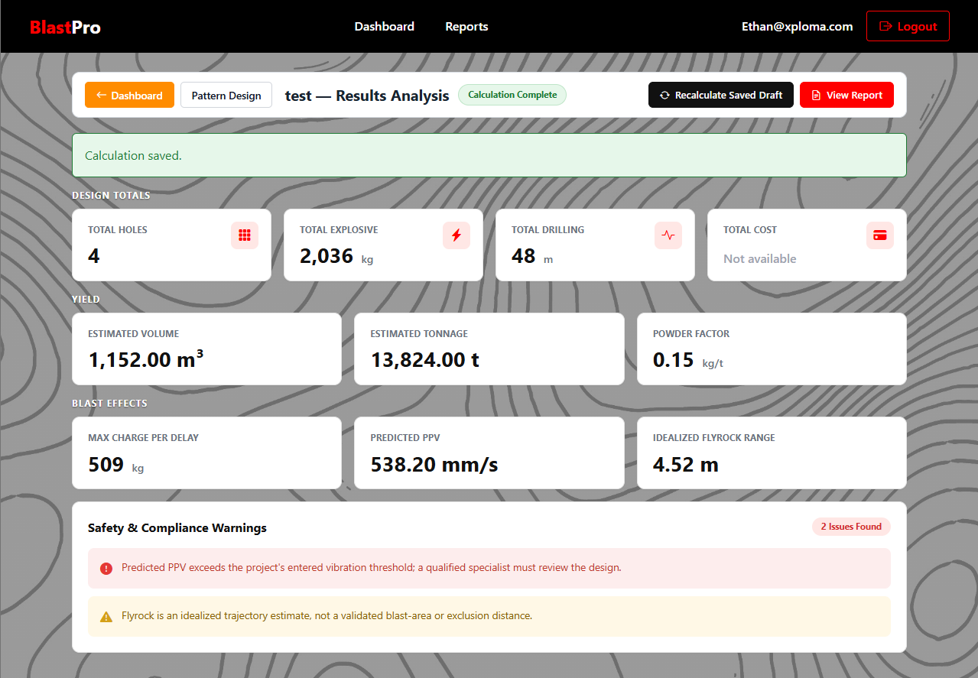
11 / CALCULATIONS
Saved results and warnings
4 holes
2,036 kg
48 m drilled
Volume, tonnage, powder factor, PPV and flyrock are shown with warnings.
Demo values only; cost needs fully priced products.
BLASTPRO / INSY7315 TASK 2
12

Slide 13
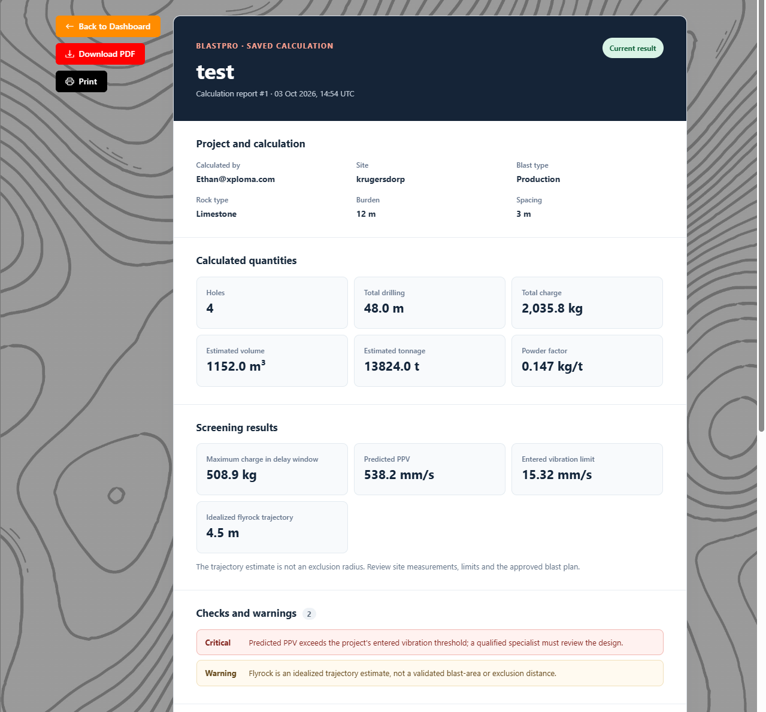
12 / REPORT
Saved calculation report
Report contents
Project, user and date
Hole and calculated quantities
PPV and fly rock screening outputs
Warnings and checks
BLASTPRO / INSY7315 TASK 2
13

Slide 14
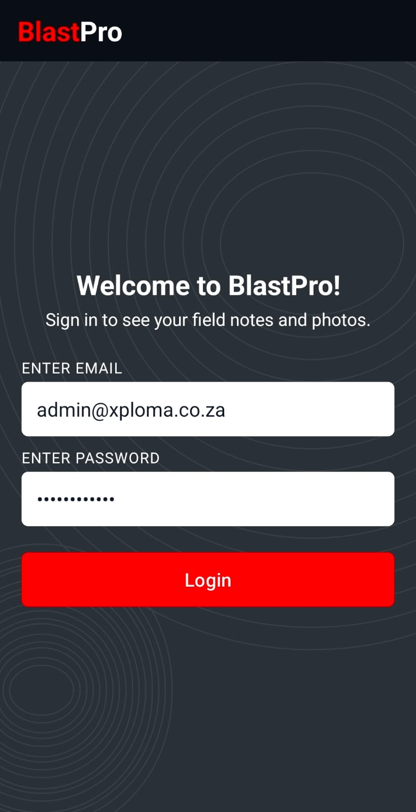
13 / ANDROID
Site notes and project photos
01
Sign in
Use a web-created account.
02
Projects
Open or create a shared project.
03
Notes
Add text and comments within a project.
04
Photos
Capture or attach up to three images per note.
The phone does not create accounts or run blast calculations.
BLASTPRO / INSY7315 TASK 2
14

Slide 15
14 / FIELD CONNECTIVITY
Current shared flow and offline goal
FIELD NEED
CURRENT BUILD
Remote blast sites may have unreliable mobile signal.
The Android app sends projects, notes, comments and photos through the shared API while connected.
BLASTPRO / INSY7315 TASK 2
15

Slide 16
15 / REQUIREMENTS ALIGNMENT
Functional requirements
REFERENCE
WHAT THE BUILD DOES
STATUS
FR-01/02/03
Identity sign-in; API checks company and ownership
Built
FR-04
Create, edit, deactivate and reactivate Blasters; five-active limit
Built
FR-09
Create, search, filter, edit and soft delete projects
Built
FR-19/21/25
Set parameters, manage holes and assign products
Built
References and descriptions are carried over from the teammate draft.
BLASTPRO / INSY7315 TASK 2
16

Slide 17
16 / REQUIREMENTS ALIGNMENT
Calculations, security and reports
REFERENCE
WHAT THE BUILD DOES
STATUS
FR-29–33
Totals, volume, tonnage, PPV, flyrock, warnings and cost
Built
NFR-01/04
API rechecks role, company and project ownership
Built
NFR-02
Hosted HTTPS; signing key and DB secrets in Azure settings
Hosted
Calculation models are demonstration estimates that need specialist review.
BLASTPRO / INSY7315 TASK 2
17

Slide 18
17 / SECURITY
Identity, access and data protection
ACCESS AND IDENTITY
DATA PROTECTION
ASP.NET Core Identity accounts
Local development password reset
MVC cookie and API JWT
Main Company User / Blaster roles
Five active Blasters per company
HTTPS for the web and API
Company and owner checks in the API
Signing key outside GitHub
Project soft delete retains history
Secret connection string in hosting
Production email delivery for self-service reset is still pending.
BLASTPRO / INSY7315 TASK 2
18

Slide 19
18 / ENGINEERING CHOICES
Decisions and challenges
DESIGN DECISIONS
CHALLENGES HANDLED
Separate API shared by web and Android
ASP.NET Core + EF Core + SQL Server on .NET 10
MVC cookie session; JWT to the API
Kotlin Android app for field notes
Every query respects company and owner
Five-seat limit is enforced in the API
PPV and flyrock marked as screening estimates
BLASTPRO / INSY7315 TASK 2
19

Slide 20
19 / HOSTING AND RELIABILITY
BlastPro is live on Azure
LOCAL DEVELOPMENT
CURRENT HOSTED SYSTEM
MVC and API run together in Visual Studio
SQL Server LocalDB
EF Core migrations on API startup
Development password-reset mailbox
Azure App Service hosts web and API
Azure SQL hosts the shared database
HTTPS serves browsers and Android
JWT key and SQL connection use app settings
Live site: https://blastpro-web-2c61c74b-axf3gvbtg9a8f3hg.southafricanorth-01.azurewebsites.net/
BLASTPRO / INSY7315 TASK 2
21

Slide 21
BLASTPRO
Planning, results and field records in one project.
Working core: accounts, projects, patterns, calculations, reports and field notes.
Live on Azure. Remaining work: GitHub Actions, direct PDF, production reset email and offline sync.

