Slide 1
阅读理解进阶三部曲
--关键知识、模型性能提升、产品化落地
巨颖 · 追一科技

Slide 2
Outline
Introduction
CMRC2018
Application

Slide 3
Outline
Introduction
CMRC2018
Application

Slide 4
Introduction
Datasets
Cloze
Multi. choices
Spans of words
Summary of human
Model

Slide 5
Introduction
Datasets
Cloze
Multi. choices
Spans of words
Summary of human
Model

Slide 6
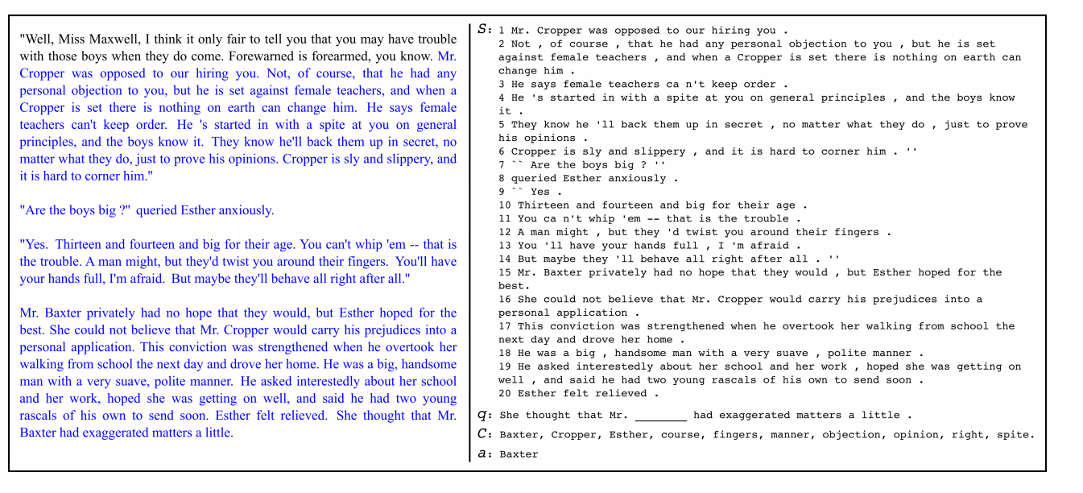
CBT

Slide 7
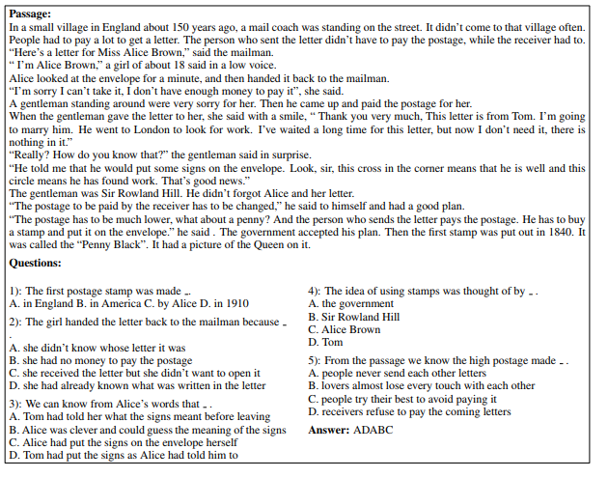
RACE

Slide 8
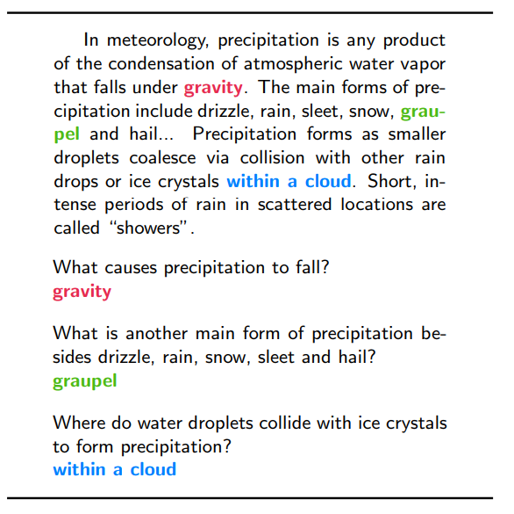
SQuAD

Slide 9
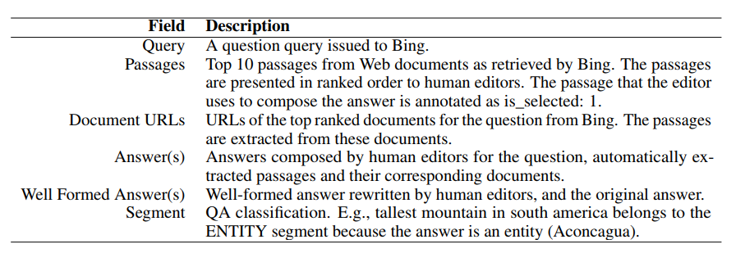
MS MARCO

Slide 10
Introduction
Datasets
Model
BIDAF
R-NET
QANet
GPT & BERT

Slide 11
Model
Embedding
Encode the question and context
Attention Layer
Selecting the span of context

Slide 12
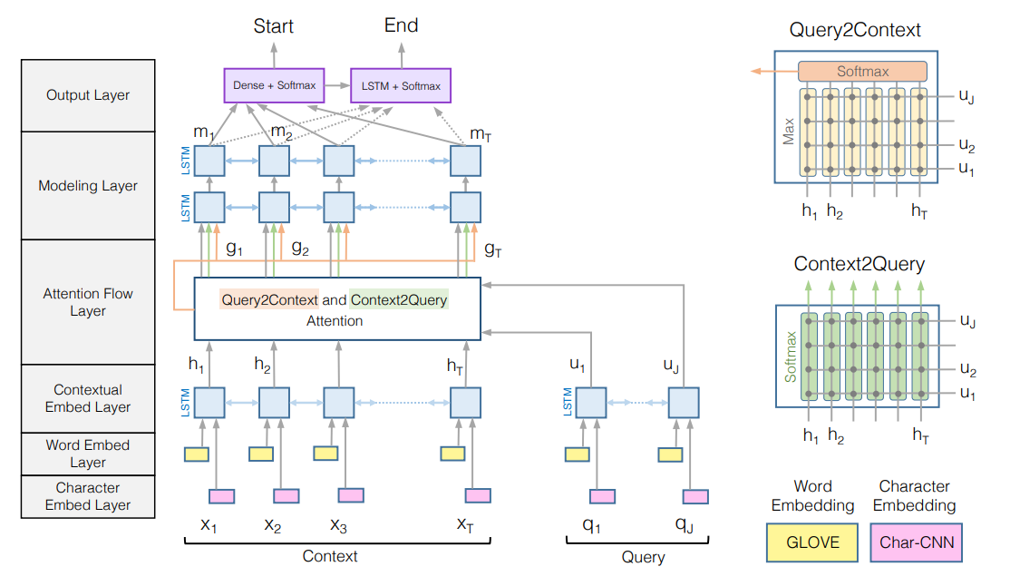
Model
BIDAF

Slide 13
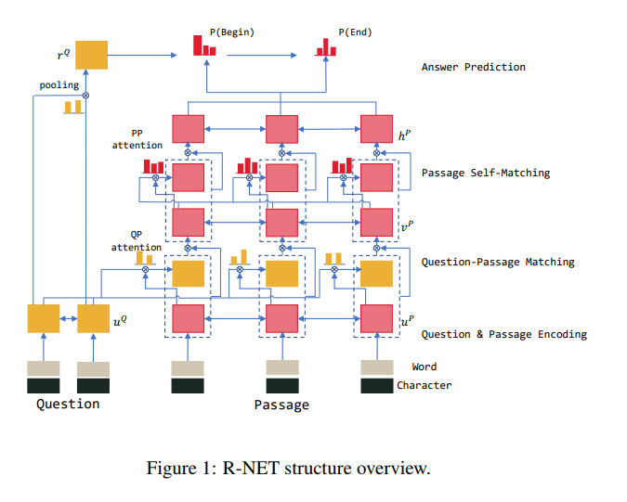
Model
R-NET

Slide 14
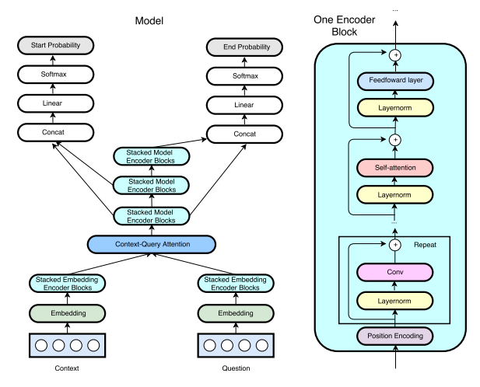
Model
QANet

Slide 15
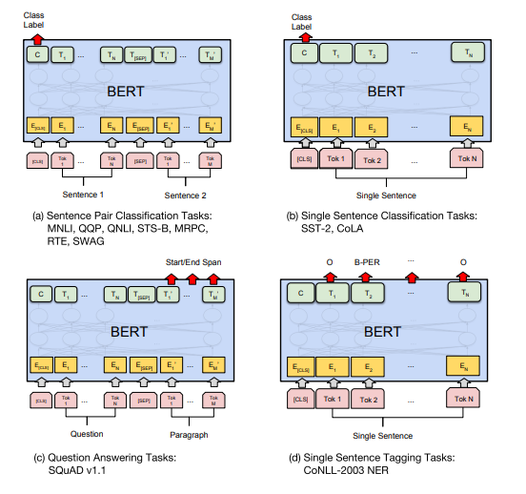
Model
GPT & BERT

Slide 16
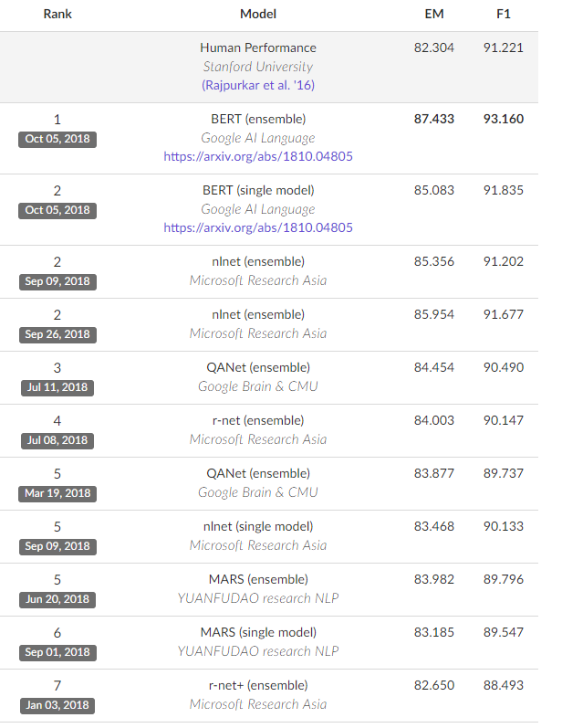
Model
GPT & BERT

Slide 17
Outline
Introduction
CMRC2018
Application

Slide 18
CMRC2018
Span-Extraction Reading Comprehension
Chinese Wikipedia
One passage per query
Queries: 19K，trial 1k, train 10k，dev 3k，test 5k
Answers: Span of words
Model Evaluation: EM & F1

Slide 19
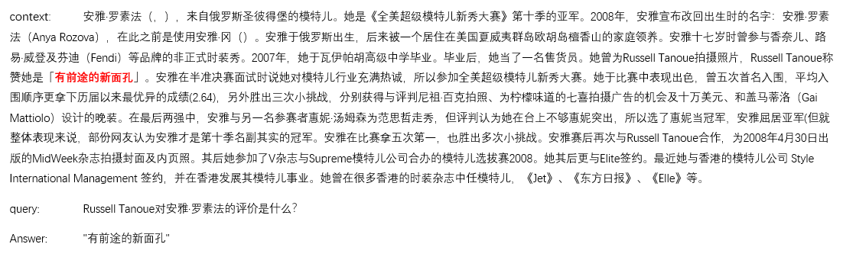
CMRC2018

Slide 20
Data Preparation
Filter query is None or answer is None
Context norm
Answer length limit & Context length limit
Data Augment

Slide 21
Data Preparation
Query type
Data quality
范廷颂是什么时候被任为主教的？ VS 九广铁路小童储值票是何时停止使用的？
1963年 1990年9月停止使用
Who | 谁，什么人，… | Where | 哪里，在哪，什么+地方， …
When | 什么+时候，哪*年，… | How | 怎样 ，…
Num | 多高，多远，多重，… | Why | 为什么，什么+原因， …
How long | 多久，多长时间，… | …

Slide 22
Data Preparation
ELMO
Contextual:
The representation for each word depends on the entire context in which it is used.
Deep:
The word representations combine all layers of a deep pre-trained neural network.
Ours:
Stroke based & Word based
Pre-trained on a large text corpus (Chinese)

Slide 23
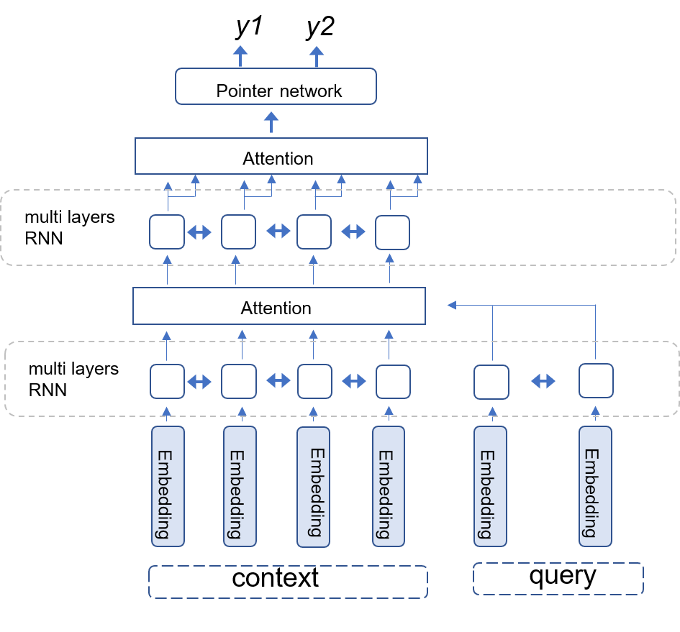
Model Description
Base on R-net

Slide 24
Model Description
Embedding
a. ELMO
b. pos embedding
c. query type embedding
d. word match
ELMO
Embedding
POS
query_type
word_match

Slide 25
Model Description
Encoding
Bidirectional GRU, multi-layers
Attention
Extra gated-dropout for query
Prediction
pointer network
prob = start * stop

Slide 26
Model Description
Training
△EM / Step 0
Step 1: +0.57
Step 2: +0.31
Step 3: ≈Step 2
ref: Born-Again Neural Networks

Slide 27
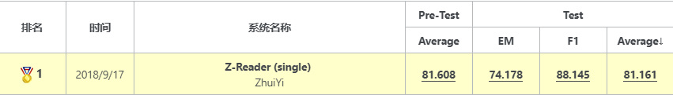
Experiment
Implementation details
Test Results
hidden | optimizer | learning rate | dropout
100 | Adam | Cosine | 0.6

Slide 28
Outline
Introduction
CMRC2018
Application

Slide 29
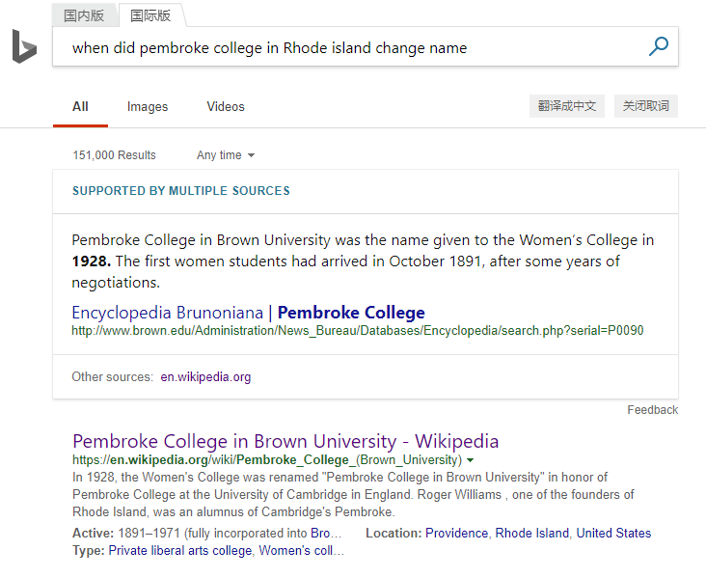
Application
Search engine
Custom Services
Finance
Education
…

Slide 30
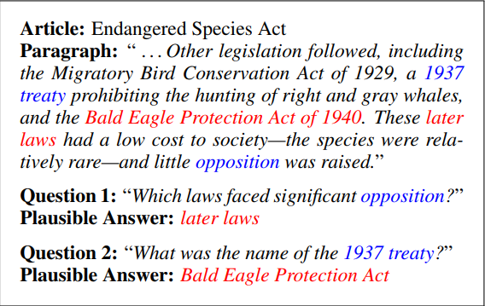
What’s next?
High level reasoning
Using commonsense knowledge
Unanswerable questions
…

Slide 31


Q&A
追一科技公众号
追一招聘公众号
问题探讨&简历投递，可联系我：bettyju@wezhuiyi.com

