Slide 1
Multithreading
Introduction to Principles of Distributed Systems

Slide 2
Concurrency
Joe Armstrong, Programming in Erlang
The World is Concurrent
Notes:
Q: what does Joe Armstrong mean when he says in his book “The world is concurrent”?
A: Concurrent = “operating or occurring at the same time”. We’re used to lots of things happening at once, each able to “think” for itself. Think about walking down the hallway between classes or driving to WalMart.
All around us, many different entities are all operating at the same time, each able to think for itself.

Slide 3
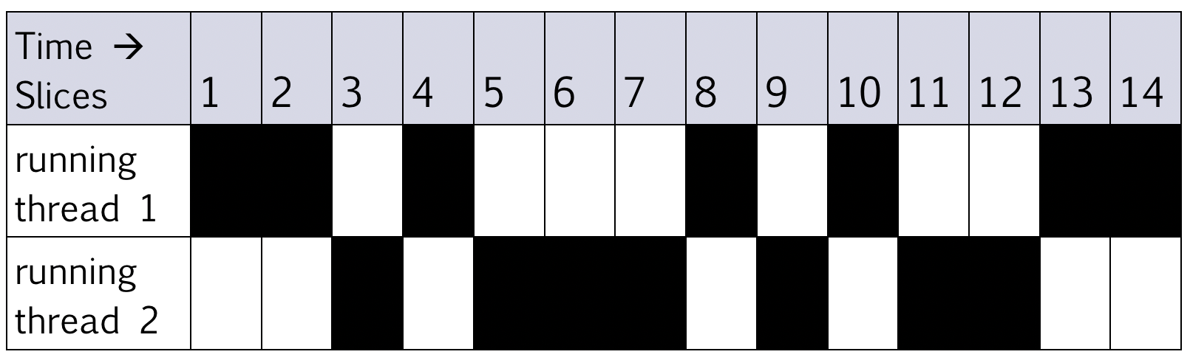
Multithreading
A technique to:
Run multiple pieces of code “simultaneously” on a single machine
Run different parts of a program on different processor cores
Notes:
Q: a) What’s a “time slice”?
A short segment of time in which a process or thread on a computer can run.
B) How do time slices make it appear that a single processor is running multiple pieces of code simultaneously?
The timing of each slice is very short (millisecs), and different process’ or thread’s slices are interwoven, so each makes progress every second.

Slide 4
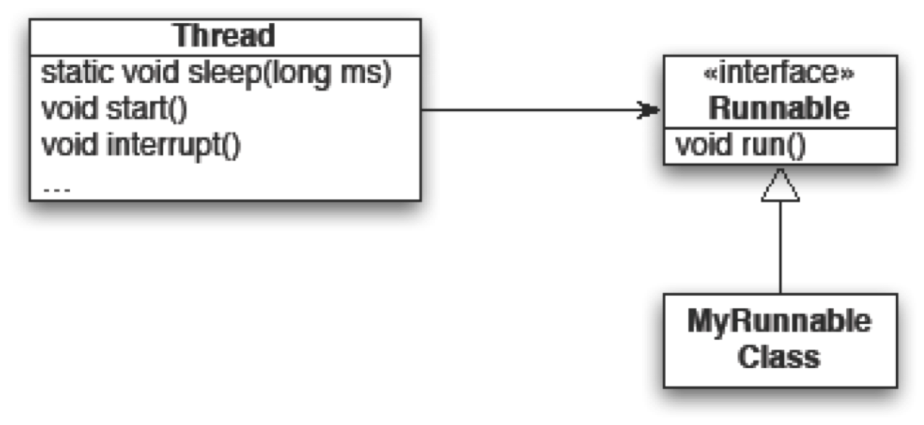
Running Our Own Code Concurrently
From java.lang
public class R implements Runnable {
...
public void run() {
while (true) {
... maybe Thread.sleep(...);
}
}
}
Our custom code
Wherever you want to start the Thread:
new Thread(object of type R).start();
Notes:
Explain the basic idea, then switch to chatter example. Play with sleep times.
Come back here for quiz questions
Q: Thread and Runnable seem very similar. Why do we pass an instance of our class that implements Runnable to a Thread and call start()? Wouldn’t it be simpler to just call our object’s run() method?
After fixing chatter.Ranter, add code to chatter.Main

Slide 5
Animation with Threads
Example 1: A single object
“Animate” it with button clicks
Animate it with a Timer
Timer timer = new Timer(50, animatorButton);
timer.start();
Animate it by using a thread
public class R implements Runnable {
...
public void run() {
while (true) {
... maybe Thread.sleep(...);
}
}
}
Wherever you want to start the Thread:
new Thread(object of type R).start();
Notes:
Look at Multithreading/animation package. Demo with button, then add Timer per TODO item. Then add thread per TODO item.
All coding in class done in animation.Main

Slide 6
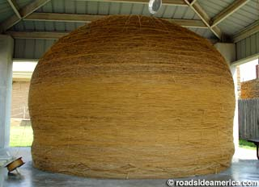
Animation with Threads
Example 2: Multiple objects
Use separate thread for each object’s “brain”
Another thread asks Java to update the GUI
http://www.roadsideamerica.com/story/8543
Notes:
Look at BallsWithThreads example. Walk through the various thread uses:
- one for each ball
- one for the display updating
- note: there is a thread for the GUI also (event dispatch thread)!
To fix code in live coding example of threadedBalls package, just change the run() method in BallWithMass.java and then right-clicking will give the red ball with the mass effect.
[Image is supposedly the World’s Largest Ball of Twine. Twine/thread, get it? --Curt]

Slide 7
Other uses of Threads
Web servers: many users connecting
Desktop applications:
layout, spellchecking, auto-save, …
Scientific computing
Weather forecasting
Almost any distributed system program of any significance
…

Slide 8
Caution
What if one thread is in the middle of performing an action when its time slice ends?
What if a second thread’s action interferes with the first’s action?
See bank example in today’s project named Multithreading
Notes:
Run the bank example. Find the lines in the output that demonstrate corruption. Explain that the error occurred because the second thread changed the value of the balance field in between when the first was running the statements:
newBalance = balance + amount;
balance = newBalance;
Can fix this using solution version in bank.BankAccount.java
Anytime that the effect of multiple threads on the same data depends on the order the threads are executed is called a race condition .
You can demonstrate how to add locks to fix this, but it is sufficient to raise this concern so students are motivated to learn how to use locks in upper-level courses like OS. (See the numbered FIXMEs in the solution code for presentation notes on adding the locks.)

