Slide 1
Internetworking (as quickly as possible)

Slide 2
Key Things to Watch For
Modularity, Layering, and Decomposition: Techniques for dividing the work of building systems; hiding the complexity of components from each other; hiding implementation details to deal with heterogeneity
Resource sharing and isolation
Models and assumptions about the environment and components
…

Slide 3
Dist. Sys challenges
Heterogeneity (ex: how many different types of devices are there on the Internet?)
Scale (how big is the Internet?);
Perhaps: Geography (speed of light is a bummer)
Security (what a mess is the Internet?)
Failure Handling (how reliable is software?)
Concurrency

Slide 4
Networks
Broadly speaking:
Circuit-switched (the phone network of old)
Packet-switched (the Internet)
We’re only talking about the latter. What does this mean? It’s all about sharing.

Slide 5

How do 2 nodes share a (wire, other medium?)
Multiplexing!
Talk at different frequencies (TV!)
Take turns -- time (how long? circuits! short fixed? TDMA)
Packets (time, but not fixed)

Slide 6
Statistical Multiplexing
Switches arbitrate between inputs
Can send from any input that’s ready
Links never idle when traffic to send
(Efficiency!)
What networks can we build with these tools?

Slide 7
Internets
An “internet”: A network of networks
The Internet: a global collection of over 18,000 individual networks that speak a common protocol (IP) and can talk to each other.
The history: Uniting a mess of different, incompatible networks
Option 1: Protocol translators
Option 2: a common protocol

Slide 8
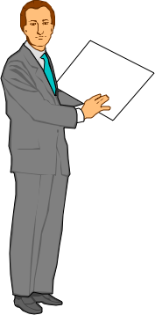

What is a Protocol
Friendly greeting
An agreement between parties on how communication should take place.
Protocols may have to define many aspects of the communication.
Syntax:
Data encoding, language, etc.
Semantics:
Error handling, termination, ordering of requests, etc.
Protocols at hardware, software, all levels!
Example: Buying airline ticket by typing.
Syntax: English, ascii, lines delimited by “\n”
Muttered reply
Destination?
Pittsburgh
Thank you

Slide 9
Interfaces
Each protocol offers an interface to its users, and expects one from the layers on which it builds
Syntax and semantics strike again
Data formats
Interface characteristics, e.g. IP service model
Protocols build upon each other
Add value
E.g., a reliable protocol running on top of IP
Reuse
E.g., OS provides TCP, so apps don’t have to rewrite

Slide 10
Common protocol
Where to unify?
How can you physically connect machines?
Optical, Electrical, Wireless, Carrier Pigeon, ...
Hm. Lots of diversity there -- we probably shouldn’t define the common layer as a physical one.

Slide 11
A Layered Network Model
The Open Systems Interconnection (OSI) Model.
7
Application
Application
6
Presentation
Presentation
5
Session
Session
4
Transport
Transport
3
Network
Network
Network
2
Data link
Data link
Data link
1
Physical
Physical
Physical

Slide 12
Internet Goals
Fundamental goal: Effective network interconnection
Goals, in order of priority:
Continue despite loss of networks or gateways
Support multiple types of communication service
Accommodate a variety of networks
Permit distributed management of Internet resources
Cost effective
Host attachment should be easy
Resource accountability
Principle: Fate Sharing
Make ability to communicate depend only on entities strictly needed...

Slide 13
Survivability
If network disrupted and reconfigured
Communicating entities should not care!
No higher-level state reconfiguration
Ergo, transport interface only knows “working” and “not working.” Not working == complete partition.
How to achieve such reliability?
Where can communication state be stored?
 | Network | Host
Failure handing | Replication | “Fate sharing”
Net Engineering | Tough | Simple
Switches | Maintain state | Stateless
Host trust | Less | More

Slide 14
The Internet Protocol Suite
Application
Applications
Presentation
Presentation
Session
Session
UDP
TCP
Transport
Waist
Network
Data link
Data Link
Physical
Physical
The waist facilitates
Interoperability.
The Hourglass Model

Slide 15
How to combine protocols?
In networking, often encapsulate
eg IP packets sent in Ethernet packets;
TCP packets sent in IP packets;
HTTP request sent as... a stream of TCP packets inside IP packets inside foo...
In OS, more likely to build on top of the abstraction, but not necessarily carry headers through

Slide 16
Questions to ask
What is the interface between components?
IP: send / receive packets
What are the semantics (promise) made?
IP: “Best-effort” delivery -- we’ll try to get your packets there, but we might drop them
or re-order them
or change the contents
or let someone listen to them
We could just as easily ask these questions about, say, an operating system, or a filesystem. Same principle is at work.
And to reason about them, we might abstract them into models...

Slide 17
System Models
ISO model of the network stack
(note differences from TCP/IP model)
Model of a communication channel
Latency - how long does it take for the first bit to reach destination
Capacity - how many bits/sec can we push through? (Often termed “bandwidth”)
Jitter - how much variation in latency?
Loss / Reliability - can the channel drop packets?
Reordering

Slide 18
Interaction models
And can even model how processes communicate
“Synchronous” model: upper and lower bounds of time to execute a step of a process
Messages received within bounded time
Each computer’s clock has bounded error from “true” time
Asynchronous model (the Internet...)
steps may take unbounded time or fail
unbounded delay and re-ordering
no accurate local clock

Slide 19
Failure models
Fail-stop:
When something goes wrong, the process stops / crashes / etc.
Fail-slow or fail-stutter:
Performance may vary on failures as well
Byzantine:
Anything that can go wrong, will.
Including malicious entities taking over your computers and making them do whatever they want.
These models are useful for proving things;
The real world typically has a bit of everything. Deciding which model to use is important!

Slide 20
Protocols and Models
An interesting thing...
We often build protocols that provide “simpler” models
Example: TCP
Provides reliable, in-order, mostly no-corruption, stream-oriented communication
so that programmers don’t have to implement these features in every application
But note limitations: TCP can’t turn a byzantine failure model into a fail-stop model...

Slide 21
Designing applications
Application architecture
Client-server? (vs p2p vs all in one)
Application requirements
Application level communication
TCP vs. UDP
Addressing
Application examples
ftp, http
End-to-end argument discussion

Slide 22



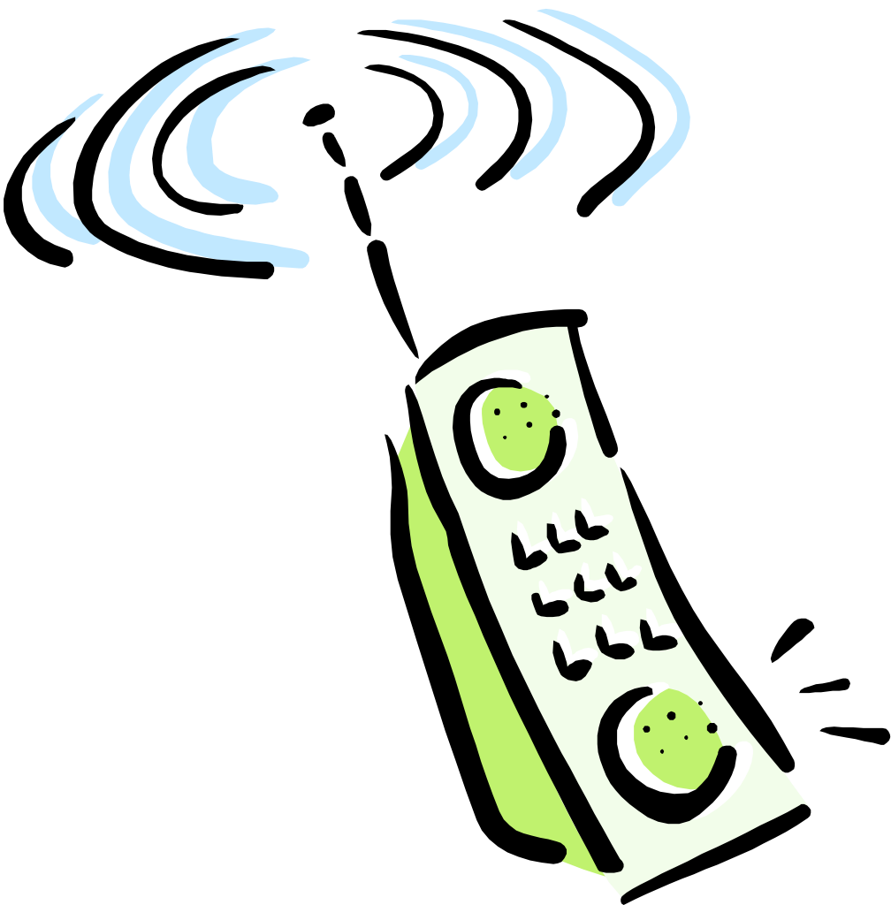

Applications and Application-Layer Protocols
Application: communicating, distributed processes
Running in network hosts in “user space”
Exchange messages to implement app
e.g., email, file transfer, the Web
Application-layer protocols
One “piece” of an app
Define messages exchanged by apps and actions taken
Use services provided by lower layer protocols
application
transport
network
data link
physical
application
transport
network
data link
physical
application
transport
network
data link
physical

Slide 23
Client-Server Paradigm
Typical network app has two pieces: client and server
Client:
Initiates contact with server (“speaks first”)
Typically requests service from server,
For Web, client is implemented in browser; for e-mail, in mail reader
Server:
Provides requested service to client
e.g., Web server sends requested Web page, mail server delivers e-mail
(We’ll cover p2p later)
application
transport
network
data link
physical
request
reply
application
transport
network
data link
physical

Slide 24
Design Question
If you want reliability, etc.
Where should you implement it?
Option 1: Hop-by-hop
Host
Host
Switch
Switch
Switch
Switch
Option 2: end-to-end

Slide 25
Options
Hop-by-hop: Have each switch/router along the path ensure that the packet gets to the next hop
End-to-end: Have just the end-hosts ensure that the packet made it through
What do we have to think about to make this decision??

Slide 26
A question
Is hop-by-hop enough?
[hint: What happens if a switch crashes? What if it’s buggy and goofs up a packet?]

Slide 27
The End-to-End Argument
If you have to implement a function end-to-end anyway (e.g., because it requires the knowledge and help of the end-point host or application), don’t implement it inside the communication system unless there’s a compelling performance enhancement
Further Reading: “End-to-End Arguments in System Design.” Saltzer, Reed, and Clark.

Slide 28
Keep in mind
This is an engineering “accepted” rule to be weighed against other design guidelines
In the Networks class, we take a “systems approach”
not a law
But in practice, it’s proved to be a nice way to think about things
You may encounter situations where you can’t (for whatever reason - technical, financial, political) implement things in the way the argument suggests. The real world can be an ugly place. :)

Slide 29
Let’s apply that to our question...
Of where to do retransmissions
What does e2e argument argue for here?
TCP uses end-to-end retransmissions
Can you think of times we might want to also implement hop-by-hop retransmission?
Hop-by-hop retransmission is cheaper and faster (count the “packet-miles” that are traveled)
So maybe a very high-loss link -- like wireless!
Your wireless card handles a few retransmissions on its own

Slide 30
Rough view of TCP
(This is a very incomplete view - take CSSE 432. :)
Source
Dest
Data pkt
ACKnowledgement
Time
What TCP does: 1) Figures out which packets got through/lost
2) Figures out how fast to send packets to use all of the unused capacity,
- But not more
- And to share the link approx. equally with other senders

Slide 31
Socket API Operation Overview
Client
Server
socket
socket
bind
open_listenfd
open_clientfd
listen
Connection
request
connect
accept
Client / Server
Session
send/write
recv/read
recv/read
send/write
close
EOF
recv/read
close

Slide 32
Blocking sockets
What happens if an application write()s to a socket waaaaay faster than the network can send the data?
TCP figures out how fast to send the data...
And it builds up in the kernel socket buffers at the sender... and builds...
until they fill. The next write() call blocks (by default).
What’s blocking? It suspends execution of the blocked thread until enough space frees up...

Slide 33
In contrast to UDP
UDP doesn’t figure out how fast to send data, or make it reliable, etc.
So if you write() like mad to a UDP socket...
It often silently disappears. Maybe if you’re lucky the write() call will return an error. But no promises.

Slide 34
Rehashing all of that...
TCP is layered on top of IP
IP understands only the IP header
The IP header has a “protocol” ID that gets set to TCP
The TCP at the receiver understands how to parse the TCP information
IP provides only “best-effort” service
TCP adds value to IP by adding retransmission, in-order delivery, data checksums, etc., so that programmers don’t have to re-implement the wheel every time. It also helps figure out how fast to send data. This is why TCP sockets can “block” from the app perspective.
The e2e argument suggests that functionality that must be implemented end-to-end anyway (like retransmission in the case of dead routers) should probably be implemented only there -- unless there’s a compelling perf. optimization

Slide 35
Questions to ponder
1) What does the end-to-end argument say about where to implement encryption for confidentiality?
2) If you have a whole file to transmit, how do you send it over the Internet?
You break it into packets (packet-switched medium)
TCP, roughly speaking, has the sender tell the receiver “got it!” every time it gets a packet. The sender uses this to make sure that the data’s getting through.
But by e2e, if you have to acknowledge the correct receipt of the entire file... why bother acknowledging the receipt of the individual packets???

Slide 36
Answers
1) Encrypt end-to-end.
A notable exception: The military sometimes uses hop-by-hop so that they can run unencrypted on physically secure links ... so that they can monitor the traffic there.
2) This is a bit of a trick question -- it’s not asking e2e vs in-network. :) The answer: Imagine the waste if you had to retransmit the entire file because one packet was lost. Ow.

Slide 37
Application Requirements
If you’re building an application... How do you choose what transport service to use?
That depends what the application’s communication requirements are...

Slide 38
What Transport Service Does an Application Need?
Data loss
Some applications (e.g., audio) can tolerate some loss
Other applications (e.g., file transfer, telnet) require 100% reliable data transfer
Timing
Some applications (e.g., Internet telephony, interactive games) require low delay to be “effective”
Bandwidth
Some applications (e.g., multimedia) require a minimum amount of bandwidth to be “effective”
Other applications (“elastic apps”) will make use of whatever bandwidth they get

Slide 39
User Datagram Protocol(UDP): An Analogy
UDP
Single socket to receive messages
No guarantee of delivery
Not necessarily in-order delivery
Datagram – independent packets
Must address each packet
Postal Mail
Single mailbox to receive letters
Unreliable ☺
Not necessarily in-order delivery
Letters sent independently
Must address each reply
Example UDP applications
Multimedia, voice over IP

Slide 40
Transmission Control Protocol (TCP): An Analogy
TCP
Reliable – guarantee delivery
Byte stream – in-order delivery
Connection-oriented – single socket per connection
Setup connection followed by data transfer
Telephone Call
Guaranteed delivery
In-order delivery
Connection-oriented
Setup connection followed by conversation
Example TCP applications
Web, Email, Telnet

Slide 41
Why not always use TCP?
TCP provides “more” than UDP
Why not use it for everything??
A: Nothing comes for free...
1) Connection setup (take on faith) -- TCP requires one round-trip time to setup the connection state before it can chat...
How long does it take, using TCP, to fix a lost packet?
At minimum, one “round-trip time” (2x the latency of the network)
That could be 100+ milliseconds!
If I guarantee in-order delivery, what happens if I lose one packet in a stream of packets?

Slide 42
One lost packet
Sent packets
Packet #
Received packets (delivered to application)
Delay,
burst
Time to retransmit lost packet
Time

Slide 43
Design trade-off
If you’re building an app...
Do you need everything TCP provides?
If not: Can you deal with its drawbacks to take advantage of the subset of its features you need?
If not: You’re going to have to implement the ones you need on top of UDP
Caveat: There are some libraries, protocols, etc., that can help provide a middle ground.
Takes some looking around - they’re not as standard as UDP and TCP.

Slide 44
Transport Service Requirements of Common Applications
Application
Data loss
Bandwidth
Time Sensitive
file transfer
e-mail
web documents
real-time audio/
video
stored audio/video
interactive games
financial apps
no loss
no loss
no loss
loss-tolerant
loss-tolerant
loss-tolerant
no loss
elastic
elastic
elastic
audio: 5Kb-1Mb
video:10Kb-5Mb
same as above
few Kbps
elastic
no
no
no
yes, 100’s msec
yes, few secs
yes, 100’s msec
yes and no
Interactions between layers are important.
persistent HTTP
encryption and compression
MPEG frame types. Loss & real-time video.

Slide 45
Server and Client
Server and Client exchange messages over the network through a common Socket API
Clients
Server
user
space
ports
TCP/UDP
TCP/UDP
Socket API
kernel
space
IP
IP
Ethernet Adapter
Ethernet Adapter
hardware

