Slide 1
Note on statically typed and compilable subset of Javascript
Wontae Choi@2013 Summer, SISA
with Koushik Sen and Swaroop Kalasapur

Slide 2
Logistics of Note
It should be updated continuously
No screen-shot. Code should be included as a text.
Fonts:
Comic-sans : Comments from meetings
Gil-sans : Wontae’s comments
Consolas : code
Calbri : anything else

Slide 3
Philosophy
SJS is a C like subset of JS with good part of JS.
SJS should be clean.
C programs should be easily ported to SJS.
Semantics of SJS should be consistent with C.
SJS programs should be type checked and executed reasonably fast on my machine.
C like JS should run on every machine.
Amount of necessary type hint should be minimal

Slide 4
Assumptions (1/3)
“Semantics of SJS should be consistent with C.”
Something should be static
Object structure cannot be changed dynamically
Variable type is fixed
No implicit type casting
Array is just array

Slide 5
Assumptions (2/3)
“SJS is a C like subset of JS with good part of JS.”
Good part of JS should be allowed
High-order function
Prorotype-based Inheritance
Hashtable

Slide 6
Assumptions (3/3)
“Amount of necessary type hint should be minimal”
Expression level type hint
assumeSameType(E,E)
assumeSubType(E,E)
dynCast(E,E)
Type should be inferred for trivial cases

Slide 7
Goal
Artifacts:
Type System
Type Inference Algorithm
Type Based Compilation
Users should be allowed to use our language to develop performance critical software with minimal distraction (e.g., type annotation)

Slide 8
Conceptual Example #1
function C(){
assumeSameType(this, C.instance);
this.x = 0;
this.y = 1;
this.next = C.instance;
//types for this simple case should be inferred
}
/*
TypeOf(C.instance) ==
{
x : int, y : int,
next : TypeOf(C.instance)
}
TypeOf(C.signature) ==
{ this: TypeOf(C.instance) }
TypeOf(C.instance) <: TypeOf(C.prototyp)
*/
Constraining type of this is enough to restrict the usage of a function (method/constructor vs function)

Slide 9
Conceptual Example #2
function f(a){
var l;
assumeSameType(a, C.instance);
assumeSameType(l, a);
var k = dynamicCast(l, {x : 1});
k.x
k.y //TYPE ERROR
}
/*
TypeOf(a) == TypeOf(C.instance)
TypeOf(l) == TypeOf(a) == TypeOf(C.instance)
TypeOf(k) == TypeOf( {x : 1} ) == { x : Int } >: TypeOf(a)
TypeOf(f) == { invoke : function, arg1 : TypeOf(C.instance)}
*/
Arguments of assumeSameType is commutative. This will keep annotation flexible and intuitive

Slide 10
Reflection
We are not going to support full reflection because it is “the ugly part of JS”

Slide 11
Model Language
P ::= S*
S ::= L:S
| E;
| var X = E;
| return E;
| if (X) S else S
| for(E;E;E) S
| for(X in E) S
| while (X) S
| break L;
| continue L;
| { S* }
| Fun
| Ty
E ::= V
| uop E
| E bop E
| E?E:E
| Lhs
| Lhs = E
| E(E*)
| (E)
| DynCase(E,E)
Lhs ::= X
| E[E]
| E.X
V ::= String
| Int
| Float
| Fun
| Lambda
| {X:E*}
Fun ::= function X(X*){ S* }
Lambda ::= function(X*){ S*}
Ty ::= assumeSameType(E, E);
| assumeSubType(E, E);

Slide 12
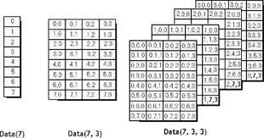
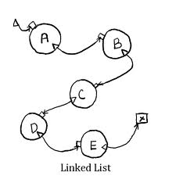
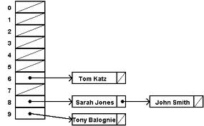
Treatment of Array
multi-dimensional array
List and Hashtable like usage
Treat them as Java does. This will be the default interpretation of array, since C consider array as an array (not a list or hashtable)
Treat it as an optional operations, which could be implemented in a very inefficient way
We can use Padded-array trick to implement it. Also, we can add one level of indirection to implement expandable array
Finding efficient representation is a compiler optimization. It is not a part of Type System. Let’s start from naïve and general representation.

Slide 13
Benchmark
sun-spider : good for understanding JS. Not good for exploring design space.
C programs : It will be a good idea to translate C programs in to JS and try to add type annotation.

Slide 14
Current Plan
Translating C program into SJS
Building benchmark and initial design

Slide 15
Problem : a/b
In JS, everything number is a floating number.
In JS : 3/2 = 1.5
In C : 3/2 = 1

