Slide 1
Motor Impairment Keyboard (MIKey) Final Presentation
Jackson Hagood, Andrew Imwalle, Brittany Jenkins, Connie Liu, Abhishek More, Max Smith
Notes:
Connie

Slide 2
AGENDA
Problem and Requirements
Alternative and Existing Solutions
System Overview
Hardware
Software
Modeling
Product Demonstration
Testing and Validation
EHS, Social, and Ethical Analysis
Manufacturing, Sustainability, and Economic Analysis
Roles and Project Management
Notes:
Connie

Slide 3
1.
Problem Background, Needs, and Objectives
What are we trying to solve?
Notes:
Connie

Slide 4
1,000,000+
60
$2,500/year
Parkinson's patients in US [1]
ABOUT PARKINSON'S
Average age of diagnosis [1]
Average cost of medication [1]
Notes:
Connie
https://www.parkinson.org/understanding-parkinsons/statistics

Slide 5
NEEDS STATEMENT:
There exists a need for a simple assistive technology that provides better computer hardware accessibility to individuals with Parkinson's disease or similar limited motor function capability.
Notes:
Connie

Slide 6
GOAL & OBJECTIVES
Goal
Make the typing experience easier for people with motor function impairments
Objectives
Cost-effective
Accessible
Easy to learn
Customizable
Should improve ability to interact with a computer
Should not compromise capabilities of a normal keyboard
Notes:
Connie

Slide 7
2. Existing and Alternative Solutions
What solutions have already been made?
Notes:
Connie

Slide 8
ALTERNATIVE SOLUTIONS
Eye-tracking with auto-complete
Increased efficiency
High barrier to entry
Learning and adjustment period
Not built for target audience (limited motor impairment)
Physical Keyboard with Speech-to-Text
Combination of limited and severe motor impairment solution
Already exists as speech-to-text, no market gap
Potential stretch goal
Touchscreen Display with Haptic Motors
Provides software flexibility along with haptic feedback
"Keys" on the screen are completely customizable
Theoretical solution
Cost & time constraints
Notes:
Connie

Slide 9
3. System Overview
What were our software, hardware, and modeling implementations?
Notes:
Brittany

Slide 10
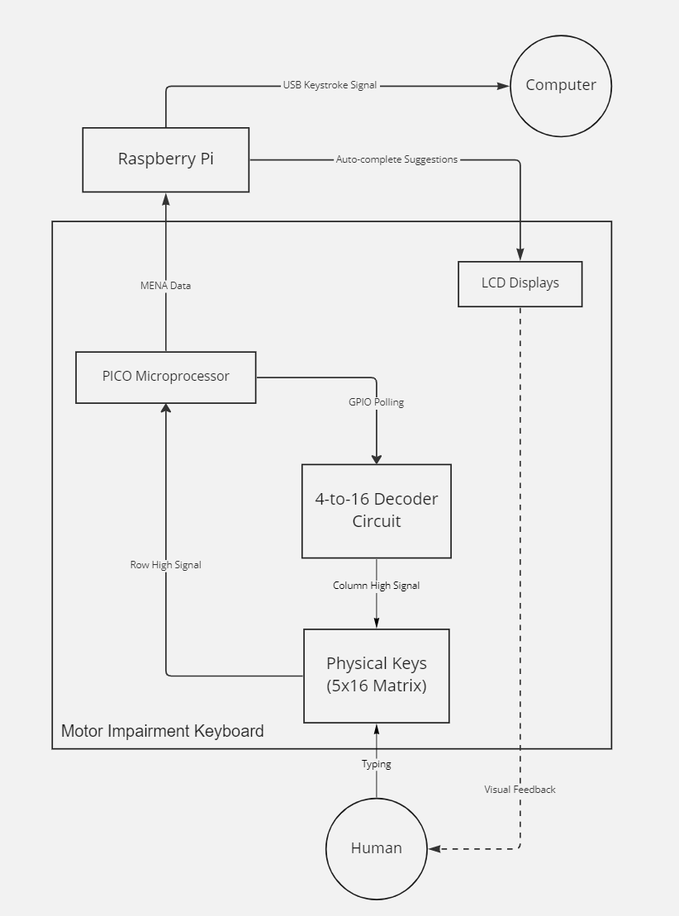
SYSTEM DIAGRAM
Notes:
Brittany
Design Alternatives/Decisions/Rationale: - Secondary processing layer (Pico) used to handle scanning & generates interrupt, so primary layer isn't polling
- https://www.geeksforgeeks.org/difference-between-interrupt-and-polling/
- Secondary layer also keeps scanning functionality/MENA processing separate
- Used Pi instead of Pico for primary layer of processing due to better support, ease of implementation
- Initially experimented w/ Pico for primary layer as well (had UART communication completely set up for MENA transmission); would have needed external flash due to memory constraints
- ***Discuss benefits of I2C protocol for LCDs
- Experimented with several methods of transmitting data from Pico to Pi. Had trouble with UART support in C++, settled on a Bash script that reads from the serial port (/dev/ttyACM0) and is piped into the driver. This was much better than a previous implementation that required several bytes to be sent per 2 byte MENA code

Slide 11
HARDWARE OVERVIEW
1
Key Matrix
2
4-to-16 Decoder Circuit
3
LCD Hardware
Notes:
Brittany

Slide 12
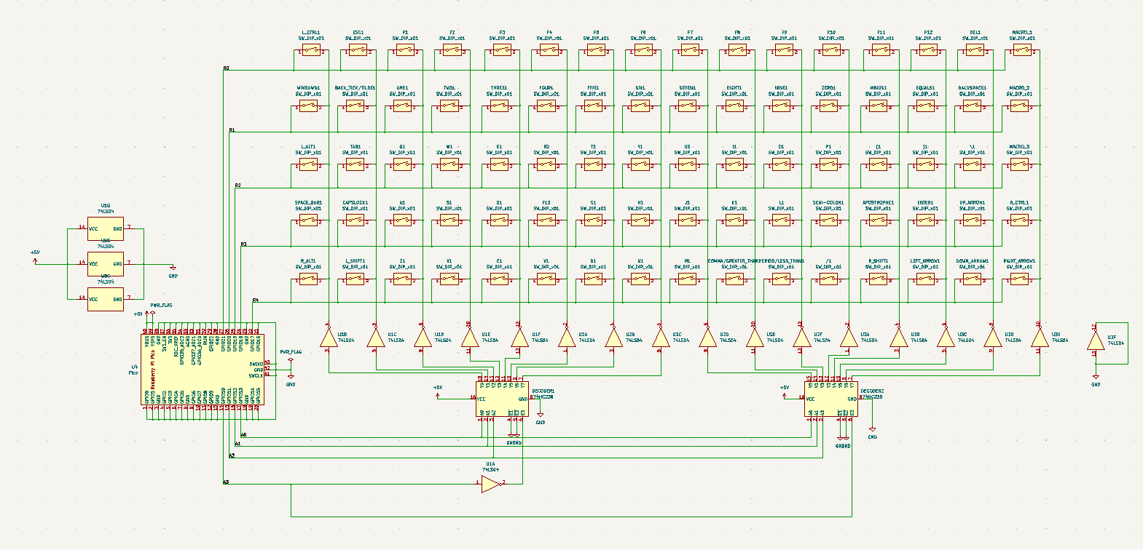
PCB Schematic
Notes:
Brittany
Components were moved to the correct location for the PCB
Key Matrix
Columns to rows
4-to-16 Decoder Circuit
Logic
Enable
Inverted
Turning 3-to-8 into 4-to-16
Components
ICs
Pi
PICO
Fabrication

Slide 13
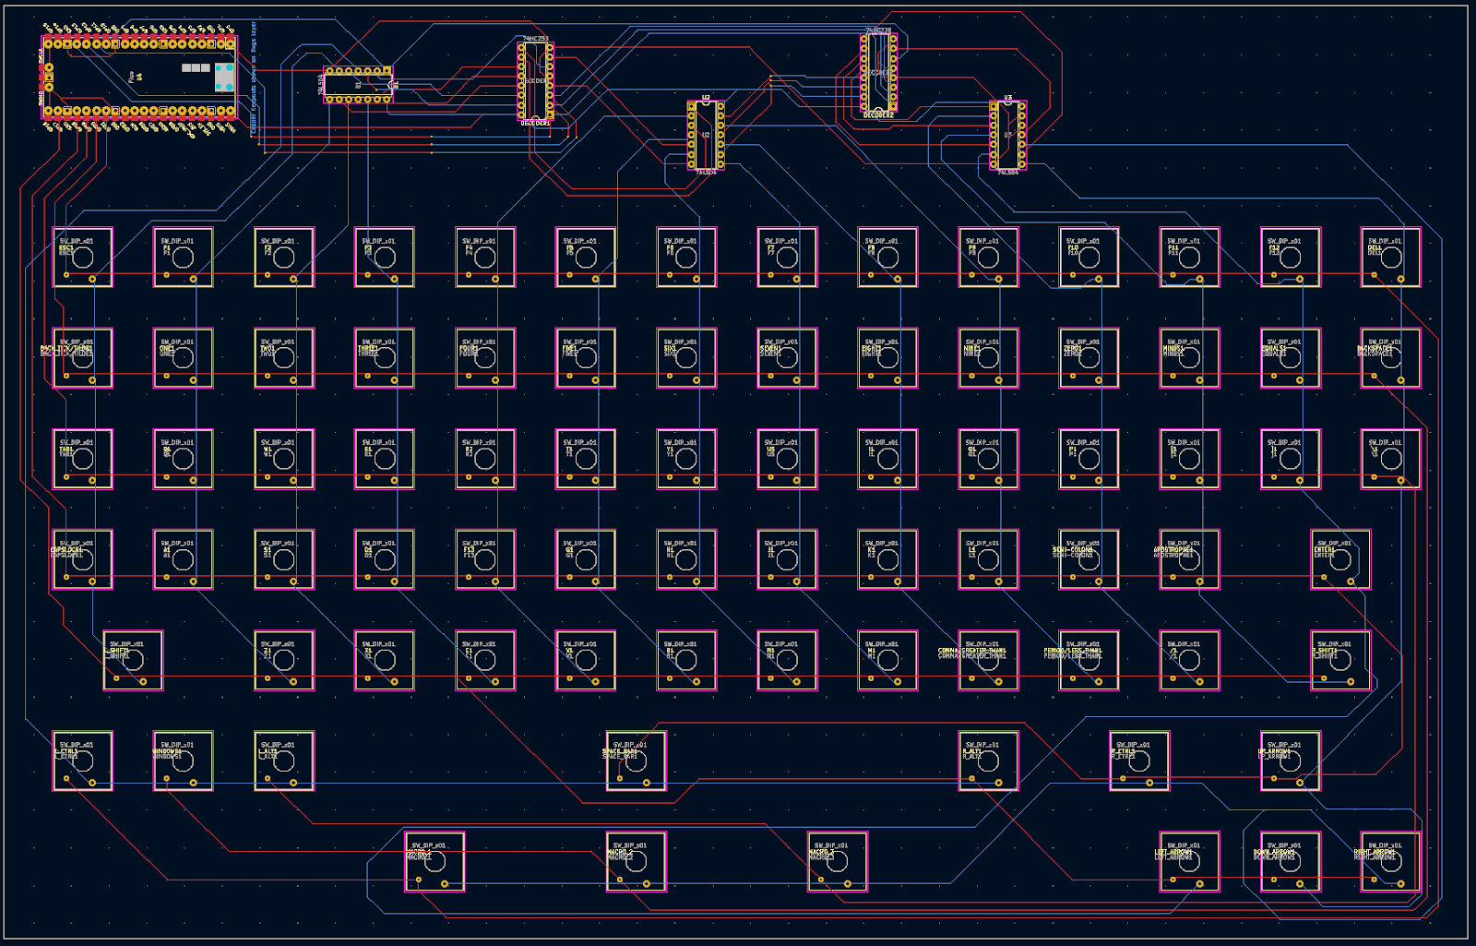
PCB Routing
Notes:
Brittany
Mention Key Mapping

Slide 14
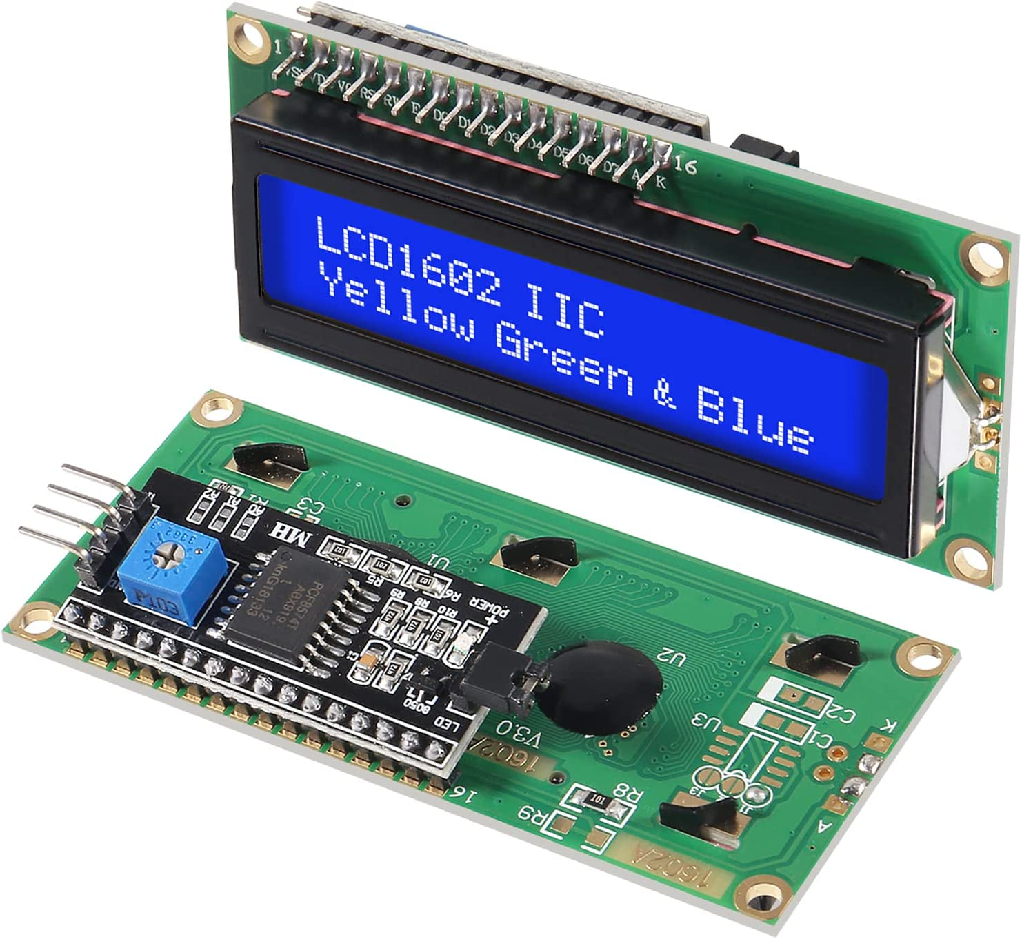
LCD Hardware
Specifications
SDA, SCL, Power, and GND all wired in parallel onto R-Pi I2C pins
Individual addresses soldered for configuration
I2C Serial Interface Adapter Module
Notes:
Abhishek

Slide 15
SOFTWARE OVERVIEW
Pico (CircuitPython):
Scan key matrix to detect key presses
Generate MENA encoding for key press
Send interrupt along with MENA data to Pi
Raspberry Pi (C++, Bash):
Receive MENA values from Pico
Run auto-complete algorithm for partial words
Update LCDs
Send keystrokes to receiving computer
Notes:
Max

Slide 16
MENA
Bit(s) | 0 | 1 | 2 | 3 | 4-7 | 8-15
Key | ALT | CTRL | SHIFT | WIN | (N/A) | Character
Integer Value | Character Key
0-9 | 0-9
10-35 | a-z
36 | `
37 | -
38 | =
...
Notes:
Max

Slide 17
Pico Software – Key Scanning
The Raspberry Pi Pico continuously powers each column of the key matrix individually and scans each row. When a key is pressed, its corresponding row and column are connected; thus, its row will be detected by the Pico when its column is powered.
In order to power the proper column, the Pico encodes the column to be powered as a 4-bit signal to send to the hardware.
Notes:
Max

Slide 18
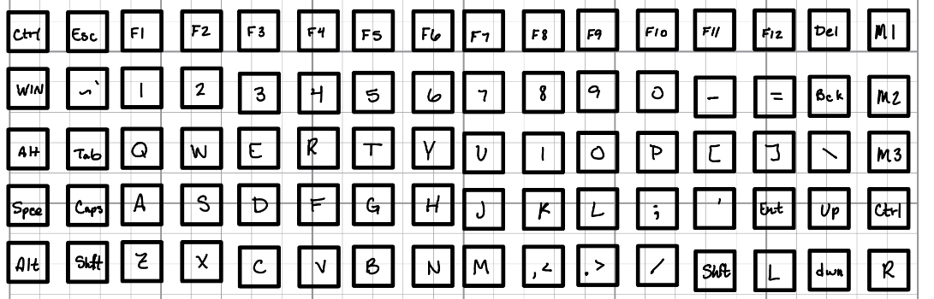
Keyboard Layout

Slide 19
Pico Software – MENA Generation
The Pico keeps a mapping from locations in the key matrix to the associated MENA value. When a key press is detected, the corresponding MENA value is retrieved from the mapping.
Bit masking is used to handle simultaneous key presses. The MENA encoding was designed in such a way as to enable modifier keys (Ctrl, Shift, etc.) to be easily added or removed from a MENA value, allowing for simple key press encoding and decoding.
Notes:
Max

Slide 20
Pico Software – Interrupt Generation / Data Transmission
After the entire 5 x 16 matrix is scanned, an interrupt is generated through a GPIO pin on the Pico if any keys were pressed, and the MENA value is sent to the Pi through the serial connection.
Notes:
Max

Slide 21
Raspberry Pi – Driver Program
Hardware interrupts start function to accept MENA.
Trie structure is traversed using partial words to get 3 auto-complete suggestions.
Auto-complete suggestions are output to the LCD's.
Keystrokes and selected auto-complete suggestions are output to the receiving computer using Key Mime Pi.
Notes:
Jackson
Helpful Courses: CSCE 121, 221, 222, 411, 462

Slide 22
Raspberry Pi – Auto-complete
As the user types partial words (one or more alphabetic characters) the auto-complete algorithm is executed. This algorithm uses a Trie data structure which is constructed using a dictionary file.
This dictionary file is a collection of the 10 thousand most typed English words from a Google study. This dictionary file could be changed for different applications.
Trie and Node have be defined as classes.
Notes:
Jackson

Slide 23
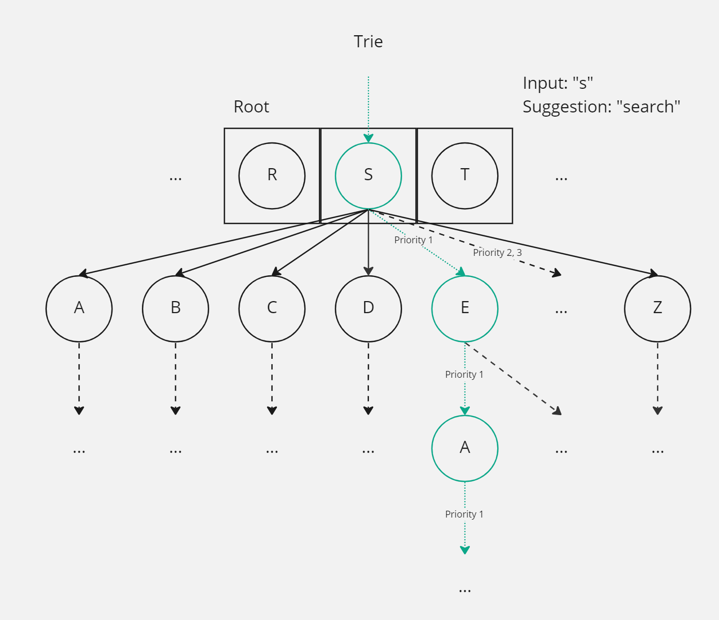
Trie Traversal
Notes:
Jackson

Slide 24
Raspberry Pi – Outputs
Auto-complete suggestions are output to LCD's using another class. These LCD's are connected using serial through GPIO (using Wiring Pi).
Keystrokes are output to the receiving computer using Key Mime Pi. This works by executing shell commands from within the driver program. Two commands are sent for each key press (press down and release).
Notes:
Jackson

Slide 25
SYSTEM DIAGRAM
Notes:
Max
Design Alternatives/Decisions/Rationale: - Secondary processing layer (Pico) used to handle scanning & generates interrupt, so primary layer isn't polling
- https://www.geeksforgeeks.org/difference-between-interrupt-and-polling/
- Secondary layer also keeps scanning functionality/MENA processing separate
- Used Pi instead of Pico for primary layer of processing due to better support, ease of implementation
- Initially experimented w/ Pico for primary layer as well (had UART communication completely set up for MENA transmission); would have needed external flash due to memory constraints
- ***Discuss benefits of I2C protocol for LCDs
- Experimented with several methods of transmitting data from Pico to Pi. Had trouble with UART support in C++, settled on a Bash script that reads from the serial port (/dev/ttyACM0) and is piped into the driver. This was much better than a previous implementation that required several bytes to be sent per 2 byte MENA code

Slide 26
3D Modeling + Printing
Objective:
To facilitate usage of a keyboard for people with motor-function impairments
Implementation:
Enlarged flat keycaps that eliminate unintentional key presses
Enclosure to house the keyboard and critical hardware
Elevate and angle LCD's with auto-complete suggestions toward user
Notes:
Andrew

Slide 27
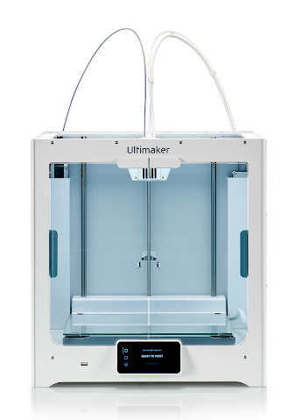
3D Printing
All parts were printed in PLA material
Infill at 20%
Printed on the Ultimaker S5
Glass bed
Notes:
Andrew

Slide 28
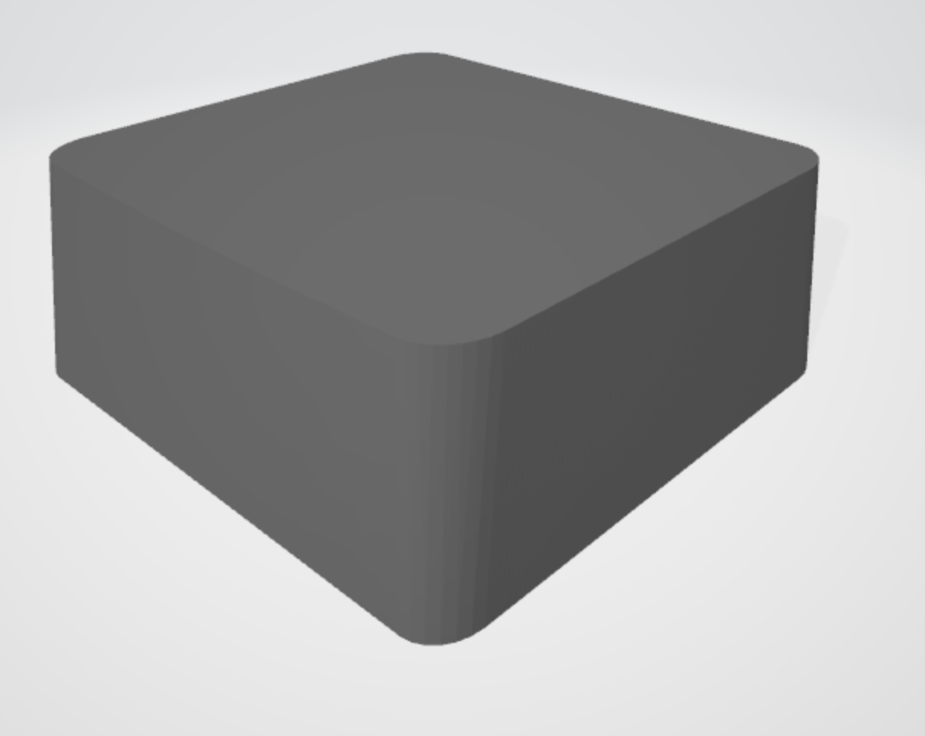

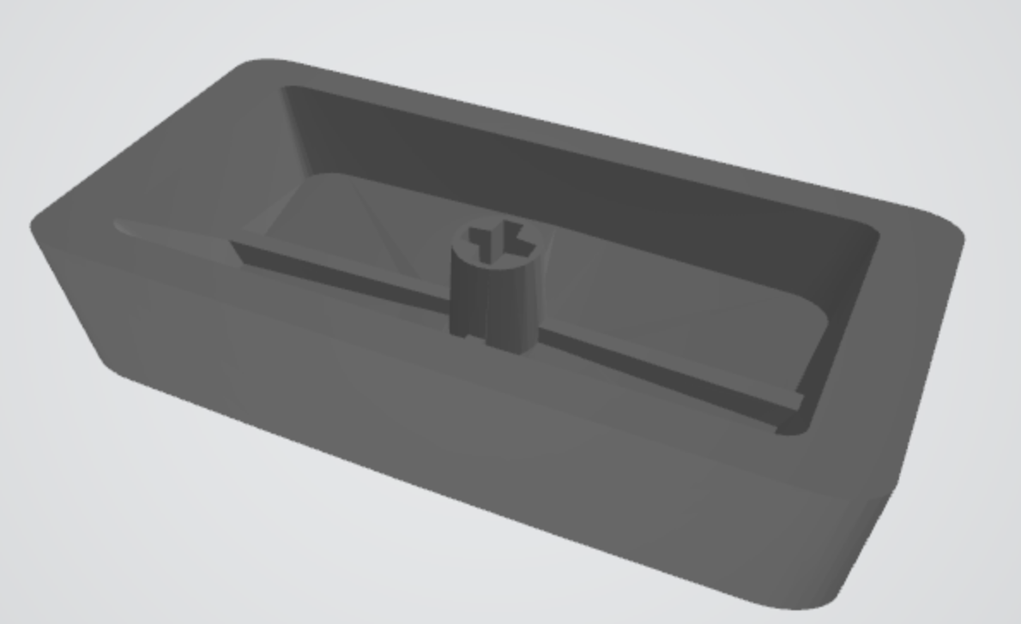
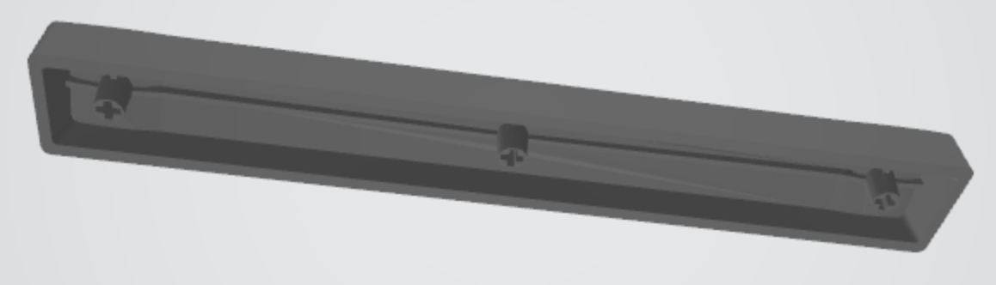
Keycaps
Flat top keys to facilitate 3D printing
Standardized switch interaction
Double wide keycaps for certain keys
Spacebar that utilizes the stem from three switches to ensure stability
Notes:
Andrew

Slide 29
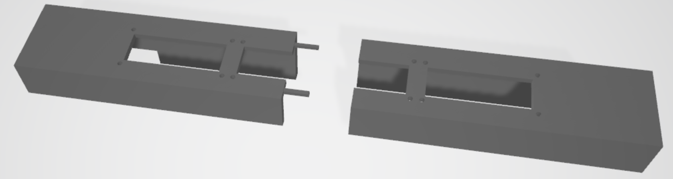
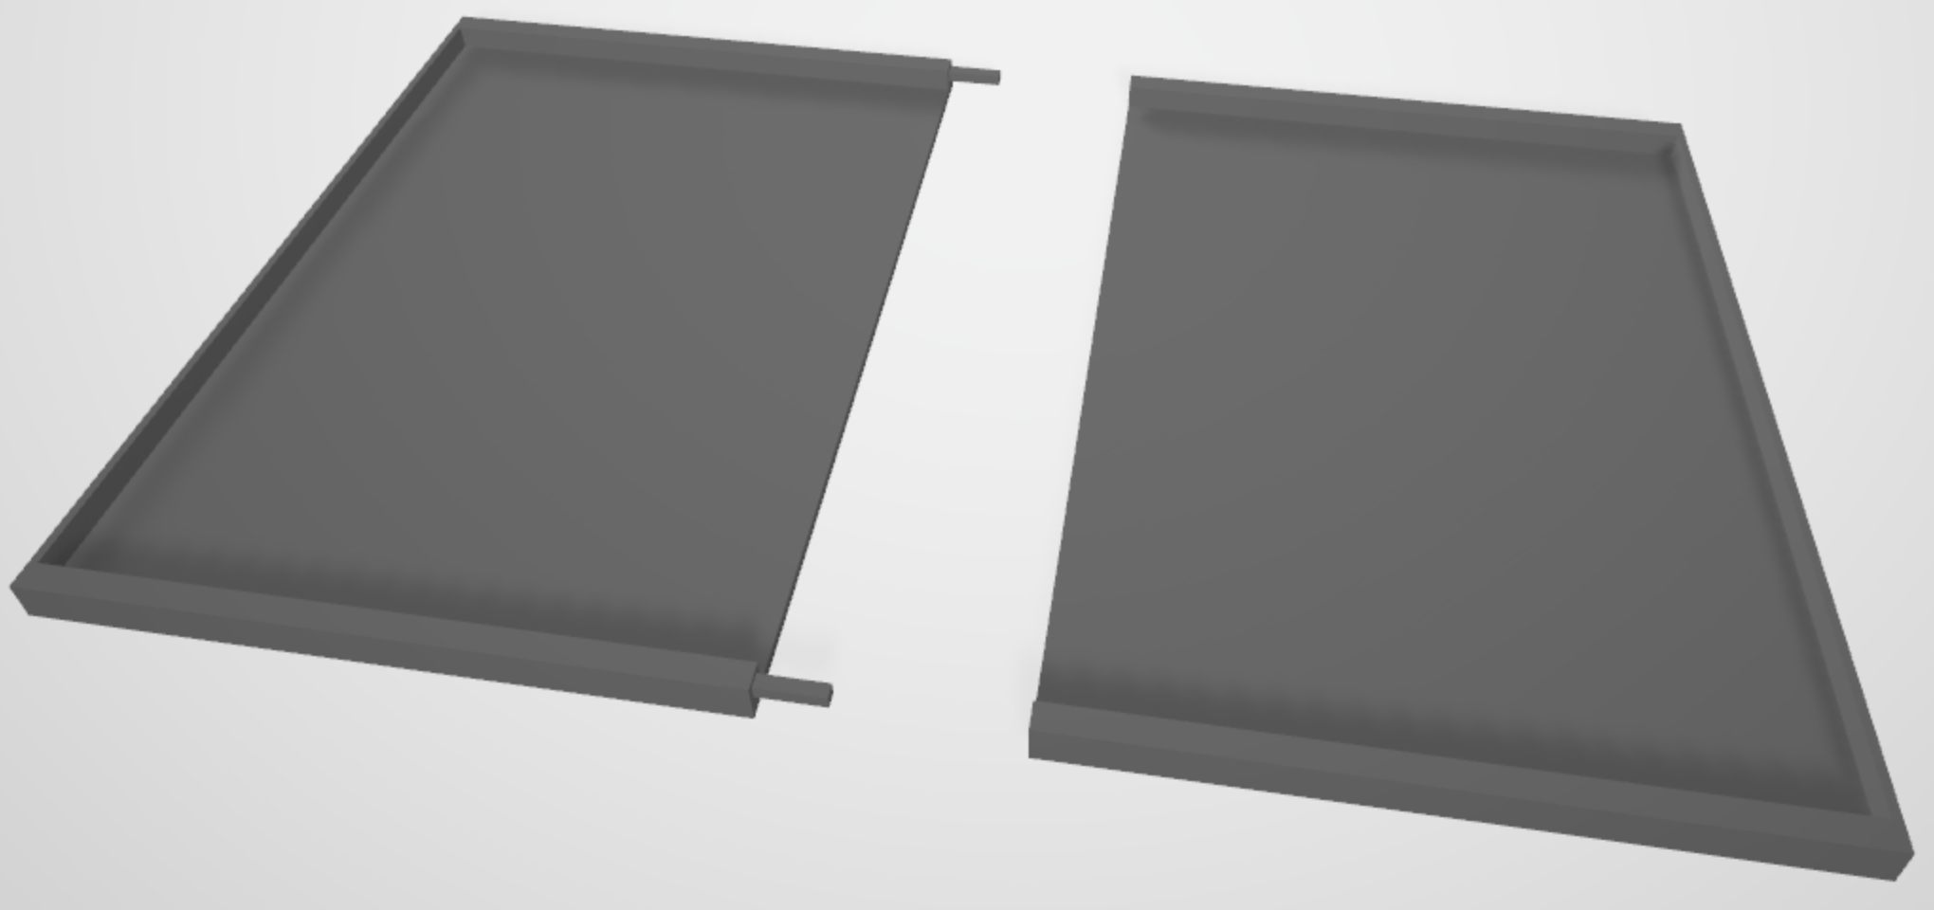
Housing
LCD slots elevated and angled toward user
Wires and circuitry fit in the space above the keycaps and below the LCDs
Split into four interlocking parts due to print volume
Notes:
Andrew

Slide 30
4. Product Demo
Does our solution work?
Notes:
Andrew

Slide 31
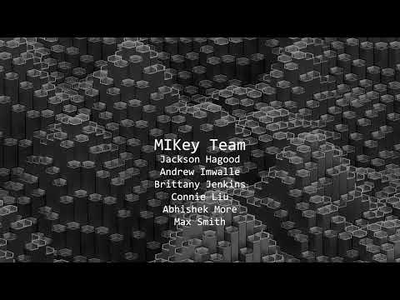

Slide 32
5. Testing and Validation
How good is our product?
Notes:
Max

Slide 33
Paragraph Tests
Example: "Paragraphs are the building blocks of papers. Many students define paragraphs in terms of length: a paragraph is a group of at least five sentences, a paragraph is half a page long, etc. In reality, though, the unity and coherence of ideas among sentences is what constitutes a paragraph."
Auto-complete predicted 39 of 40 words.
Auto-complete saved around 30 % of keystrokes.
Notes:
Max

Slide 34
Latency Test
Reaction time test showed no significant difference between a standard keyboard and the MIKey device.
Demo shows that repeated characters take longer to register (by design, to reduce likelihood of accidently pressing key twice).
Notes:
Max

Slide 35
6. EHS, Social, and Ethical Analysis
What is our impact?
Notes:
Connie

Slide 36



IMPACT ON SOCIETY, SAFETY, AND THE ENVIRONMENT
Notes:
Connie

Slide 37
7. Manufacturing, Sustainability, and Economic Analysis
What are the costs?
Notes:
Abhishek

Slide 38
MARKET STATE
$7.93 billion
Expected market growth for assistive technology from 2020 to 2025 [2]
34% Growth
Market growth contributed by North America [2]
60,000/year
Americans diagnosed with Parkinson's [1]
Notes:
https://www.prnewswire.com/news-releases/assistive-technology-market-to-witness-usd-7-93-bn-growth--driven-by-rising-cases-of-orthopedic-conditions--technavio-301573863.html#:~:text=NEW%20YORK%2C%20June%2024%2C%202022,significant%20growth%20in%20North%20America.
Abhishek

Slide 39
Proposal Budget
Product | Cost ($)
Raspberry Pi 0 | 79.99
3 LCD Displays | 15.99
Keyboard Switches | 47.98
O-rings | 6.99
PLA Filament | 18.99
PCB Material | 90
$259.94 USD
Total
Notes:
Abhishek

Slide 40
Final Costs
Product | Cost ($)
Raspberry Pi Pico | 20.82
3 LCD Displays | 23.79
Keyboard Switches | 43.29
PCB Material | 43.16
$131.06 USD
Total
Notes:
Abhishek

Slide 41
Manufacturing Unit Costs
Product | Cost ($)
Pico (2) | 7
3 LCD Displays | 4.5
Keyboard Switches | 32
PCB Material | 7.41
Housing Material | 9.99
$60.90 USD
Total
Notes:
Abhishek

Slide 42
8. Roles and Project Management
How did we work together?
Notes:
Brittany

Slide 43
APPROXIMATE TIMELINE
Preliminary research of technologies, algorithms, and motor impairments
Ordered components
Began designing digital circuitry
Debugging & Adjustments
Unit testing
Assembled prototype
SPRINT 1
FEB
MAR
SPRINT 2
MAY
JUN
SPRINT 3
AUG
SEP
SPRINT 4 & 5
NOV
DEC
Set up development environment & begin software implementation
Keycap modeling and printing
Began hardware and software testing
Finalized hardware design & ordered PCB
Housing modeling and printing
System Testing
Notes:
Brittany

Slide 44
BREAKDOWN OF ROLES
Technical Role | Team Member(s)
Hardware | Andrew, Brittany, Connie
Software | Jackson, Max, Abhishek
3D Modeling | Andrew & Connie
Non-Technical Role | Team Member(s)
Project Manager/SCRUM Masters | Andrew, Brittany, Jackson
Financials & Marketing | Abhishek
Technical Reports/Meeting Notes | Connie & Max
Notes:
Brittany

Slide 45
Appendix B: Extended Software Details

Slide 46
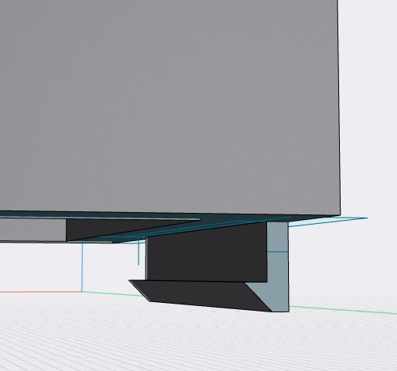
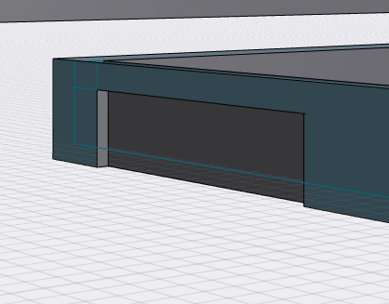
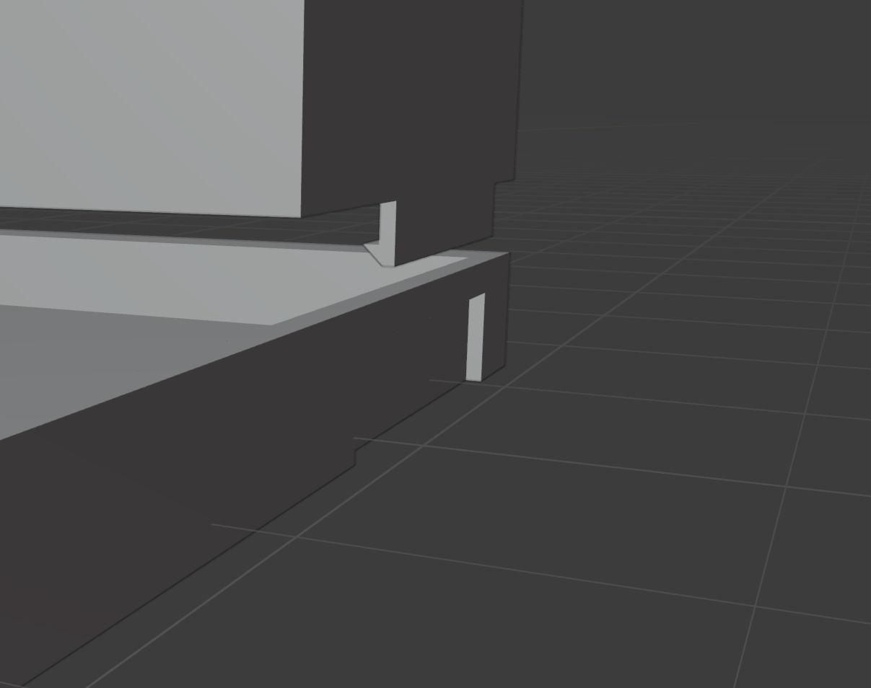
Appendix C: Design Changes & Improvements
Attempted, but failed due to tolerances and low-fidelity printing
Non Destructive Debugging
Allows user to remove the cover and modify the contrast on LCD
Latch Interface for LCD and Circuitry Housing

Slide 47
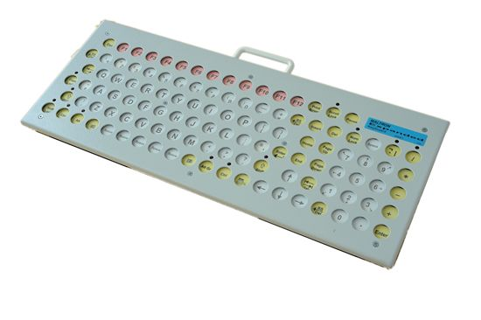
Appendix C: Design Changes & Improvements, Cont.
Key guard that functions to inset the keys into the frame.
Latching interface to allow user to remove if it is not desired
Ensures user does not perform accidental input
Example of a key guard implementation

Slide 48
Appendix D: User Testing and IRB

Slide 49
Appendix E: Helpful Coursework

