Slide 1
Interim Video Presentation
By Jackson Hau

Slide 2
Content
Project Vision and background
Project plan and Sprints
UML models
Initial prototype
Challenges faced

Slide 3
Project Vision and background
I like my 2D car game simple and fun. My simple game makes you go "wow." Make games fun for everyone is my goal.
To combine old-school racing characteristics with current game play to create an entertaining 2D automobile game that lets players escape reality.
ScreenRant claims driving games' high speed helps players improve their hand-eye coordination and reaction time. Racing games range from goofy go-karts to realistic racing and driving simulations.

Slide 4
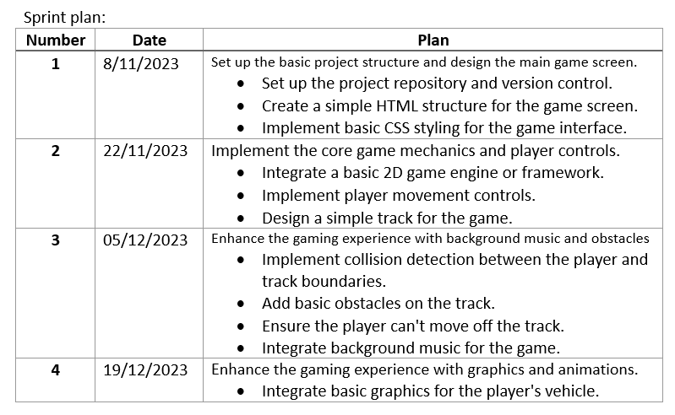
Project Plans and Sprints

Slide 5
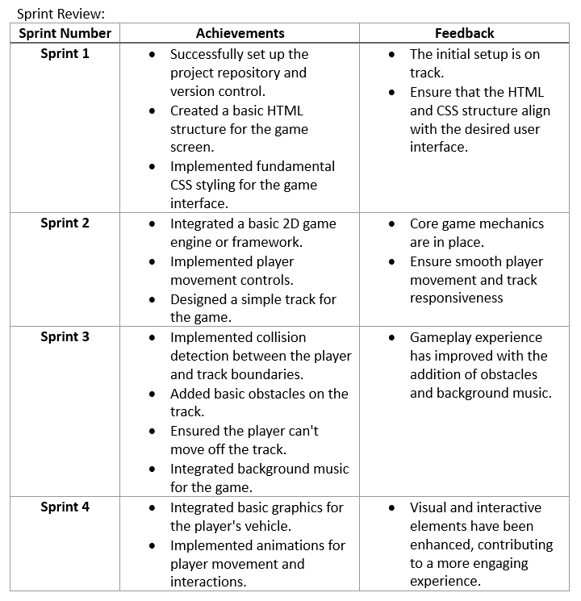
Project Plans and Sprints

Slide 6
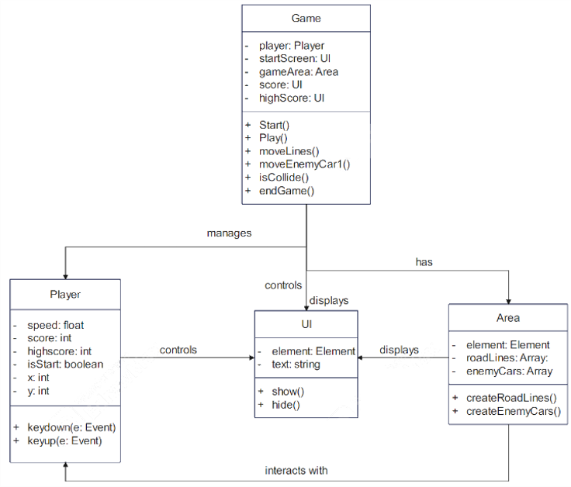
UML models

Slide 7
Initial prototype

Slide 8
Challenges faced
Adding road and lines
Adding different cars
Background music
Making different maps
Making different levels
Audio Integration
Game bugs

Slide 9
Thanks for watching

