Slide 1

MELODY MOODSYNC
A Music Recommendation Database System
Lemuel Amouh, Yousuf Stanikzay, Lamisa Tahseen, Courtney Dickenson, Angelina John,
Jahnavi Dhulipalla, Jack Hoggard, Jalay Shukla, Preston Hearn

Slide 2


PROJECT OVERVIEW
Problem
Existing music recommendation systems overemphasize popularity over user preferences.
Solution
A system that emphasizes mood, tone, and genre to help users discover music that matches their tastes is reflected in the final design.
Goals
Support smaller artists, provide personalized recommendations, and ensure data privacy.

Slide 3
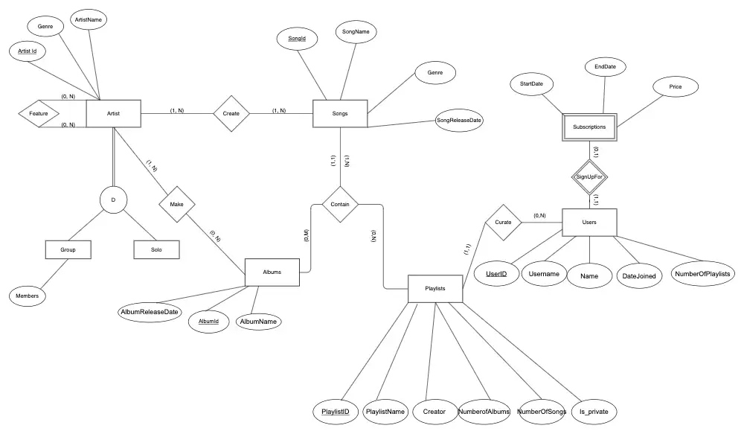
EER Diagram
Key entities include Albums, Songs, Playlists, Users, Subscriptions, Artists, Features, and Genres.
Relationships involve:
Songs connected to Albums, Artists, and Genres
Playlists associated with Users and Songs
Artists linked to Features, Genres, and Group Members
All relationships are in 3NF, eliminating the need for further normalization.

Slide 4

BACKGROUND AND RELATED WORK
Music4All
Comprehensive music database for research.
Focuses on tags, lyrics, and audio clips.
Difference: Our project is simpler and tailored for recommendations.
Smart Spotify Assistance System:
Recommends multiple songs based on a single query.
Relies on existing streaming platforms.
Difference: Our project creates a standalone database and avoids relying on popularity.
Music Database with data mining
Uses algorithms for grouping songs and recommendations.
Includes a front-end for browsing and managing songs.
Difference: We manually input song characteristics and provide a streamlined interface.

Slide 5
WHAT IS MELODY MUSIC SYNC
01
02
03
A database for personalized song recommendations
Focuses on genre, tone, and mood over popularity
Helps users discover new music and supports smaller artists
04
05
Prioritizes secure handling of user data
Our process ensures that each project is meticulously planned and executed. From the initial consultation to the final walkthrough, we collaborate closely with clients to ensure their vision is brought to life with precision and creativity.

Slide 6
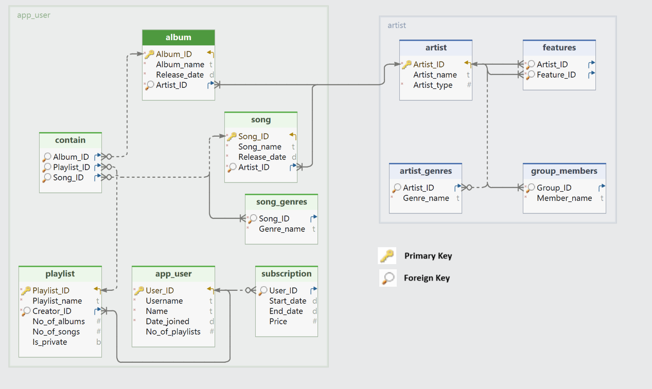
RELATIONAL MODEL

Slide 7


MELODY MOODSYNC
Live Demo

Slide 8
KEY FINDINGS
Problem in Current Systems
1
Existing music recommendation systems overemphasize popularity, overlooking personalized user preferences.
Effective Database Design
2
Our system emphasizes mood, tone, and genre, enabling personalized song discovery while maintaining a normalized, efficient design.
Robust Implementation
3
Functional dependencies and composite keys ensure data consistency, supporting efficient querying and future scalability.

Slide 9

FUTURE WORK
Automatic Data Collection
Implement data mining algorithms to automatically extract song attributes.
Add More Attributes
Infuse further melodic attributes.

Slide 10
QUESTIONS?

