Slide 1
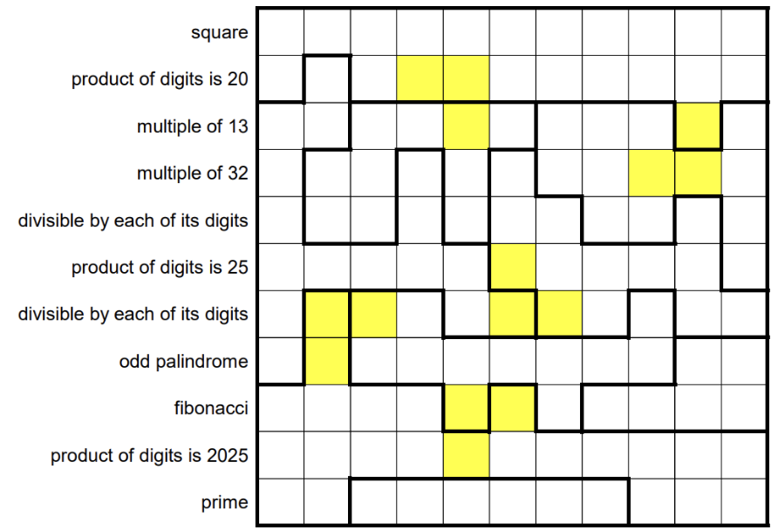
2/0 | 3 | 4 | 2 | 2 | 2 | 5 | 2/0 | 3 | 2 | 4
5 | 4 | 2/0 | 2X | 2X | 5 | 2/0 | 2 | 5 | 2 | 2/0
4/0 | 5 | 3 | 4 | 3X | 3/0 | 6 | 5 | 4/0 | 2X | 6
7 | 3 | 6 | 4/0 | 3 | 2 | 4/0 | 5 | 4X | 4X | 4/0
4/0 | 5 | 5 | 5 | 3/0 | 2 | 2 | 4/0 | 8 | 1 | 6
5 | 5 | 4/0 | 5 | 5 | 1X | 1/0 | 1 | 5 | 5 | 4/0
4/0 | 3X | 6X | 7 | 4 | 4X | 1X | 2 | 6/0 | 2 | 4
7 | 3X | 7 | 6/0 | 9 | 9 | 6 | 9 | 9 | 9 | 7/0
3 | 4 | 3/0 | 4 | 6X | 3X | 6 | 8 | 7/0 | 8 | 9
5 | 3 | 5 | 9 | 3X | 3/0 | 5 | 9 | 5 | 3 | 3
3/0 | 4 | 7 | 7/0 | 8 | 8 | 7 | 7/0 | 4 | 3 | 3
ANSWER

