Slide 1
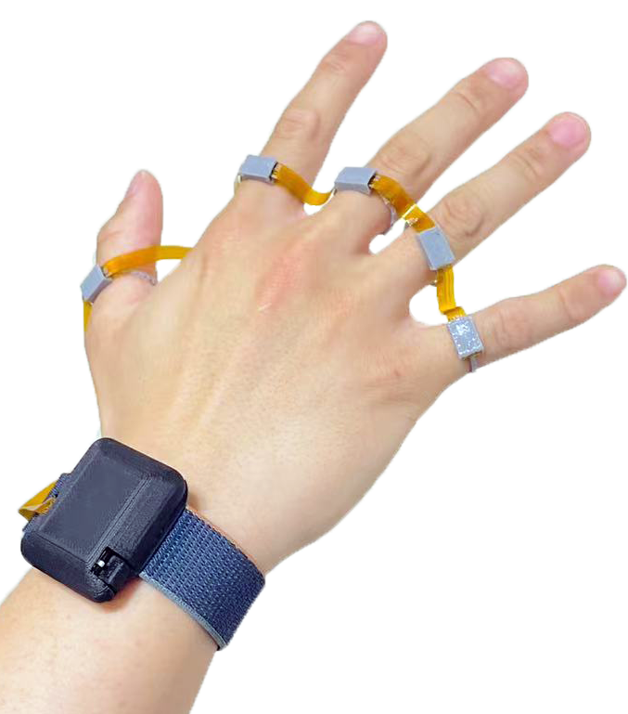
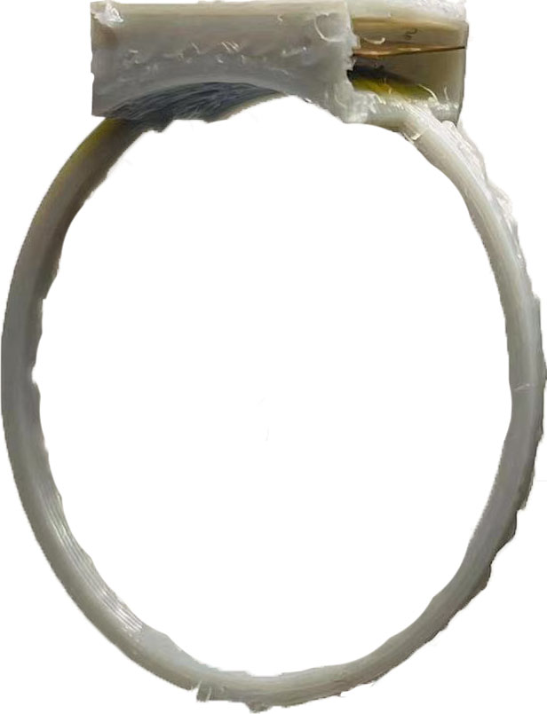
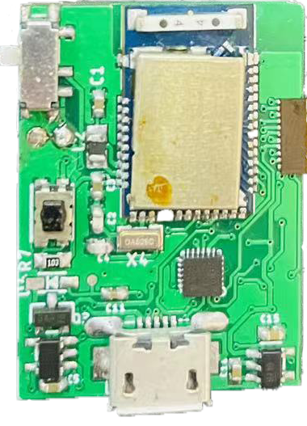
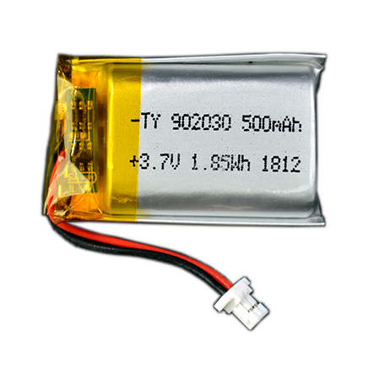
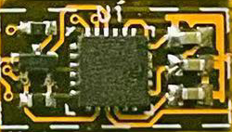
22 mm
30 mm
IMU Finger Sensor Module
Microprocessor BLE Module
(c)
(a)
Battery
10 mm
5.8
mm
(b)
(d)

Slide 2
Z
Y
X
Sensor Local Frame
Z
Y
X
Wrist Coordinate Frame

