Slide 1
Quarter Two
Jackson Paull, 8

Slide 2
What I did this Quarter
I worked mostly on two games, a small shooter and a rogue-lite. All of the code featured in this presentation will be from the rogue-lite. The small shooter is attached in the folder with an in-depth README.html detailing all of the processes behind the game as well as all of its functions and gameplay. The main goal I had with the rogue-lite for this semester was to create fully functional pathfinding, as well as basic mechanics like collision and movement. I have succeeded on both counts and will provide as in depth a README.html for the rogue-lite as I can, but it is significantly more complicated

Slide 3
TEAKS
Featuring code from the rogue-lite

Slide 4
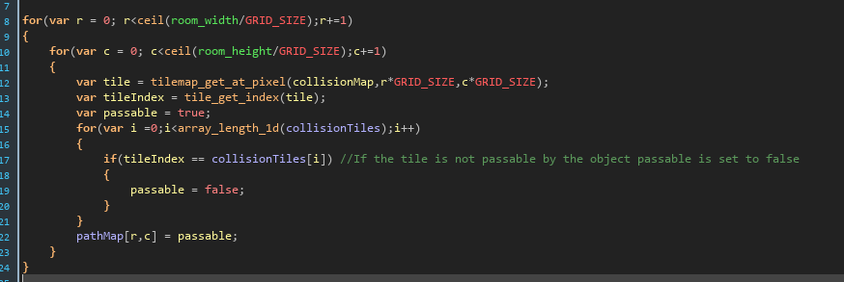

TEAK 1: Looping
In the top section of code I use loops to pass through an array consisting of the entire map, and setting areas where the object should not be able to move equal to false, for reference in other areas of my code.
In the bottom section of code I continuously process nodes until I have found my destination

Slide 5
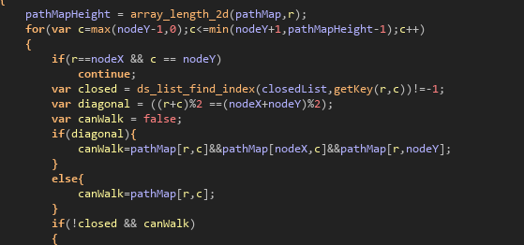
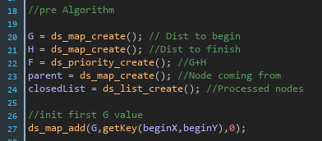
TEAK 2: Data Structures
In the top section of code I get data from a map I created previously to check if it has already been processed so that I eliminate infinite loops
In the bottom section of code I created all 5 maps, lists, and priority queues that I would need for the algorithm and instantiated the first value for the G map

Slide 6
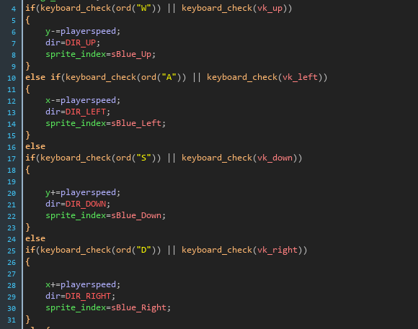
TEAK 3: Input and Output
This section of code handles player movement by checking if the player is holding down the arrow keys or wasd and adjusts the position, direction, and sprite accordingly.
The output is seen in game through fluid movement

Slide 7
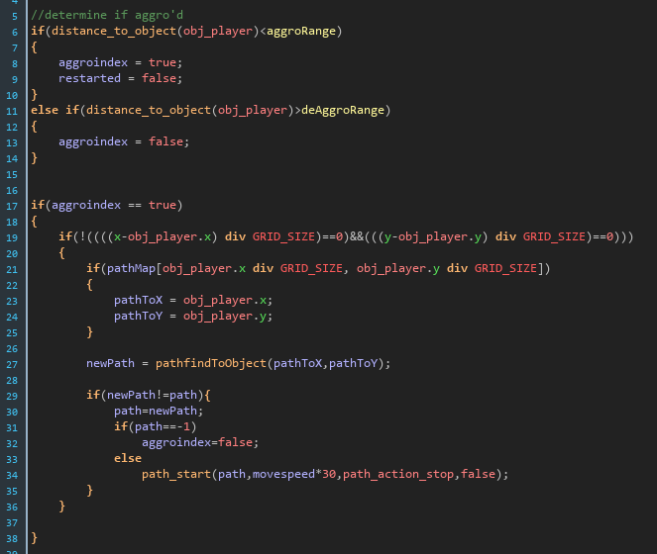
TEAK 4: if and else if
This section uses if statements and else statements to continuously determine whether or not an enemy should be trying to follow the player or not, as well as having heuristics in place to prevent crashes

Slide 8
TEAKS 5&6 - Methods and Classes
The language I used to develop the game (GML) does not explicitly have methods or classes, instead it has scripts and objects. Both of these things accomplish the same goals that are accomplished by methods and classes respectively, and thus there are a few issues like no lines instantiating objects, and instance variables needing to be set through a specific process in the editor. If you have any questions as to how the code I show properly outlines and fulfills the TEAKS don’t hesitate to ask as I would be more than happy to explain.

Slide 9
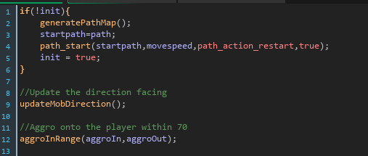
TEAK 5: Methods
This section uses several scripts, which are essentially methods, to not only create a more readable chunk of code, but also to keep each object from having the same instance variables, as each script is called with different variables. These scripts are also used across different objects of different classes.

Slide 10
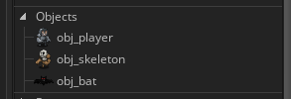
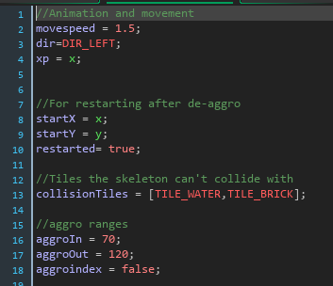
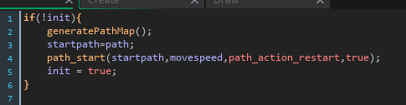
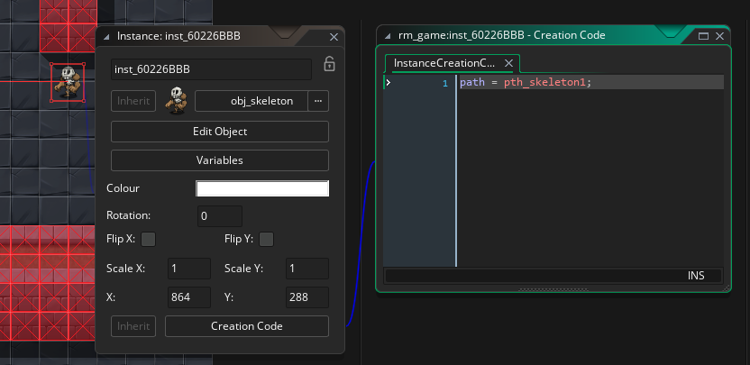
TEAK 6: Classes
Each object is kind of it’s own class, as I :
create instance variables and constants for each class
Instantiate different instances of each class with unique instance variables
can reference each individual instance of an object
Can set instance variables and receive instance variables
Can create methods to process data and return information

Slide 11
Thanks for reading!

