Slide 1
INHERITANCE & CASCADE

Slide 2
DOCUMENT tree
Each HTML document can actually be referred to as a document tree. We describe the elements in the tree like we would describe a family tree. There are ancestors, descendants, parents, children and siblings.
Ancestor
Descendant
Parent and Child
Sibling

Slide 3
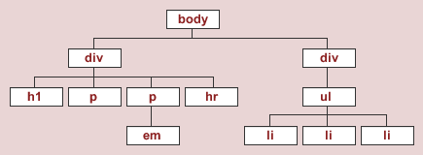

Slide 4
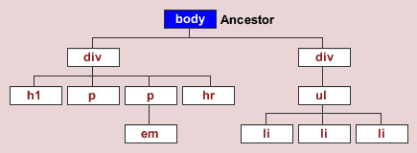

Slide 5
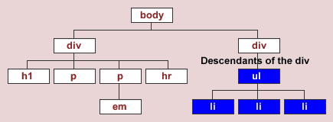

Slide 6
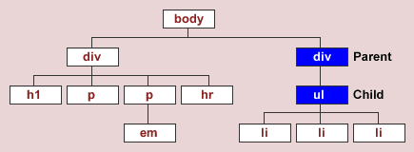

Slide 7
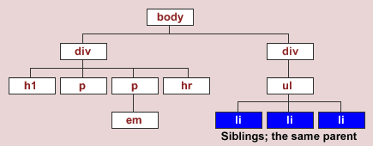

Slide 8
Inheritance
Styles which are passed down from the parent or ancestor element to the children and the descendants.
Inherited properties: (color, font-family, font-size, and so on)
Non-inherited properties: (border, margin, padding, display, and so on)
Demo ☺

Slide 9
Cascade
In CSS, styles sheets cascade by order of importance. If rules in different style sheets conflict with one another, the rule from the most important style sheet wins.
Below is a list of possible sources of a CSS rule. They are listed by order of importance. As the creator of the style sheet, you're the author.
Author inline styles
Author embedded styles (aka: internal style sheets)
Author external style sheet
User style sheet
Default browser style sheet

