Slide 1
INHERITANCE & CASCADE

Slide 2
DOCUMENT tree
Each HTML document can actually be referred to as a document tree. We describe the elements in the tree like we would describe a family tree. There are ancestors, descendants, parents, children and siblings.
Ancestor
Descendant
Parent and Child
Sibling

Slide 3
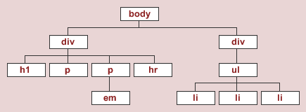

Slide 4
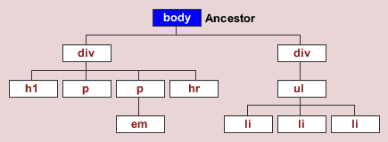

Slide 5
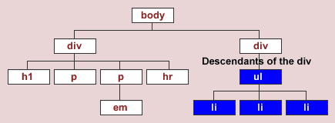

Slide 6
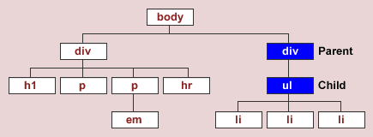

Slide 7
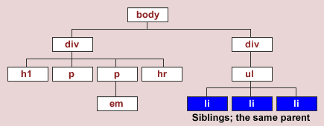

Slide 8
Inheritance
Styles which are passed down from the parent or ancestor element to the children and the descendants.
Inherited properties: (color, background-color, font-family, font-size, and so on)
Non-inherited properties: (border, margin, padding, display, and so on)

Slide 9
Cascade
In CSS, styles sheets cascade by order of importance. If rules in different style sheets conflict with one another, the rule from the most important style sheet wins.
Example: Browser default style, style.css
What happens with conflicts?
Answer: Orders matter

