Slide 1
BENV0091 Lecture 0: Computer Orienteering
Patrick de Mars

Slide 2
Computer Hardware
Input
The hard drive is the long-term storage unit for your computer
When a computer is working on a task (using your central processing unit (CPU)), the instructions and required data are loaded into memory (RAM)
Processing
Memory
CPU
Output
Often memory is the limiting factor in data science!
1 KB = 1000 bytes (B)
1 MB = 1000 KB
1 GB = 1000 MB
1 TB = 1000 GB
Notes:
Let's start with computer hardware. I want to talk about three components: hard drive, memory and CPU (processor). You are probably aware that your hard drive is the main storage component for your computer. It is long term storage: files on there remain even when your computer is switched off. When your computer is working on a task, it pulls data from hard drive into memory. Processing is conducted on data stored in memory. That processing is performed by your CPU. Memory is often a bottleneck in data science! Large files that are bigger than your memory can't easily be worked on without chunking it up into smaller pieces.

Slide 3
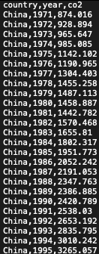
File Formats
Comma-Separated Values (CSV) file
A file’s format determines how it can be dealt with and follow certain conventions
You can’t open a pdf in Excel!
Common (and very handy) file format for data is the CSV (.csv) file
You will need to specify file format when coding
Don’t use spaces in file names! Use snake_case
Notes:
Lots of different file formats that you're probs aware of: txt, pdf etc. The file extension indicates the format. File formats determine what you can do to that file. E.g. can't open a pdf document in Ecel! Some file formats are very complex e.g. MS powerpoint, with complex formatting, animations and a lot more. If you opened that in a text editor it would not be readable. CSV is a file type you will become familiar that is human readable. It is essentially a file format for spreadsheets - you can open with excel. It is much more lightweight than excel though. Have a look on the right hand side. Each column is separated by a comma. The simplicity has benefits and drawbacks: Drawbacks are that you can't include complex formatting that might be useful for a reader. Benefits are that you can handle this file programmatically (i.e. with code) much more easily than an Excel file. You may not have been used to naming files with their extensions - get used to it! It is necessary when you are code as you must be precise. SPeaking of naming files: don't use spaces! Code does not like spaces (in general). Snake case, where spaces are replaced with underscores is a good alternative.

Slide 4
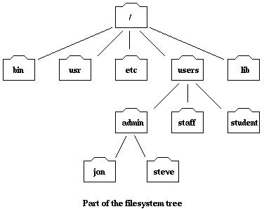
Files and Directories
Directories (AKA folders) are structures for organising files
They follow a hierarchical, tree-like structure with parent directories and sub-directories
The top-most directory is often known as the root
Location of a file or directory is called its path:
/users/admin/steve
Notes:
Now we've covered files, let's think about how they are organised in your computer. You will be aware of folders (AKA directories) as a way of holding files. You are also aware of the fact that you can put folders within folders. A folder inside another folder is called a sub-directory. We can visaulise the entire computer's filesystem as a tree. At the top of the tree is the root, which contains all of the computer's files. Each file or directory has a unique location called its path. E.g. look at Steve.

Slide 5
Managing Directories
/
patrick
guest
project1
project2
data
code
data
code
file1.csv
analysis.R
plots.R
file1.csv
file2.csv
analysis.R
/patrick/project1/code/analysis.R
Same filename – different path!
/patrick/project2/code/analysis.R
Notes:
Let's look at this filesystem that i've mocked up. (Describe). Notice that I have two projects which have very similar sturcture. In fact I have directories with the same name. This might be considered problematic in some cases (what if I need to search for it), but remember these have unique paths! That means my computer does not care if they have the same name. In fact, it is useful to set up projects with the same sturcture, as it helps you stay organised and consistent. You can develop your own conventuiosn, but ultimately you should strive to be as organised as possible. In addition, you should try and keep everything that is related to a particular project in a self-contained part of the filesystem. Try and avoid putting important things like data in the Downloads folder - put them in relevant places!
CLICK
In fact, let's look at an isolated part of the filesystem. We can isolate this project and consider it as its own filesystem.

Slide 6
Working Directory
Setting a working directory makes locating files easier and more concise
We can reference files with relative paths
Keeping a project in a neat sub-directory makes it more transferrable
Be aware of your working directory – it is a common cause of bugs!
Suppose project2 is my working directory
project2
data
code
file1.csv
file2.csv
analysis.R
data/file1.csv
data/file2.csv
code/analysis.R
Notes:
Project 2 is its own filesystem, and we can assign the root of this filesystem to something called the working directory. The working directory is an important concept and cause of issues for people just starting out! Once the working directory is set, we can deal with relative paths. Instead of considering the whole path right the way up to the root, we can reference files in terms of their location relative to the WD. For instance, data/file.csv, not /Patrick/project2… This is helpful for brevity. In addition, organising your filesystem in this way is useful because it is more transferrable to other computers. In summary: keep your computer organised and keep projects in self-contained areas of your filesystem. You can then set a working directory at the root of that filesystem and life becomes easy!

Slide 7
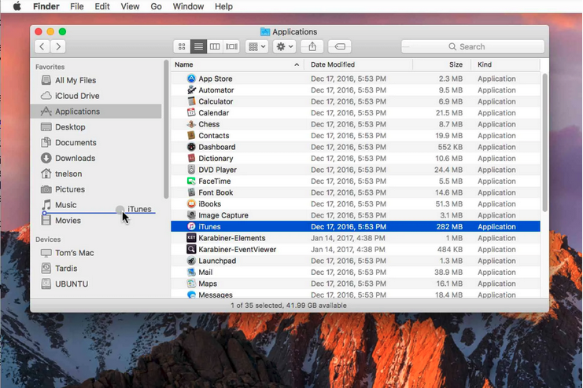
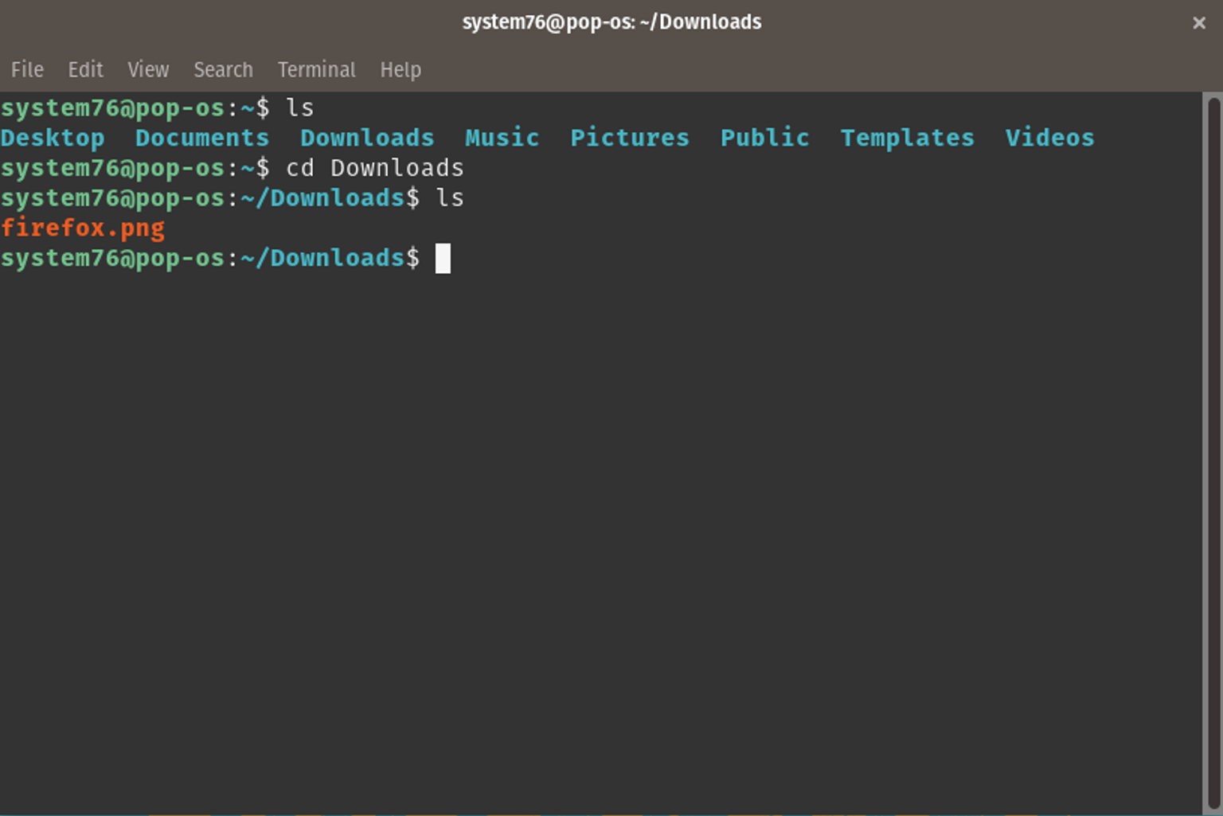
Interfacing with your Computer
Graphical User Interface (GUI)
Command Line Interface (CLI)
Intuitive, easy to pickup
Difficult to automate tasks
Steeper learning curve
Usually more lightweight
Ability to automate tasks
Notes:
Let’s look briefly at how you interface with your computer. There are several ways to do this: most people are familiar with the graphical user interface (GUI). In the GUI, we issue commands by way of clicking on icons, buttons and menus, usually with a mouse. This is intuitive and easy to pick up: new software that has been well-designed can be mastered quickly. By contrast, with the command line interface we use text commands issued on the command line. I will demo this in the next video. This is generally more difficult to get the hang of, but potentially powerful. It is hard to automate tasks with a GUI - relatively straightforward if you’re proficient in CLI. In addition, it’s let’s hard work for your computer - using less RAM and can be quicker. It’s ideal for little tasks such as moving files, downloading/installing software, and you may use it for version control which we will cover later.

Slide 8
To the Command Line!
Notes:
In the next section I’ll provide some details of how to use the command line. Depending on whether you’re a Mac/Linux user or a Windows user, you should watch the relevant video. Thanks for watching!

