Slide 1

BENV0091 Lecture 4
Patrick de Mars

Slide 2
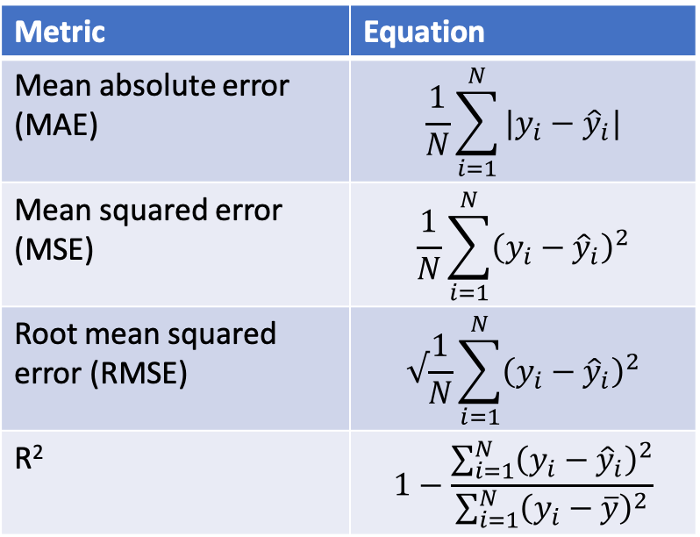
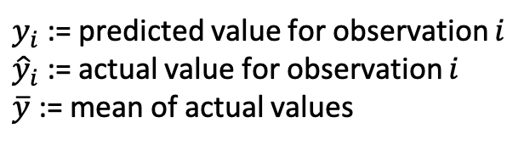
Accuracy Metrics (Regression)
Accuracy metrics for regression
Metric | Equation
Mean absolute error (MAE) | $$\frac{1}{N}\sum_{i=1}^{N}{|y_{i}−{\hat{y}}_{i}|}$$
Mean squared error (MSE) | $$\frac{1}{N}\sum_{i=1}^{N}{{\left(y_{i}−{\hat{y}}_{i}\right)}^{2}}$$
Root mean squared error (RMSE) | $$√\frac{1}{N}\sum_{i=1}^{N}{{\left(y_{i}−{\hat{y}}_{i}\right)}^{2}}$$
R² | $$1−\frac{\sum_{i=1}^{N}{{\left(y_{i}−{\hat{y}}_{i}\right)}^{2}}}{\sum_{i=1}^{N}{{\left(y_{i}−\overline{y}\right)}^{2}}}$$
While final decisions in model selection can come down in part to the data scientist’s intuition or preference, it is also essential to compare models in terms of their error
Common metrics for regression include:
Mean absolute error (MAE)
Mean squared error (MSE)
Root mean squared error (RMSE)
$y_{i}$ := predicted value for observation $i$
${\hat{y}}_{i}$ := actual value for observation $i$
$\overline{y}$ := mean of actual values

Slide 3
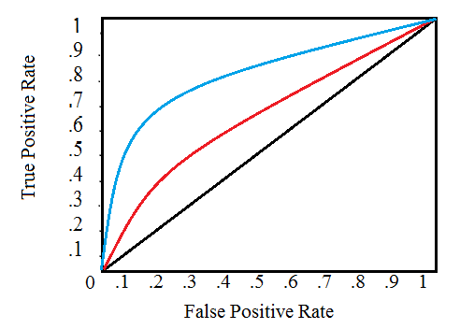
Accuracy Metrics (Classification)
ROC curve
Accuracy measurements for classification include:
Proportion of correct classifications
Area Under the Receiver Operating Characteristic Curve (ROC AUC)
Log loss/cross entropy loss

Slide 4
Model Selection
Hierarchical decisions in model selection
Linear regression
Decision tree
Neural network
Choosing a learning algorithm
There are infinitely many models that can be trained with supervised learning for a given task, but not all will be equally good
We want to choose a model that gives the best performance and has appropriate characteristics for the task
Model selection can broadly be split into 3 components:
Choosing a learning algorithm
Hyperparameter tuning
Model fitting
Model fitting is always done computationally using methods such as gradient descent while the other choices might be made manually based on knowledge of the problem or model requirements
Network architecture
Learning rate
Hyperparameter tuning
Coefficients (linear regression)
Decision rules (decision tree)
Model fitting
Fitting is the process of adjusting model parameters to achieve the best performance - usually minimising a loss function
Notes:
Trouble is that the space of possible models is very large!

Slide 5
Choosing a Learning Algorithm
Clear box
Choosing the learning algorithm automatically can be very computationally expensive, so is often done manually
The choice of model is determined based on:
The model’s predictive power
Interpretability
Computational expense
Linear Regression
Decision Tree
K Nearest Neighbours
Interpretability
Random Forest
Neural Network
Black box

Slide 6
Hyperparameter Tuning
Each learning method has its own hyperparameters which can significantly impact predictive power and convergence time

Slide 7
Overfitting
Models which don’t fit the training data well enough have been underfitted
Models which fit the training data too well have been overfitted
Overfitting is often more of a problem than underfitting
If we did not have a validation set, we would have no way of knowing how our model had performed

Slide 8
Train, Validate, Test
Common approach to splitting data for supervised learning
All labelled data
In order to prevent overfitting, data is split into training and test sets
We can do whatever we like with the training data during model selection
The testing data should only be used once to evaluate the final model
Train
Test
Fit
Validate

Slide 9
How not to do Supervised Learning
The task of supervised learning in practice is to find the best model to fit to our data.
The worst approach: choose a few different models; fit them all to the data; choose the one with the smallest error
Less bad approach: split the data into train and test sets; fit all the models; choose the one which performs best on the test set

Slide 10
Cross-Validation and Bootstrapping

Slide 11
The modelr Package

Slide 12
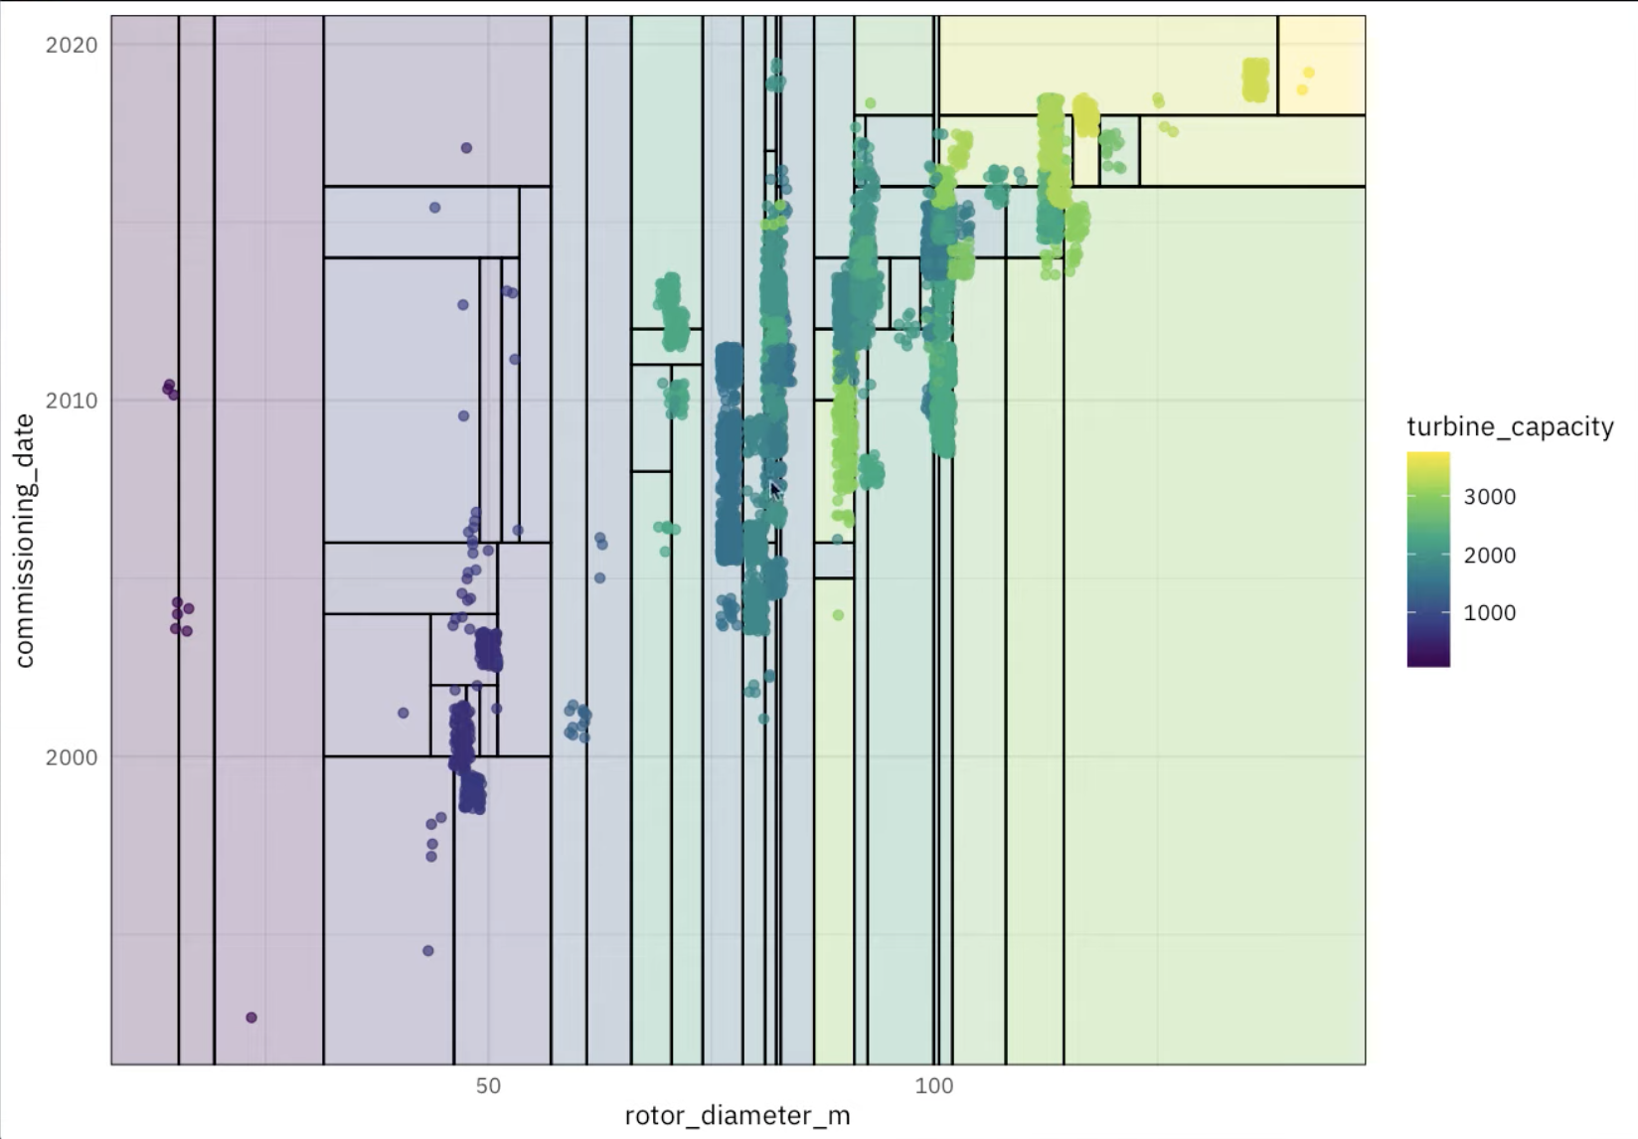

Slide 13
OWID: CO2 Changes for Multiple Countries
Using a for loop and the function written previously, calculate the emissions changes for France, Spain and Germany between 2000 and 2010
Create a custom vector using c(x, y, z)
Include variables in strings using the glue package: library(glue)
E.g. print(glue(“My name is {name}))

