Slide 1
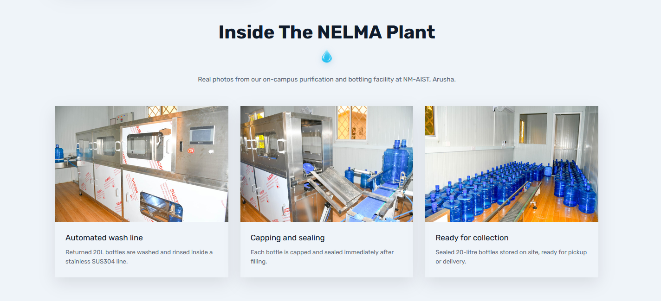

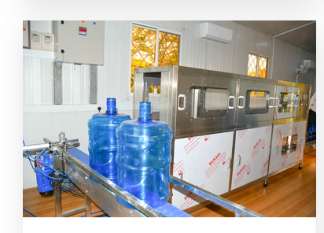

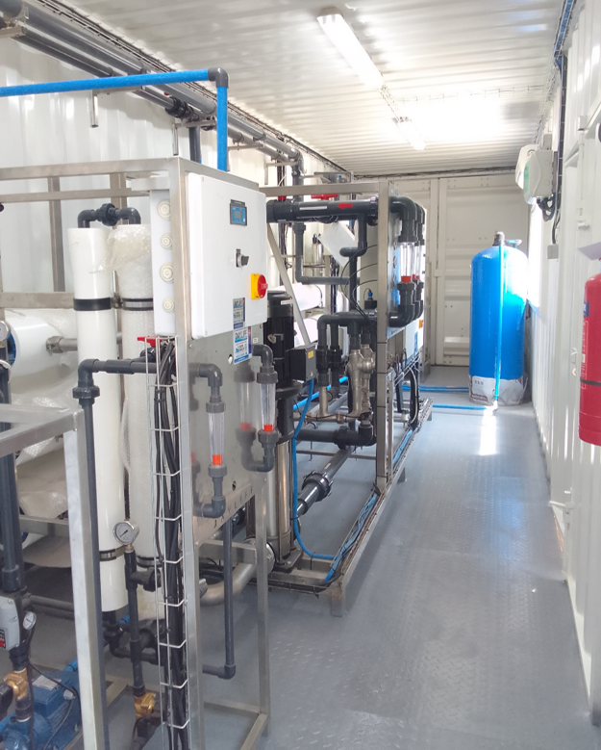
hizi picha ndo zibaki
Pretreatment Tanks.
Pretreatment tanks and control valves forming the initial stage of the water purification process, where incoming water is conditioned and prepared for further purification.
Water Purification System
An integrated purification system where water undergoes successive purification stages, including RO membrane filtration, to achieve the required quality for drinking.
Water Filling Machine
Automated equipment for washing, filling, and capping purified water into 20-litre reusable bottles, ensuring hygienic and efficient packaging.

Slide 2
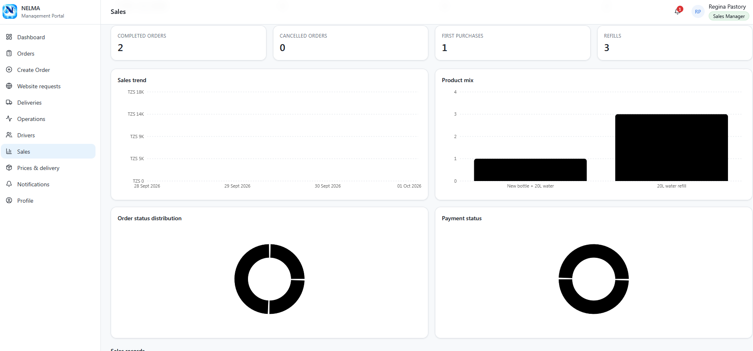
In here just change color of
1.new bottle+20l water bar (iwe blue)
2.20l refill iwe bar (green)
3.hizo cycle za order status distribution na payment status ziwe na rangi tofaut tofauti(blue,green,red….)na percent zake % na ni nini yan mfano kwenye cycle ya payment status 50% ni cash payment(green), 50% bank payment(blue), kwenye cycle ya order status distribution call/text 30% yellow, app 60% orange, website 10% green,whatsapp10% blue sio lazima iziwe rangi hizo(rangi zozote tu)

Slide 3
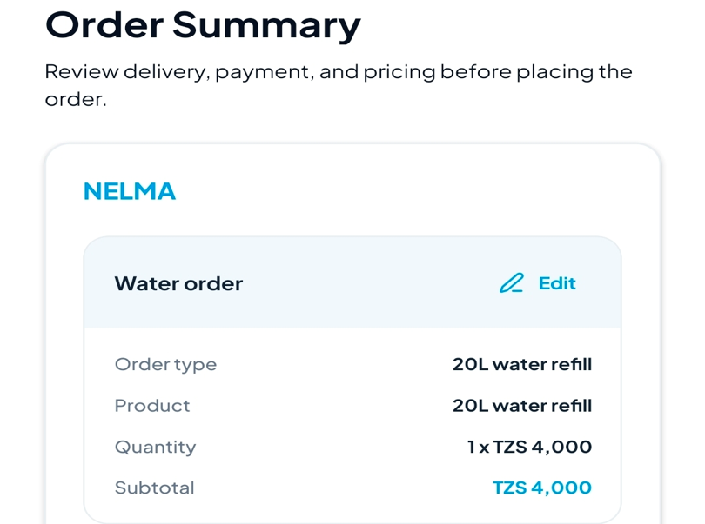
Kwenye app:1. ondoa order type kwenye app:1.ondoa order type
2.app iwe na sehemu ya kuchange language(English or Swahili)

Slide 4
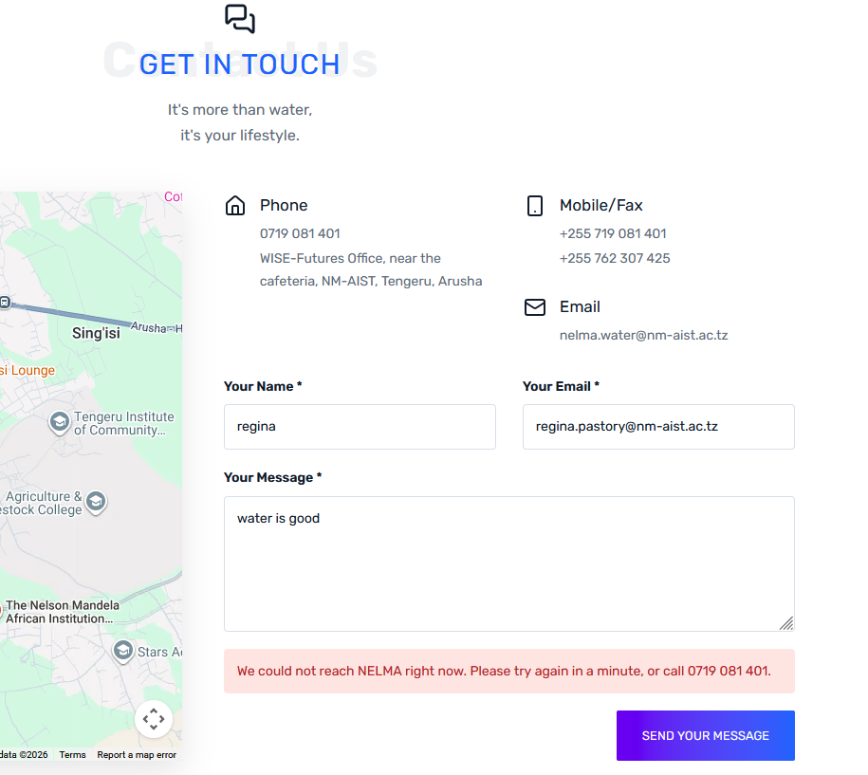
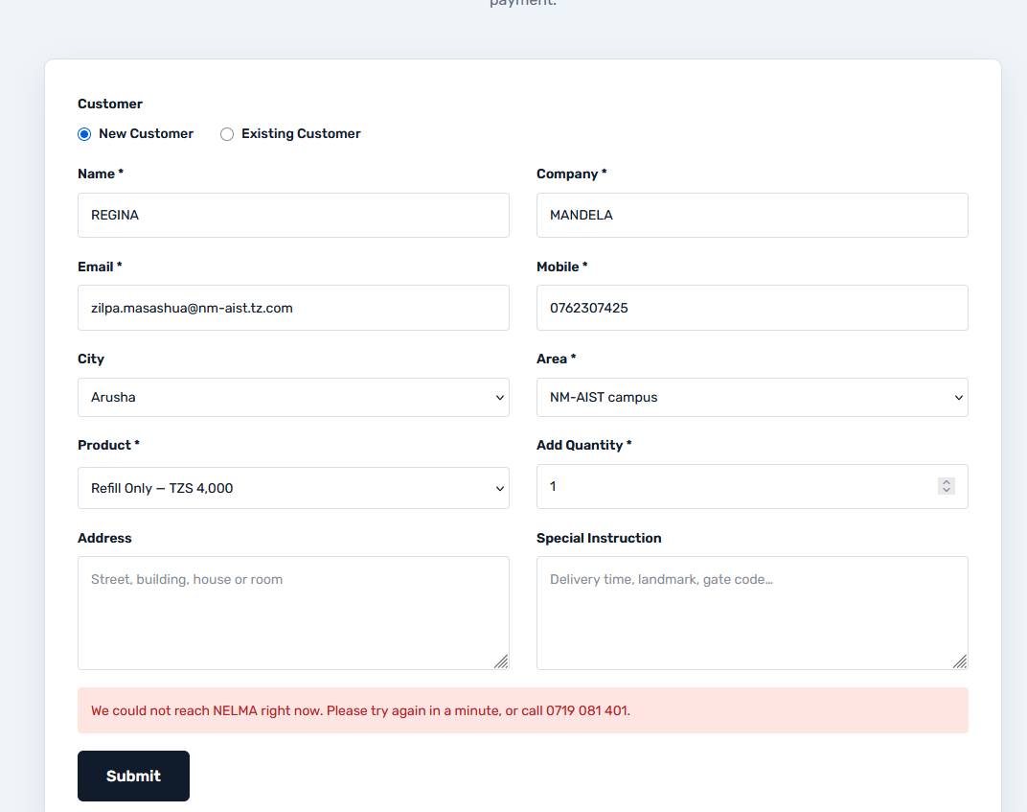
mtu hawezi kuweka order kupitia website(kwenye upande wa kuorder website haijaconnectiwa na management portal)

Slide 5
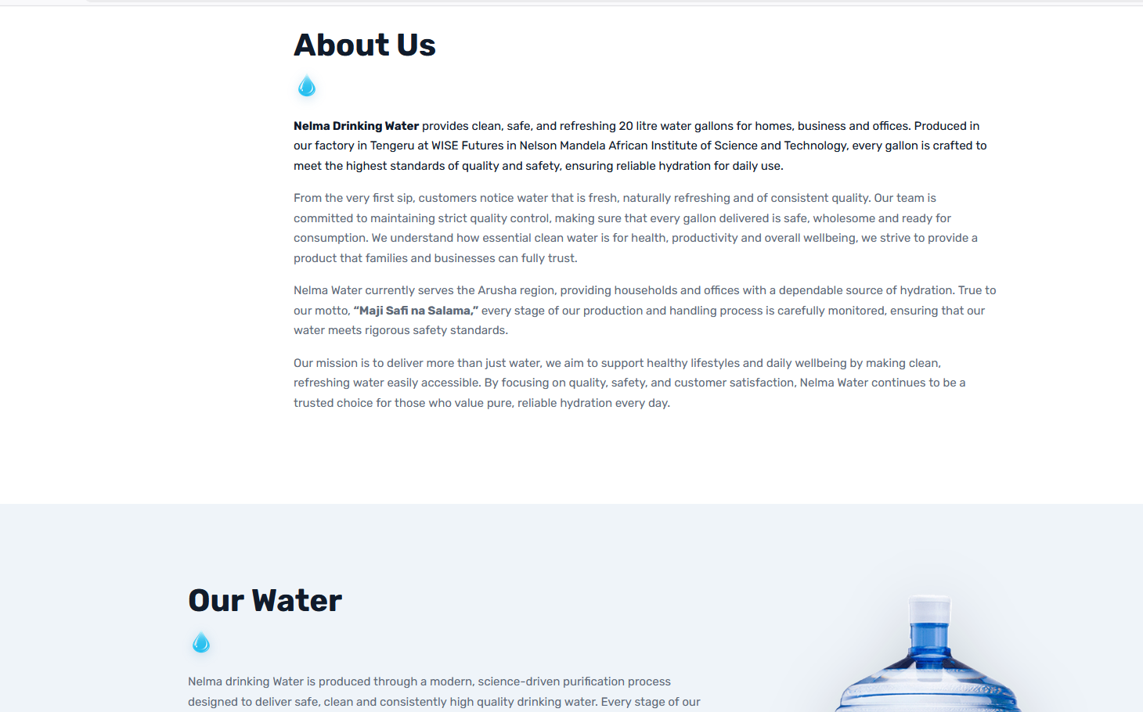
Hapa ni alignment:maneno ya about us yaanze sawa na our water kama mengine

