Slide 1
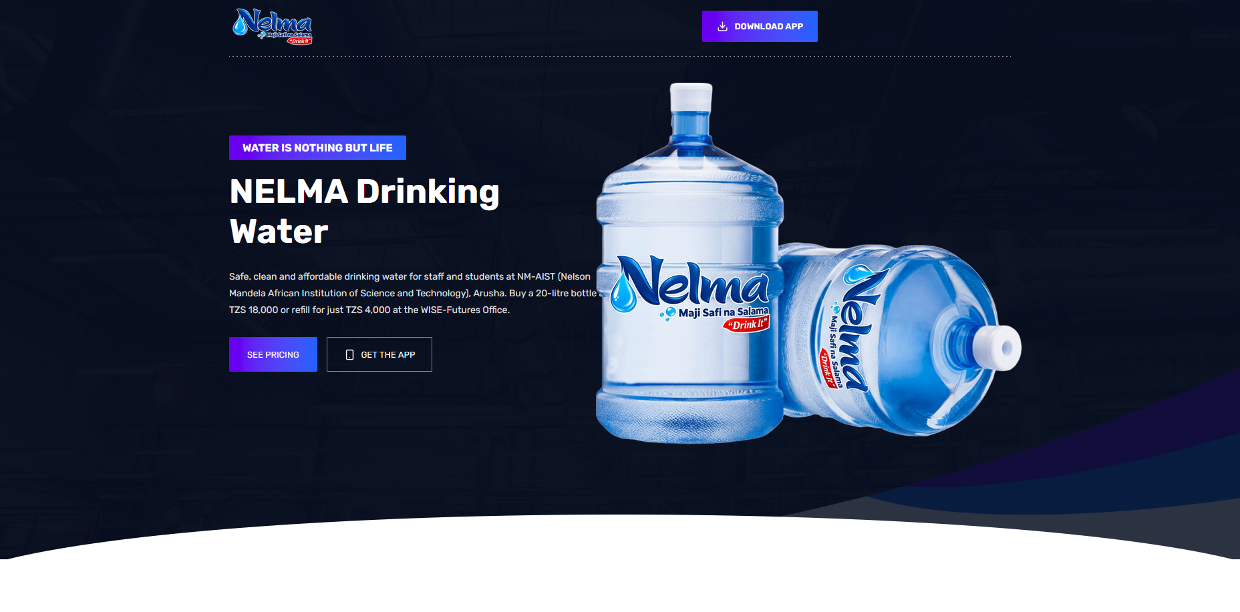





Slide 2
SUGGESTION ON VIEW
IN HOME PAGE
About Us
Nelma Drinking Water provides clean, safe, and refreshing 20 litre water gallons for homes, business and offices. Produced in our factory in Tengeru at WISE Futures in Nelson Mandela African Institute of Science and Technology, every gallon is crafted to meet the highest standards of quality and safety, ensuring reliable hydration for daily use.
From the very first sip, customers notice water that is fresh, naturally refreshing and of consistent quality. Our team is committed to maintaining strict quality control, making sure that every gallon delivered is safe, wholesome and ready for consumption. We understand how essential clean water is for health, productivity and overall wellbeing, we strive to provide a product that families and businesses can fully trust.
Nelma Water currently serves the Arusha region, providing households and offices with a dependable source of hydration. True to our motto, “Maji Safi na Salama,” every stage of our production and handling process is carefully monitored, ensuring that our water meets rigorous safety standards.
Our mission is to deliver more than just water, we aim to support healthy lifestyles and daily wellbeing by making clean, refreshing water easily accessible. By focusing on quality, safety, and customer satisfaction, Nelma Water continues to be a trusted choice for those who value pure, reliable hydration every day.

Slide 3
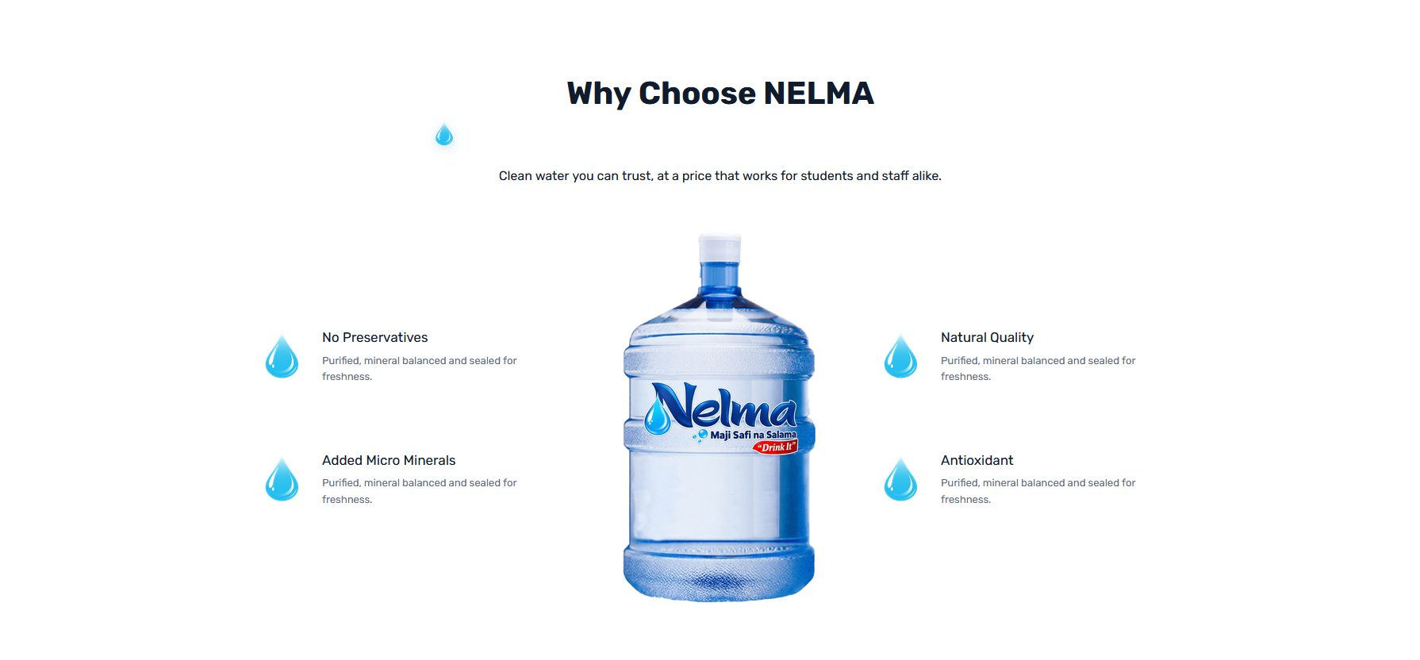
IN OUR WATER PAGE
Our Water
Nelma drinking Water is produced through a modern, science-driven purification process designed to deliver safe, clean and consistently high quality drinking water. Every stage of our production follows strict hygiene protocols, advanced filtration methods, and continuous monitoring, ensuring the water that reaches our customers meets the highest safety standards.
We source our water and refine it using a carefully structured multi-stage purification system that effectively removes impurities while maintaining a smooth and refreshing drinking experience. Each part of the process is precisely managed to uphold quality, stability and consistency in every batch.
Our commitment to excellence, innovation, and reliability drives us to continually improve our systems in line with evolving consumer needs and regulatory requirements. This dedication to quality is what defines Nelma Water clean, safe, and trusted by the communities we proudly serve.

Slide 4
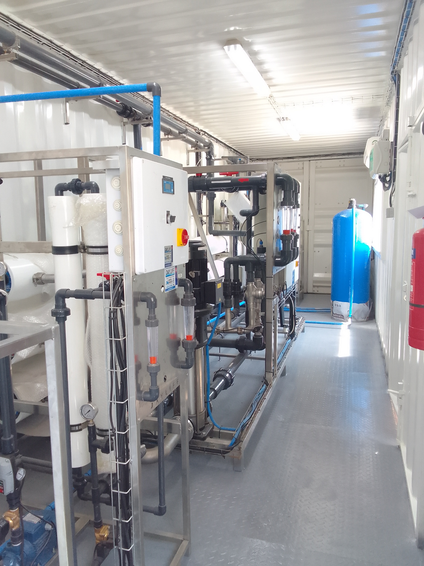
Our Process
Nelma Drinking Water is produced through a 10-stage purification process to ensure clean, safe, and refreshing drinking water. The process begins with carefully selected source water, followed by sediment, sand, activated carbon, and micron filtration to remove particles, impurities, unwanted tastes, and odors.
The water then passes through Reverse Osmosis (RO) membranes, which remove dissolved salts, contaminants, and microorganisms at a very fine level. It is then treated with UV sterilization and ozone disinfection to provide additional protection and maintain freshness.
Throughout the process, water quality is regularly monitored and tested to ensure safety and consistency. Finally, the purified water is hygienically bottled and sealed to preserve its quality until it reaches your home or office.

Slide 5
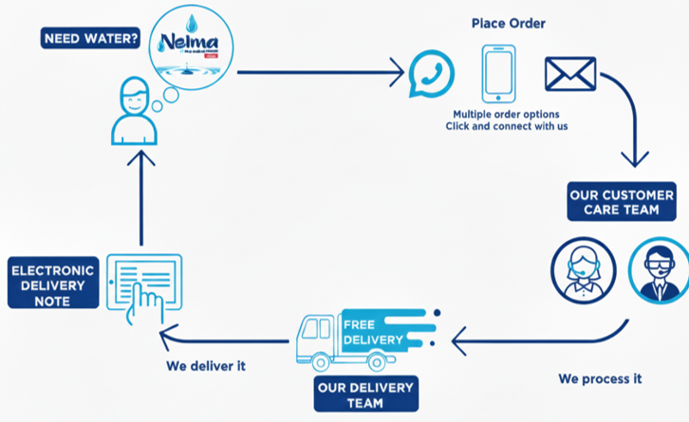

Delivery
We know life is busy, and convenience matters. A 20-litre bottle of water is heavy, but our specialized delivery team takes care of the lifting for you! When you buy 20 bottles or more, delivery is done across all our service areas, whether you are a large office, a small shop or a home.
Our deliveries run on scheduled routes, ensuring you receive your water on a reliable, regular basis. If you ever run out unexpectedly, we can accommodate same-day or urgent delivery to keep you stocked. Ordering is easy you can reach us via phone, WhatsApp, email, or our website at any time.

Slide 6
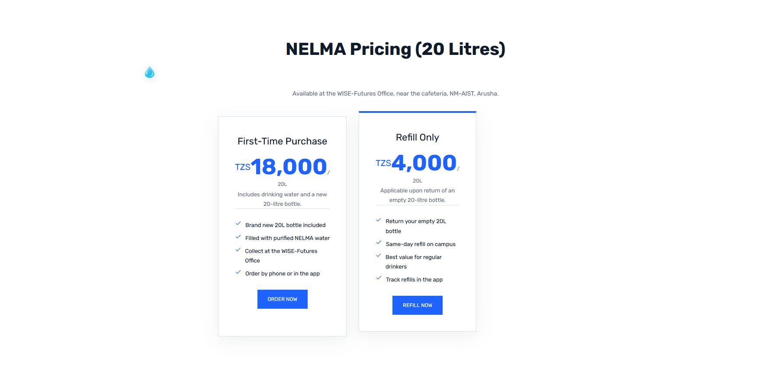

IN PRICING PAGE

Slide 7
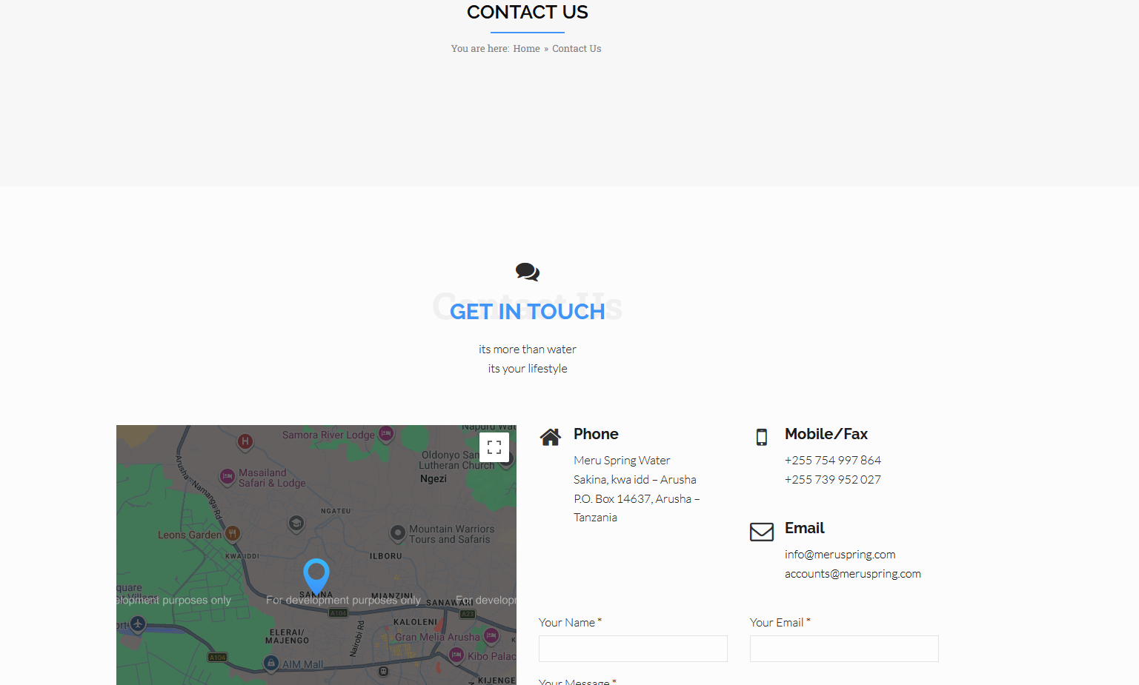
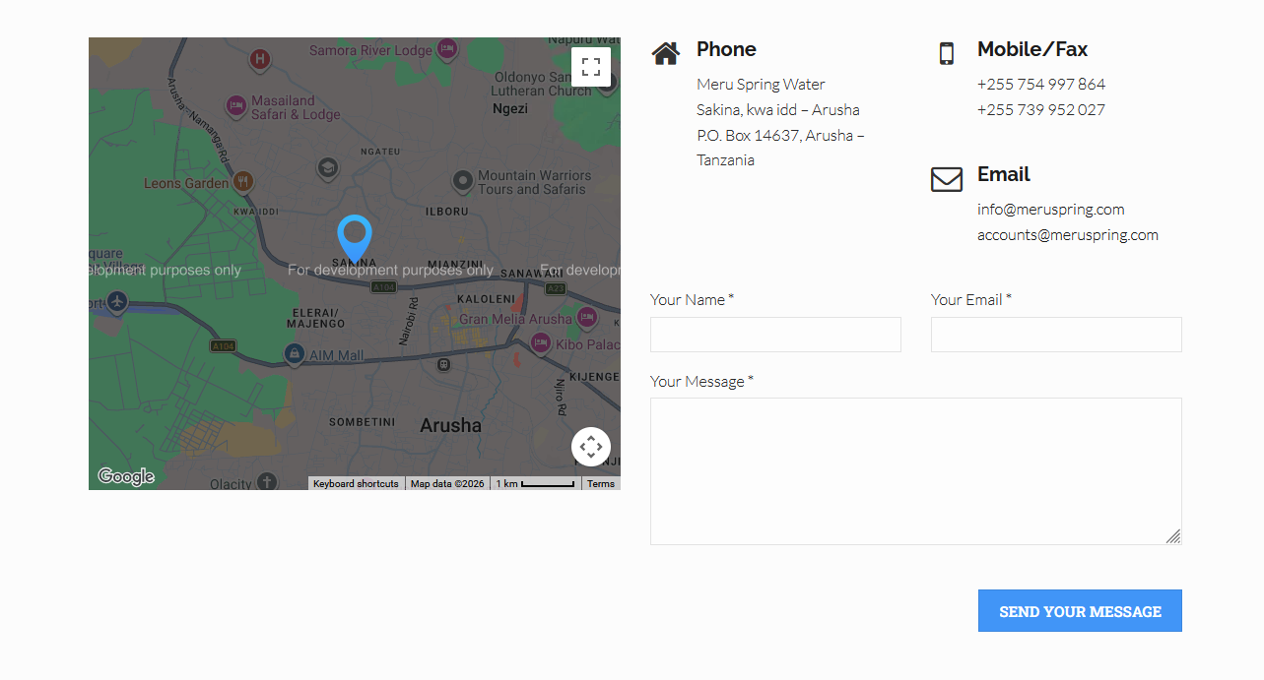





IN CONTACT US PAGE

Slide 8
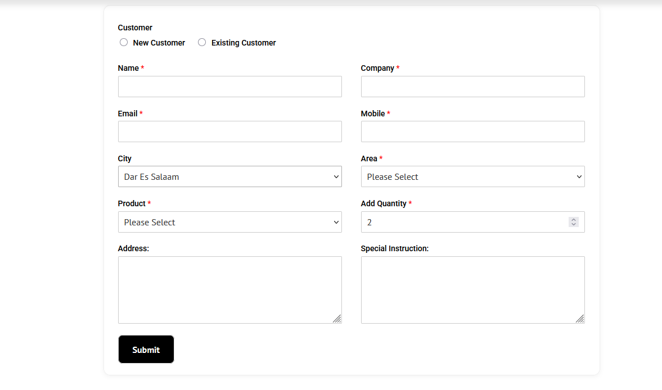
IN ORDER NOW PAGE

Slide 9
CHANGE THIS HOME PAGE :

Slide 10
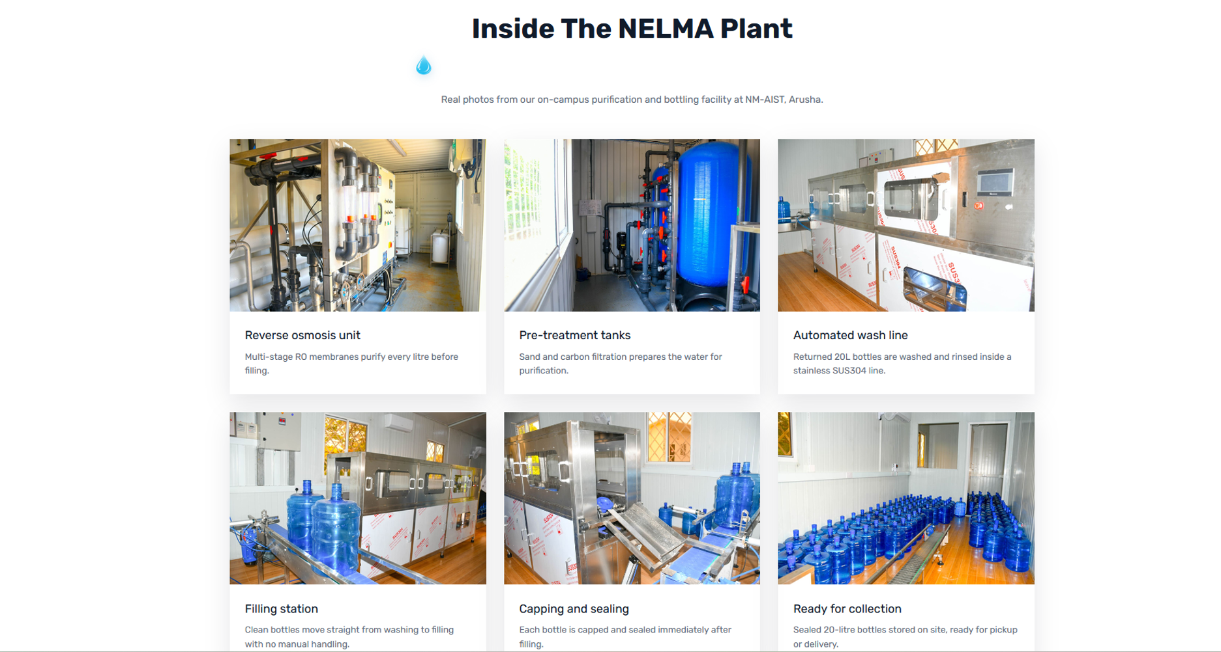
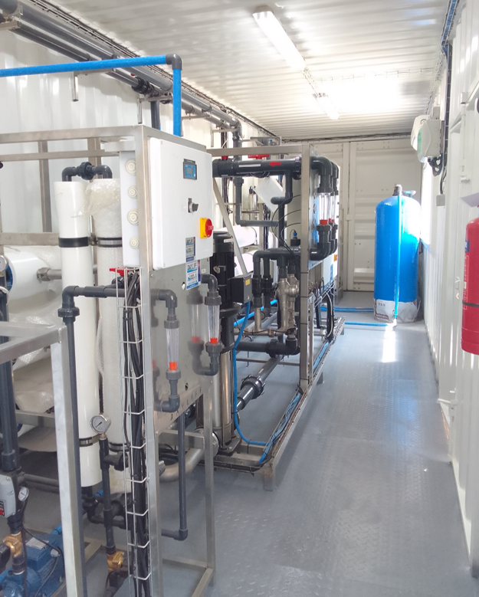
REMOVE 3 IMAGE

Slide 11
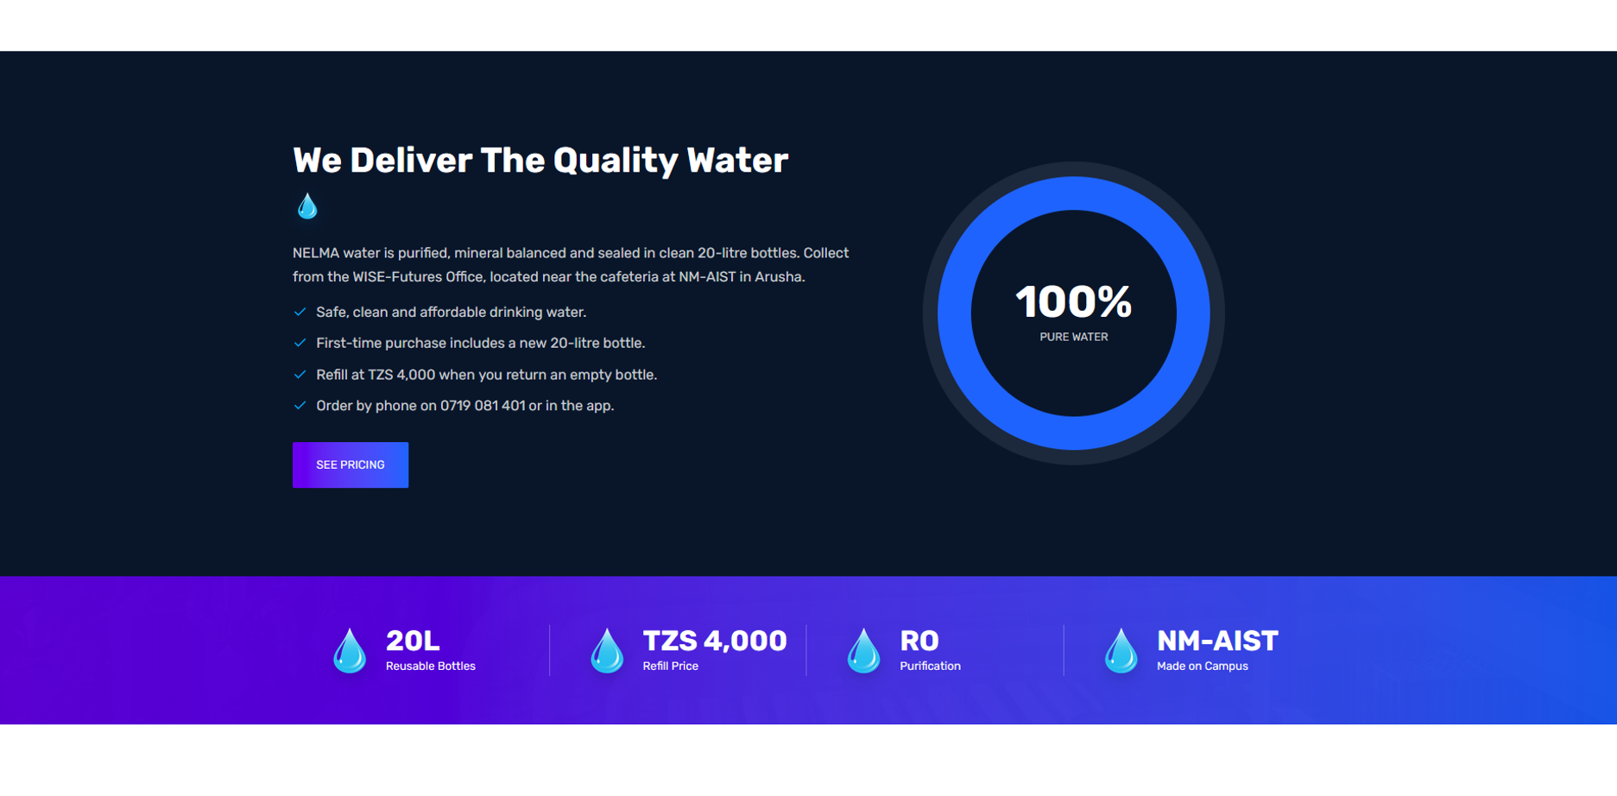
REMOVE THIS

Slide 12

REMOVE

Slide 13
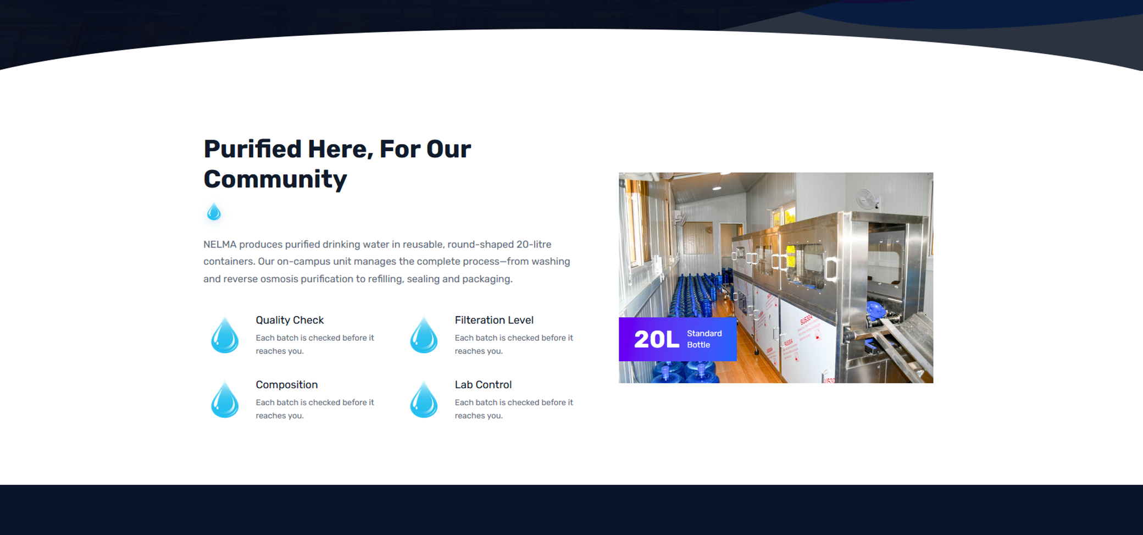
REMOVE

Slide 14
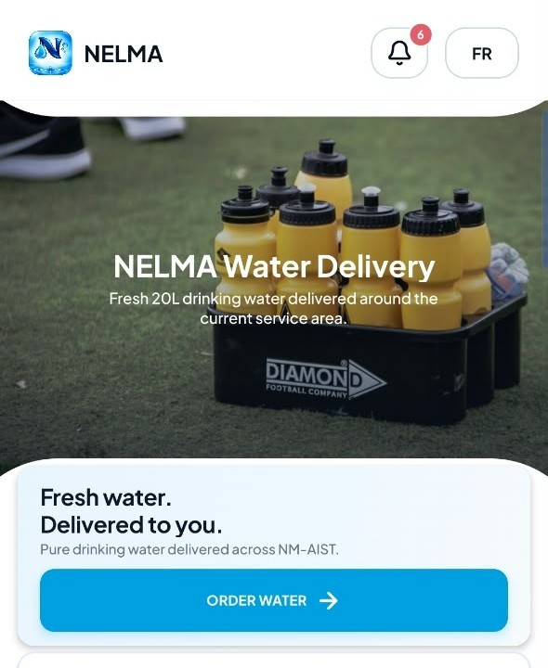
CHANGE THAT BACKGROUND IN APP

Slide 15
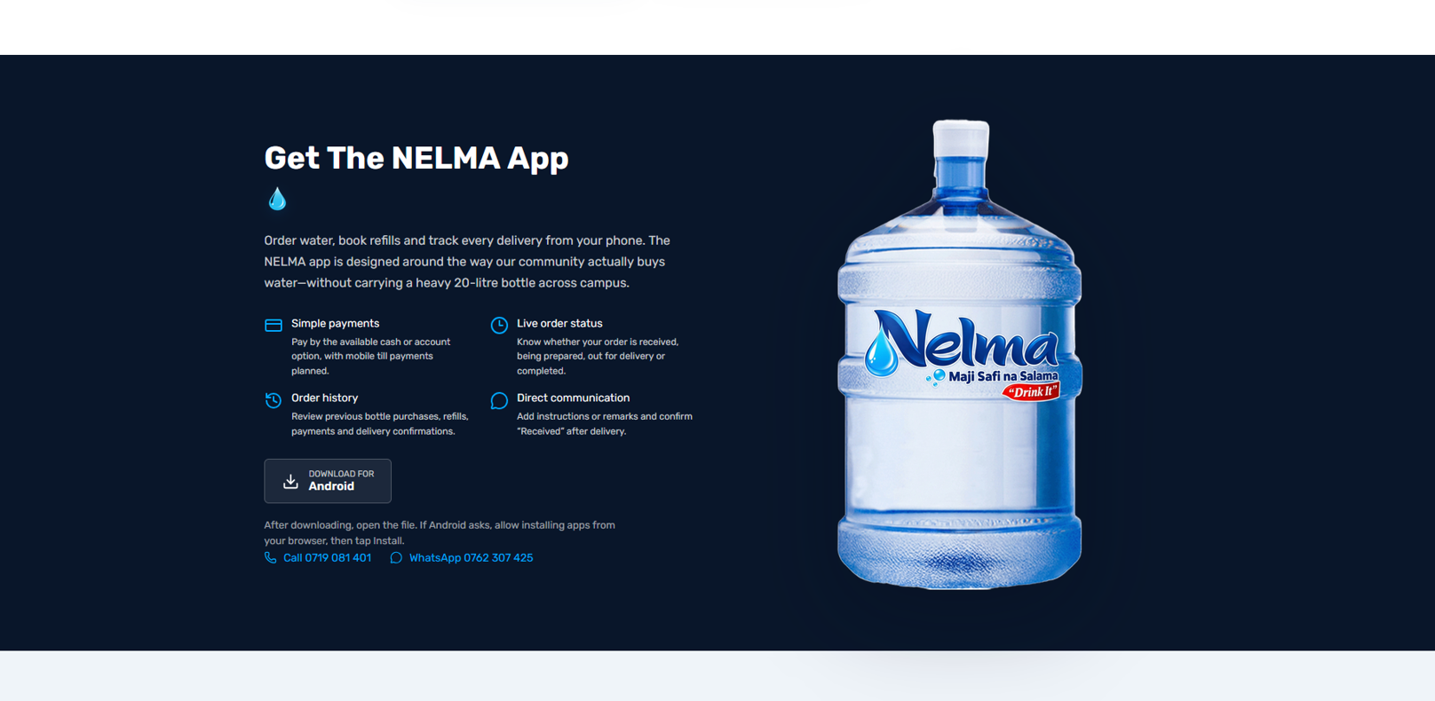
REMAIN

Slide 16

REMOVE/REMAIN

Slide 17
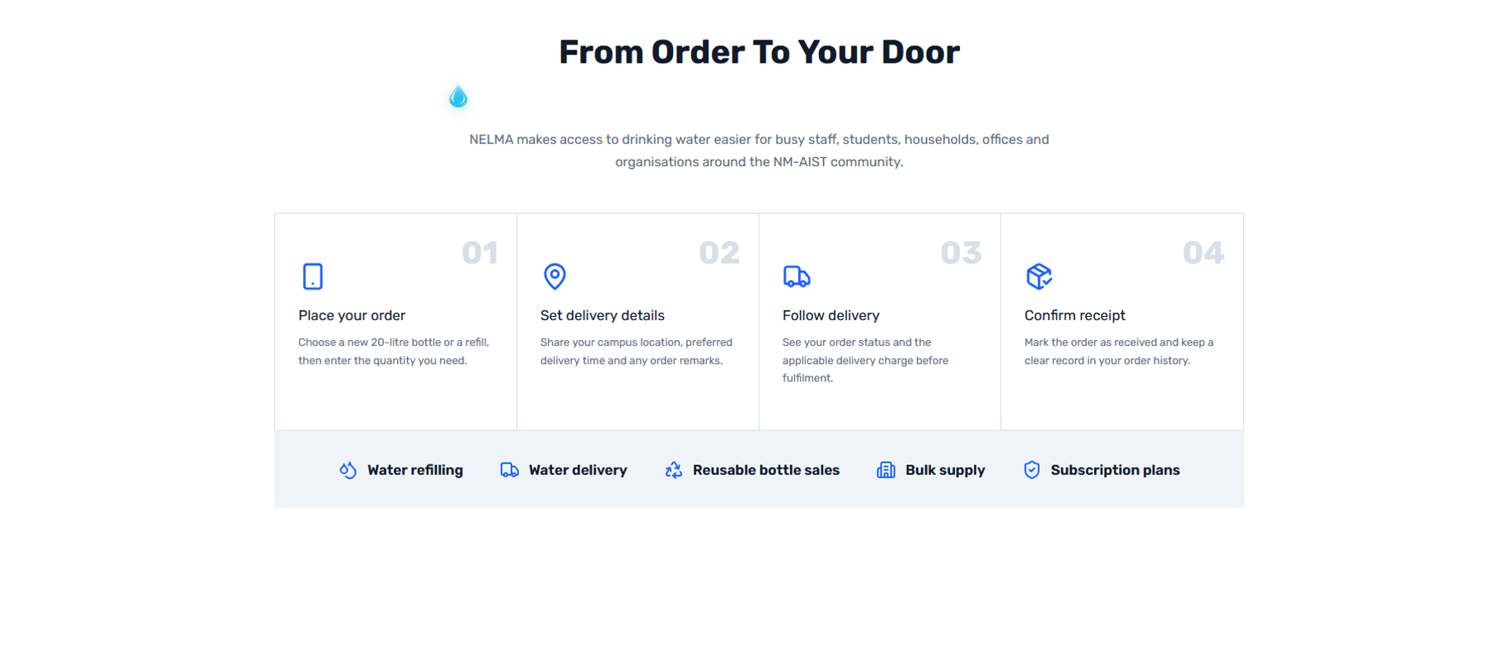
REPLACE/REMAIN

Slide 18
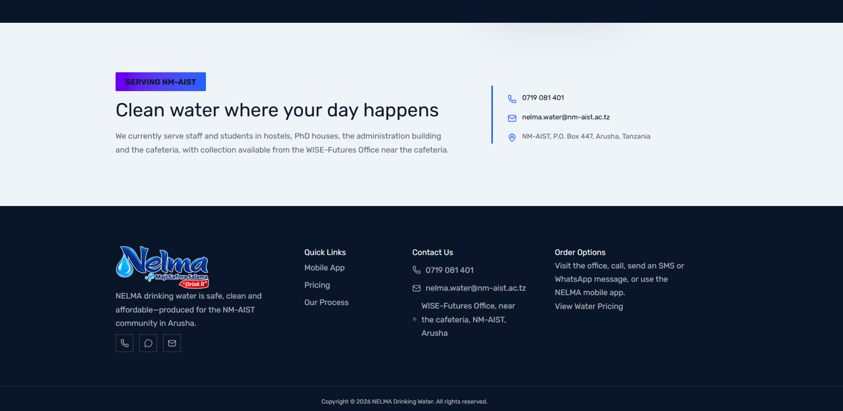
REMAIN

