Slide 1
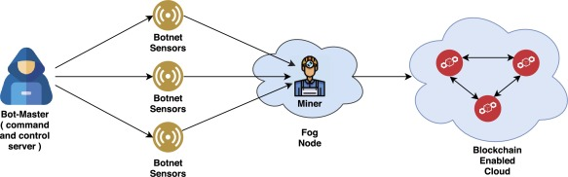
Detecting DDoS Attacks in Blockchain-enabled IoT Networks using Distributed Intrusion Detection System and Machine learning
Team Members:
Divyansh Bisht, Manu Shukla, Manthan Kojage, Hrugved Wath and Kartavya
Mentor: Dr. Sandeep Kumar Shukla

Slide 2
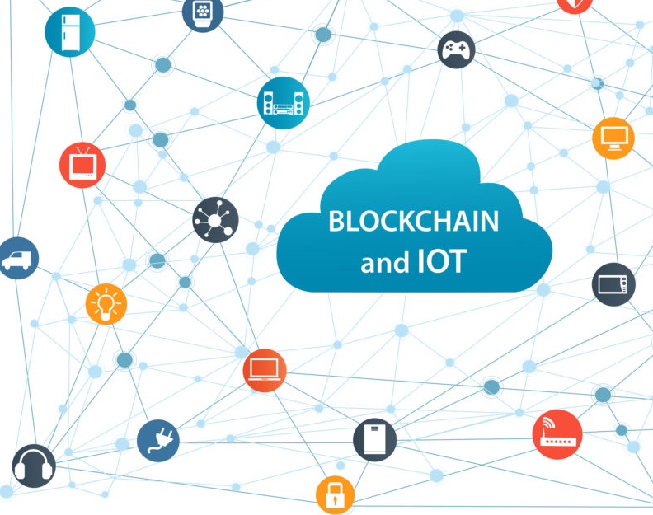
Introduction
The Internet of Things (IoT) is emerging as a new technology for the development of various critical applications. However, these applications are still working on centralized storage architecture and have various key challenges like privacy, security, and single point of failure.
Blockchain can be leveraged to solve privacy, security, and single point of failure (third-part dependency) issues of IoT applications. Thus, it has emerged as a backbone for the IoT-based application development.
However, there are numerous security problems and challenges occur in the mining pool of blockchain-enabled IoT network.
One of these are the Distributed Denial of Service (DDoS) attack on mining pool which have exposed the critical fault-lines among blockchain-enabled IoT network.
In order, to detect these DDoS attacks, a secure and robust security mechanism is required.

Slide 3

Motivation
Ensuring
Ensuring distributed security framework for blockchain-based IoT network.
Ensuring
Ensuring a security mechanism uses appropriate analytical tool in a distributed working architecture and is capable of handling huge data generated by IoT devices in a distributed manner.
Building
Building an effective IDS that can differentiate normal and attack transactions.

Slide 4
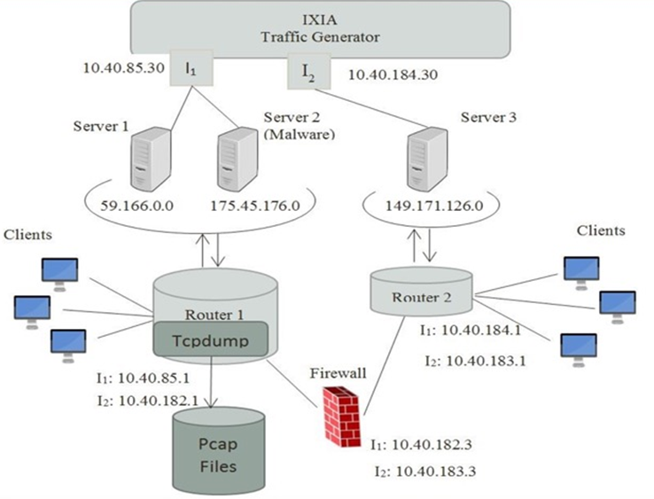
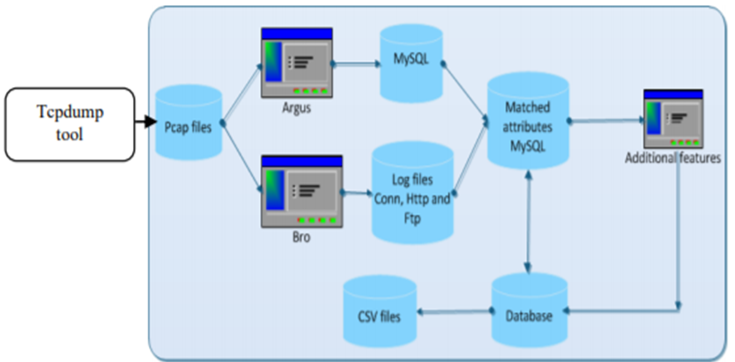
BoT-IoT Dataset |UNSW Canberra
The BoT-IoT dataset was created by designing a realistic network environment in the Cyber Range Lab of the UNSW Canberra. The environment incorporates a combination of normal and botnet traffic. The dataset’s source files are provided in different formats, including the original pcap files, the generated argus files and csv files. The files were separated, based on attack category and subcategory, to better assist in labeling process. Further details about the dataset will be provided as the presentation progresses as many different version of the dataset are there now.

Slide 5
BoT-IoT Dataset - (1)
Bot IoT dataset was generated with the help of Ostinato Tool. Ostinato tool is used to generate realistic data with the help of a cloud server consisting of Virtual Machines and Kali machines. In the Kali machines, DNS, SSH, FTP, HTTP and various other services were deployed. Node red tool was used for the simulation of IoT devices and MQTT protocol was used for communication between IoT devices.
Five IoT scenarios were implemented in cloud server to collect the dataset:
A weather station
A smart fridge
Motion activated lights
A remotely activated garbage door
A smart thermostat
We used this dataset because this version was mainly built of the Dos/DDos attacks which originally was the motive to solve.

Slide 6
Description of the Bot-IOT(1) dataset
FEATURE​ | DESCRIPTION​
seq​ | Argus sequence number​
stddev​ | Standard deviation of aggregated records​
N_IN_Conn_P_SrcIP​ | Number of inbound connections per source IP.​
min​ | Minimum duration of aggregated records​
state_number​ | Numerical representation of the feature state​
mean​ | Average duration of aggregated records​
N_IN_Conn_P_DstIP​ | Number of inbound connections per destination IP.​
drate​ | Destination to source packets per second​
srate​ | Source to destination packets per second​ ​
max​ | Maximum duration of aggregated records​ ​
Attack | Class label: 0 for Normal traffic, 1 for Attack Traffic
Category | Traffic category
Subcategory | Traffic Subcategory
We have performed data exploration techniques on our BoT-IoT dataset.
Several features were present in the dataset, but only a few were useful. So, we found out the ten best features and started working on the same.
We selected our target features too, namely "attack", "category" and "subcategory".
The ten best features we found with the target features are given:

Slide 7
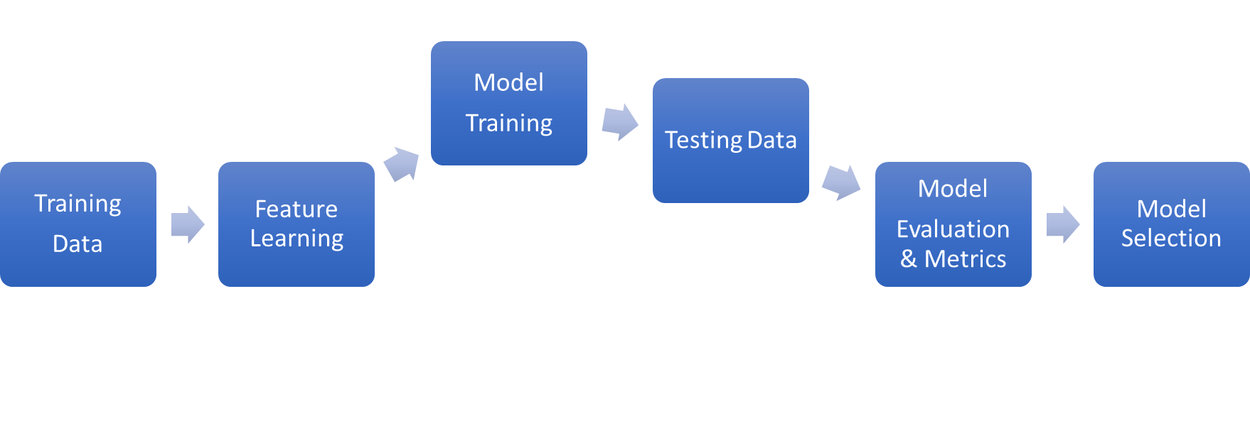
Modelling Architecture

Slide 8
LOGS CLIENT
DATABASE(MYSQL)
BACKEND(NodeJS)
MODEL(PYTHON)
FRONT END (REACT)
CLIENT 1
CLIENT 2
CLIENT N
SERVER
FRONTEND(React)
Client-Server App Architecture

Slide 9
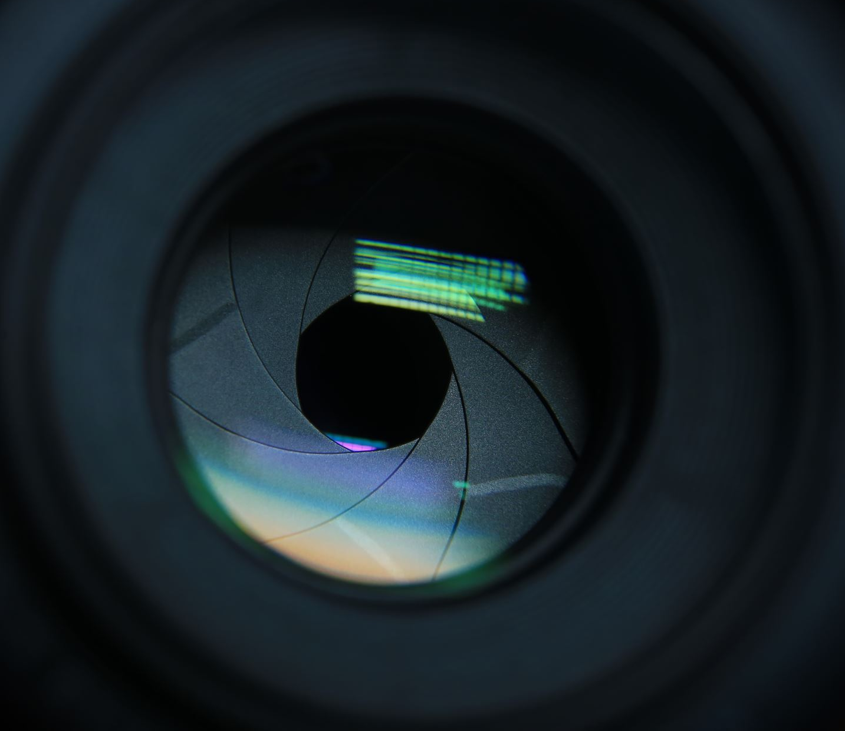
Demo:
https://drive.google.com/file/d/10vA2L-M5j8WI4btDVXH_neq8AlJsytBe/view?usp=sharing

Slide 10
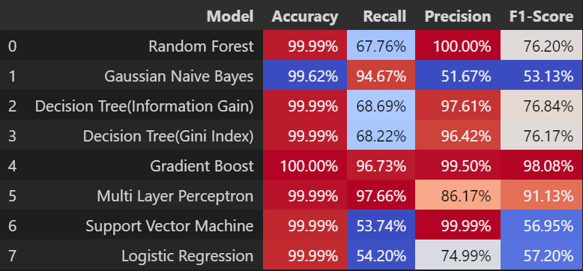
Model Performance Evaluation on the BoT-IoT Dataset(1)
Note : Calculation of metrics are done for each label by find their unweighted mean. This does not take label imbalance into account.

Slide 11
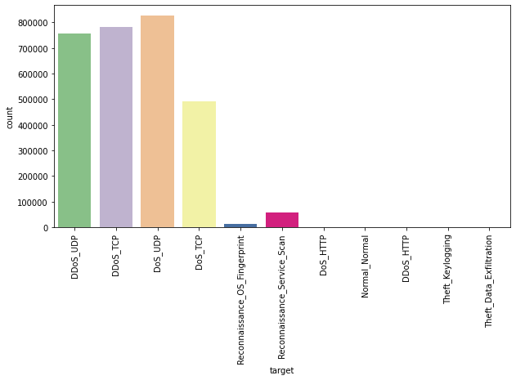
Problems Faced
The dataset on which we evaluated our models was an extraction of the original UNSW-NB15 Dataset which was consisting attacks like DoS, DDoS, Reconnaissance and Theft attacks., with the DDoS and DoS attacks further organized, based on the protocol used(TCP/UDP).
We noticed from the model evaluation done on this dataset that the False Positives for the normal traffic was causing an issue.
We found out that the extracted dataset was highly biased containing majority traffic as an attack and thus our models are giving us high accuracy because as the majority of the traffic were attacks, the model is predicting it correct that whereas, for normal traffic even if the model is predicting an attack , it won't affect the accuracy significantly.
We then proceeded with a different dataset which was also based on UNSW NB15 dataset.

Slide 12
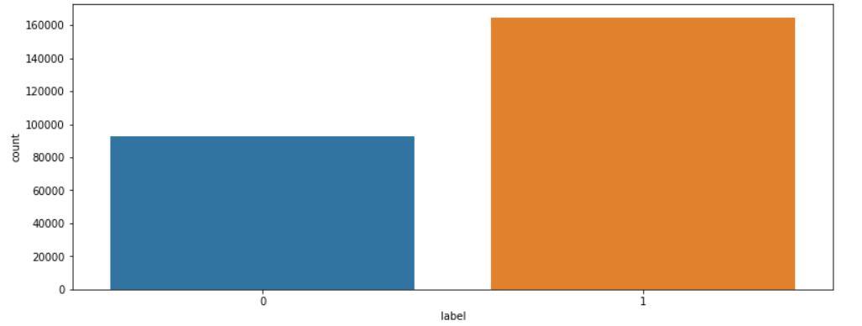
Resolution for the problem: BoT-IoT Dataset (2) / UNSW-NB15 Datatset
The previous problem of the dataset being highly biased was resolved when we used the new dataset as the class ratio in that dataset was 0.6:1 for attack and normal traffic.
The plot shows the class ratio where counts are the no. of traffic for that label which are being 1 for attack and 0 for normal traffic in the dataset.

Slide 13
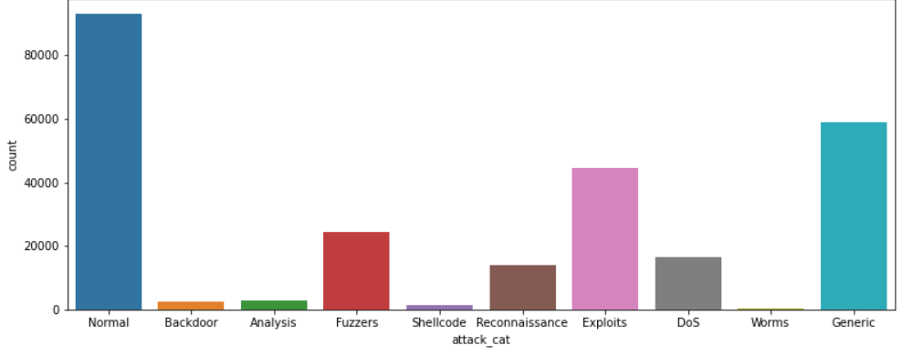
Further, the attacks are categorized into Backdoor, Analysis, Fuzzers, Shellcode, Reconnaissance, Exploits, DDoS, Dos, Worms, Generic attacks.
The following distribution shows the counts of each of those attack category traffic in the dataset compared with the normal traffic.

Slide 14
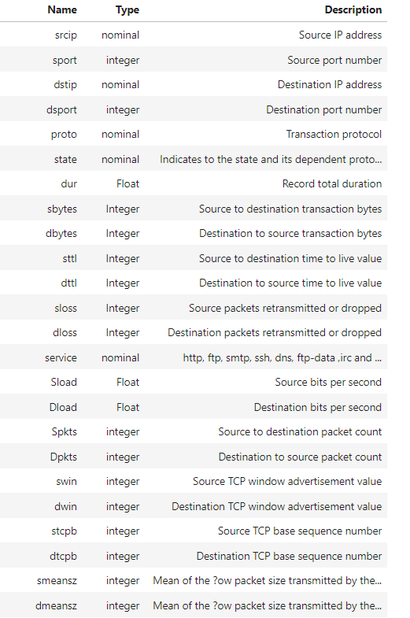
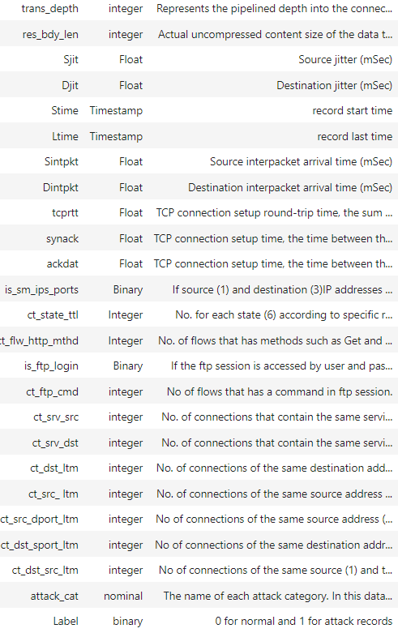
Following table explain the meaning of each feature of the dataset with its type.

Slide 15

Feature engineering on the BoT-IoT dataset(2)
We performed feature engineering on the dataset like, we kept one feature from a set of highly correlated features
We applied CLAMPING which is pruning the extreme values to reduce the skewness of some distributions
We applied log function to nearly all numeric, since they are all mostly skewed to the right
We reduced the cardinality of the categorical features to <= 6 since all of them had mostly < 6 classes that formed the majority and dimensionality will not explode when encoding is done later

Slide 16
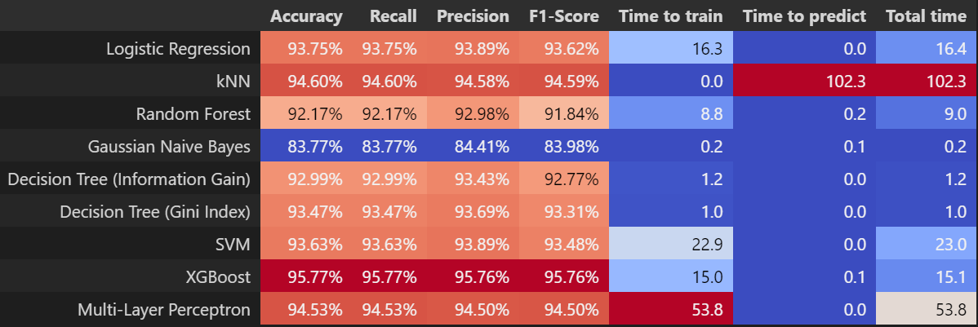
Model Performance Evaluation on the BoT-IoT Dataset(2)

Slide 17
Web App Architecture
Training
Data
Feature Engineering
Model Training
Testing Data
Model Evaluation & Metrics
Model Selection
Predicting real-time using our saved model
Data generation has 2 options – attack and normal
Creating a Web Page and Generating random traffic from the remaining 95% of the UNSW-NB15
Saving the model using pickle

Slide 18
User Interface:
https://drive.google.com/file/d/1OEZhIerYh-UR0XRIryHXFBF9_FuRto7a/view?usp=sharing

Slide 19
Conclusion
XGBoost gave the best performance among all algorithms for the BoT-IoT dataset.
The accuracy given by XGBoost was 95.77%.
The latency is also less as time to predict was only 0.1s only by XGBoost.
The data generated by these applications(DDoS) are huge, which causes big data related issues.
Thus, to address this issue ML can work as an analytical tool that provides useful information to decision making, classification, prediction and detection of future actions in blockchain-enabled IoT network.

Slide 20
Artifacts
Research Paper: https://www.sciencedirect.com/science/article/pii/S0743731522000351
BoT-IoT Dataset(1): https://cloudstor.aarnet.edu.au/plus/s/umT99TnxvbpkkoE?path=%2FCSV%2FTraning%20and%20Testing%20Tets%20(5%25%20of%20the%20entier%20dataset)%2F10-best%20features%2F10-best%20Training-Testing%20split
BoT-IoT Dataset (2): https://cloudstor.aarnet.edu.au/plus/index.php/s/2DhnLGDdEECo4ys?path=%2FUNSW-NB15%20-%20CSV%20Files%2Fa%20part%20of%20training%20and%20testing%20set
Models: https://github.com/manu1003/BoT-IoT
Client-Server App: https://github.com/manu1003/BoT-IoT/tree/ruke
Web-App: https://github.com/manu1003/BoT-IoT/tree/main/FRONT

Slide 21

THANK YOU!

Slide 22


Contributions:
Contributions | Divyansh Bisht | Manthan Kojage | Manu Shukla | Hrugved Wath | Kartavya
ML model train
2. Datasets searching, combining and filtering
3. Feature selection
4. Model's performance analysis
5. Client-server app
6. Front end web app
7. Testing on unseen data
8. Slides work
9. Report

