Slide 1
UE Informationsvisualisierung (186.143) CS2 Budapest Major - Match Data Visualization
Benjamin Weber (12025956), Csikos Mate (12535753),
Jack Maerschand (52202487)
Institute of Visual Computing & Human-Centered Technology, TU Wien, Austria

Slide 2
Research Question & Motivation
How can interactive visualization reveal hidden patterns in professional CS2 match data - covering economy management, positional tendencies, aim profiles, and side-specific performance - and what do those patterns tell us about team strategy and individual player roles?
Specific angles we investigated:
Are there positional patterns across maps that reveal strategic decisions or default setups?
What is the relationship between headshot percentage and kills per round?
Does playing CT vs T side measurably impact individual and team performance?

Slide 3
Data & Preprocessing
Source: Raw .dem files downloaded from HLTV.org (8GB+)
These files log every server tick: player positions, weapon fires, economy changes, grenade trajectories - all down to the millisecond.
Pipeline: Parsed using the awpy library into 7 structured CSVs:
Player stats, match details, economy, positions, player outcomes, team outcomes, weapon kills
Key challenge: Position data had to be downsampled from 128 ticks/sec to 8 samples/sec, then binned into spatial grids to make heatmap generation feasible

Slide 4
Data & Preprocessing
Raw .dem files
8 Gigabytes
Python Processing Scripts
CSV Files
Player Statistics
Match Details
Team Outcomes
Player Positions
Round Economy
Notes:
Player stats, match details, economy, positions, player outcomes, team outcomes, weapon kills

Slide 5
Data & Preprocessing
Key challenge: Position data had to be down sampled from 128 ticks/sec to 8 samples/sec, then binned into spatial grids to make heatmap generation feasible
Key challenge: Parsing the .dem files was challenging due to limited documentation. (Used AI Agent to review AWPY Python package)

Slide 6
Visualization Methods
Built with Plotly + Streamlit as an interactive dashboard. Five visualizations:
Position Heatmap: Player density overlaid on actual map images using custom coordinate conversion
Headshot % vs KPR Scatter: Bubble chart with regression trendline and team-colored clusters
Spider Chart: Radar comparing 1-2 players across combat + utility metrics (Deaths inverted)
CT vs T Diverging Bar: Side-specific stats, hover reverses normalization to show raw values
Economy Timeline: Team economy across rounds, lines broken at halftime/OT boundaries

Slide 7
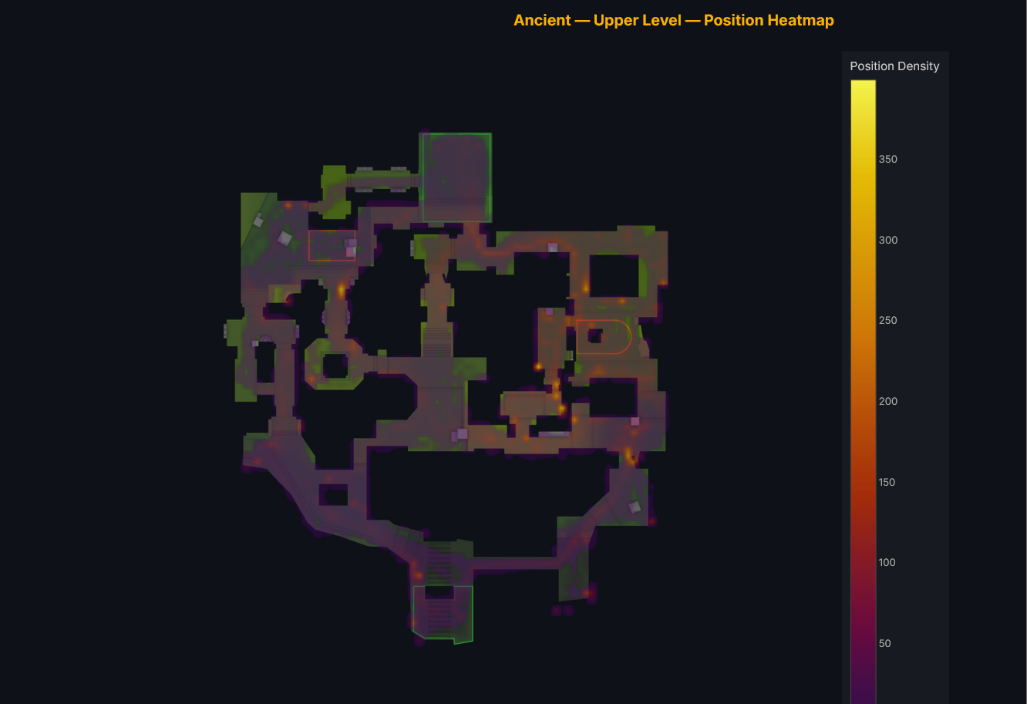
Visualization Methods
Position Heatmap

Slide 8
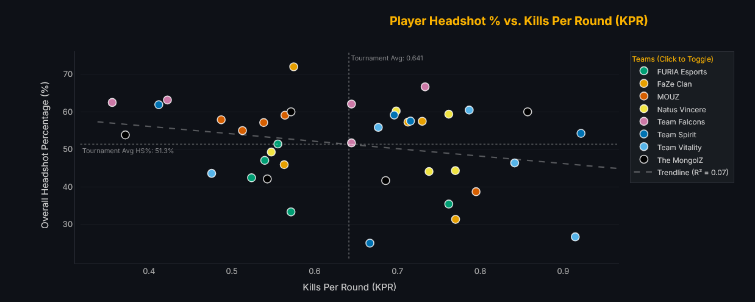
Visualization Methods
Headshot % vs KPR Scatter

Slide 9
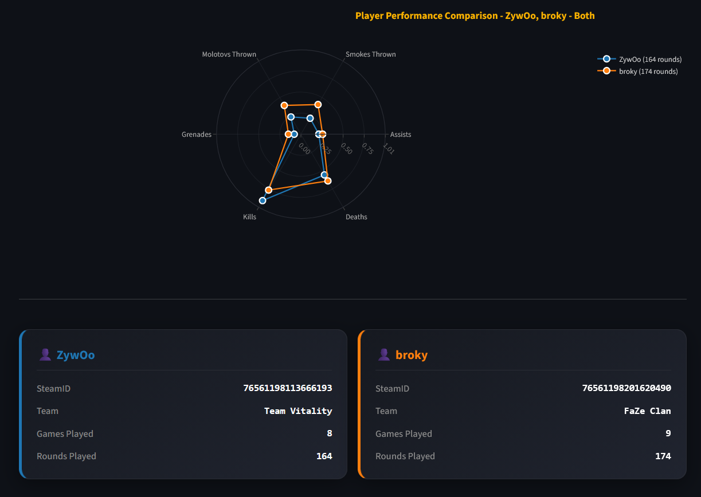
Visualization Methods
Spider Chart

Slide 10
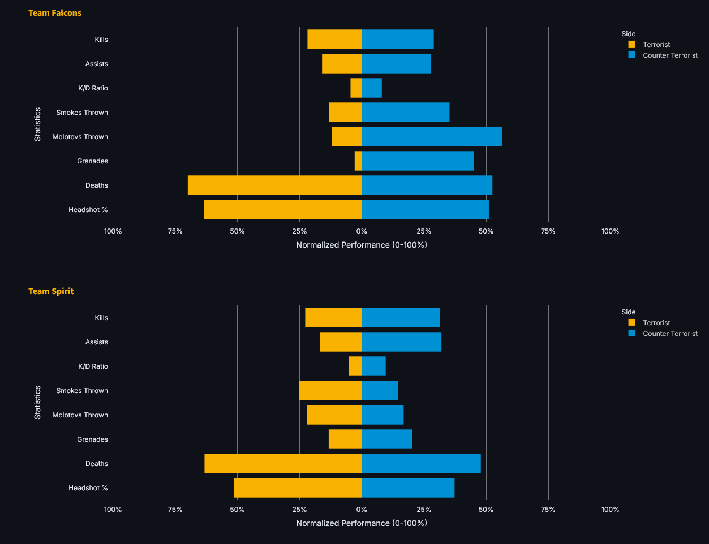
Visualization Methods
CT vs T Diverging Bar

Slide 11
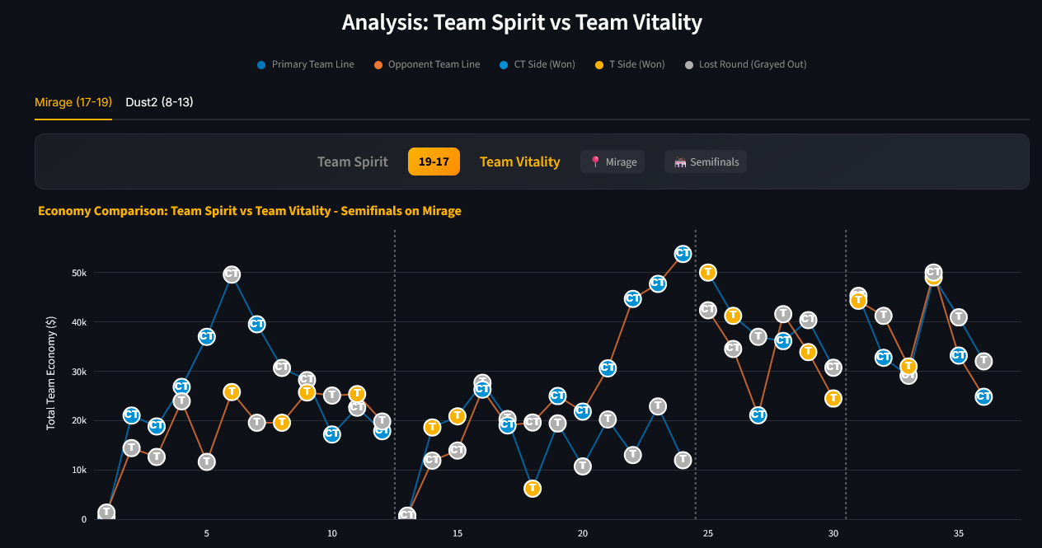
Visualization Methods
Economy Timeline

Slide 12
Demo
http://localhost:8501

Slide 13
Interaction & Implementation
Interaction
Semantic sidebar filtering: slice by tournament stage, map, team, player, side (CT/T)
Rich tooltips that reverse normalization to show raw stats on hover
Legend click to isolate/hide teams, drag-to-zoom on dense clusters
Implementation Highlights
Custom coordinate conversion to overlay heatmaps on 1024x1024 map radar images
Economy lines broken at phase boundaries (halftime, OT) to prevent misleading visual connections
Centralized RAM caching (@st.cache_data) for fast UI responsiveness

Slide 14
Findings & Conclusions
Heatmaps: Clear clustering around utility spots and hold angles. On Mirage B site, "jumpsquatting" to peek a corridor is visible in the density.
HS% vs KPR: Negative trend - more kills correlates with lower HS%. donk (rifler, high HS%) vs ZywOo (AWPer, low HS%) confirms weapon choice drives the split.
Spider Chart: No player dominates all axes. donk vs Twistzz shows complementary roles - kills vs utility usage.
CT vs T Bar: Side imbalances are map-driven, not team-driven. Utility diverges depending on map: example: CT throws more smokes, T throws more molotovs.

