Slide 1
论文调研
智能推荐系统期末报告
董辰尧
10185102144

Slide 2
Contents
MF
IF-MF
CB-MF
UIS-MF
DuLDA-MF
BPR-OPT
SBPR
BPRDR
TNBPR
AFM
IFM
PRM

Slide 3

MF
Motivation :
tries to explain the ratings by characterizing both items and users on, say, 20 to 100 factors inferred from the ratings patterns. MF models map both users and items to a joint latent factor space of dimensionality f.
Method :

Slide 4
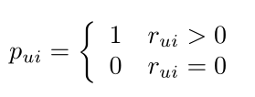


IF-MF
Motivation :
How to make good use of a large number of implicit data? How does the implicit data show the user's preference for item?
Method :

Slide 5
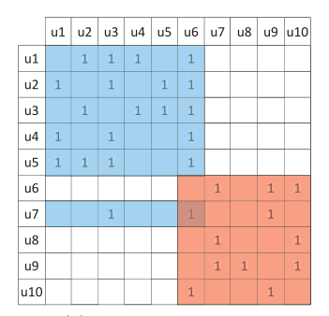
CB-MF
Motivation :
CF approaches utilize follower-followee relationships lead to higher precision but data sparsity remains a challenge. Forming communities enables us to reduce data sparsity and focus on discovering the latent characteristics of communities instead of individuals.
Method :
utilize the LDA model to discover communities
applied matrix factorization on each community found.

Slide 6
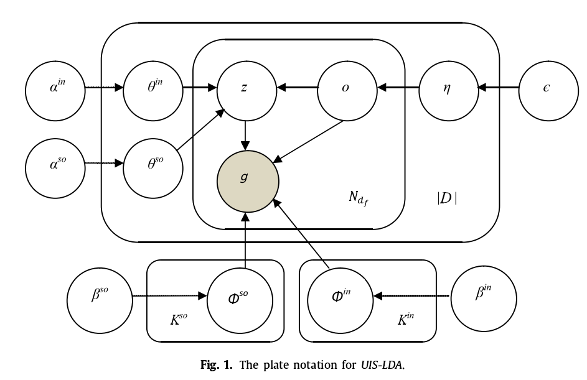
UIS-MF
Motivation :
a major problem of existing methods is that they assume ever follower-followee user pairs are equally likely, and this leads to the coarse user following preferences inferring. Intuitively, a user’ s adoption of others a followees may be motivated by her interests as well as social connections, hence a good recommender should be able to separate the two situations and take both factors into account for better recommendation results.
Method :
Topic Extraction ： UIS-LDA
User Recommendation ： CB-methods

Slide 7
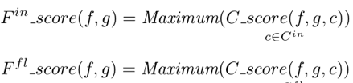
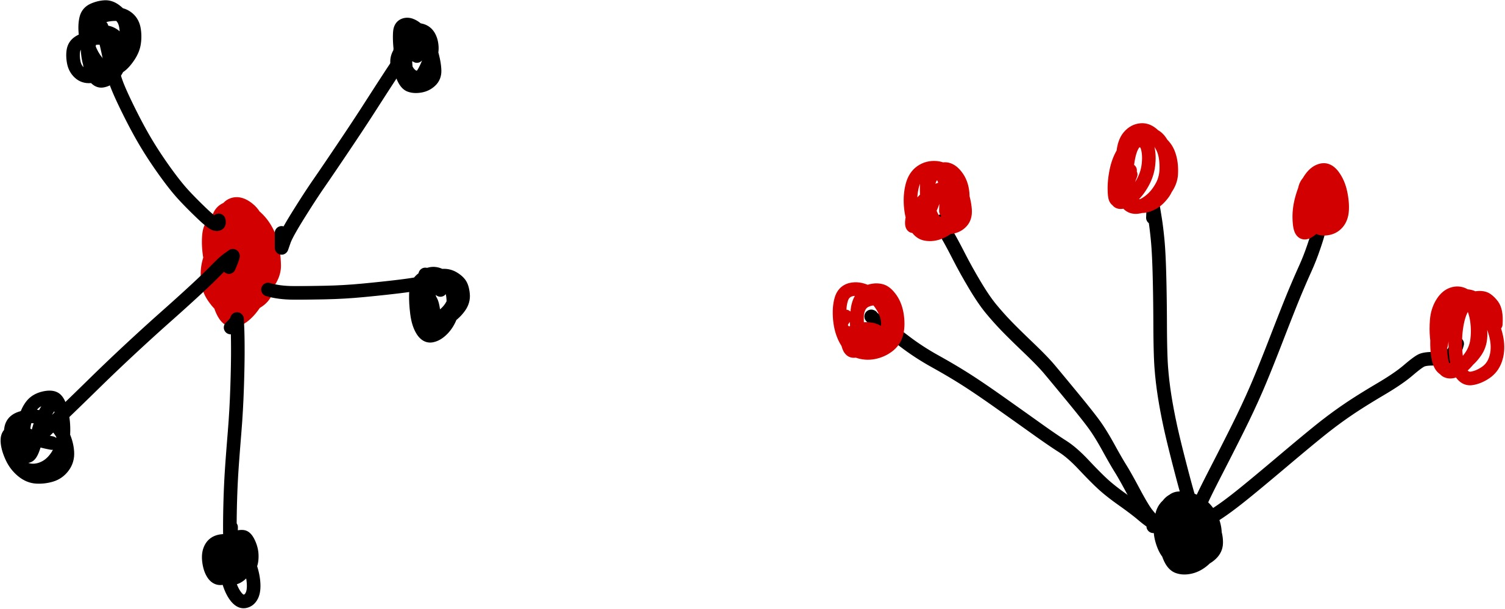

DuLDA-MF
Motivation :
we are more likely to accept viewpoints from whom we trust. Trustee recommendation aims to provide a target individual with a list of candidate users she might be trust. However, most existing work on this topic for focuses on the use of trusters’ interest but ignores the influence of trustees for recommendation.
Method :
Topic Extraction ： introduce LDA twice on truster-documents corpus and trustee-documents corpus respectively to discover interest communities of users and influence communities of users.
User Recommendation ：

Slide 8
From MF to BPR
Disadvantages of MF：
No negative example sample utilized.
BPR:
Use the idea of Pairwise to construct partial order relations.
The goal is no longer to minimize the root-mean-square error as in MF, but needs to satisfy the best relative ordering of items.

Slide 9
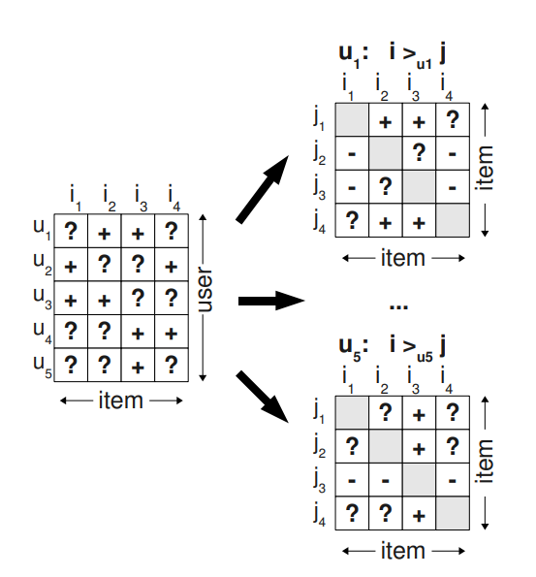
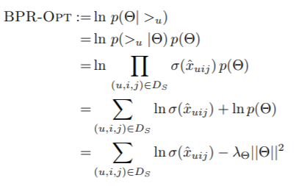

BPR
Motivation :
Existing methods are designed for the item prediction task of personalized ranking, none of them is directly optimized for ranking.
Method :

Slide 10
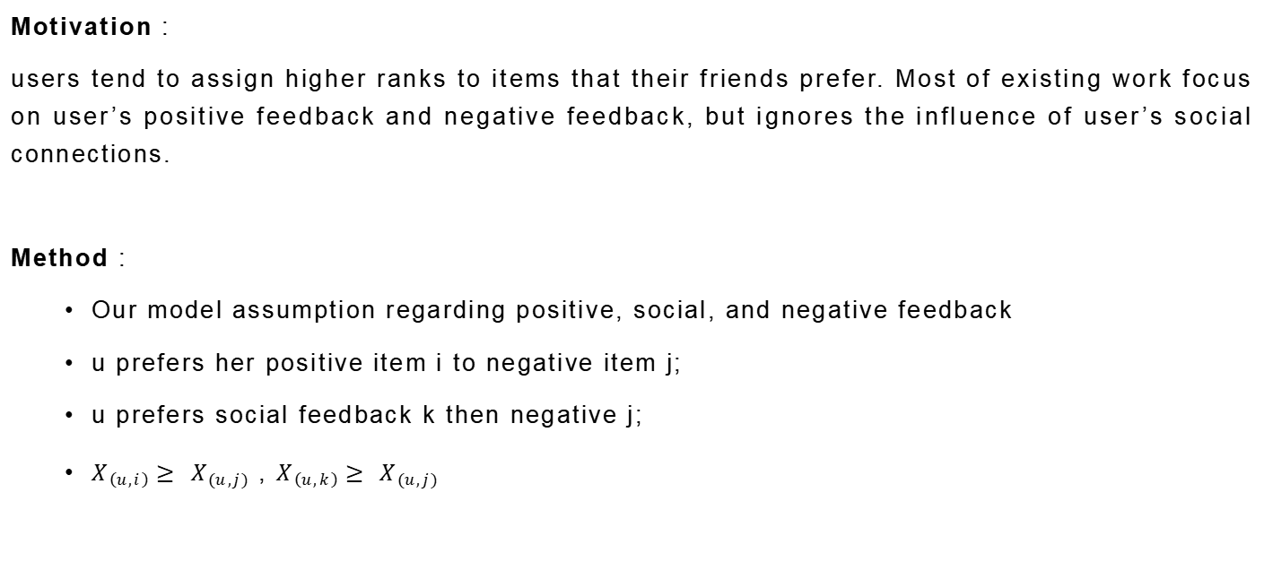
SBPR
Motivation :
users tend to assign higher ranks to items that their friends prefer. Most of existing work focus on user’s positive feedback and negative feedback, but ignores the influence of user’s social connections.
Method :
Our model assumption regarding positive, social, and negative feedback
u prefers her positive item i to negative item j;
u prefers social feedback k then negative j;
$X_{\left(u,i\right)}≥ X_{\left(u,j\right)}$ , $X_{\left(u,k\right)}≥ X_{\left(u,j\right)}$

Slide 11
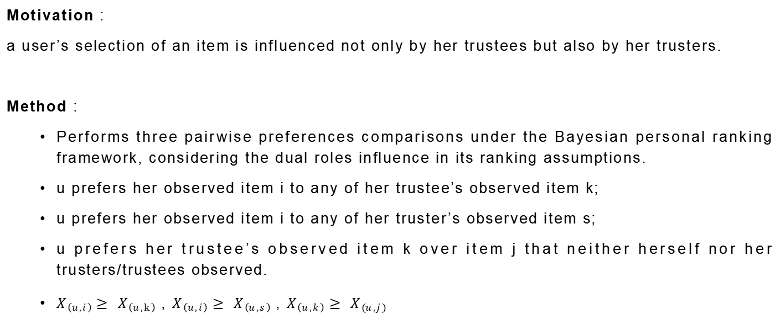
BPRDR
Motivation :
a user’s selection of an item is influenced not only by her trustees but also by her trusters.
Method :
Performs three pairwise preferences comparisons under the Bayesian personal ranking framework, considering the dual roles influence in its ranking assumptions.
u prefers her observed item i to any of her trustee’s observed item k;
u prefers her observed item i to any of her truster’s observed item s;
u prefers her trustee’s observed item k over item j that neither herself nor her trusters/trustees observed.
$X_{\left(u,i\right)}≥ X_{\left(u,k\right)}$ , $X_{\left(u,i\right)}≥ X_{\left(u,s\right)}$, $X_{\left(u,k\right)}≥ X_{\left(u,j\right)}$

Slide 12
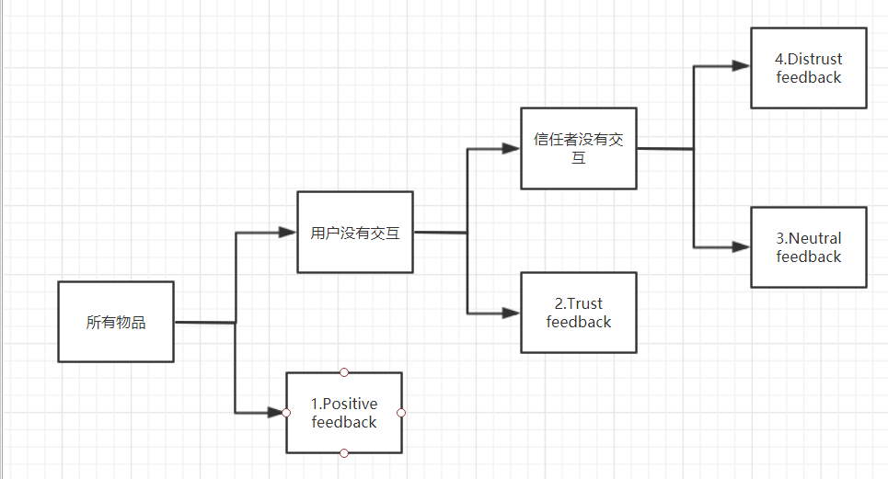

TNDBPR
Motivation :
there lack of methods using distrust relations to derive more accurate ranking-based model. This paper simultaneously leverages trust, distrust, and neutral relations for item ranking.
Method :
Positive feedback : user u have rated. (i)
Trust feedback : user u did not choose but at least one of her trusted users selected. (k)
Distrust feedback : user u and her trusted users did not choose, but at least one of her distrusted users selected. (z)
Neutral feedback : neither user u nor any of her trusted or distrusted users choose. (j)

Slide 13
From MF to FM
Differences：
Different forms of input data.
Different ways of integrating additional information.
MF is a special case for FM.

Slide 14
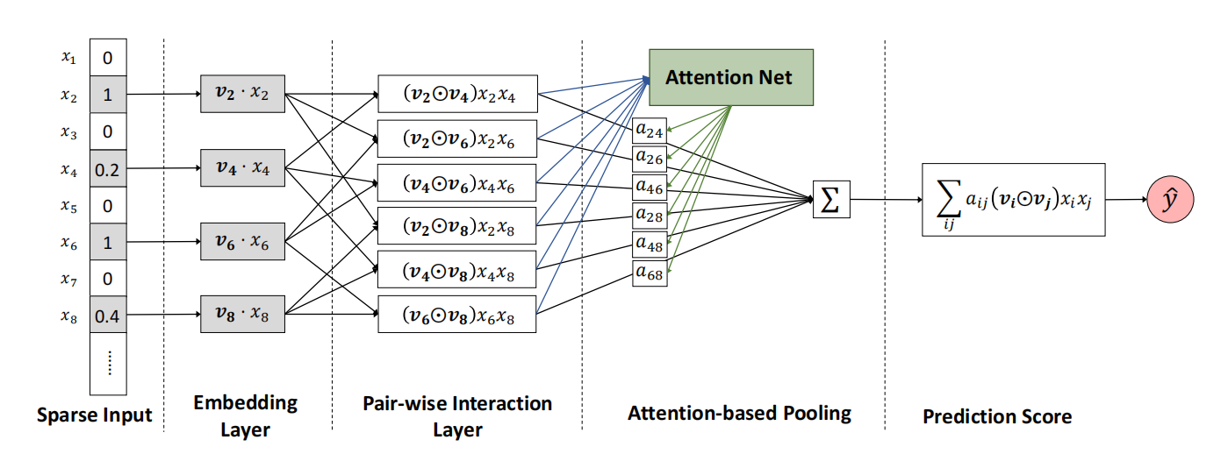
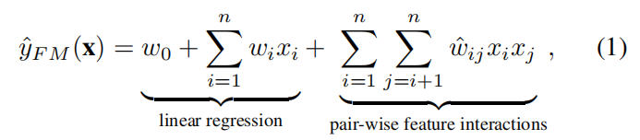
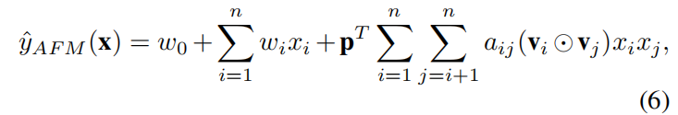
AFM
Motivation :
Despite effectiveness, FM can be hindered by its modelling of all feature interactions with the same weight, as not all feature inter actions are equally useful and predictive. For example, the interactions with useless features may even introduce noises and adversely degrade the performance.
Method :

Slide 15
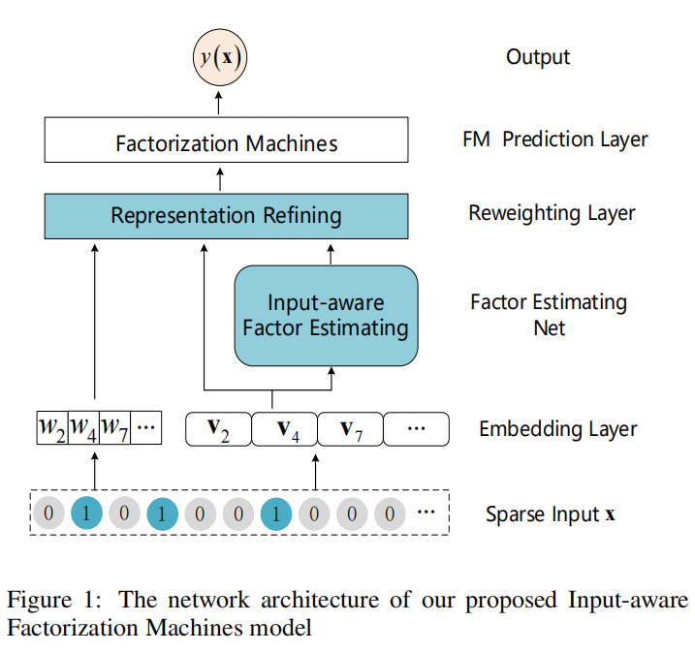
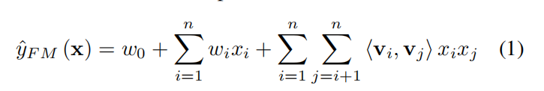
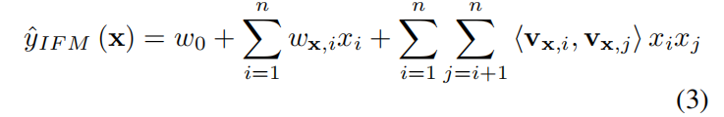
IFM
Motivation :
the accuracy of FMs can be adversely affected by the fixed representation trained for each feature, as the same feature is usually not equally predictive and useful in different instances. In fact, the inaccurate representation of features may even introduce noise and degrade the overall performance.
Method :

Slide 16

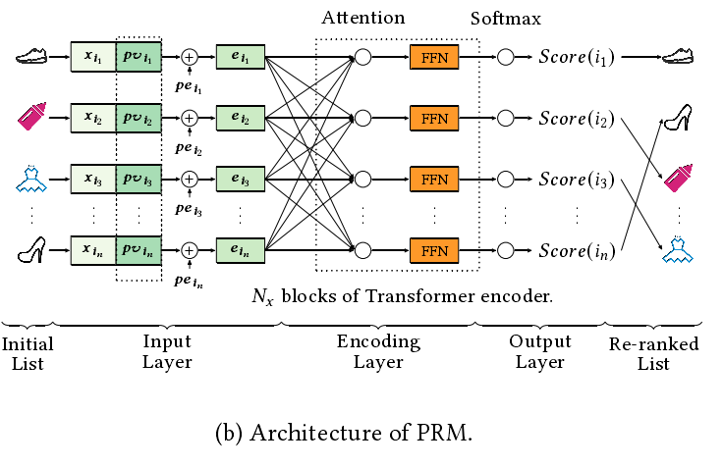
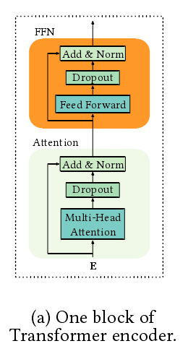
PRM
Motivation :
Typically, a rankingfunction is learned from the labeled dataset to optimize the globalperformance, which produces a ranking score for each individualitem. However, it may be sub-optimal because the scoring functionapplies to each item individually and does not explicitly considerthe mutual in uence between items, as well as the di erences of users’ preferences or intents.
Method :
new loss based in LTR:
input：
PV：

Slide 17
Summarize
trends：
In-depth development.
More data.
Interactive use of methods.
More diverse feature representation.
The starting point of the method:
Dealing with data sparsity:MF、CB-MF.
Application of implicit data:IF-MF、UIS-MF、DuLDA-MF、SBPR、BPRDR、TNDBPR
Personalisation of objects or users:AFM、IFM、PRM

Slide 18
2021
Thanks for watching

