Slide 1
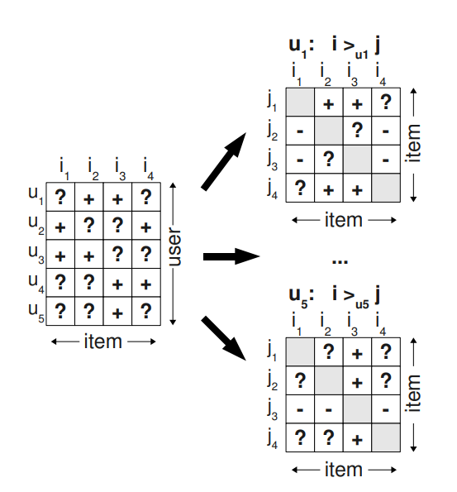
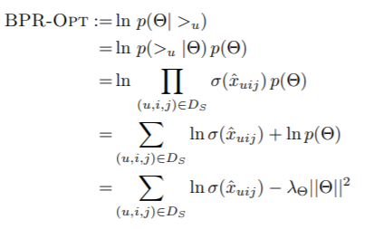

BPR-OPT
Motivation :
Existing methods are designed for the item prediction task of personalized ranking, none of them is directly optimized for ranking.
Method :

Slide 2
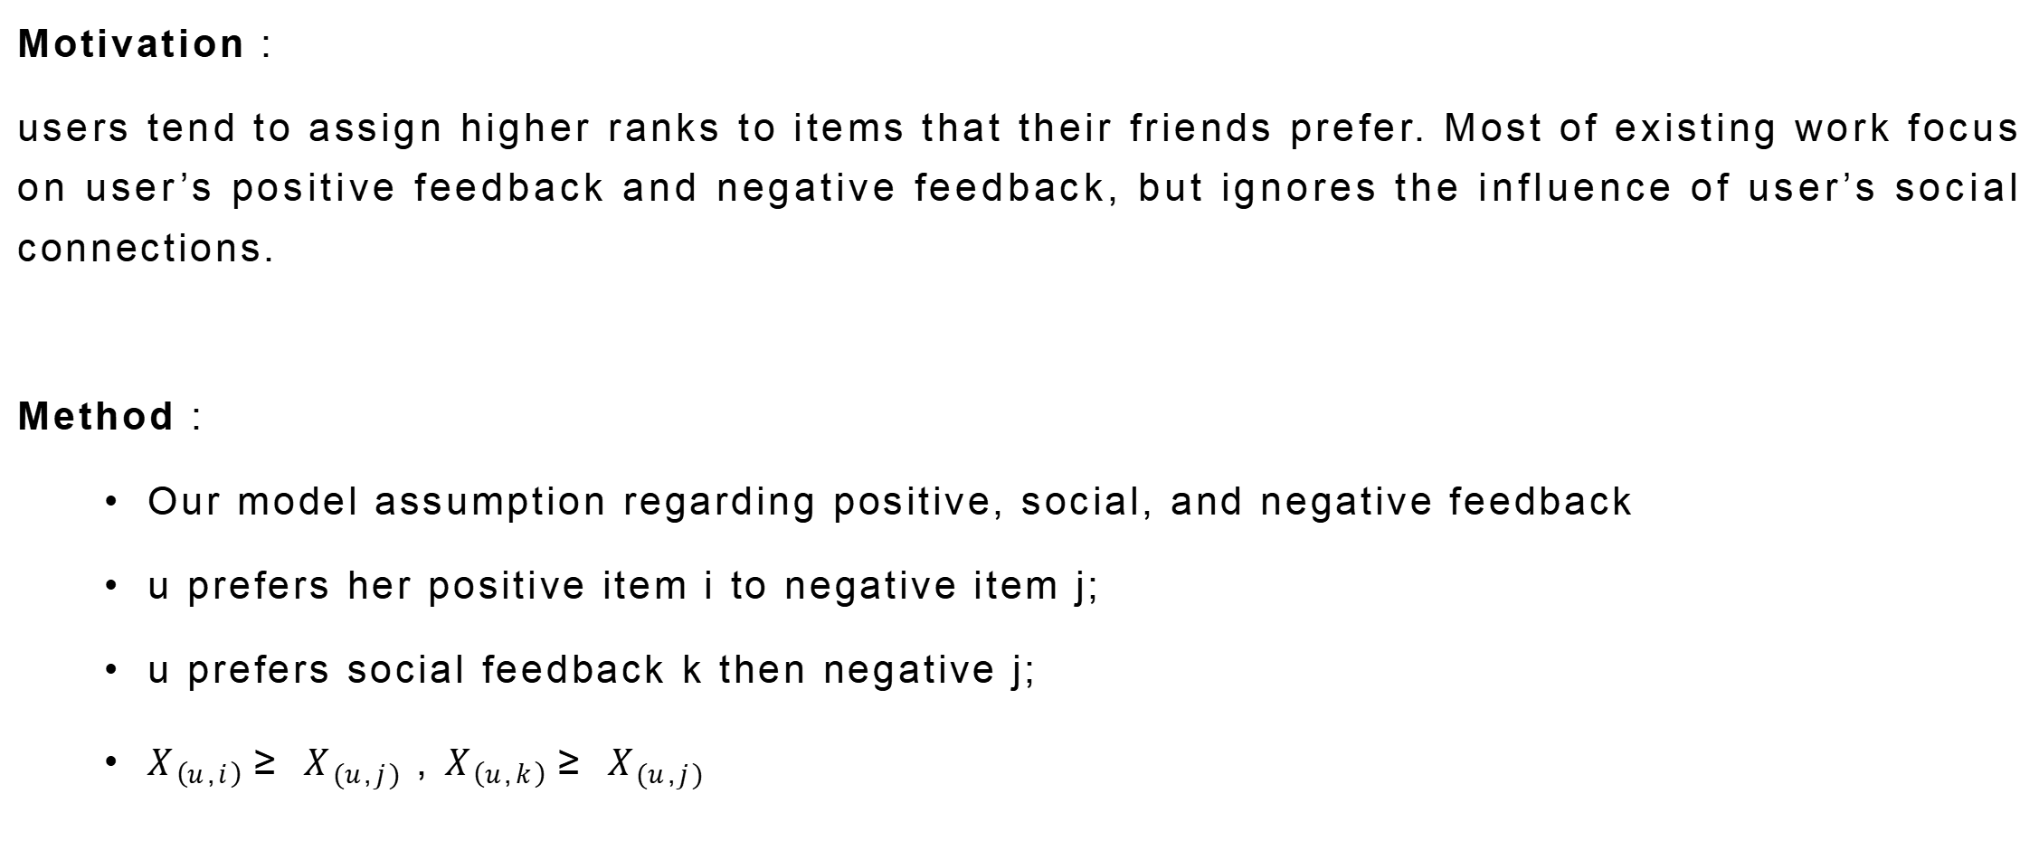
SBPR
Motivation :
users tend to assign higher ranks to items that their friends prefer. Most of existing work focus on user’s positive feedback and negative feedback, but ignores the influence of user’s social connections.
Method :
Our model assumption regarding positive, social, and negative feedback
u prefers her positive item i to negative item j;
u prefers social feedback k then negative j;
$X_{\left(u,i\right)}≥ X_{\left(u,j\right)}$ , $X_{\left(u,k\right)}≥ X_{\left(u,j\right)}$

Slide 3
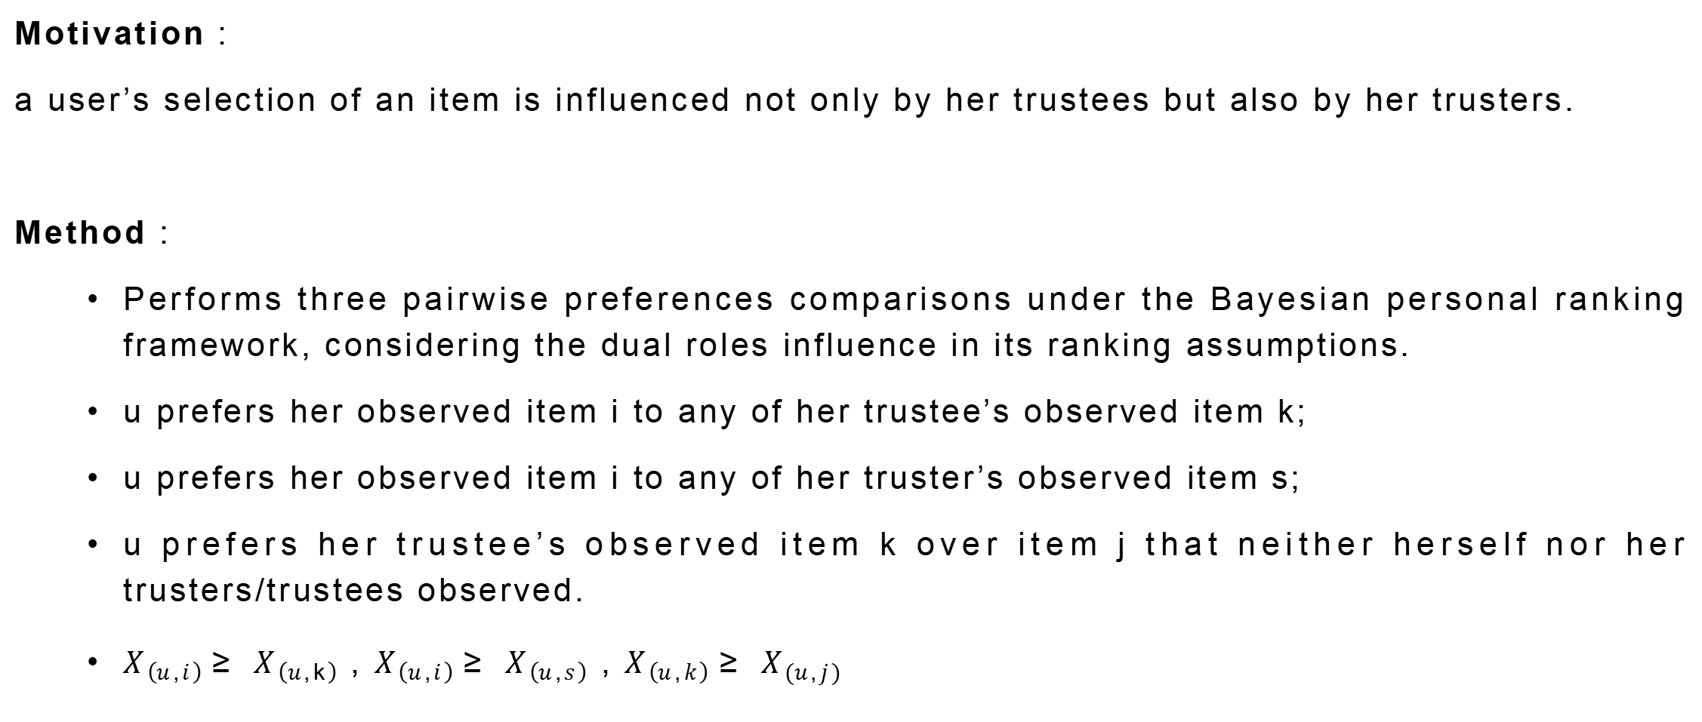
BPRDR
Motivation :
a user’s selection of an item is influenced not only by her trustees but also by her trusters.
Method :
Performs three pairwise preferences comparisons under the Bayesian personal ranking framework, considering the dual roles influence in its ranking assumptions.
u prefers her observed item i to any of her trustee’s observed item k;
u prefers her observed item i to any of her truster’s observed item s;
u prefers her trustee’s observed item k over item j that neither herself nor her trusters/trustees observed.
$X_{\left(u,i\right)}≥ X_{\left(u,k\right)}$ , $X_{\left(u,i\right)}≥ X_{\left(u,s\right)}$, $X_{\left(u,k\right)}≥ X_{\left(u,j\right)}$

Slide 4
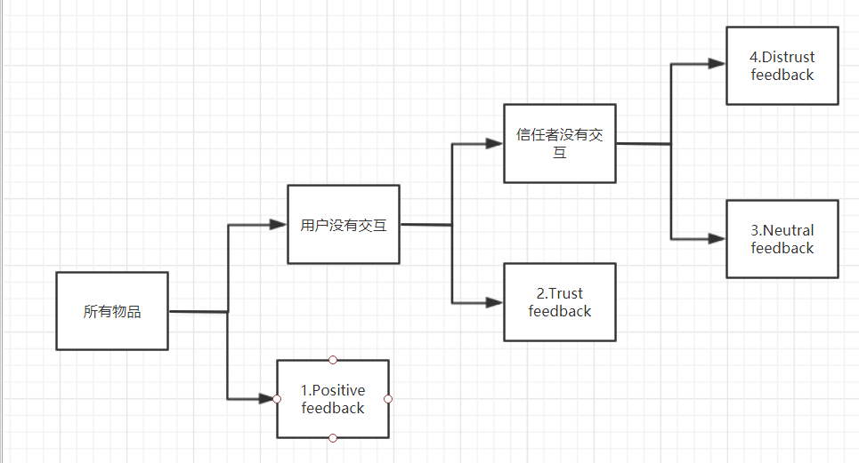

TNDBPR
Motivation :
there lack of methods using distrust relations to derive more accurate ranking-based model. This paper simultaneously leverages trust, distrust, and neutral relations for item ranking.
Method :
Positive feedback : user u have rated. (i)
Trust feedback : user u did not choose but at least one of her trusted users selected. (k)
Distrust feedback : user u and her trusted users did not choose, but at least one of her distrusted users selected. (z)
Neutral feedback : neither user u nor any of her trusted or distrusted users choose. (j)

Slide 5
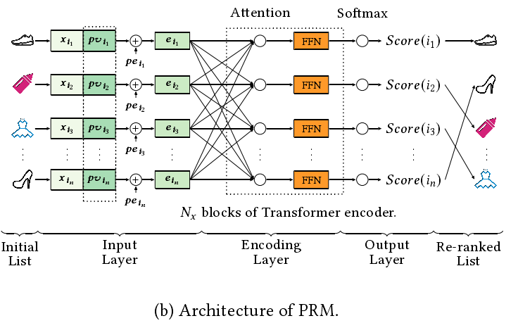
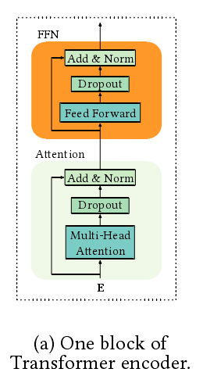
PRM
Motivation :
Typically, a rankingfunction is learned from the labeled dataset to optimize the globalperformance, which produces a ranking score for each individualitem. However, it may be sub-optimal because the scoring functionapplies to each item individually and does not explicitly considerthe mutual in uence between items, as well as the di erences of users’ preferences or intents.
Method :
new loss based in LTR:
input：
PV：

