Slide 1


实验课：三维渲染 Practice for Computer Graphics：3D world
李洋 副教授
计算机科学与技术学院
华东师范大学
yli@cs.ecnu.edu.cn

Slide 2
Outline
Recall
Exercise
Reference

Slide 3
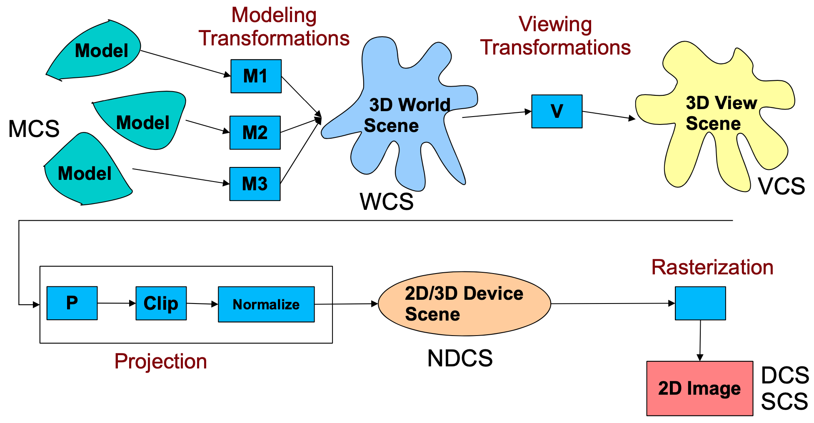
3D pipeline
recall the 3D pipeline we have learned

Slide 4
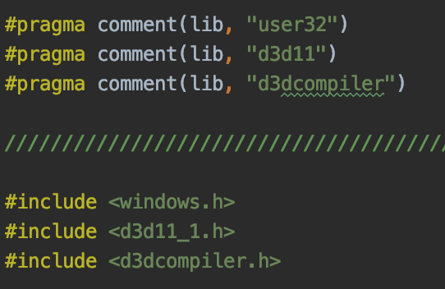
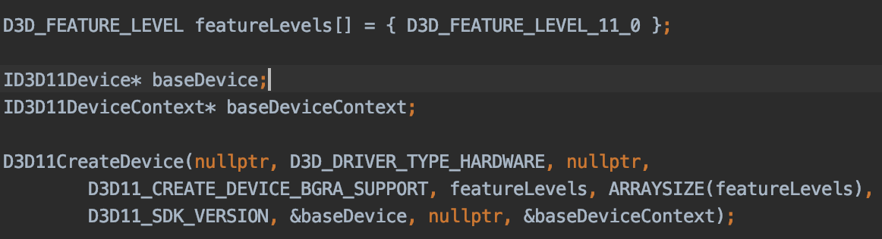
D3D init
initialize the D3D environment

Slide 5
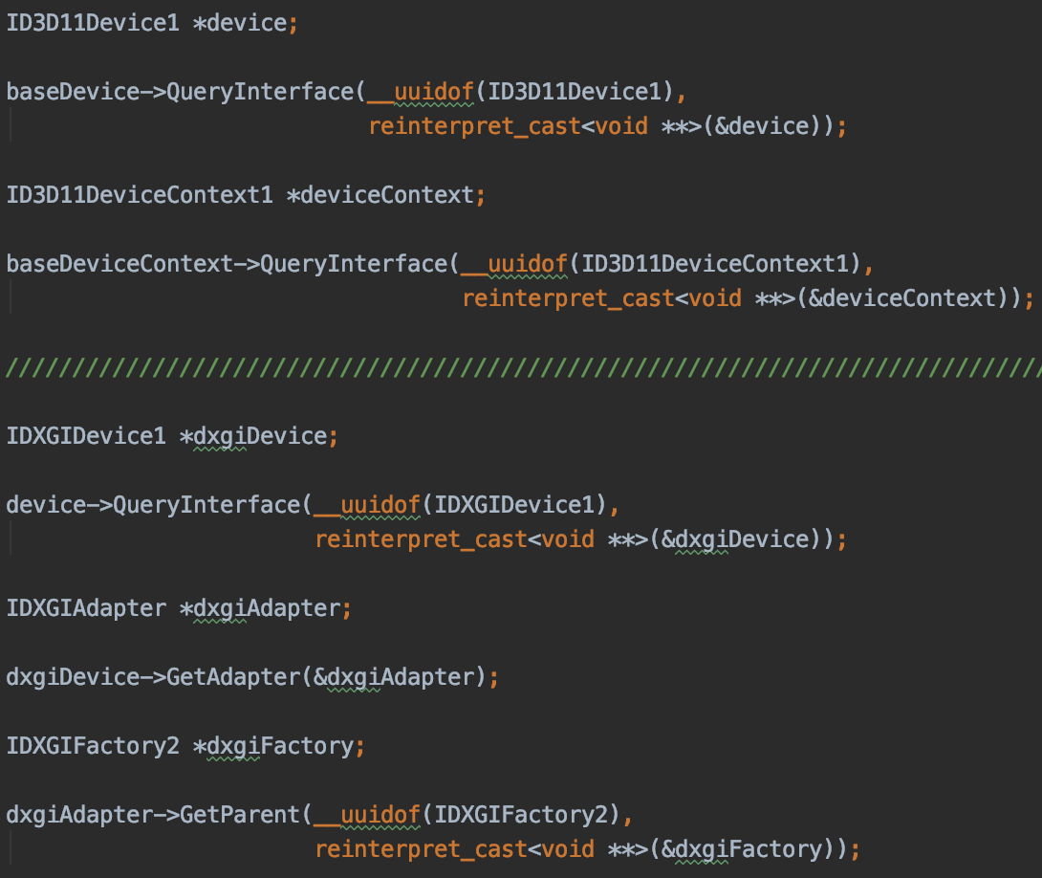
D3D init
Also, here we use d3d11, reinterpret the device into according interfaces
and, Microsoft DirectX Graphics Infrastructure (DXGI) related instance

Slide 6
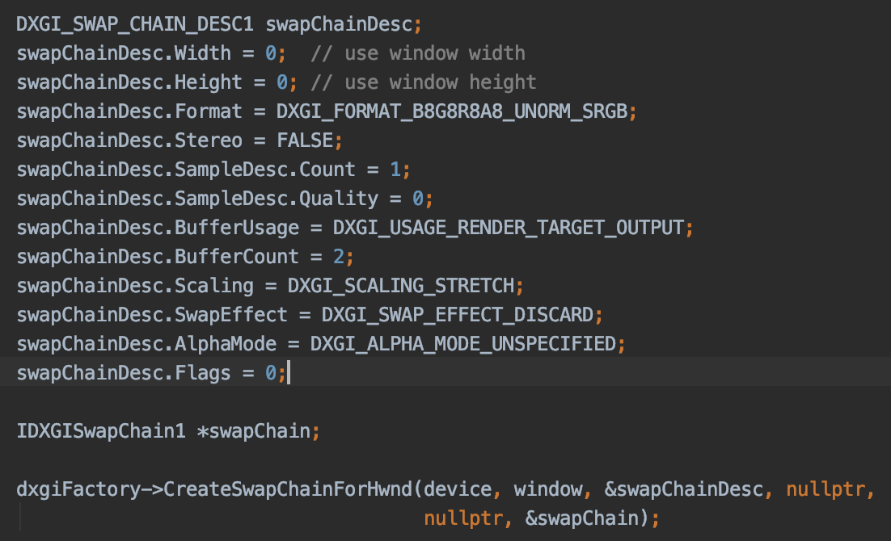
Swap
Remember the swap buffer and we need to init it

Slide 7
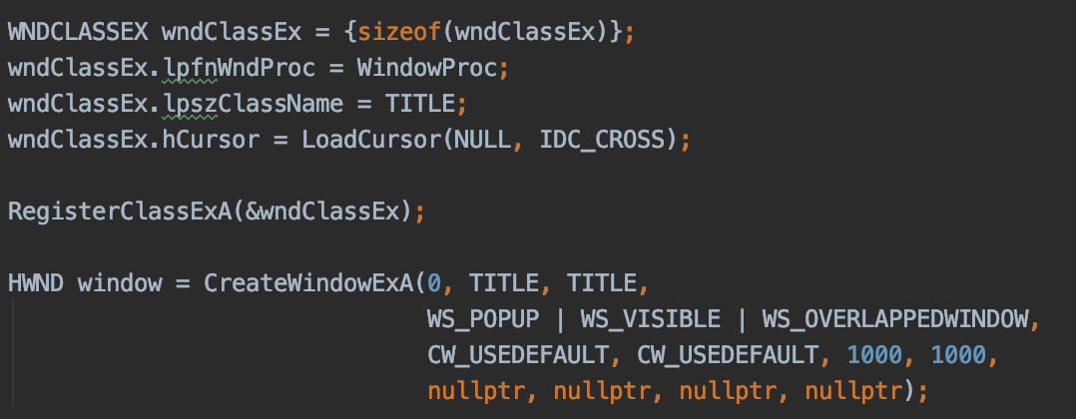
Windows
Also, D3D is still a window app
Don’t forget the windows init

Slide 8
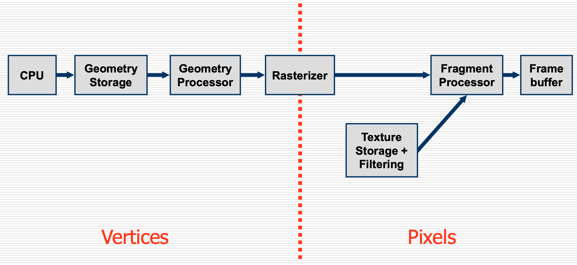
GPU pipeline

Slide 9
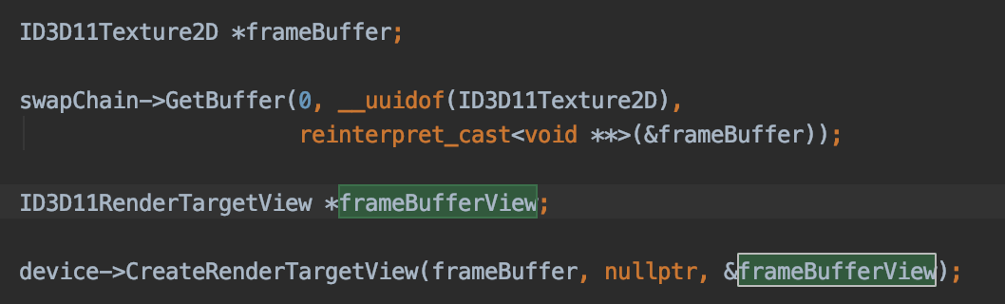
Frame buffer
we need a memory place to draw our 3D stuff

Slide 10
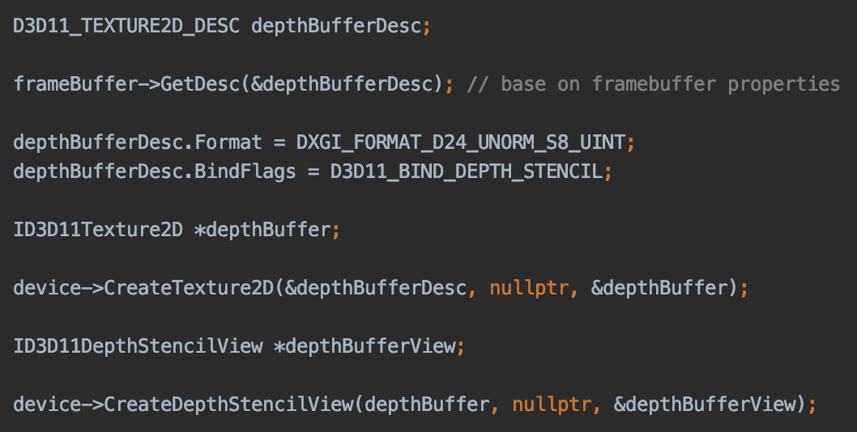
Depth buffer
since it is 3D, we need a memory to store the occlusion status

Slide 11
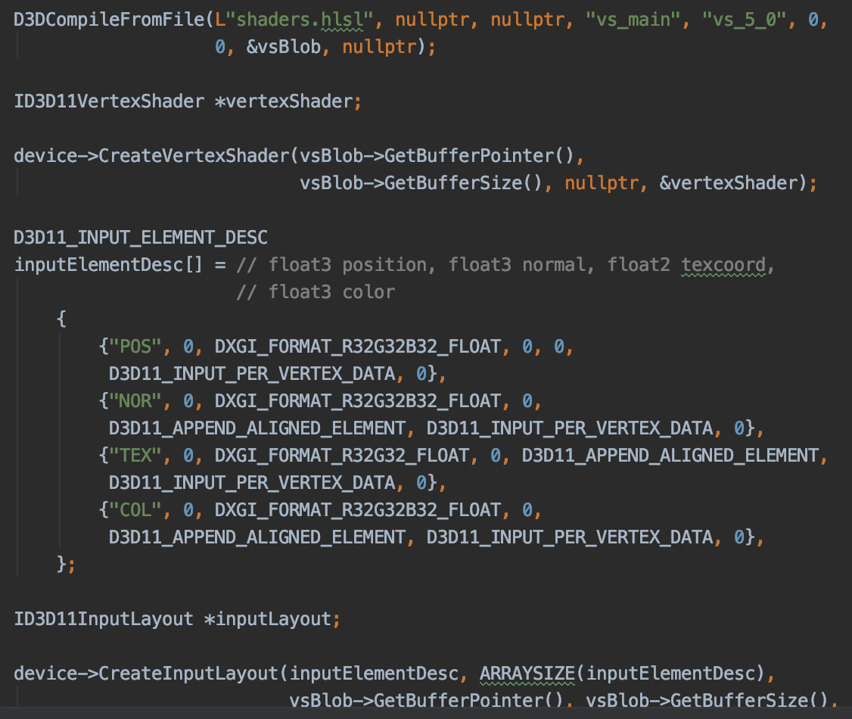
Vertex Shader
since D3D11 only support programmable pipeline, we need to set up our vertex shader
and set up the data structure

Slide 12
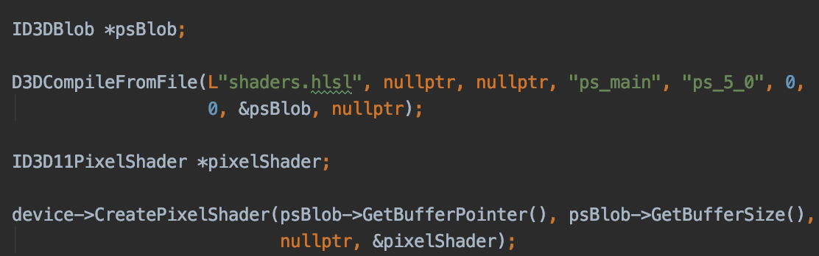
Pixel shader
And pixel shader

Slide 13
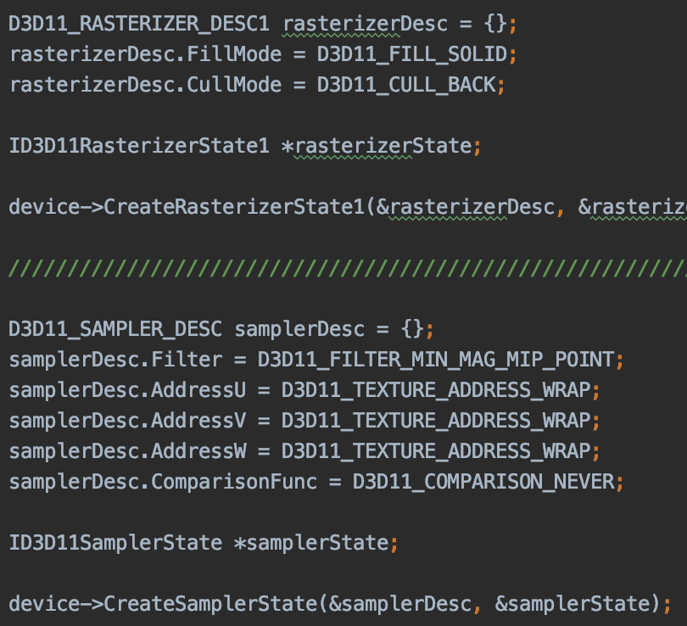
Other settings
how to rasterizer
how to sample
how to behave in depth check

Slide 14
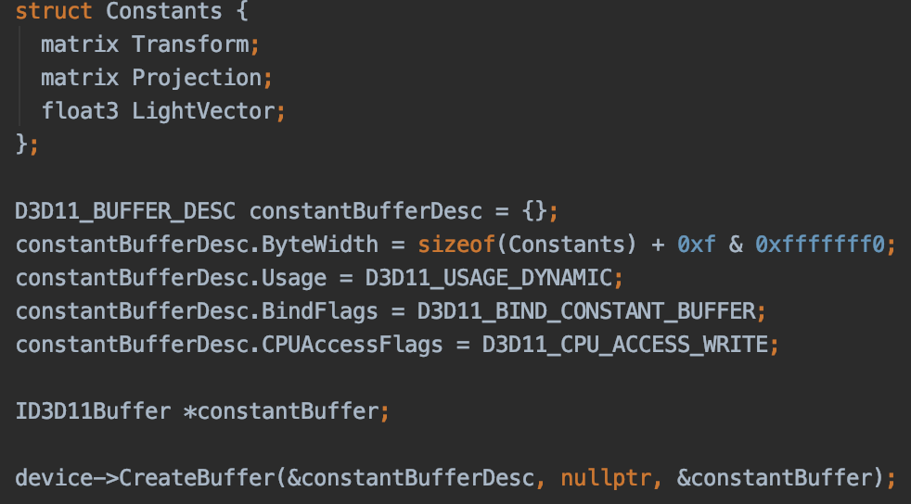
Prepare Data for rendering

Slide 15
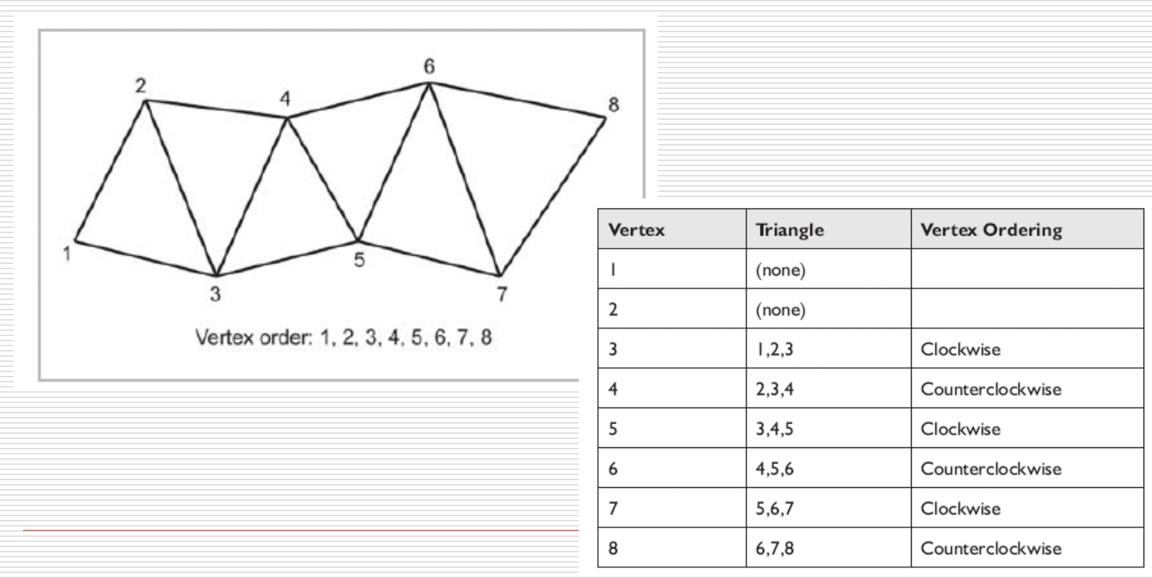
Triangle list render mode

Slide 16
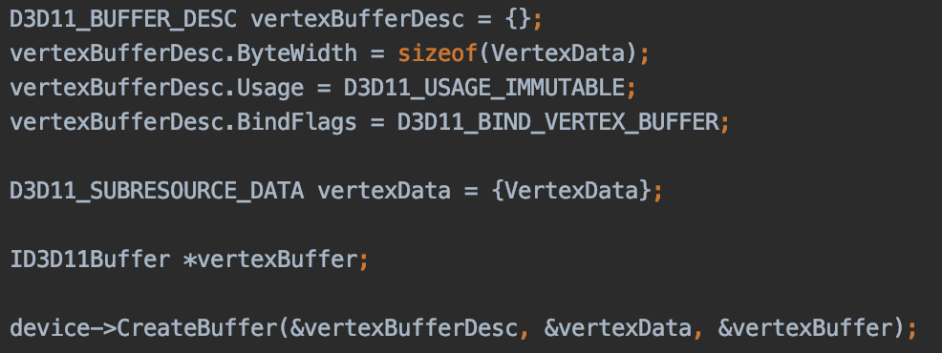
Prepare Data for rendering

Slide 17
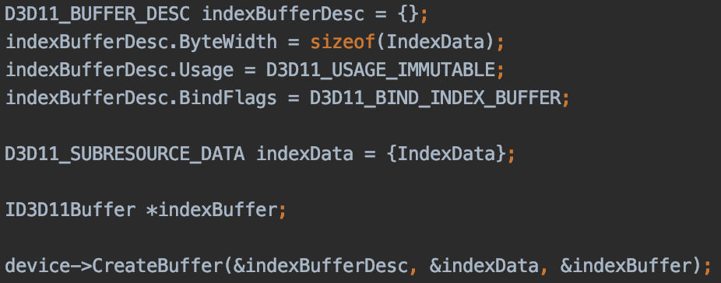
Prepare Data for rendering

Slide 18
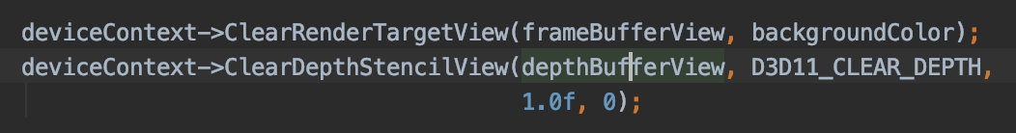
Ready to render
Clear up the buffers

Slide 19
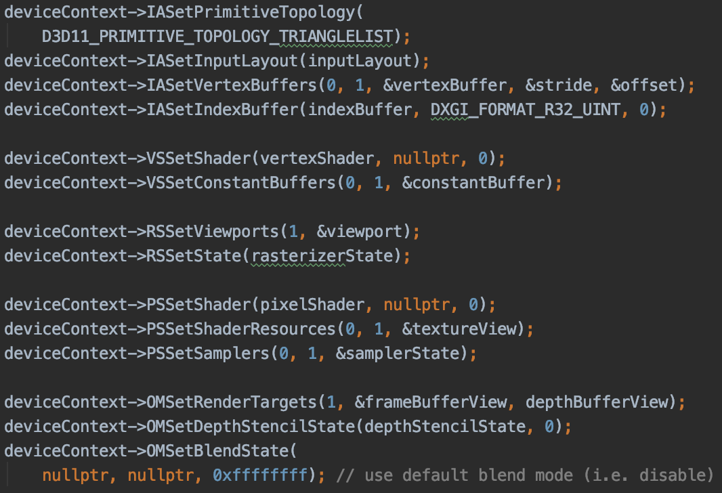
Setup pipeline

Slide 20
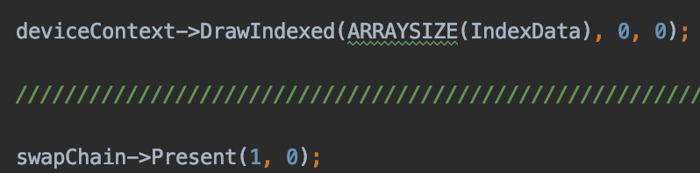
Draw and swap

Slide 21
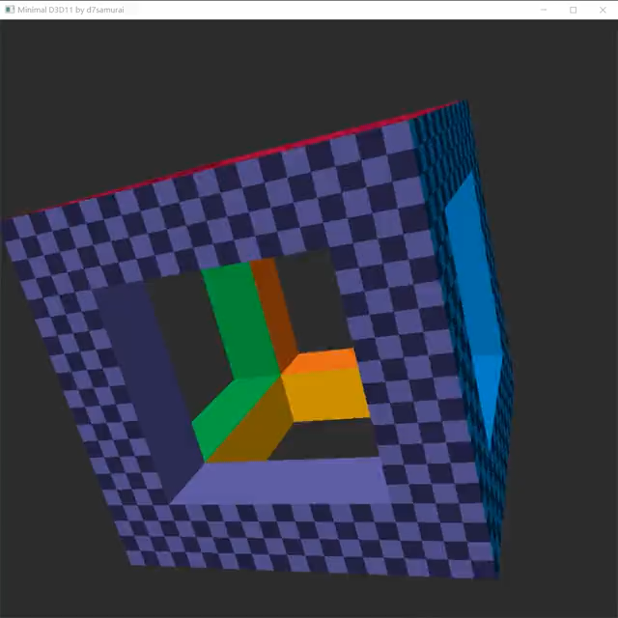
实验练习

Slide 22
实验练习
实验编号：9
实验名称：D3D流水线
实验目的：利用D3D API实现基本3D流水线。
实验环境：
Windows 10
Visual studio X
D3D 11

Slide 23
实验练习
实验内容与实验步骤：
读懂代码
增加旋转功能

Slide 24
附加题
我们已经学习了所有的基本算法
尝试说说3D流水线中，各个对应部分和2D练习中的关系

Slide 25
Reference
http://www.directxtutorial.com/Lesson.aspx?lessonid=11-4-2
http://www.rastertek.com/tutdx11.html
https://antongerdelan.net/opengl/d3d11.html
https://www.scratchapixel.com/lessons/3d-basic-rendering/perspective-and-orthographic-projection-matrix/building-basic-perspective-projection-matrix

