Slide 1
Contents
LDA for user recommendation
Social-LDA
UIS-LDA
MF
IF-MF
CB-MF
UIS-MF
DuLDA-MF
BPR-OPT
BPR-MF
SBPR
BPRDR
TNBPR
SLIM

Slide 2
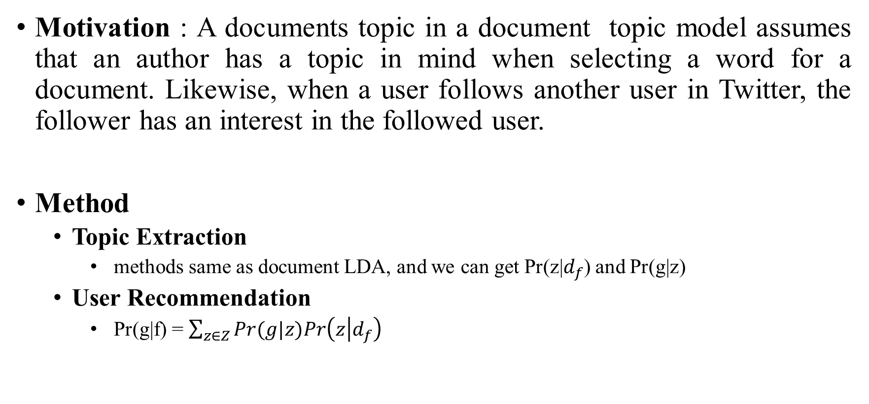
LDA for user recommendation
Motivation : A documents topic in a document topic model assumes that an author has a topic in mind when selecting a word for a document. Likewise, when a user follows another user in Twitter, the follower has an interest in the followed user.
Method
Topic Extraction
methods same as document LDA, and we can get Pr(z|$d_{f}$) and Pr(g|z)
User Recommendation
Pr(g|f) = $\sum_{z∈Z}{Pr(g|z)Pr\left(z | d_{f}\right)}$

Slide 3
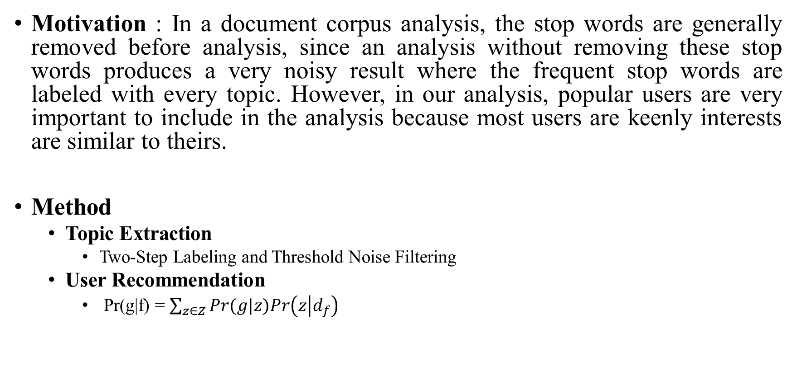
Social-LDA
Motivation : In a document corpus analysis, the stop words are generally removed before analysis, since an analysis without removing these stop words produces a very noisy result where the frequent stop words are labeled with every topic. However, in our analysis, popular users are very important to include in the analysis because most users are keenly interests are similar to theirs.
Method
Topic Extraction
Two-Step Labeling and Threshold Noise Filtering
User Recommendation
Pr(g|f) = $\sum_{z∈Z}{Pr(g|z)Pr\left(z | d_{f}\right)}$

Slide 4
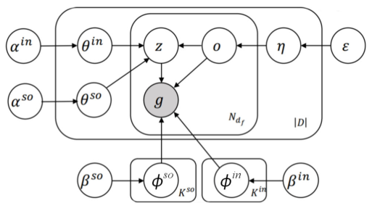
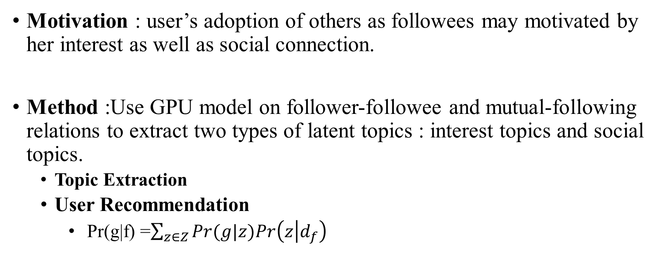
UIS-LDA
Motivation : user’s adoption of others as followees may motivated by her interest as well as social connection.
Method :Use GPU model on follower-followee and mutual-following relations to extract two types of latent topics : interest topics and social topics.
Topic Extraction
User Recommendation
Pr(g|f) =$\sum_{z∈Z}{Pr(g|z)Pr\left(z | d_{f}\right)}$
Notes:
GPU模型用在sample的时候，一般训练的时候我们会直接为第ｉ篇文档中的第ｊ个词随机赋予一个话题 ，一遍一遍的循环下去直到主题收敛。但是我们这里对于有双向关注，也即有兴趣主题的，我们不仅为第i篇文档的第j个词随机赋予一个社交主题，还会加大第j篇文档的第i个词的社交主题分布的概率。

Slide 5

MF
Motivation : tries to explain the ratings by characterizing both items and users on, say, 20 to 100 factors inferred from the ratings patterns. MF models map both users and items to a joint latent factor space of dimensionality f.
Method :

Slide 6
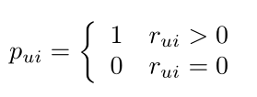


IF-MF
Motivation : How to make good use of a large number of implicit data? How does the implicit data show the user's preference for item?
Method :

Slide 7
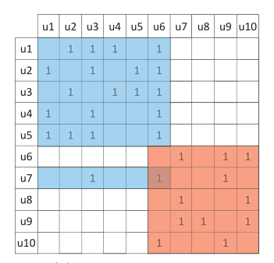
CB-MF
Motivation : CF approaches utilize follower-followee relationships lead to higher precision but data sparsity remains a challenge. Forming communities enables us to reduce data sparsity and focus on discovering the latent characteristics of communities instead of individuals.
Method :
utilize the LDA model to discover communities
applied matrix factorization on each community found.

Slide 8
UIS-MF
Motivation : a major problem of existing methods is that they assume every follower-followee user pairs are equally likely, and this leads to the coarse user following preferences inferring. Intuitively, a user’ s adoption of others as followees may be motivated by her interests as well as social connections, hence a good recommender should be able to separate the two situations and take both factors into account for better recommendation results.
Method :
Topic Extraction ： UIS-LDA
User Recommendation ： CB-methods

Slide 9
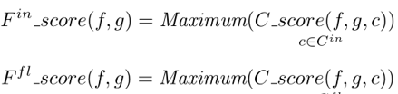

DuLDA-MF
Motivation : we are more likely to accept viewpoints from whom we trust. Trustee recommendation aims to provide a target individual with a list of candidate users she might be trust. However, most existing work on this topic for focuses on the use of trusters’ interest but ignores the influence of trustees for recommendation.
Method :
Topic Extraction ： introduce LDA twice on truster-documents corpus and trustee-documents corpus respectively to discover interest communities of users and influence communities of users.
User Recommendation ：

Slide 10

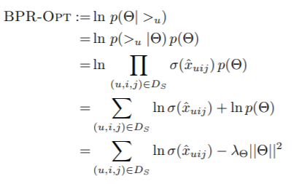
BPR-OPT
Motivation : Existing methods are designed for the item prediction task of personalized ranking, none of them is directly optimized for ranking.
Method :

Slide 11


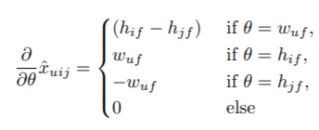

BPR-MF
Method :

Slide 12
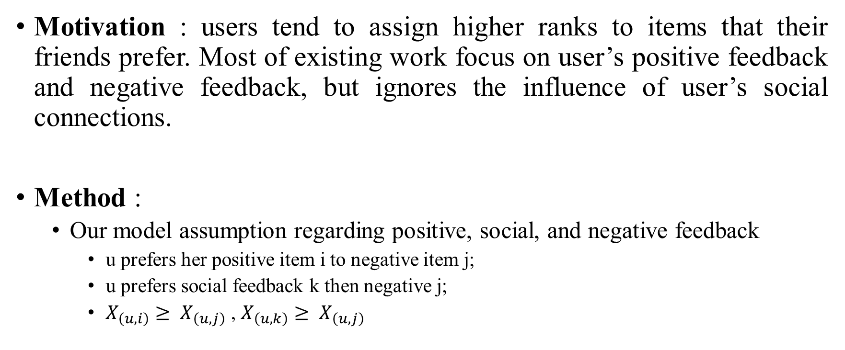
SBPR
Motivation : users tend to assign higher ranks to items that their friends prefer. Most of existing work focus on user’s positive feedback and negative feedback, but ignores the influence of user’s social connections.
Method :
Our model assumption regarding positive, social, and negative feedback
u prefers her positive item i to negative item j;
u prefers social feedback k then negative j;
$X_{\left(u,i\right)}≥ X_{\left(u,j\right)}$ , $X_{\left(u,k\right)}≥ X_{\left(u,j\right)}$

Slide 13
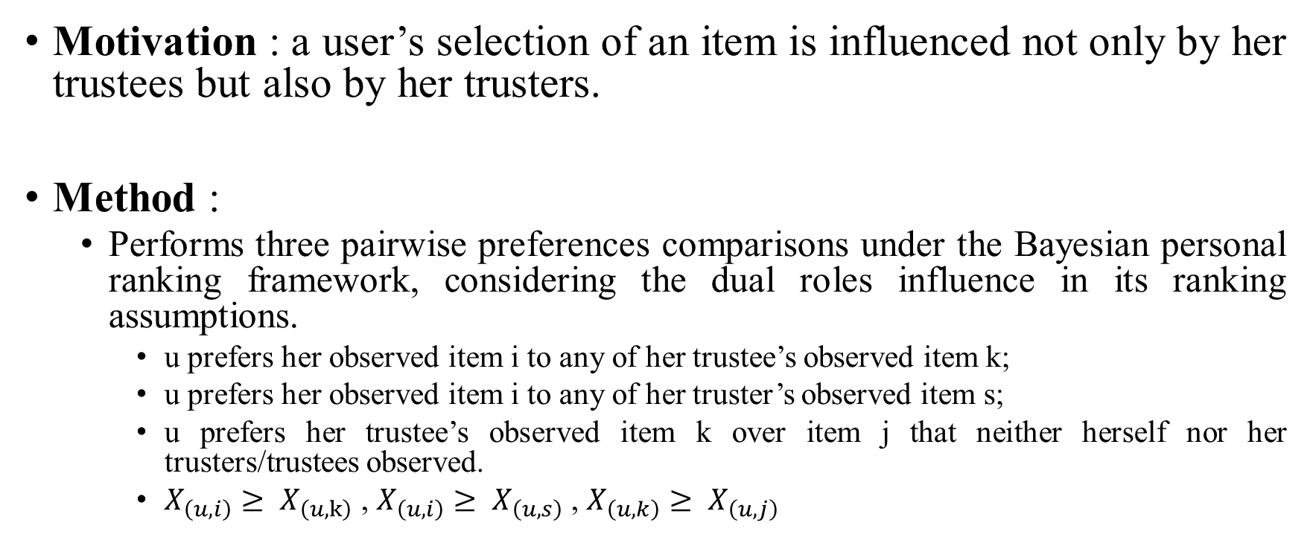
BPRDR
Motivation : a user’s selection of an item is influenced not only by her trustees but also by her trusters.
Method :
Performs three pairwise preferences comparisons under the Bayesian personal ranking framework, considering the dual roles influence in its ranking assumptions.
u prefers her observed item i to any of her trustee’s observed item k;
u prefers her observed item i to any of her truster’s observed item s;
u prefers her trustee’s observed item k over item j that neither herself nor her trusters/trustees observed.
$X_{\left(u,i\right)}≥ X_{\left(u,k\right)}$ , $X_{\left(u,i\right)}≥ X_{\left(u,s\right)}$, $X_{\left(u,k\right)}≥ X_{\left(u,j\right)}$

Slide 14

TNDBPR
Motivation : there lack of methods using distrust relations to derive more accurate ranking-based model. This paper simultaneously leverages trust, distrust, and neutral relations for item ranking.
Method :
Positive feedback : user u have rated. (i)
Trust feedback : user u did not choose but at least one of her trusted users selected. (k)
Distrust feedback : user u and her trusted users did not choose, but at least one of her distrusted users selected. (z)
Neutral feedback : neither user u nor any of her trusted or distrusted users choose. (j)

Slide 15
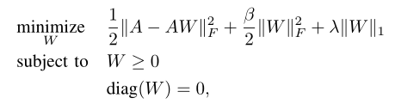
SLIM
Motivation : demands for high quality and efficiency in top-N recommender systems concurrently, so it is better suitable for real-time applications.
Method : SLIM learns a sparse coefficient matrix for the items in the system solely from the user purchase/rating profiles by solving a regularized optimization problem.

