Slide 1




SDC HACKATHON 2026 · DOMAIN 2
Every order
WhatsApp · Aisyah
240 kopi 3-in-1 + 30 kuih lapis. Deliver 28 Oct before 3pm.
starts as a message.
Email · Sarah
Make sure it becomes one.
200 nasi lemak + 100 kaya toast. Delivery 27 Oct, 11:30am.
SmartOrder Hub turns WhatsApp, email and spreadsheet orders into one reviewable order desk. AI reads the message. Rules check the business. The owner approves.
Spreadsheet · Mr Lee
12 nasi lemak + 20 kaya toast. Address missing.
READY TO REVIEW
Empathy Coders
ORD-0001 · Aisyah Rahman
Orbyte Smart SME Challenge · Less busywork, better business
RM 828.00 · Medium risk · 2 items short
CONFIRM
Synthetic data only. No real payments, purchase orders or statutory filings.
Notes:
Open with the hook: every order begins as a message, but most SMEs never turn it into a reliable order record. SmartOrder Hub is the missing order desk between the chat and the business. Keep this to ~25 seconds.

Slide 2



THE PROBLEM
One order. Six messages.
Three places to check.
Orders hide in conversations
A small coffee supplier takes orders on WhatsApp, receives POs by email and keeps stock in a spreadsheet. The owner re-types the same order, checks stock from memory, guesses supplier lead time, then decides whether the margin is worth it.
Chats, DMs and inboxes are not an order desk. The order is somewhere between the small talk.
The same data is re-typed
Every copy is a chance to get quantity, price, address or delivery date wrong.
One missed message becomes a missed sale.
One copy error becomes a wrong delivery.
Stock and margin are checked late
The work is recurring. The cost compounds.
The promise is made before the business knows it can keep it — or whether it should.
Not a one-off admin task — an evening routine.
SDC Hackathon 2026 · Domain 2 · SmartOrder Hub
02
Notes:
Tell the story of one small coffee supplier: WhatsApp order, email PO, spreadsheet stock. The pain is not one message; it is the recurring handoff and re-keying. This is the specific SME pain Domain 2 asks for.

Slide 3








THE PRODUCT THESIS
The missing layer is the handoff.
The message is not the problem. Everything between reading it and promising it is.
01
02
03
04
05
Trigger
Extract
Check
Approve
Log
WhatsApp, email, spreadsheet or manual entry.
AI reads customer, items, address, date and industry fields.
Rules test stock, supplier lead time, revenue, cost, margin and completeness.
Owner accepts, rejects, asks for information or overrides with a reason.
Order record, purchase drafts, activity trail and CSV/Excel export.
HUMAN
AI only where it adds value
Deterministic business math
Every action is logged
Domain 2 must-have: trigger → data → logic → approval → logged outcome
SDC Hackathon 2026 · Domain 2 · SmartOrder Hub
03
Notes:
Walk left to right: trigger, extract, check, approve, log. Emphasise that the human approval step is deliberately in the middle of the flow, not bolted on at the end. This is the Domain 2 must-have journey.

Slide 4
THE TIME MATH
The evening you get back.
A conservative estimate: 11 minutes of manual order entry vs 3 minutes with SmartOrder Hub.
11 min manual − 3 min automated = 8 min saved per order
SMALL CAFE
RESTAURANT
PER ORDER
20 orders/week
100 orders/week
8 min
2.7 h
13.3 h
saved per order
back every week
back every week
73%
≈ 139 hours a year
≈ 693 hours a year
less manual handling
≈ 17 working days
≈ 87 working days
11 min → 3 min
Source: Esker 2025 order-management benchmark (median 11 min manual vs 3 min automated). 52 weeks/year; 8-hour working day. Savings are estimates to validate with pilot SMEs.
SDC Hackathon 2026 · Domain 2 · SmartOrder Hub
04
Notes:
Quantify the pain before the demo. The benchmark is 11 minutes of manual order entry versus 3 minutes with automation, so 8 minutes saved per order. At 20 orders a week, that is about 2.7 hours a week, or roughly 139 hours a year. A restaurant doing 100 orders a week gets about 13.3 hours a week, or roughly 693 hours a year. These are estimates, not measured pilot results; the source is the Esker 2025 order-management benchmark. Keep this slide short: the point is that the saving is real, recurring and grows with order volume.

Slide 5
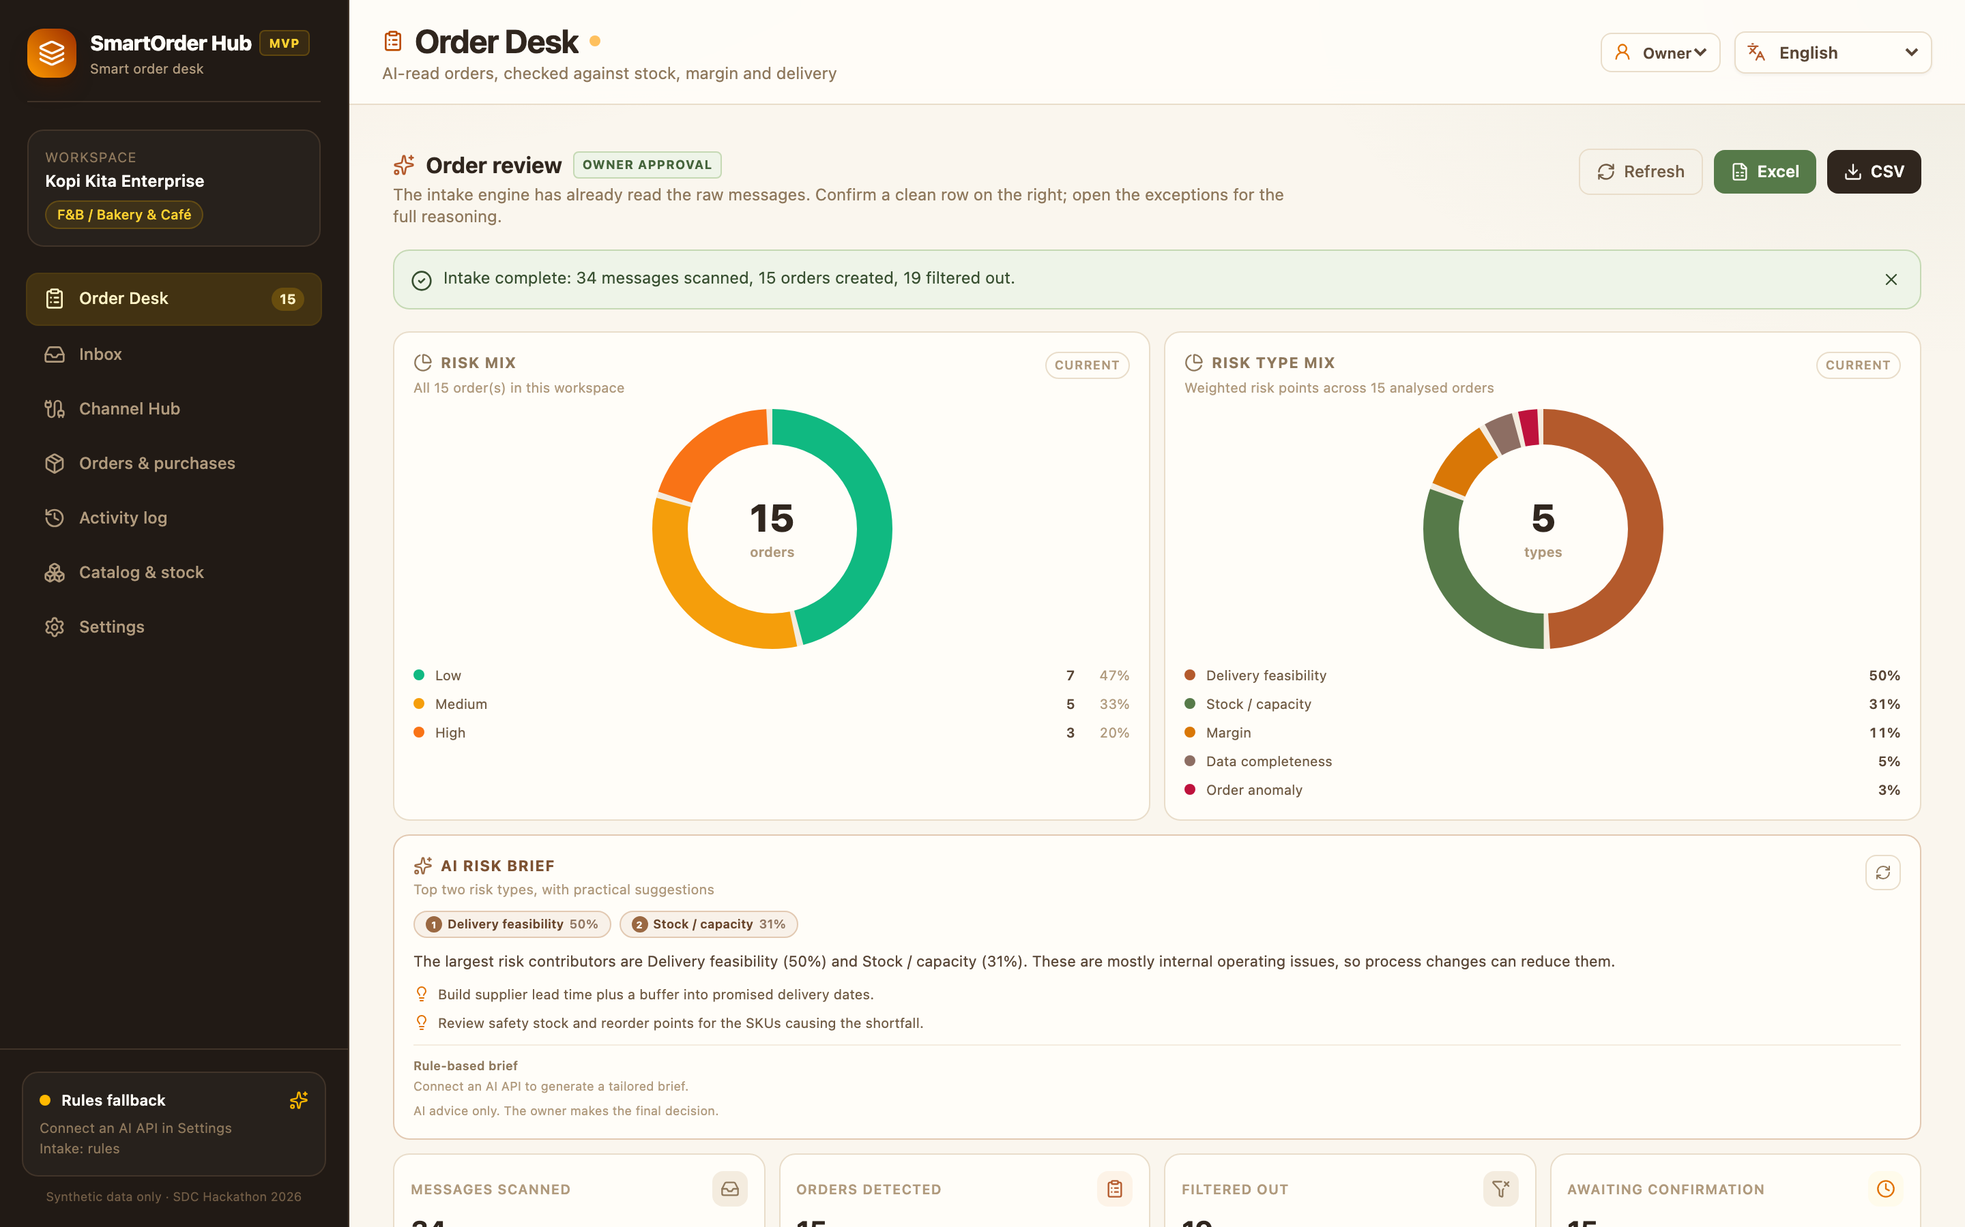

THE ORDER DESK
One order desk. Every channel.
One decision.
smartorderhub.local / order desk
34
15
19
messages scanned
orders created
filtered out
Every row is decision-ready
Customer, items, total, delivery, stock signal, margin, risk and recommendation.
Owner confirms on the right
Staff can review everything; only the owner can approve, reject or request information.
Risk updates after every intake
Two donuts show risk band mix and the factors driving the score.
WhatsApp
Messenger
Instagram
Telegram
Email
TikTok
SDC Hackathon 2026 · Domain 2 · SmartOrder Hub
05
Notes:
Hero screen. Point at the stats: 34 messages scanned, 15 orders, 19 filtered out. Point at one row: customer, items, total, delivery, stock, margin, risk and Confirm. The owner is one click from a decision.

Slide 6

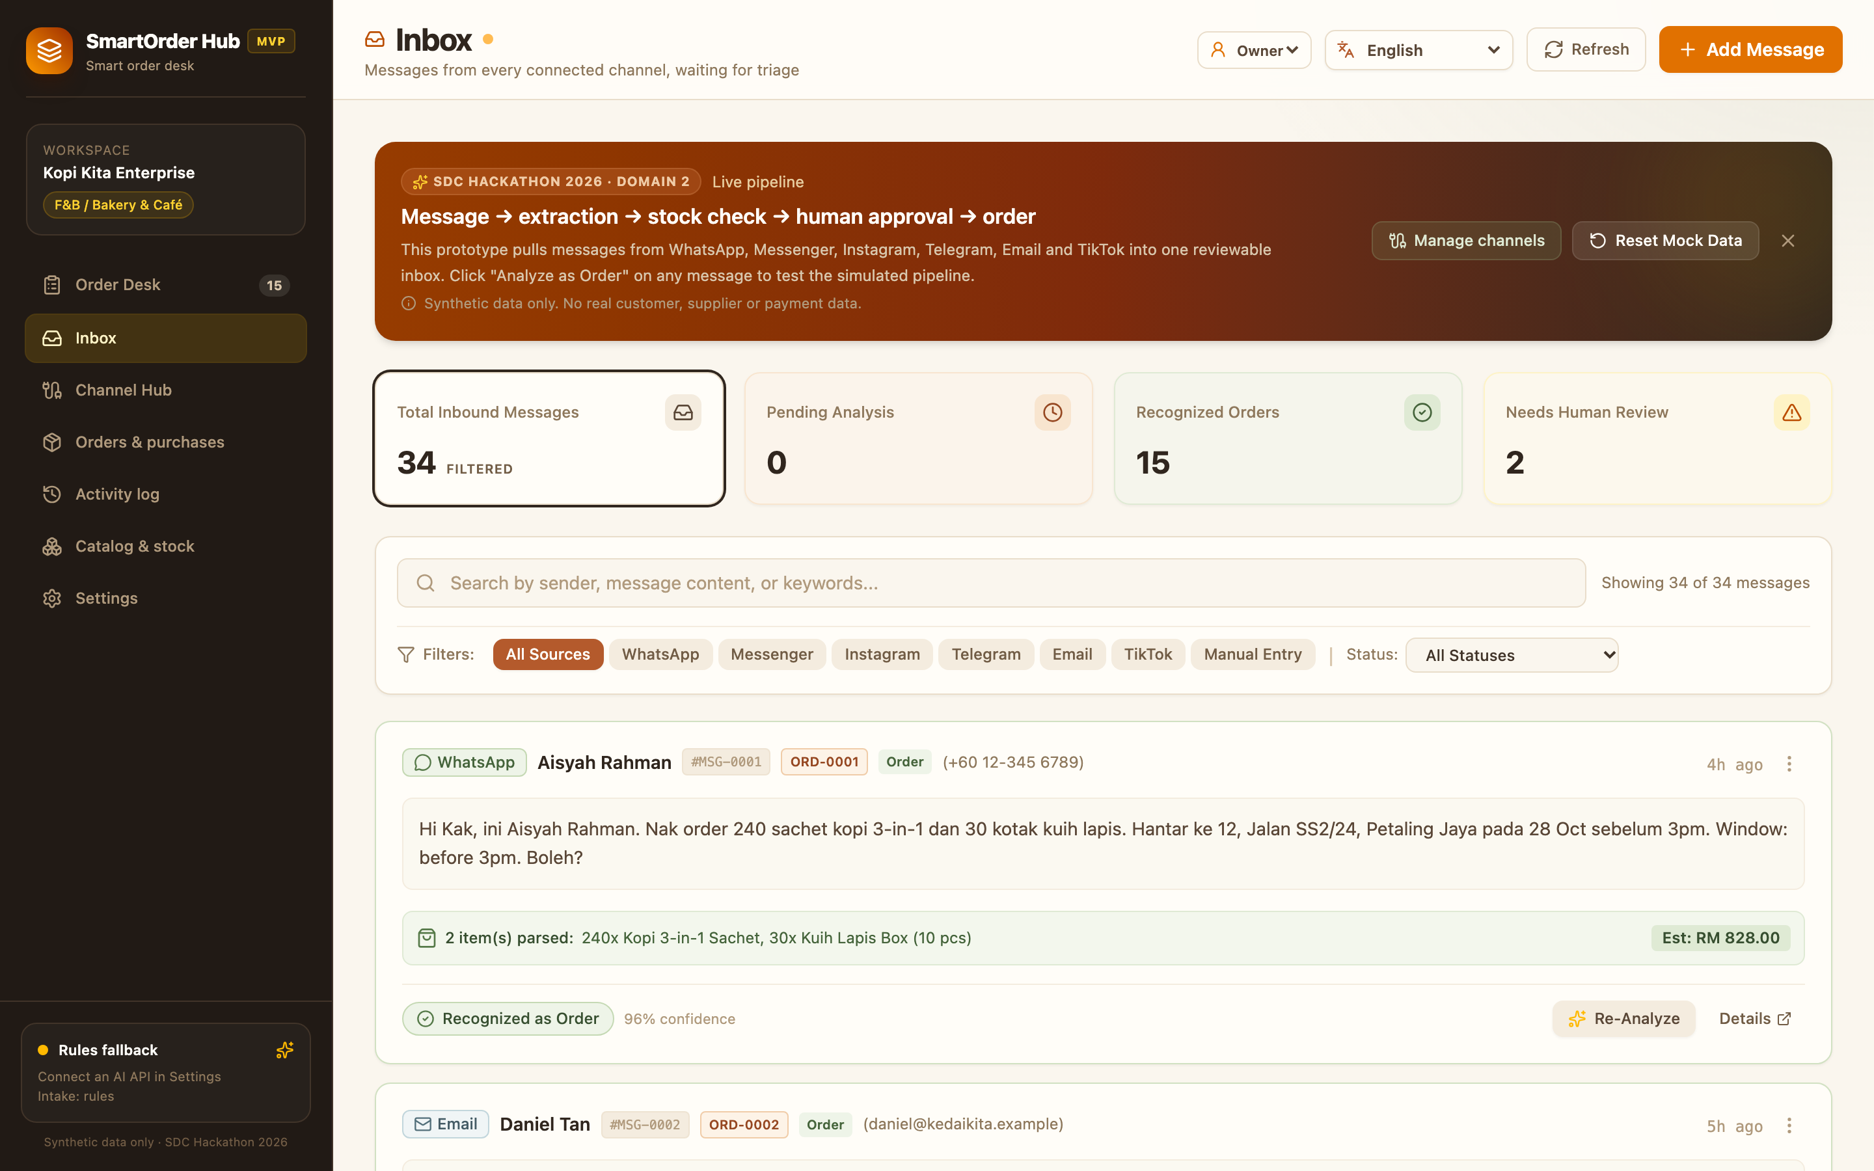

INTAKE & EXTRACTION
34 raw messages become 15 reviewable orders.
smartorderhub.local / inbox
Classify
Order, inquiry, ad, after-sales or other. 19 messages are filtered out.
Extract
Customer, items, quantities, address, delivery window and industry fields.
Show confidence
The Aisyah order has 96% extraction confidence; missing fields become review tasks.
Keep the source
Every order links back to its message and original text.
19 filtered out
4 inquiries · 4 ads · 4 after-sales · 4 other · 3 uncertain
Every message, its source, classification and extraction confidence — the raw trail stays visible.
SDC Hackathon 2026 · Domain 2 · SmartOrder Hub
06
Notes:
Open the Inbox and show the raw message behind ORD-0001. Explain classification: 19 non-orders filtered out. Show parsed items and 96% confidence. Missing fields become review tasks, not silent guesses.

Slide 7
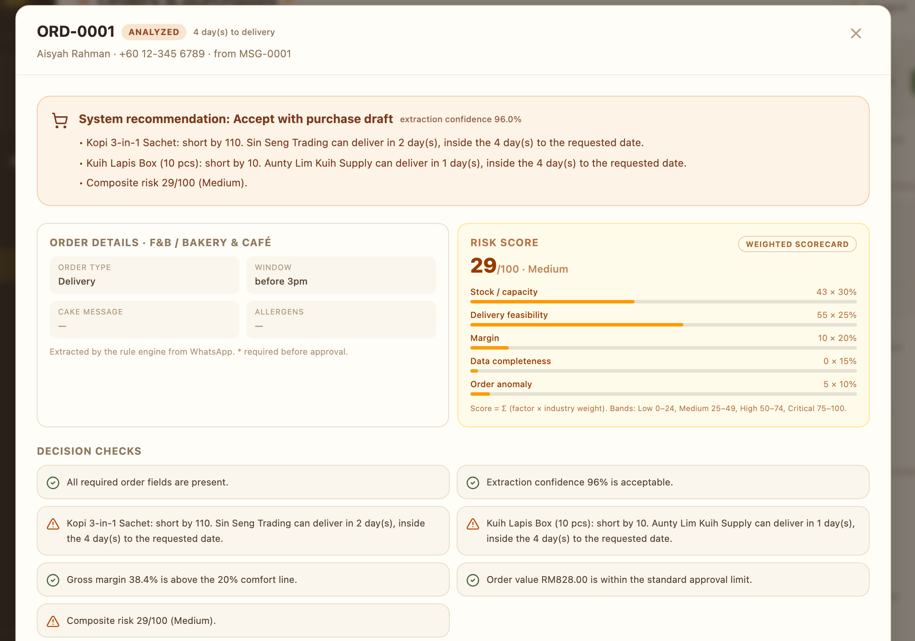


DECISION & APPROVAL
The decision arrives with its evidence.
ORD-0001 / review
Five-factor risk
Stock / capacity · Delivery
Margin · Data · Anomaly
Plain-language checks
Short by 110 units; supplier can deliver in 2 days.
Gross margin 38.4% — above the 20% line.
Composite risk 29/100 — Medium.
Human action
Accept with purchase draft.
Request information. Do not accept.
Override requires a written reason.
The model never approves. The owner does.
Synthetic data only. No payment or real purchase order is created.
SDC Hackathon 2026 · Domain 2 · SmartOrder Hub
07
Notes:
Open the review modal. Show the recommendation, the five-factor risk score, stock shortfall and supplier lead time. Then say: the model never approves; the owner chooses accept, request info, reject, or override with a reason.

Slide 8




GUARDRAILS
AI reads. Rules decide. The owner approves.
AI extraction
Deterministic rules
Human approval
Only where it adds value
The business math
The final decision
Reads messy text into structured JSON.
Stock, safety stock and supplier lead time.
Owner-only approval and override.
DeepSeek Flash or any compatible model.
Revenue, cost, profit and margin.
Staff can view, not decide.
Rule-based parser when AI is unavailable.
Completeness, duplicates and anomalies.
Every action is written to the audit log.
No AI model calculates stock, margin or risk.
Prompt-injection guarded
Rules fallback by default
Owner approval required
AI output is treated as untrusted data. Catalog prices are authoritative.
SDC Hackathon 2026 · Domain 2 · SmartOrder Hub
08
Notes:
This is the AI policy. AI reads messy text only. The rules engine does stock, cost, margin, delivery and risk. If the model is unavailable, the rule parser keeps the demo working. Human approval is always required.

Slide 9
EXPLAINABLE RISK
A risk score the owner can argue with.
Five independent factors, weighted by industry. Each one shows its evidence — not just a colour.
COMPOSITE RISK · ORD-0001
Stock / capacity
30%
weight
29
/ 100
MEDIUM
Delivery feasibility
25%
weight
Example: short by 110 units; supplier can deliver in 2 days; margin 38.4%; all required fields present.
Margin
20%
weight
Low
Medium
High
Critical
Data completeness
15%
0–24
25–49
50–74
75–100
weight
Hard blockers floor the score at High. The owner sees the factors before the recommendation.
Order anomaly
10%
weight
Factor scores are computed by rules from stock, supplier, order and market data. Weights are visible and industry-specific.
Recommendation: Accept with purchase draft · Request information · Do not accept · Override with reason
SDC Hackathon 2026 · Domain 2 · SmartOrder Hub
09
Notes:
Explain the weighted score. Each factor has evidence: stock, supplier lead time, margin, completeness, anomaly. Hard blockers floor the score. The owner can argue with the score because the reasoning is visible.

Slide 10
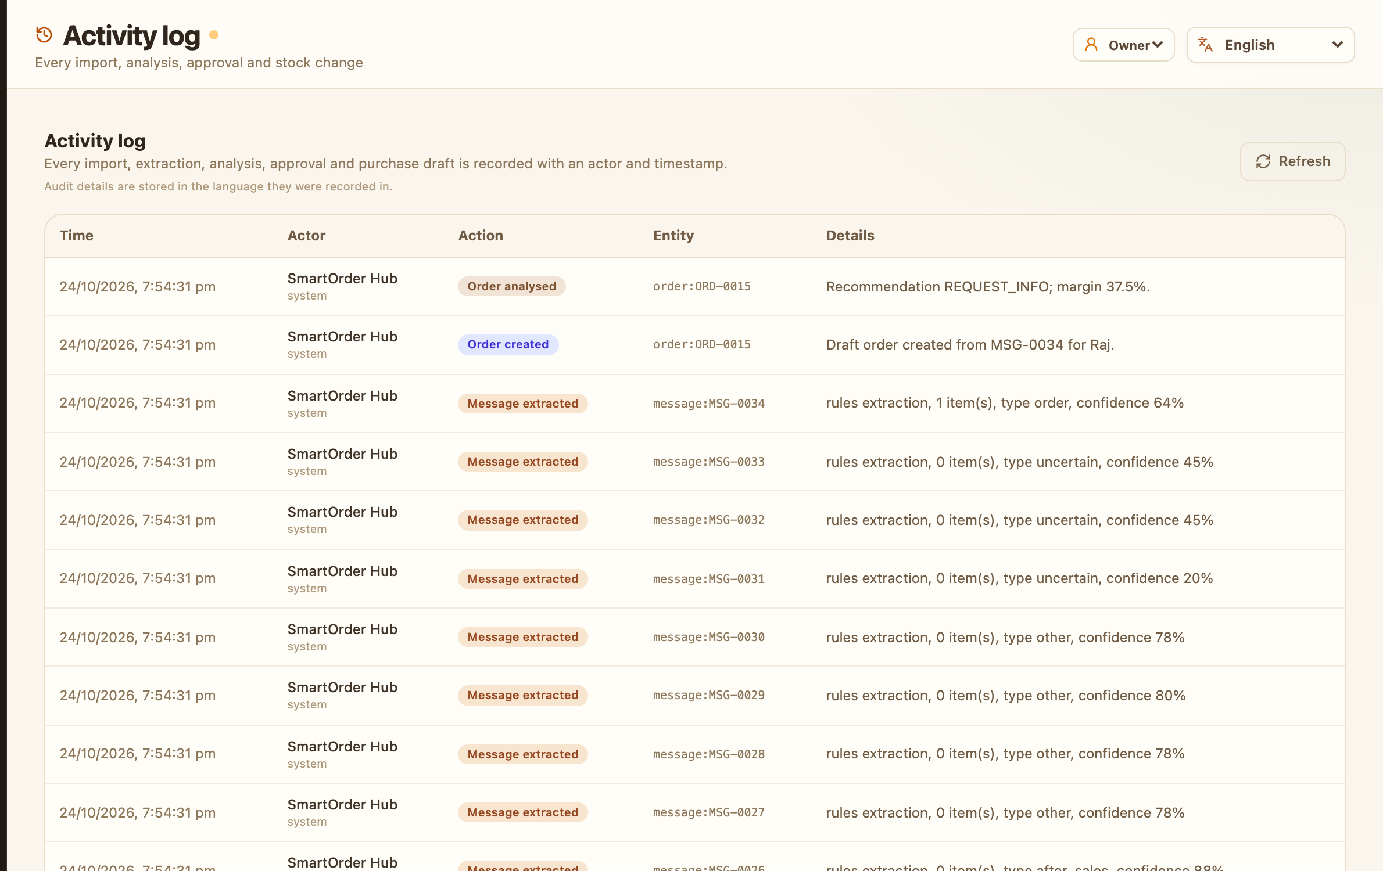

HUMAN CONTROL
People stay in control.
The system prepares the decision. It does not make it.
smartorderhub.local / activity log
Owner
Approve · Reject · Request info · Override with reason.
DECISION MAKER
Staff
View orders, stock, margin, risk and activity. No decision buttons.
VIEW ONLY
Every import, extraction, analysis, approval and purchase draft is recorded with actor and timestamp.
NO PAYMENTS · NO REAL POs
Activity log: the audit trail is a first-class screen, not a hidden table.
SDC Hackathon 2026 · Domain 2 · SmartOrder Hub
10
Notes:
Show roles: Owner decides; Staff can see everything but cannot act. Show the Activity log: every import, extraction, analysis, approval and draft is recorded. No payments, no real POs, no statutory filings.

Slide 11






ORBYTE FIT & REUSE
One workflow. Six SME contexts.
Same order journey; industry-aware fields, stock semantics and risk weights.
F&B / Bakery
Retail
ORBYTE FIT
Delivery window · allergens
SKU · size / colour
Connected hub, not another silo.
SmartOrder Hub
Wholesale
Services
MOQ · tier price
Appointment · deposit
OrbyteAdapter
Orbyte ecosystem
Manufacturing
Logistics
Material · tolerance
Vehicle · drop-off
Mock adapter today. Swap in Orbyte catalog, roles, approvals and audit APIs without changing the order workflow.
EN · 中文 · BM
Easy to learn: one table, three languages, no formal training.
REUSABLE ACROSS SMEs
SDC Hackathon 2026 · Domain 2 · SmartOrder Hub
11
Notes:
Explain reuse: six industry profiles, each with its own fields, stock semantics and risk weights. The mock OrbyteAdapter is the seam: today it returns synthetic data; tomorrow it can call Orbyte catalog, identity, approval and audit APIs.

Slide 12

FEASIBILITY & ARCHITECTURE
Working today. Built to survive a pilot.
BUILT
ARCHITECTURE
HARDEST RISK → FALLBACK
React 19 + TypeScript + Tailwind
No live Orbyte access
React SPA
Mock adapter; no dependency for the demo.
FastAPI + Pydantic backend
Read-only IMAP connector
FastAPI API
AI output varies
Atomic JSON store + file lock
Rule extraction fallback + human approval.
Rules & risk
JSON store
34 automated tests
Email provider limits
Live on Replit
IMAP inbox
AI (optional)
IMAP app password today; OAuth next.
Rules remain the source of truth for stock, margin and risk.
NO LIVE ORBYTE DEPENDENCY
Security: owner password option · CORS allowlist · read-only IMAP · CSV-injection guards · no secrets in the repo
SDC Hackathon 2026 · Domain 2 · SmartOrder Hub
12
Notes:
Feasibility: the core journey is running live on Replit, backed by the GitHub repo and 34 tests. Name the hardest risk: no live Orbyte access, so we built the adapter seam. AI variability is covered by rules fallback and human approval.

Slide 13





IMPACT & SDG
Less busywork. Better business.
What changes for the owner — and what we will prove in a pilot.
34 → 15
1 screen
6
100%
messages → reviewable orders
to review and approve
channels consolidated
actions logged
Illustrative impact
Pilot scorecard
8 minutes saved per order × 20 orders/week ≈ 2.7 hours/week back to the owner.
Measure: order-entry time · missed orders · pricing errors · stockout surprises · approval turnaround.
Illustrative only — validate with each pilot SME.
Baseline vs target set with each SME; no invented benchmark.
SDG LINK
8.2
Productivity through technology upgrading
8.3
SME growth and entrepreneurship
10
Reduced inequalities (optional)
12
Responsible consumption (optional)
SDC Hackathon 2026 · Domain 2 · SmartOrder Hub
13
Notes:
Impact: 34 to 15 in the demo; one screen to decide; six channels; every action logged. The 2.7 hours/week is illustrative, not a measured claim. Pilot scorecard names the metrics. SDG 8.2 and 8.3 are the main links; 10 and 12 are optional.

Slide 14


THANK YOU
Give the owner
back the evening.
LIVE DEMO
GITHUB
SmartOrder Hub — less busywork, better business.
Try it: open the Order Desk, review ORD-0001, confirm it,
then follow the event into the Activity log.
Open the order desk
Source & docs
Empathy Coders
THANK YOU · QUESTIONS WELCOME
SDC Hackathon 2026 · Domain 2
smart-order-hub-1.replit.app
github.com/Jacky-Godlike/Empathy-Coders
Synthetic data only. No real payments, purchase orders or statutory filings.
SDC Hackathon 2026 · Domain 2 · SmartOrder Hub
14
Notes:
Close on the human outcome. Invite judges to the live demo: review ORD-0001, confirm, then open Activity log to see the audit trail. QR codes point to the live app and the public repo.

