Slide 1

Experiment 1:

Slide 2
Description
Objective: Measure the retrieval ability of the retriever that whether it can correctly retrieve the context
Test Set: 90 Questions for 9 PDFs
Assumption: Users will ask in Chinese
Methodology:
Retrieve context based on all PDF
Retrieve context based on single PDF
Evaluation Metrics (Hit rate)
Goal: Improve the retrieval accuracy

Slide 3
Retriever
Embedding Model: Chuxin-Embedding
Base model: bge-m3-retromae
Model Size: 568M parameters
Vectorstore: Chroma
Search Type: Use similarity-based search to retrieve the most relevant document chunks.
Chunk size: Split by pages

Slide 4
Dataset
Source: HKMA Supervisory Policy Manual
Finance Regulatory Domain
Language :
7 in Chinese, 2 in English
Memory Size: 5 MB
Tokens Count by Retriever:
317,440 tokens
Topic | Language | Pages | Tokens
Corporate Governance of Locally Registered Authorized Institutions | Chinese | 38 | 38912
Climate Risk Management | English | 35 | 35840
Guidelines on Combating Money Laundering and Counter-Terrorist Financing | Chinese | 83 | 84992
Risk-based Regulatory System | Chinese | 30 | 30720
Outsourcing | Chinese | 14 | 14336
Regulatory Approach to Combating Money Laundering and Terrorist Financing | Chinese | 20 | 20480
Risk management of electronic banking | English | 37 | 37888
General Principles of Technology Risk Management | Chinese | 29 | 29696
Continuing business operations planning | Chinese | 24 | 24576
Total |  | 310 | 317440

Slide 5
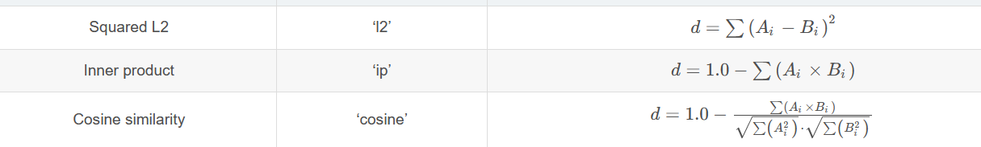
Squared L2 Distance: [0, +inf.)
Measure the absolute differences between corresponding elements
Very sensitive to magnitude differences
Inner Product: [0, 1]
Measure both the direction and magnitude of the vectors
Sensitive to both magnitude and direction
Cosine Similarity: [0, 1]
Measures the directionality between the two vectors
Insensitive to magnitude; focuses on direction

Slide 6
Correctly rerieved
Location | 應如何處理服務供應商的表現監察工作？ | Score
SA-2-Ch page 7 (target) | 服務供應商的能力 2 3 1 在選擇服務供應商前，認可機構應作出適當的嚴格調查。在評估服務供應商時，除考慮成本因素及服務水平外，認可機構還應顧及服務供應商的財政穩健程度、信譽、管理技巧、技術能力、營運能力及規模、與認可機構的企業文化和未來發展策略的配合程度、對銀行業的熟悉程度，以及緊貼市場創新步伐的能力。 …… | L2: 0.7775167 (Rank 1) IP: 0.3887585 (Rank1) Cosine: 0.3887584 (Rank 1)
The target paragraph ranked top by using all methods.

Slide 7
rerieved
Location | 銀行在進行滲透測試時，應涵蓋哪些範圍？ | Score
TM-E-1 page 12 | Supervisory Policy Manual …… If an AI’s policy framework for independent assessment does not include penetration tests, the senior management should further ensure that regular penetration tests are performed by qualified independent parties. For the purpose of this module, a penetration test should assess, at the minimum, the AI’s Internet banking and any financial services delivered over the Internet or via a wireless network (covering enquiry-only services and relevant outsourced systems) annually. Penetration tests should be carefully planned and carried out so as not to unduly disrupt the AI’s production systems/channels …… | ip: 0.6012 (Rank 20) Cosine: 0.524 (Rank 1) L2: 1,223 (Rank 1)

Slide 8
Result
Hit Rate
 | Context in Chinese PDF | Context in English PDF | Total
Single(1) PDF with Chinese query | 60/70 (85.71%) | 9/20 (45%) | 69/90
Multiple(9) PDF with Chinese query | 50/70 (71.43%) | 3/20 (15%) | 53/90
Focus on 2 English PDF
Hit Rate
 | Chinese Query | English Query
Single(1) PDF | 9/20 (45%) | 15/20 (75%)
Multiple(9) PDF | 3/20 (15%) | 14/20 (70%)

Slide 9
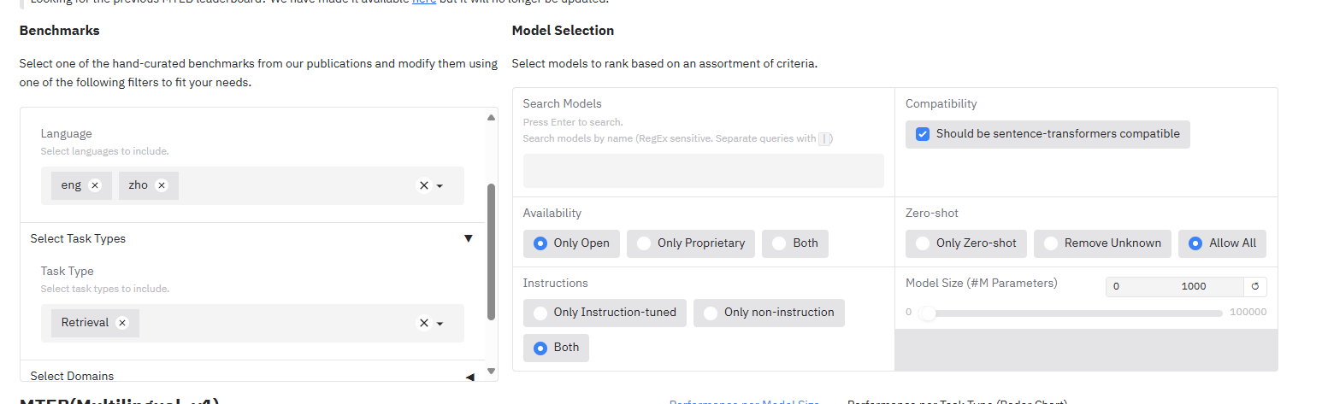
Discussion
The translation ability of the embedding model may be poor
Found another embedding model at MTEB to improve the accuracy of retrieving english document
MTEB (Massive Text Embedding Benchmark)
Language: Chinese + English
Model size: less than 1000 parameters
Task type: Retrieval
Availability: Only Open Source

Slide 10
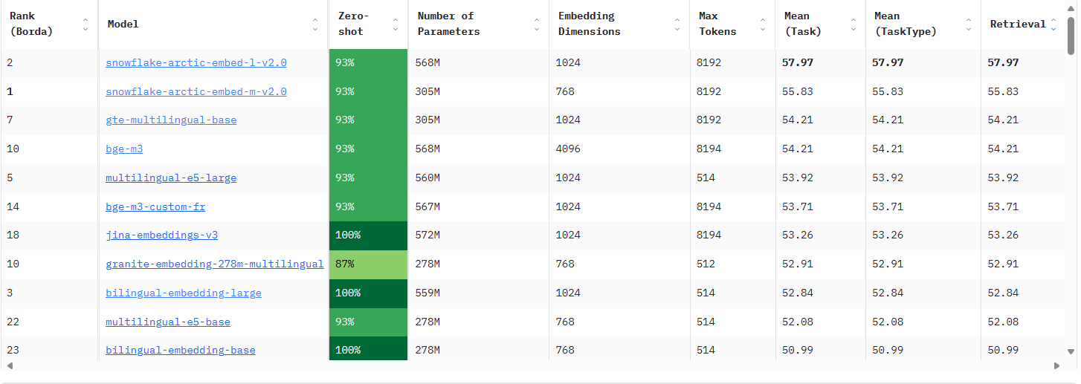
MTEB (Massive Text Embedding Benchmark)
Select:
Snowflake/snowflake-arctic-embed-l-v2.0
Alibaba-NLP/gte-multilingual-base

Slide 11
Result:
 |  | Context in Chinese PDF | Context in English PDF | Total
Chuxin Embedding | Single(1) PDF with Chinese query | 60/70 (85.71%) | 9/20 (45%) | 69/90
 | Multiple(9) PDF with Chinese query | 50/70 (71.43%) | 3/20 (15%) | 53/90
Snowflake/snowflake-arctic-embed-l-v2.0 | Single(1) PDF with Chinese query | 58/70 (82.83%) | 13/20 (65%) | 71/90
 | Multiple(9) PDF with Chinese query | 50/70 (71.43%) | 9/20 (45%) | 59/90
Alibaba-NLP/gte-multilingual-base | Single(1) PDF with Chinese query | 56/70 (80%) | 13/20 (50%) | 69/90
 | Multiple(9) PDF with Chinese query | 49/70 (70%) | 3/20 (15%) | 52/90

Slide 12
Result: Focus on 2 English PDF
 | Hit Rate on English document
 |  | Chinese Query | English Query
Chuxin Embedding | Single(1) PDF | 9/20 | 15/20
 | Multiple(9) PDF | 3/20 | 14/20
Snowflake/snowflake-arctic-embed-l-v2.0 | Single(1) PDF | 13/20 | 17/20
 | Multiple(9) PDF | 9/20 | 13/20
Alibaba-NLP/gte-multilingual-base | Single(1) PDF | 13/20 | 15/20
 | Multiple(9) PDF | 3/20 | 15/20
If we english query to search from those English document, the retrieval accuracy may also increase.

Slide 13
Discussion
Snowflake/snowflake-arctic-embed-l-v2.0 have better proficiency
Change the embedding model from Chuxin-Embedding to this model.
If we can locate the document first, the performance may be better

Slide 14
Next
Recalculate the accuracy after updating the embedding model and compare it to existing chatbot system
Method: Retrieve the relevant document from single pdf and generate the response by LLM
Model:
Gemma2-9b-it
Yi-1.5-9b-chat
Evaluation method: Accuracy
For Copilot:
The student account cannot access the copilot studio.
So, I just import single pdf into copilot chat and ask the question from pdf
For perplexity AI: only 3 free rag questions per day, so doesn’t include this time

Slide 15
Accuracy
RAG
 | Bleu | Rouge-1 | Roug-e-h | Meteor
Gemma2-9b-it | 0.315 | 0.532 | 0.451 | 0.486
Yi-1.5-9b-chat | 0.156 | 0.403 | 0.296 | 0.419
Copilot | 0.409 | 0.606 | 0.522 | 0.537

Slide 16
Future work
Adjust different chunk size
Test different vector store

