Slide 1
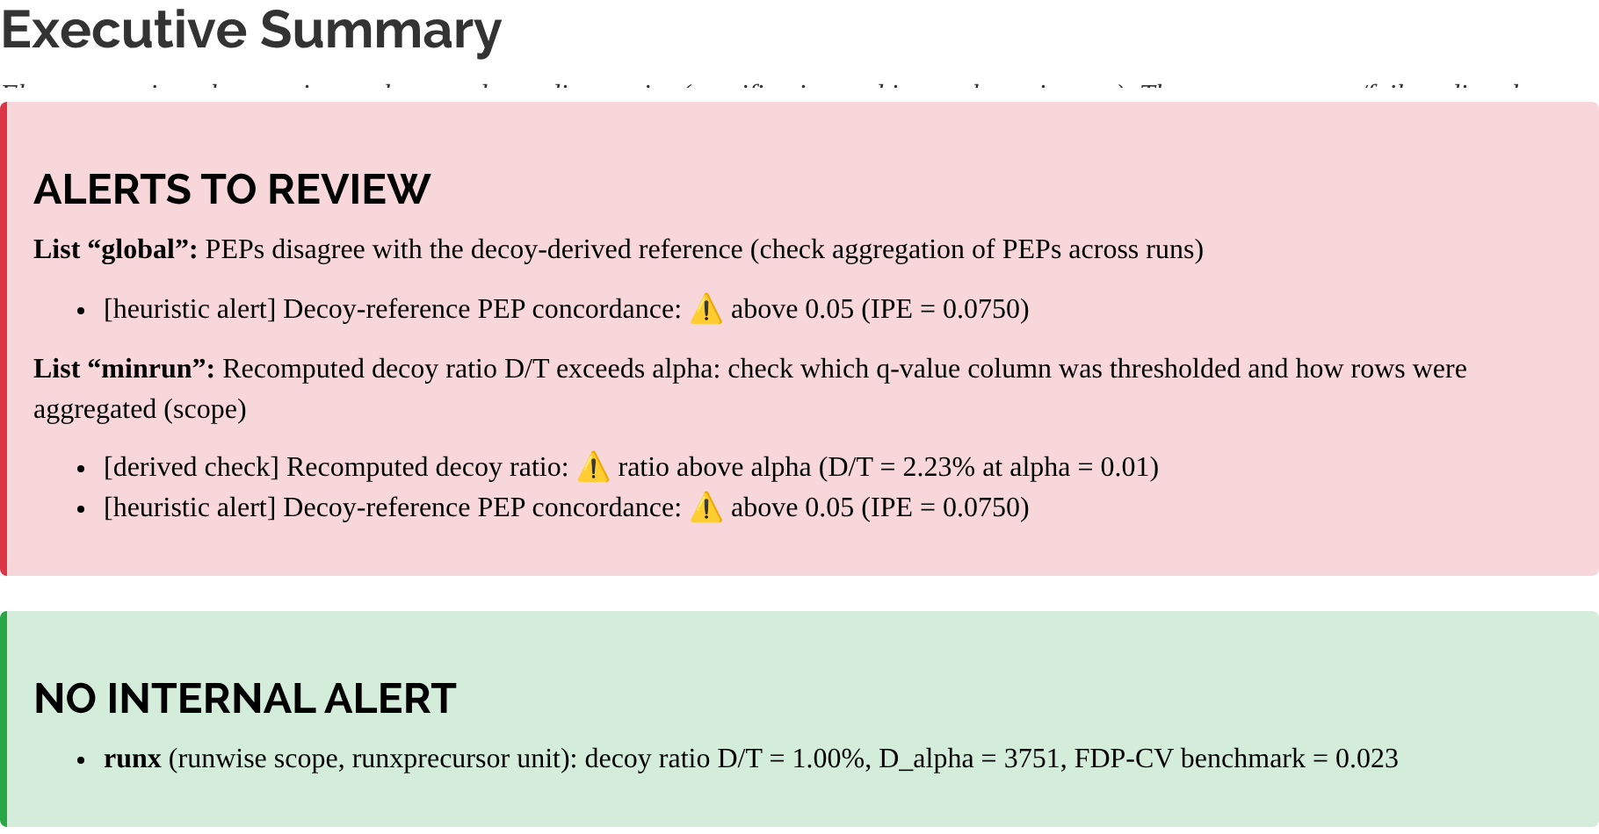
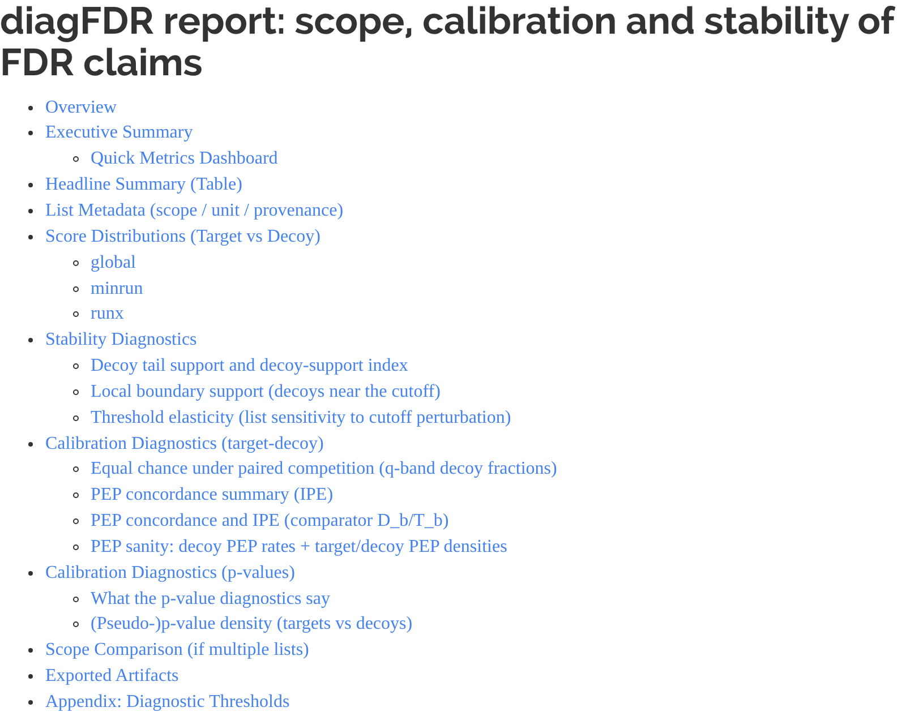
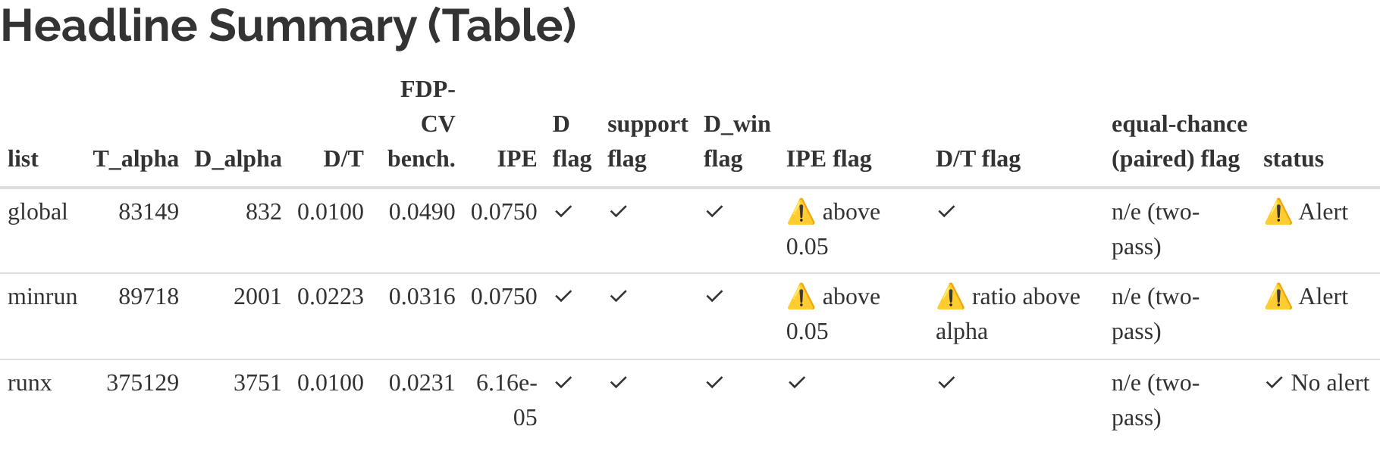
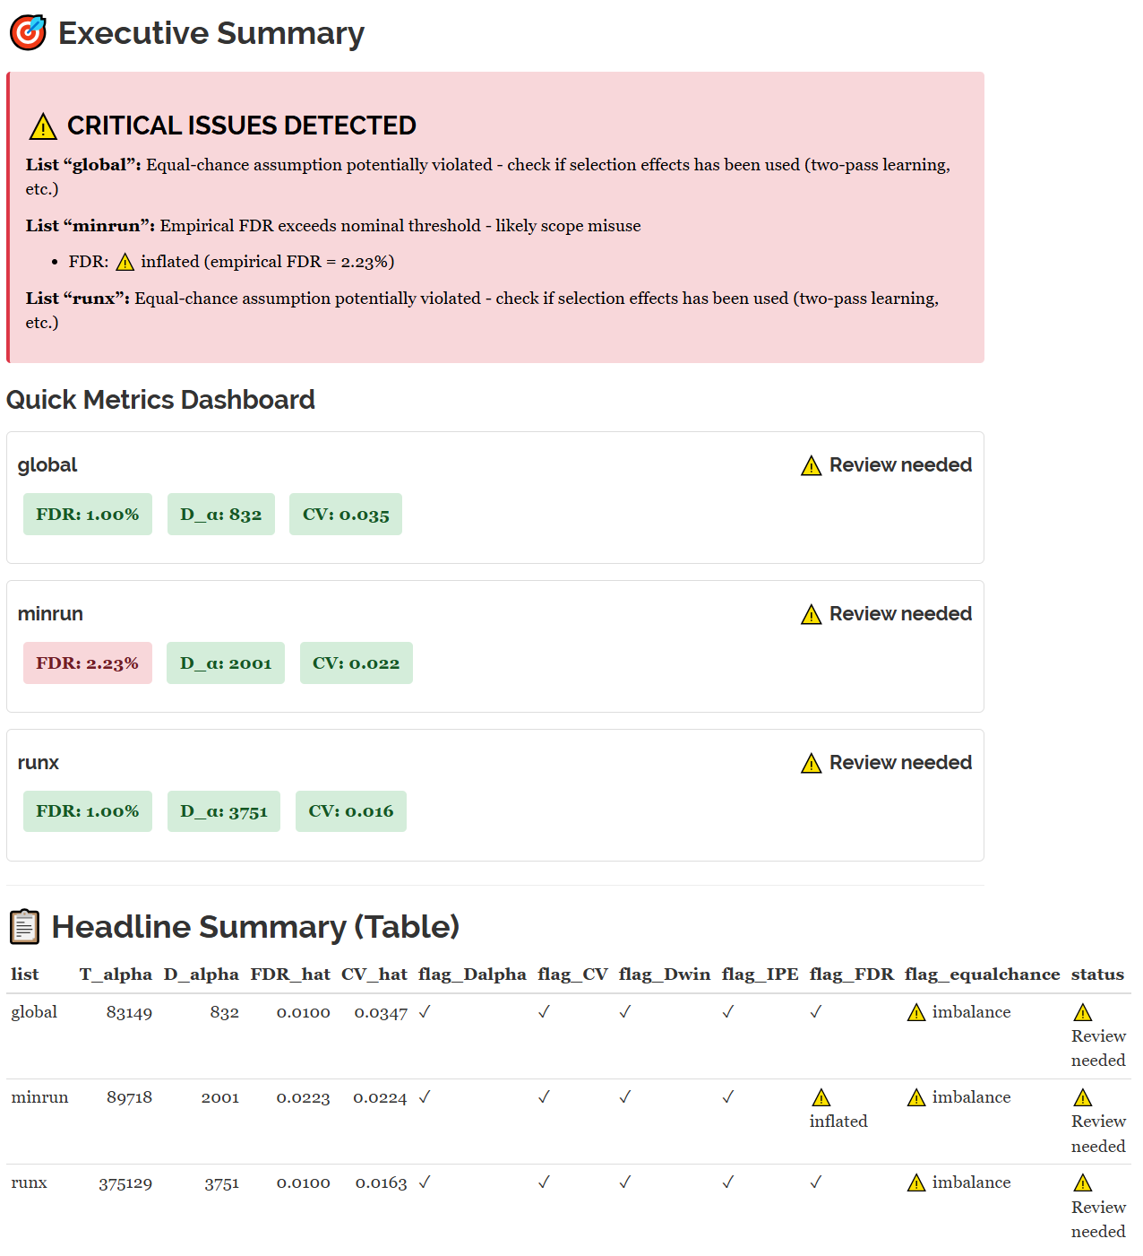
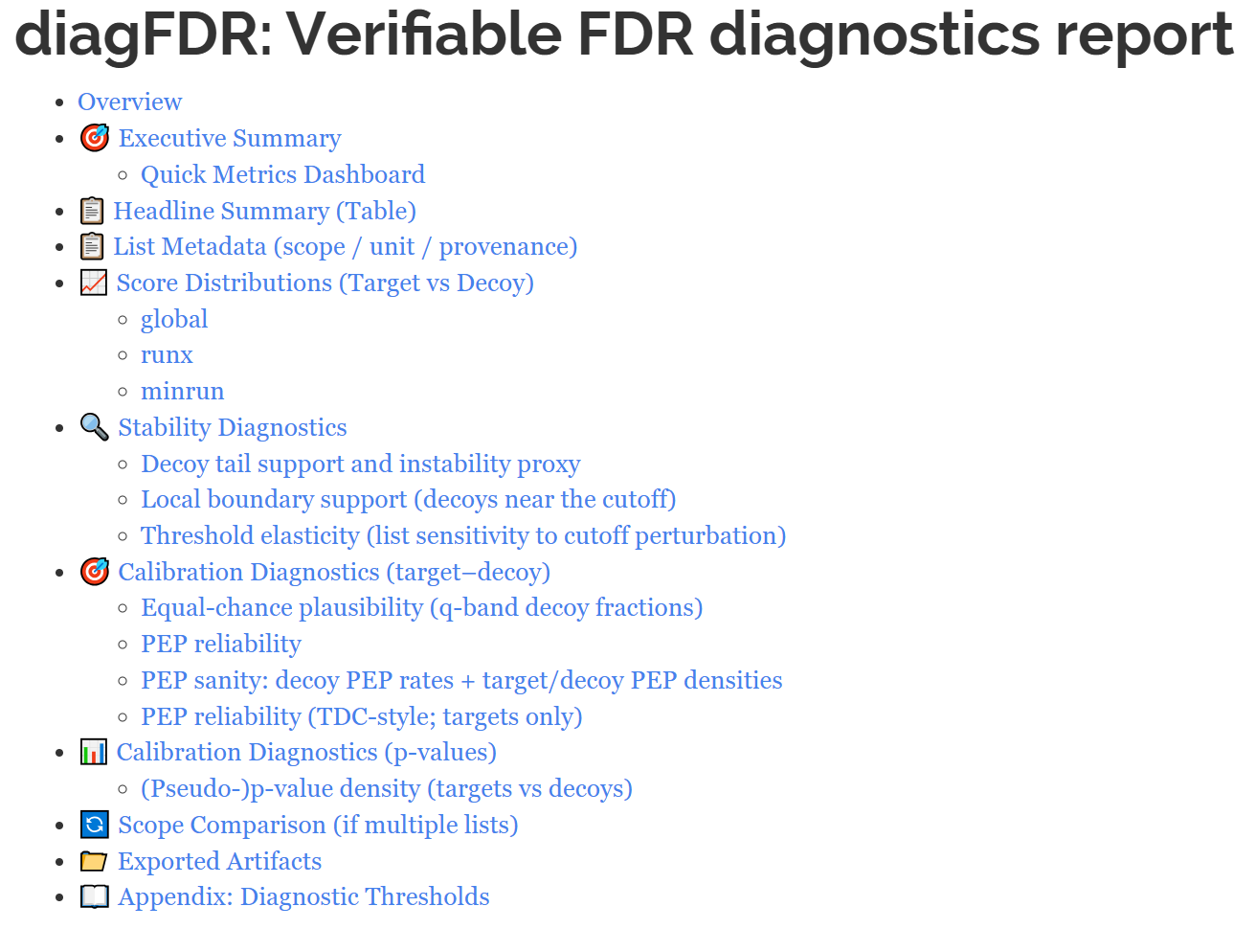
A
Installing and loading diagFDR in R
Input
install.packages("diagFDR"); library(diagFDR)
Output
Any search engine output
Import data (tool-agnostic) in R
1
Reproducible bundle
Required: score, is_decoy, id
Any format as long as columns are mapped
dfdr_write_report()
Optional: q-value, p-value, run/charge/RT
• plots (PNG)
PSM-level table (targets + decoys)
Run diagnostics
2
dfdr_run_all()
• tables (CSV)
Provided adapters
Calibration • separation • stability • plausibility checks
• manifest + README + summary
read_dfdr_maxquant_psm("msms.txt")
read_dfdr_mzid ("file.mzid", "file.mzIdentML")
Optional: if p-values are missing, derive pseudo p from decoys
HTML report
read_diann_parquet("report.parquet")
score_to_pvalue(method = "decoy_ecdf")
dfdr_render_report()
read_mokapot_psms("file.psms.txt", "file.decoy.psms.txt")
Report and share
3
reader/reviewer friendly HTML page
single entry point with all diagnostics
One command
B

