Slide 1
Computer and Robot Vision I
Chapter 11
Arc Extraction and Segmentation
Presented by: 邱熹哲
d09945011@ntu.edu.tw
授課教授：傅楸善 博士

Slide 2
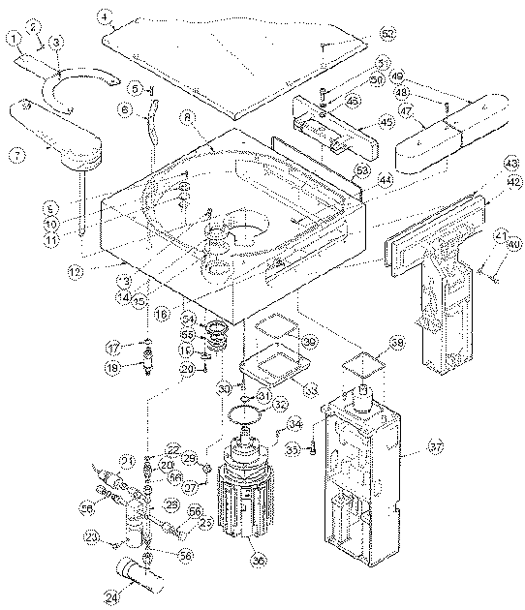
11.1 Introduction
In some image sets, lines, curves, and circular arcs are more useful than regions or helpful in addition to regions.
object recognition
stereo matching
document analysis
2
Notes:
物件辨識
立體匹配
文件分析

Slide 3
11.1 Introduction
In this Ch., we discuss techniques for extracting sequences of pixels that belong to the same curve.
Source: a segmented or
labeled image
3

Slide 4
11.1 Introduction
Grouping Operation :
After edge labeling or image segmentation
To extract sets or sequences of labeled or border pixel positions.
The extracted pixel’s positions:
belong to the same curve (group)
sequence of pixels group features
4

Slide 5
11.1 Introduction
Labeling
edge detection: label each pixel as edge or not
additional properties: edge direction, gradient magnitude, edge contrast….
Grouping
grouping operation: edge pixels participating in the same region boundary are grouped together into a sequence.
boundary sequence simple pieces
analytic descriptions shape-matching
5

Slide 6
11.2 Extracting Boundary Pixels from a Segmented Image
Regions have been determined by segmentation or connected components
boundary of each region can be extracted
Boundary extraction for small-sized images:
scan through the image → first border of each region
first border of each region → follow the border of the connected component around in a clockwise direction until reach itself
6

Slide 7
11.2 Extracting Boundary Pixels from a Segmented Image
Boundary extraction for small-sized images:
→ memory problems; for large-sized one, simple boarder-tacking algo. may result in excessive I/O to storage
4K UHD – (3840 × 2160) ~= 8.3M pixel
Many techniques like down-sampling
It may be a problem back to 1992; how about TODAY?
Border-tracking algorithm: border
Input: symbolic image
Output: a clockwise-ordered list of the coordinates of its border pixels
In one left-right, top-bottom scan through the image
During execution,
there are 3 sets of regions: current, past, future
7

Slide 8
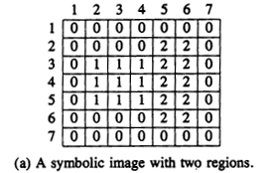
11.2.2 Border-Tracking Algorithm
Past region: null
Current region: 2
Future region: 1
8

Slide 9
11.2.2 Border-Tracking Algorithm
Past region: 1
Current region: 2
Future region: null
9

Slide 10
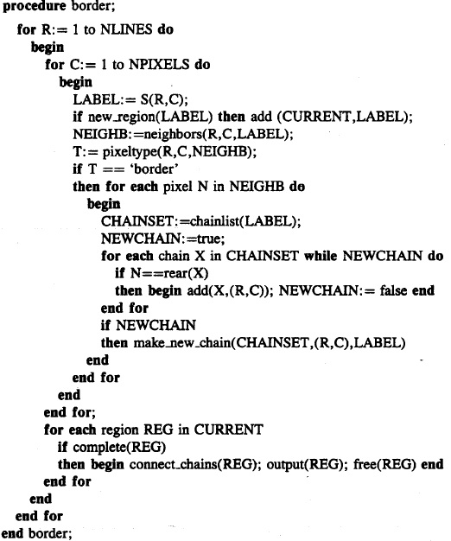
10

Slide 11
11.2.2 Border-Tracking Algorithm
11

Slide 12
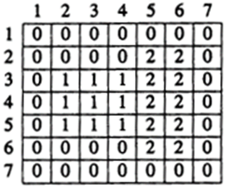



11.2.2 Border-Tracking Algorithm
12

Slide 13



11.2.2 Border-Tracking Algorithm
(active)
13

Slide 14
11.2.2 Border-Tracking Algorithm
(Inactive) CHAINSET (2) -> (2,5) -> (2,6)
(active) CHAINSET (1) -> (3,2)
(3,2) NEIGHB (3,3), (4,2)
14

Slide 15
11.2.2 Border-Tracking Algorithm
(Inactive) CHAINSET (2) -> (2,5) -> (2,6)
(active) CHAINSET (1) -> (3,2)
- (3,3) NEIGHB (3,2),(3,4),(4,3)
- (active) CHAINSET (1) -> (3,2) -> (3,3)
15

Slide 16
11.2.2 Border-Tracking Algorithm
(Inactive) CHAINSET (2) -> (2,5) -> (2, 6)
(active) CHAINSET (1) -> (3,2) -> (3,3)
- (3,4) NEIGHB (3,3),(4,4)
- (active) CHAINSET (1) -> (3,2) -> (3,3) -> (3,4)
16

Slide 17
11.2.2 Border-Tracking Algorithm
(Inactive) CHAINSET (2) -> (2,5) -> (2,6)
(inactive) CHAINSET (1) -> (3,2) -> (3,3) -> (3,4)
(active) CHAINSET (2) -> (3,5)
(3,5) NEIGHB (2,5), (3,6), (4,5)
17

Slide 18
11.2.2 Border-Tracking Algorithm
(inactive) CHAINSET (2) -> (2,5) -> (2,6)
(inactive) CHAINSET (1) -> (3,2) -> (3,3) -> (3,4)
(active) CHAINSET (2) -> (3,5)
- (3,6) NEIGHB (2,6), (3,5), (4,6)
- active CHAINSET change! (clockwise-ordered)
- (active) CHAINSET (2) -> (2,5) -> (2,6) -> (3,6)
18

Slide 19
11.2.2 Border-Tracking Algorithm
(inactive) CHAINSET (2) -> (2,5) -> (2,6) -> (3,6)
(inactive) CHAINSET (1) -> (3,2) -> (3,3) -> (3,4)
(inactive) CHAINSET (2) -> (3,5)
(active) CHAINSET (1) -> (4,2)
(4,2) NEIGHB (3,3),(4,3),(5,2)
19

Slide 20

11.2.2 Border-Tracking Algorithm
(inactive) CHAINSET (2) -> (2,5) -> (2,6) -> (3,6)
(inactive) CHAINSET (1) -> (3,2) -> (3,3) -> (3,4)
(inactive) CHAINSET (2) -> (3,5)
(active) CHAINSET (1) -> (4,2)
20

Slide 21
11.2.2 Border-Tracking Algorithm
……………………………
21

Slide 22
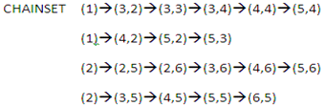
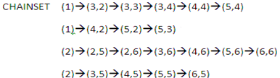
11.2.2 Border-Tracking Algorithm
22

Slide 23
11.2.2 Border-Tracking Algorithm
CHAINSET
(1)→(3,2)→(3,3)→(3,4)→(4,4)→(5,4)
(1)→(4,2)→(5,2)→(5,3)
(2)→(2,5)→(2,6)→(3,6)→(4,6)→(5,6)→(6,6)
(2)→(3,5)→(4,5)→(5,5)→(6,5)
CHAINSET
(1)→(3,2)→(3,3)→(3,4)→(4,4)→(5,4)→(5,3)→(5,2)→(4,2)
(2)→(2,5)→(2,6)→(3,6)→(4,6)→(5,6)→(6,6)→(6,5)→(5,5) →(4,5)→(3,5)
23

Slide 24
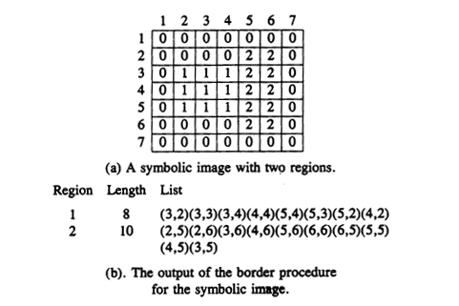
11.2.2 Border-Tracking Algorithm
24

Slide 25
11.3 Linking One-Pixel-Wide Edges or Lines
Border tracking: each border bounded a closed region → NO point would be split into two or more segments.
Tracking symbolic edge (line) segments: more complex
→ value:1 edge; 0: non-edge
→ not necessary for edge pixels to bound closed regions
→ segments consist of connected edge pixels that go from endpoint, corner, or junction to endpoint, corner, or junction.
-> pixeltype() is more complex
25

Slide 26
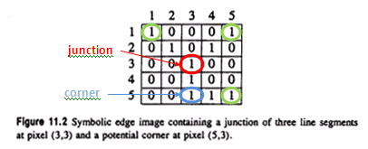
11.3 Linking One-Pixel-Wide Edges or Lines
*INLIST, OUTLIST
26

Slide 27
11.3 Linking One-Pixel-Wide Edges or Lines
pixeltype() → determines a pixel point
isolated point
starting point of an new segment
interior pixel of an old segment
ending point of an old segment
junction
corner
Instead of past, current, future regions, there are past, current, future segments.
27

Slide 28
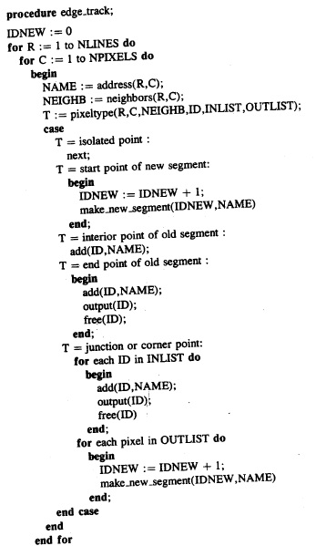

28

Slide 29
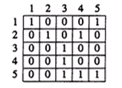
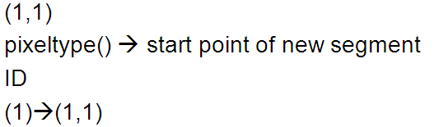
11.3 Linking One-Pixel-Wide Edges or Lines
29

Slide 30
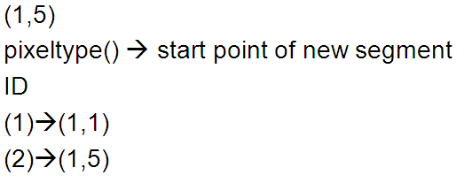
11.3 Linking One-Pixel-Wide Edges or Lines
30

Slide 31
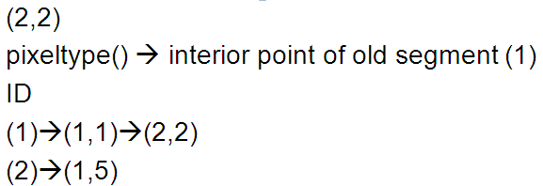
11.3 Linking One-Pixel-Wide Edges or Lines
31

Slide 32
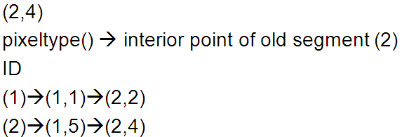
11.3 Linking One-Pixel-Wide Edges or Lines
32

Slide 33
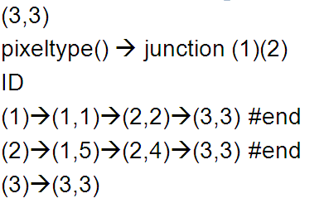
11.3 Linking One-Pixel-Wide Edges or Lines
33

Slide 34
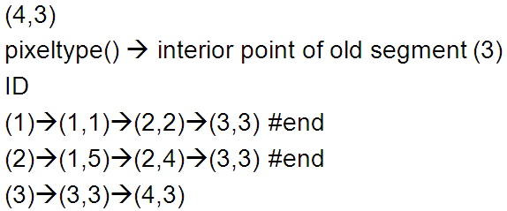
11.3 Linking One-Pixel-Wide Edges or Lines
34

Slide 35
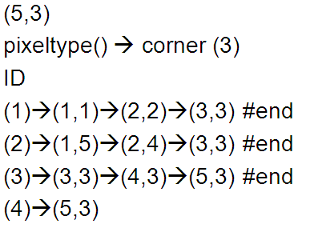
11.3 Linking One-Pixel-Wide Edges or Lines
35

Slide 36
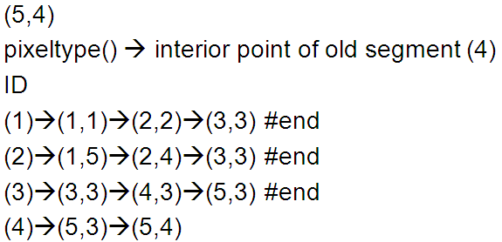
11.3 Linking One-Pixel-Wide Edges or Lines
36

Slide 37
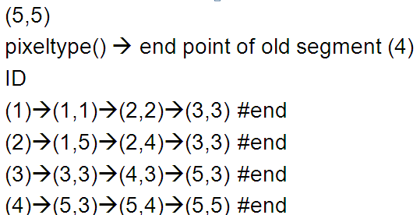
11.3 Linking One-Pixel-Wide Edges or Lines
37

Slide 38
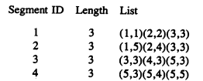
11.3 Linking One-Pixel-Wide Edges or Lines
38

Slide 39
11.3 Linking One-Pixel-Wide Edges or Lines
39

Slide 40
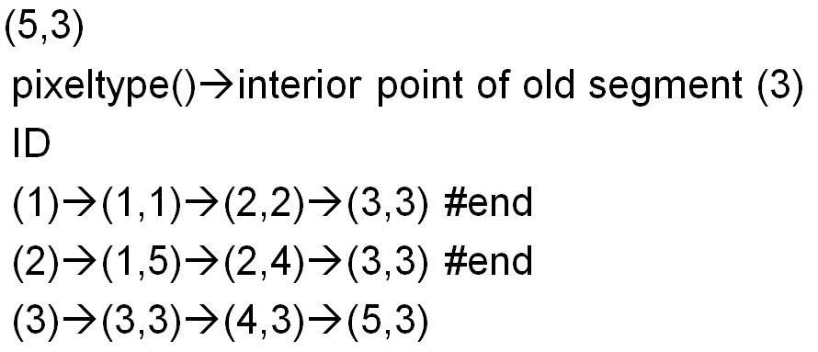
11.3 Linking One-Pixel-Wide Edges or Lines
40

Slide 41
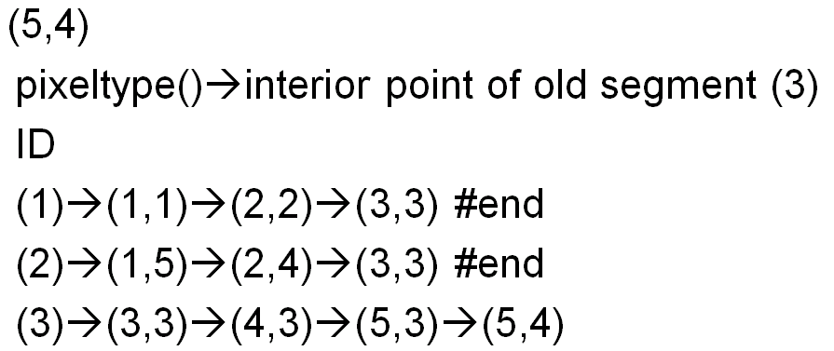
11.3 Linking One-Pixel-Wide Edges or Lines
41

Slide 42
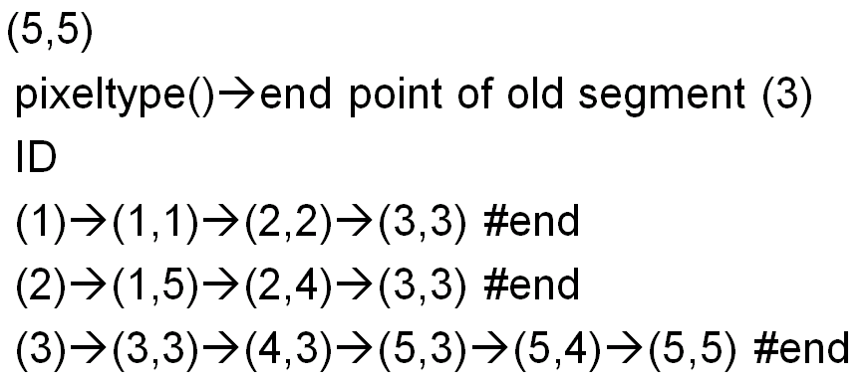
11.3 Linking One-Pixel-Wide Edges or Lines
42

Slide 43
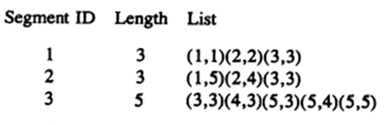
11.3 Linking One-Pixel-Wide Edges or Lines
43

Slide 44
11.4 Edge and Line Linking Using Directional Information
Previous edge_track : no directional information
In this section, assume each pixel is marked to indicate whether it is an edge (line):
Yes, there is an associated angular direction
pixels that have similar enough directions can form connected chains and be identified as an arc segment.
The arc has a good fit to a simple curvelike line
No
44

Slide 45
11.4 Edge and Line Linking Using Directional Information
The linking process -> scan the labeled edge image in top-down, left-right and if a labeled pixel has:
No previous labeled neighbors
It begins a new group
One previous labeled neighbors
T-test
Two or more previous labeled neighbors
T-test
Merge test
45

Slide 46


11.4 Edge and Line Linking Using Directional Information
No previous labeled neighbors:
initialize the scatter of group ->
: priori variance
: # of pixels
46

Slide 47

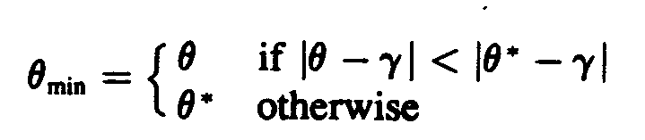
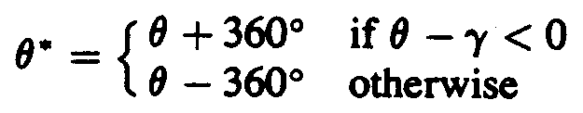

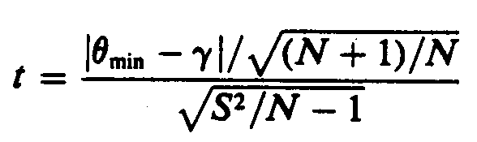
11.4 Edge and Line Linking Using Directional Information
If an encountered label pixel has previously encountered labeled neighbors: Measure t-statistic
47

Slide 48

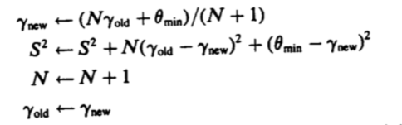
11.4 Edge and Line Linking Using Directional Information
If the pixel is added to the group; the mean and scatter of the group are updated:
48

Slide 49
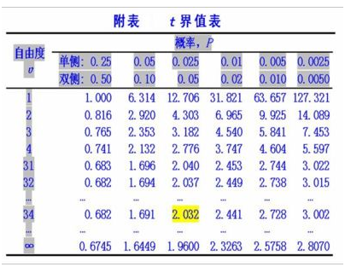

11.4 Edge and Line Linking Using Directional Information
49

Slide 50
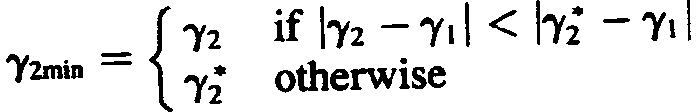

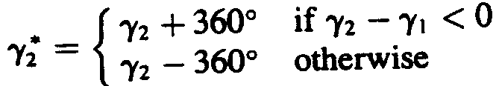
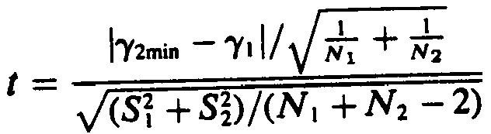
11.4 Edge and Line Linking Using Directional Information
If there are two or more previously encountered labeled neighbors,
50

Slide 51

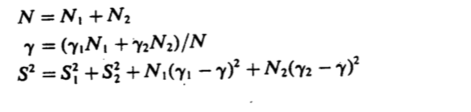
11.4 Edge and Line Linking Using Directional Information
then merge two groups
Create a new group having:
51

Slide 52
11.5 Segmentation of Arcs into Simple Segments
Arc segmentation: partition
extracted digital arc sequence → digital arc subsequences (each is a maximal sequence that can fit a straight or curve line)
Simple arc segment: straight-line or curved-arc segment
The endpoints of the subsequences are called corner points or dominant points.
52

Slide 53
11.5 Segmentation of Arcs into Simple Segments
Identification of all locations:
(a) have sufficiently high curvature
(b) are enclosed by different lines and curves
techniques: iterative endpoint fitting and splitting, using tangent angle deflection, or high curvature as basis of the segmentation
53

Slide 54
11.5.1 Iterative Endpoint Fit and Split
To segment a digital arc sequence into subsequences that are sufficiently straight.
one distance threshold d*
L={(r,c)| αr+βc+γ=0} where |(α,β)|=1
The straight line composed by 2 endpoints of this arc
d_{i}=| αr_{i}+βc_{i}+γ | / |(α,β)| = | αr_{i}+βc_{i}+γ |
The length of the perpendicular line composed by any single pixel of this arc and L
d_{m}=max(d_{i})
If d_{m}> d* , then split at the point (r_{m},c_{m})
54

Slide 55
11.5.1 Iterative Endpoint Fit and Split
55

Slide 56
11.5.1 Iterative Endpoint Fit and Split
d_{m}=max(d_{i})
L
56

Slide 57
11.5.1 Iterative Endpoint Fit and Split
d_{m}=max(d_{i})
L
57

Slide 58
11.5.1 Iterative Endpoint Fit and Split
Circular arc sequence
initially split by two points apart in any direction
Sequence only composed of two line segments
Golden section search
58

Slide 59
11.5.2 Tangential Angle Deflection
To identify the locations where two line segments meet and form an angle.
a_{n}(k)=(r_{n-k} – r_{n} , c_{n-k} - c_{n})
b_{n}(k)=(r_{n} – r_{n+k} , c_{n} –c_{n+k})
59

Slide 60
11.5.2 Tangential Angle Deflection
60

Slide 61
11.5.2 Tangential Angle Deflection
(r_{n} – r_{n+k} , c_{n} –c_{n+k})
(r_{n-k} – r_{n} , c_{n-k} - c_{n})
61

Slide 62
11.5.2 Tangential Angle Deflection
(r_{n} – r_{n+k} , c_{n} –c_{n+k})
b_{n}(k)
(r_{n-k} – r_{n} , c_{n-k} - c_{n})
a_{n}(k)
62

Slide 63
11.5.2 Tangential Angle Deflection
At a place where two line segments meet
→ the angle will be larger → cosθ_{n}(k_{n}) smaller
A point at which two line segments meet
cosθ_{n}(k_{n}) < cosθ_{i}(k_{i}) for all i,|n-i| ≦ k_{n}/2
k=?
63

Slide 64
11.5.3 Uniform Bounded-Error Approximation
segment arc sequence into maximal pieces whose points deviate ≤ given amount
optimal algorithms: excessive computational complexity
64

Slide 65
11.5.3 Uniform Bounded-Error Approximation
65

Slide 66
11.5.4 Breakpoint Optimization
after an initial segmentation: shift breakpoints to produce a better arc segmentation
first → shift odd final point (i.e. even beginning point) and see whether the max. error is reduced by the shift.
If reduced, then keep the shifted breakpoints.
then→ shift even final point (i.e. odd beginning point) and do the same things.
66

Slide 67
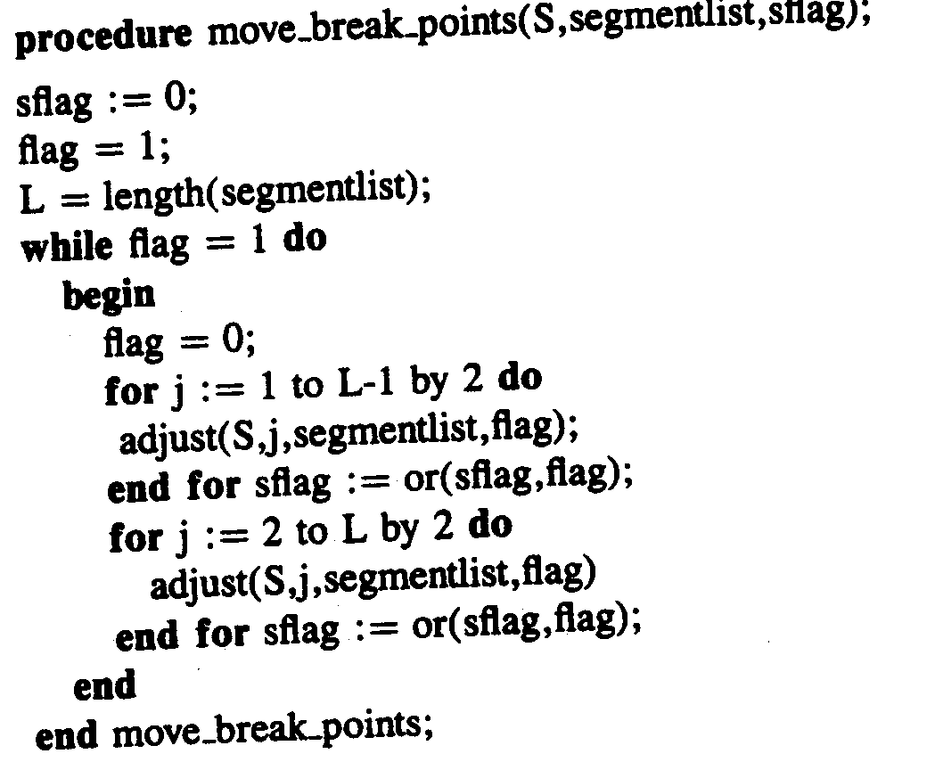
11.5.4 Breakpoint Optimization
67

Slide 68
11.5.5 Split and Merge
first: split arc into segments with the error sufficiently small
second: merge successive segments if resulting merged segment has sufficiently small error
third: try to adjust breakpoints to obtain a better segmentation
repeat: until all three steps produce no further change
68

Slide 69
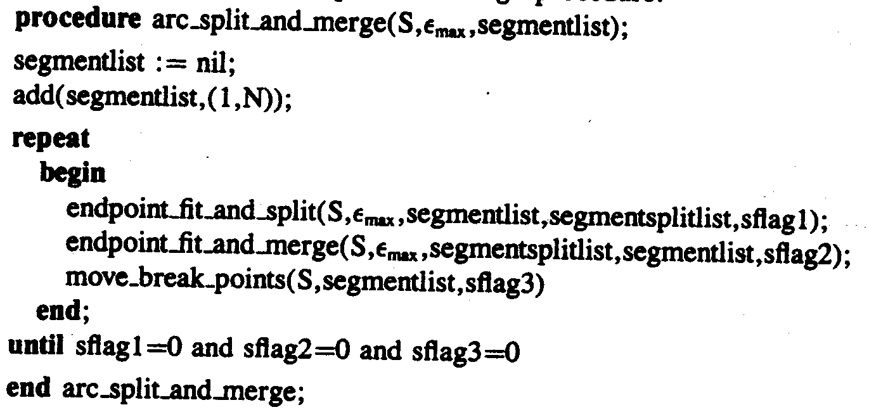
11.5.5 Split and Merge
69

Slide 70
11.5.6 Isodata Segmentation
Iterative Selforganizing Data Analysis Techniques Algorithm
iterative isodata line-fit clustering procedure: determines line-fit parameter
then each point assigned to cluster whose line fit closest to the point
70
Notes:
http://img.rritw.com/2013-01-17/1358350718_8022.gif

Slide 71
11.5.6 Isodata Segmentation
71
Notes:
http://img.rritw.com/2013-01-17/1358350718_8022.gif

Slide 72
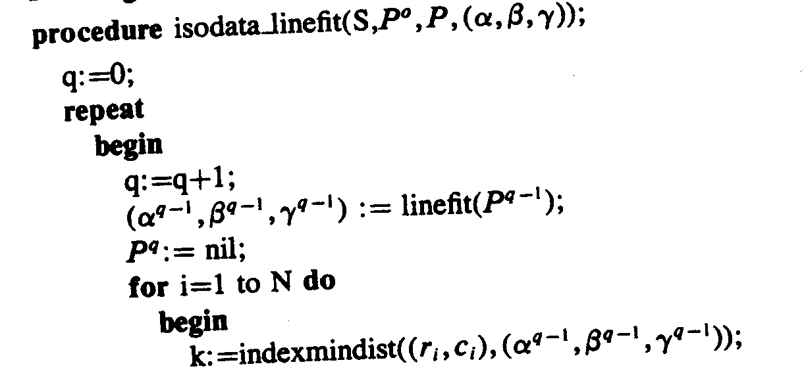
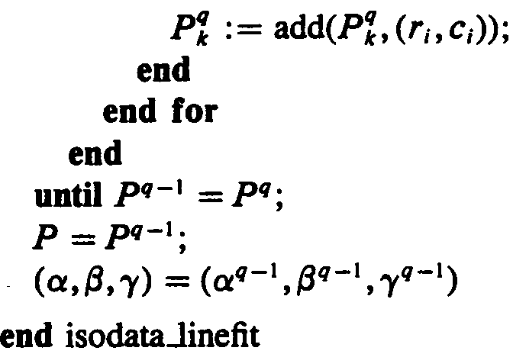
11.5.6 Isodata Segmentation
72

Slide 73
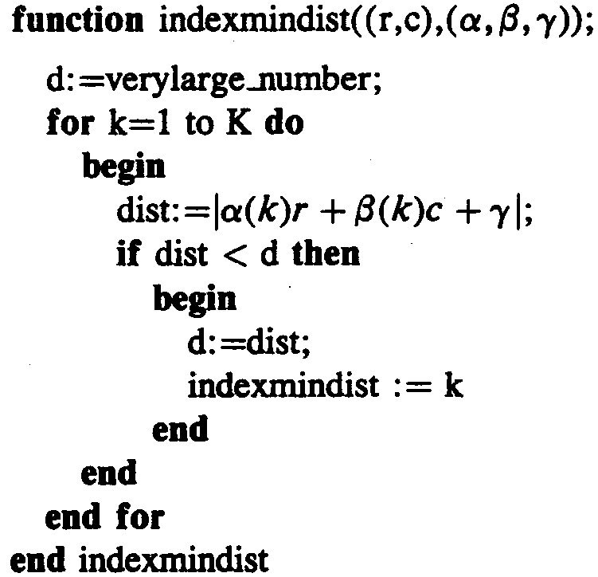
11.5.6 Isodata Segmentation
73

Slide 74
11.5.7 Curvature
The curvature is defined at a point of arc length s along the curve by
Δs : the change in arc length
Δθ : the change in tangent angle
74

Slide 75
11.5.7 Curvature
natural curve breaks: curvature maxima and minima
curvature passes: through zero local shape changes from convex to concave
75

Slide 76
11.5.7 Curvature
surface elliptic: when limb in line drawing is convex
surface hyperbolic: when its limb is concave
surface parabolic: wherever curvature of limb zero
76
Notes:
Elliptic:凸
Hyperbolic:雙曲
Parabolic:拋物線

Slide 77
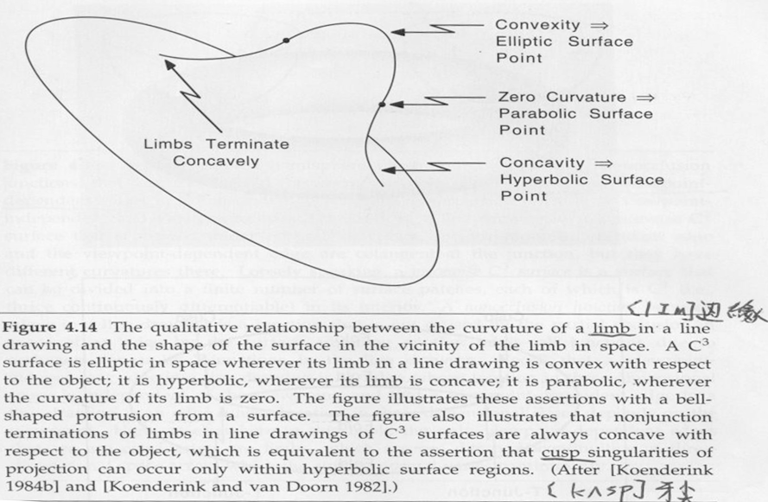
11.5.7 Curvature
Nalwa, A Guided Tour of Computer Vision, Fig. 4.14 􀀀
77

Slide 78
11.6 Hough Transform
Hough Transform: method for detecting straight lines and curves on gray level images.
Hough Transform: template matching
The Hough transform algorithm requires an accumulator array whose dimension corresponds to the number of unknown parameters in the equation of the family of curves being sought.
78

Slide 79
Finding Straight-Line Segments
Line equation → y=mx+b
point → (x,y)
slope → m , intercept → b
x
b
．(1,1)
m
1=m+b
y
79
Notes:
Slope:斜率
Intercept:截距

Slide 80
Finding Straight-Line Segments
Line equation → y=mx+b
point → (x,y)
slope → m , intercept → b
x
b
．(1,1)
．(2,2)
m
1=m+b
y
2=2m+b
80

Slide 81
Finding Straight-Line Segments
Line equation → y=mx+b
point → (x,y)
slope → m , intercept → b
x
b
．(1,1)
(1,0)
．(2,2)
m
1=m+b
y
y=1*x+0
2=2m+b
81

Slide 82
Example
(3,2)
b
(1,0)
．
x
(0,1)
(1,0)
．
．
．
(1,1)
(2,1)
m
(0,1)
．
(3,2)
(1,1)
y
(2,1)
82

Slide 83
Example
(3,2)
b
(0,1)
(1,0)
．
(0,1)
x
y=1
(1,0)
．
．
．
m
(0,1)
(1,1)
(2,1)
．
(3,2)
(1,1)
y
y=x-1
(1,-1)
(2,1)
83

Slide 84
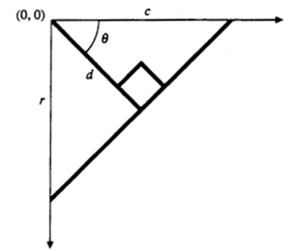
Finding Straight-Line Segments
Vertical lines → m=∞ → doesn’t work
d : perpendicular distance from line to origin
θ : the angle the perpendicular makes with the x-axis (column axis)
84

Slide 85
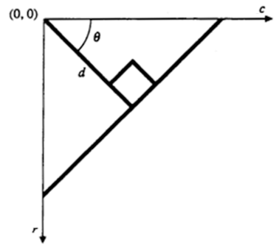
Finding Straight-Line Segments
Θ
Θ
．(r,c)
Θ
．(dsinθ,dcosθ)
85

Slide 86
Example
c
r
86

Slide 87
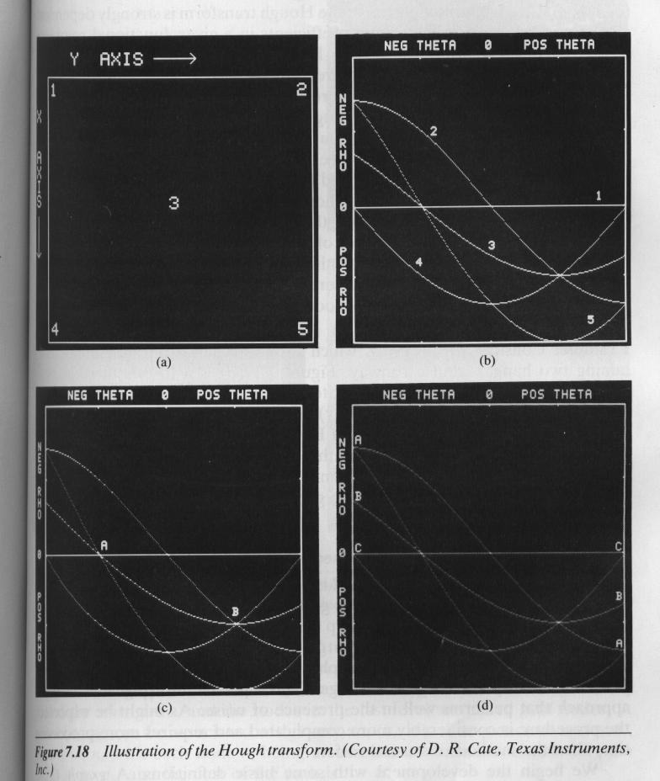
87

Slide 88
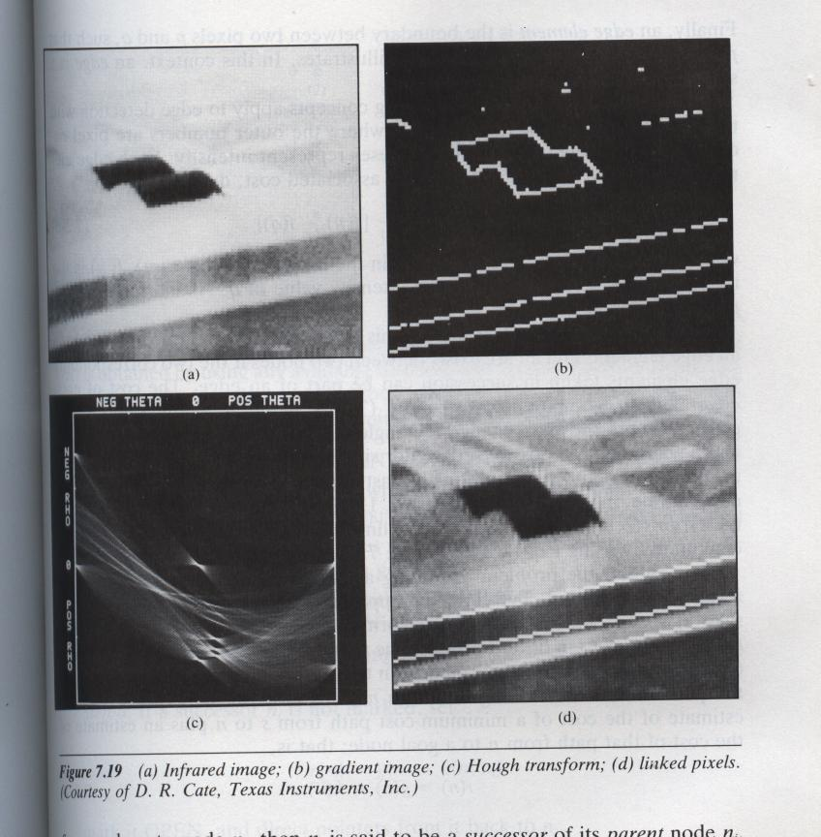
88

Slide 89
Example
．
x
．
c
(1,0)
(0,1)
．
．
．
．
．
．
(0,1)
(1,1)
(2,1)
(1,0)
(1,1)
(1,2)
．
．
(3,2)
(2,3)
y
r
89

Slide 90
Example
．
c
(0,1)
 | -45° | 0° | 45° | 90°
(0,1) | 0.707 | 1 | 0.707 | 0
(1,0) | -0.707 | 0 | 0.707 | 1
(1,1) | 0 | 1 | 1.414 | 1
(1,2) | 0.707 | 2 | 2.121 | 1
(2,3) | 0.707 | 3 | 3.535 | 2
．
．
．
(1,0)
(1,1)
(1,2)
．
(2,3)
r
90

Slide 91
Example
 | -45° | 0° | 45° | 90°
(0,1) | 0.707 | 1 | 0.707 | 0
(1,0) | -0.707 | 0 | 0.707 | 1
(1,1) | 0 | 1 | 1.414 | 1
(1,2) | 0.707 | 2 | 2.121 | 1
(2,3) | 0.707 | 3 | 3.535 | 2
accumulator array
 | -0.707 | 0 | 0.707 | 1 | 1.414 | 2 | 2.121 | 3 | 3.535
-45° | 1 | 1 | 3 | - | - | - | - | - | -
0° | - | 1 | - | 2 | - | 1 | - | 1 | -
45° | - | - | 2 | - | 1 | - | 1 | - | 1
90° | - | 1 | - | 3 | - | 1 | - | - | -
91

Slide 92
Example
．
c
(0,1)
．
．
．
(1,0)
(1,1)
(1,2)
．
(2,3)
accumulator array
r
 | -0.707 | 0 | 0.707 | 1 | 1.414 | 2 | 2.121 | 3 | 3.535
-45° | 1 | 1 | 3 | - | - | - | - | - | -
0° | - | 1 | - | 2 | - | 1 | - | 1 | -
45° | - | - | 2 | - | 1 | - | 1 | - | 1
90° | - | 1 | - | 3 | - | 1 | - | - | -
92

Slide 93
Example
．
c
(0,1)
．
．
．
(1,0)
(1,1)
(1,2)
．
(2,3)
accumulator array
r
 | -0.707 | 0 | 0.707 | 1 | 1.414 | 2 | 2.121 | 3 | 3.535
-45° | 1 | 1 | 3 | - | - | - | - | - | -
0° | - | 1 | - | 2 | - | 1 | - | 1 | -
45° | - | - | 2 | - | 1 | - | 1 | - | 1
90° | - | 1 | - | 3 | - | 1 | - | - | -
93

Slide 94
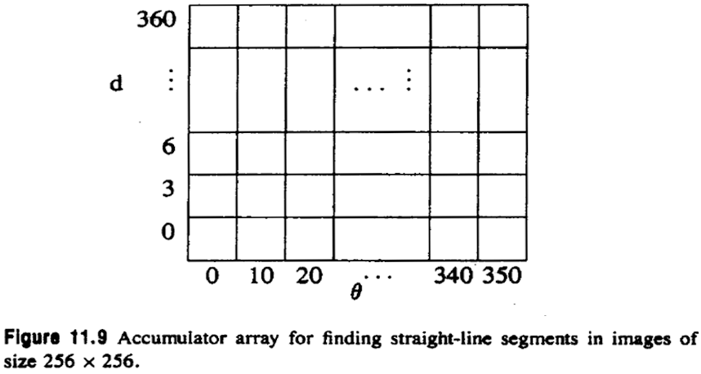
Finding Straight-Line Segments
94

Slide 95

Finding Circles
: row
: column
: row-coordinate of the center
: column-coordinate of the center
: radius
: implicit equation for a circle
95

Slide 96
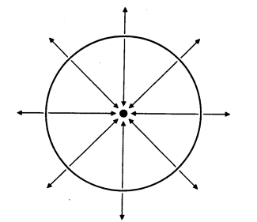
Finding Circles
96

Slide 97
Extensions
The Hough transform method can be extended to any curve with analytic equation of the form , where denotes an image point and is a vector of parameters.
97

Slide 98
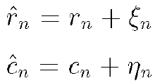

11.7 Line Fitting
→ points before noise perturbation
→ lie on the line
→ noisy observed value
→
→ independent and identically distributed with mean 0 and variance
98

Slide 99
11.7 Line Fitting
procedure for the least-squares fitting of line to observed noisy values
principle of minimizing the squared residuals under the constraint that
Lagrange multiplier form:
99
Notes:
http://episte.math.ntu.edu.tw/entries/en_lagrange_mul/

Slide 100



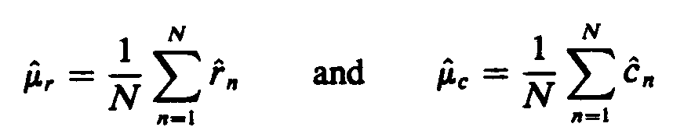
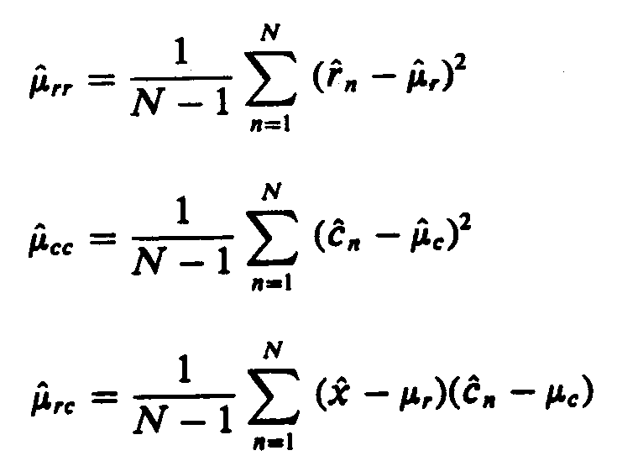
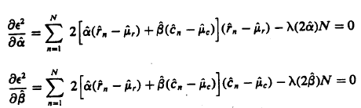
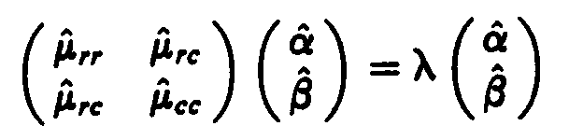
11.7 Line Fitting
→
→
→
100

Slide 101




→
→
→
101

Slide 102
11.7.2 Principal-Axis Curve Fit
The principal-axis curve fit is obviously a generalization of the line-fitting idea.
The curve
e.g. conics :
102

Slide 103
11.7.2 Principal-Axis Curve Fit
The curve
minimize
→
103

Slide 104

11.8 Region-of-Support Determination
region of support too large: fine features smoothed out
region of support too small: many corner points or dominant points produced
k=?
104
Notes:
k個有序前點和k個有序後點組成的一個邊緣片段稱為點的2k+1支撐區域。

Slide 105


11.8 Region-of-Support Determination
Teh and Chin
Calculate , until
Region of support:
105
Notes:
http://www.ecice06.com/CN/article/downloadArticleFile.do?attachType=PDF&id=13978

Slide 106

11.9 Robust Line Fitting
Fit insensitive to a few outlier points
Give a least-squares formulation first and then modify it to make it robust.
106
Notes:
iteratively

Slide 107
11.9 Robust Line Fitting
In the weighted least-squares sense:
107

Slide 108
11.10 Least-Squares Curve Fitting
Determine the parameters of the curve that minimize the sum of the squared distances between the noisy observed points and the curve.
108

Slide 109
11.10 Least-Squares Curve Fitting
‧
‧
109

Slide 110
11.10 Least-Squares Curve Fitting
‧
‧
‧
110

Slide 111




11.10 Least-Squares Curve Fitting
→
→
→
111

Slide 112
11.10 Least-Squares Curve Fitting
Distance d between and the curve :
112

Slide 113



11.10.1 Gradient Descent
113
Notes:
一個函數的梯度方向是增大最陡的方向
梯度方向是一個函數變化最劇烈的方向。也就是沿著這個方向你移動L的距離得到的函數值變化是最大的。

Slide 114
11.10.1 Gradient Descent
First-order iterative technique in minimization problem
Initial value :
(t+1)-th iteration →
First-order Taylor series expansion around
should be in the negative gradient direction
114

Slide 115

11.10.2 Newton Method
Second-order iterative technique in minimization problem
Second-order Taylor series expansion around
→ second-order partial derivatives, Hessian
Take partial derivatives to zero with respect to
115
Notes:
http://ccjou.wordpress.com/2013/09/09/%E7%AD%94%E5%BC%B5%E7%9B%9B%E6%9D%B1%E2%94%80%E2%94%80%E9%97%9C%E6%96%BC-hessian-%E7%9F%A9%E9%99%A3%E8%88%87%E5%A4%9A%E8%AE%8A%E9%87%8F%E5%87%BD%E6%95%B8%E7%9A%84%E6%B3%B0%E5%8B%92%E5%B1%95%E9%96%8B/
http://zh.wikipedia.org/wiki/%E6%B5%B7%E6%A3%AE%E7%9F%A9%E9%98%B5

Slide 116
11.10.4 Fitting to a Circle
Circle :
116

Slide 117
11.10.4 Fitting to a Circle
117

Slide 118
11.10.6 Fitting to a Conic
In conic :
118

Slide 119

11.10.3 Second-Order Approximation to Curve Fitting
==Nalwa, A Guided Tour of Computer Vision, Fig. 4.15== 􀀀
119

Slide 120

11.10.9 Uniform Error Estimation
Nalwa, A Guided Tour of Computer Vision, Fig. 3.1 􀀀
120

Slide 121
The End

