Slide 1
ArtEx
The Digital Art Exchange
AI-powered fractional art investment for the digital era
EFREI Paris · 2025–2026 · L2 Innovation Project

Slide 2
THE PROBLEM
Art investment is broken
$50K+
0%
Minimum ticket size to buy a single blue-chip artwork — locking out 99% of investors
Secondary market liquidity for most physical art — you can wait years to exit
12–15%
Opaque
Typical gallery/auction commission that eats into every transaction
Pricing is negotiated behind closed doors — no transparent market price

Slide 3
MARKET OPPORTUNITY
A $67B market shifting online
$67B
$10.8B
+12%
Global art market total value (2024)
Online art & collectibles sales
YoY online segment growth rate
• Art Basel / UBS 2024 Report: online art sales reached $10.8B, up from $8.4B in 2021
• 73% of new collectors (under 40) say they prefer to discover and buy art digitally
• Digital art (NFTs + licensed digital works) is the fastest-growing sub-category
• Traditional platforms (Christie's, Sotheby's) are not built for retail — minimum lots $5,000+
• No existing platform combines fractional ownership + AI advisory + leveraged trading

Slide 4
COMPETITIVE LANDSCAPE
Existing platforms leave a critical gap
Feature
Artsy
OpenSea
ArtEx
Fractional Ownership
No
No
Yes
AI Buy Recommendations
No
No
Yes
Leveraged Trading
No
No
Yes
Traditional Art
Yes
No
Yes
Digital / NFT Art
No
Yes
Yes
Active Price Discovery
No
Volatile
Yes
Retail Accessible
No
Partial
Yes

Slide 5
OUR SOLUTION
ArtEx — Where Art Meets Finance
ArtEx is a web platform that democratises digital art investment through fractional ownership, AI-powered advisory, and a transparent secondary market — accessible from any browser.
01
02
03
04
Fractional Ownership
AI Advisor
Leveraged Perpetuals
Active Secondary Market
Buy as little as 0.1% of a digital artwork. No $50K barriers — invest from any amount.
DeepSeek-powered chat assistant analyses market trends and surfaces personalised picks.
Up to 5× leverage on art price exposure. GBM-based price simulation with live P&L.
Resell your shares instantly at the current market price — true liquidity for art.

Slide 6
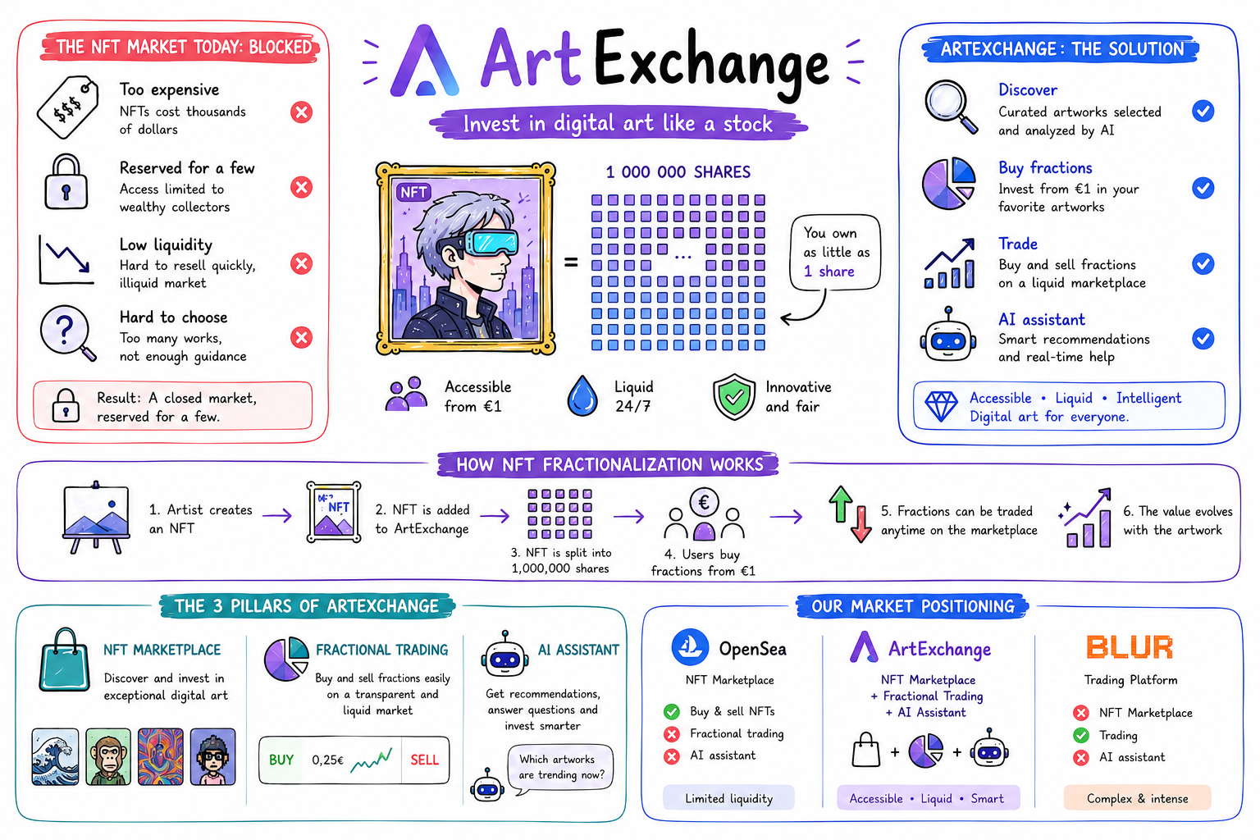

Slide 7
USER POSITIONING
Four distinct user segments
RA
DA
CT
CE
Retail Art Investor
Digital Art Collector
Crypto-Native Trader
Curious Enthusiast
Age 25–45 · mid income Wants portfolio diversification beyond stocks Locked out by high minimums of physical art
Age 20–35 · tech-savvy Collects digital works for passion & value Needs a transparent pricing mechanism
Age 22–40 · crypto fluent Familiar with leverage & perpetuals Looks for non-correlated assets beyond BTC/ETH
Age 18–30 · student / early career Passionate about art but can't afford entry Needs guidance + fractional access

Slide 8
PLATFORM FEATURES
Everything you need to trade digital art
Gallery & Marketplace
AI Personal Assistant
Leveraged Trading
Browse 200+ curated digital artworks. Filter by style, artist, price range. Real-time price charts powered by GBM simulation.
Chat with DeepSeek AI for buy/sell recommendations. AI profiles your risk appetite and monitors price alerts for you.
Open long/short positions with up to 5x leverage. Live P&L tracking, margin display, one-click trade execution.
Portfolio & Analytics
Account & Security
Subscription Tiers
Real-time portfolio dashboard, allocation pie chart, BTC/USD balance, position history, and performance metrics.
Email registration, JWT auth, Google OAuth (coming), forgot-password via email, delete-account with confirmation.
Free tier: browse + small fractions. Pro tier: full leverage, AI advisor, real-time alerts, portfolio export.

Slide 9
BUSINESS MODEL
Multiple revenue streams from day one
Trading Commission
Pro Subscription
Artist Listing Fee
Spread Revenue
0.5–1.5%
$9.99/mo
$49–$199
Maker/Taker
Fee on every buy/sell transaction. Scales directly with trading volume.
Unlocks AI advisor, full leverage, real-time price alerts, portfolio export.
Artists pay to list and tokenise their digital works on the platform.
Bid-ask spread on perpetual contracts captured by the platform as market maker.
Positioning: B2C SaaS + transaction revenue · Target break-even at 2,000 active monthly traders

Slide 10
TECHNOLOGY
Modern, production-ready stack
FRONTEND
BACKEND
AI / DATA
EXTERNAL
— Vue 3 + Composition API
— Spring Boot 4 REST API
— DeepSeek LLM via Dify proxy
— CoinGecko API (BTC/ETH price)
— Pinia state management
— MyBatis + MySQL 8.0
— GBM price simulation (client-side)
— BlockCypher (blockchain data)
— Tailwind CSS (dark design system)
— JWT authentication (HMAC256)
— Personalised risk profiling
— Google GSI (OAuth 2.0 ready)
— Vite 6 build tool + proxy
— Global exception handling
— Real-time price alert engine
— Vercel / cloud deployment

Slide 11
ENVIRONMENTAL COMMITMENT
Art without the carbon footprint
Physical Art Event
ArtEx Platform
30,000
15–30
VS
tonnes CO₂e (Art Basel 2023, single event)
kg CO₂e / month (at 1,000 daily active users)
Our 5 eco-design commitments:
✓ No Proof-of-Work blockchain — we use certificate-based digital provenance only
✓ 100% renewable energy cloud hosting target by end of 2026
✓ Eco-design: lazy loading, efficient queries, minimal JS bundle (< 250 kB gzipped)
✓ No physical shipping, no printed catalogues, no intercontinental art transport
✓ Carbon calculator available in-app so users see their impact per trade

Slide 12
OUR TEAM
Built by six EFREI engineers
YH
Yuhao Huang
YR
Yinghui Ren
LM
Lena Makri
Team Lead · PM · Design · Frontend
Backend Engineer
Backend Engineer
Vue 3 frontend, Tailwind UI, Vite config, project management, AI feature integration, deployment & design system
Spring Boot REST API, MyBatis/MySQL, JWT auth, user controller, Spring 4 migration & endpoint design
Spring Boot API co-dev, MyBatis mapper layer, data modelling & database queries
BJ
Berena-Jackie Douanla
NK
Nelson-Harold Kamteu
JM
Junior Mevi
Market Research
UML & Architecture
AI Skill Writing
Competitor analysis (Artsy / OpenSea), market sizing (TAM/SAM/SOM), user survey & feasibility study
Use-case diagrams, class diagrams, sequence diagrams, system architecture and technical documentation
Dify AI skill authoring, prompt engineering for the art advisor, AI training data & scenario testing

Slide 13
ROADMAP & NEXT STEPS
What's coming next
Phase 1 (Done)
Phase 2 Q3 2026
Phase 3 Q4 2026
MVP
Growth
Scale
▸ Frontend UI complete
▸ Google OAuth login
▸ Real fractional ownership (legal)
▸ JWT auth + registration
▸ Forgot-password email flow
▸ Stripe payment integration
▸ AI chat advisor live
▸ Artist onboarding portal
▸ Carbon footprint dashboard
▸ 6 artworks seeded in DB
▸ Mobile-responsive redesign
▸ Public beta launch
ArtEx — Making art investment as liquid and accessible as the stock market.

