Slide 1
Differential clone abundance

Slide 2
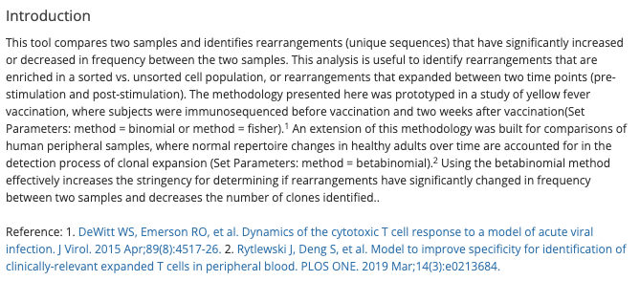
Method
Described in Adaptive Immunoseq Differential Abundance Tool
(retrieved from Adaptive Immunoseq 2024 Nov)

Slide 3
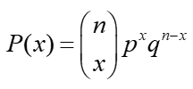
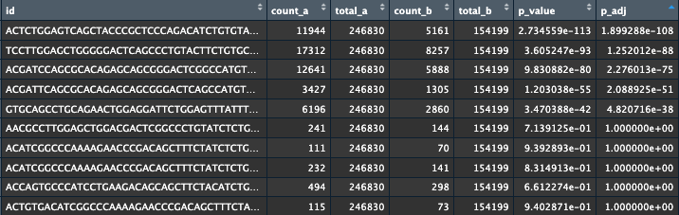
Binomial test example
Binomial test is run independently for each clone to compare their relative abundance between two samples
p value from the binomial test is an absolute p value
BH/FDR adjustment is run over all p values
x = count_a
n = count_a + count_b
p = total_a / (total_a + total_b)
q = 1 - p

