Slide 1
Differential clone abundance

Slide 2
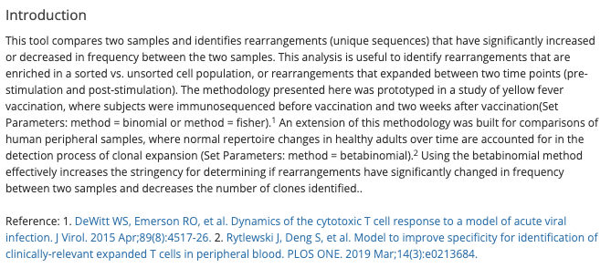
Method
Described in Adaptive Immunoseq Differential Abundance Tool

Slide 3
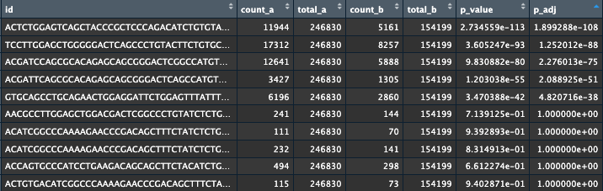
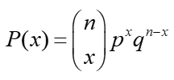
Binomial test example
x = count_a
n = count_a + count_b
p = total_a / (total_a + total_b)

