Slide 1
Clonality Crash Course

Slide 2
Background
TCRseq overview
TCRseq is an emerging technology that purports to give insight into local and systemic, adaptive immune responses
TCRseq of tumors can hint towards TME immune status
The presence of highly dominant T cell clones (low diversity = high clonality) may suggest antigen-specific T-cell growth and an ongoing, T-cell-mediated immune response
TCRseq of serial peripheral blood samples can hint towards modulation of systemic immune response
The emergence of novel T cell clones on-treatment and/or the leveling of T cell frequency across clones (high diversity = low clonality) may suggest systemic sensitivity to new antigens
The “goodness” of T cell repertoire diversity is context dependent
High clonality in the TME is cited as evidence antigen specific response and has been associated with longer survival
Lower clonality in the periphery is cited as evidence for sensitivity to diverse antigens or more permissive T-cell selection in thymus
Different ICB treatments impact T cell repertoire differently
Anti-PD1 is thought to have the greatest impact in the TME and has limited impact on circulating T-cell repertoire
Anti-CTLA4 has been shown to increase circulating repertoire diversity

Slide 3
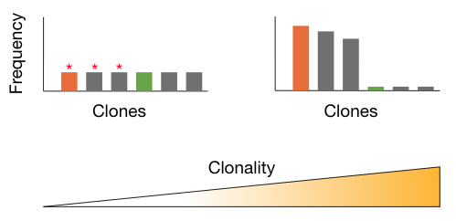
Important terms
TCRseq overview
TCR count
An individual read or UMI associated with a single TCR molecule.
TCR repertoire
Total of all TCR counts in a sample/subject
T cell clone/clonotype
There is no set definition of T cell clone. It can be used to describe all TCR counts that share a common nucleic acid sequence or all TCR counts that share a common amino acid sequence. In practice, I will specify for clarity, e.g. T cell clones (AA).
Richness
Richness is the number of unique T cell clones in a repertoire
Clonality vs. Diversity
Highly diverse repertoires have TCR counts spread across a large number of distinct T cell clones. The most diverse repertoire would have equal number of counts across all clones. Highly clonal repertoires have the lions share of counts concentrated among a small fraction of unique T cell clones. The most clonal repertoire would have a single clone.
Oligoclonal
A T cell repertoire that is dominated by more than one clone.

Slide 4
How repertoire diversity is summarized
Diversity metrics
Information theory – probability based
Shannon
Summarizes: when pulling one random, individual TCR molecule, what is the probability of a second pull being in the same clonotype
Better at highlighting oligoclonal repertoires
Shannon entropy: starts at 0 (perfectly clonal) and increases with diversity
Shannon clonality: scaled from 0 (perfect diversity) to 1 (perfect clonality)
Simpson
Summarizes: when pulling two random TCR molecules, what is the probability that they are the same clonotype
Better at highlighting clonal dominance
Simpson clonality: scaled from 0 (perfect diversity) to 1 (perfect clonality)
Sample distribution – geometrically based
D50
When ordered by rank dominance, the number of unique T cell clones that represent half of the total repertoire
Reported as fraction of T cell richness required to occupy 50% of all TCR counts
Diversity index
When plotted by rank dominance, the area above the curve

Slide 5
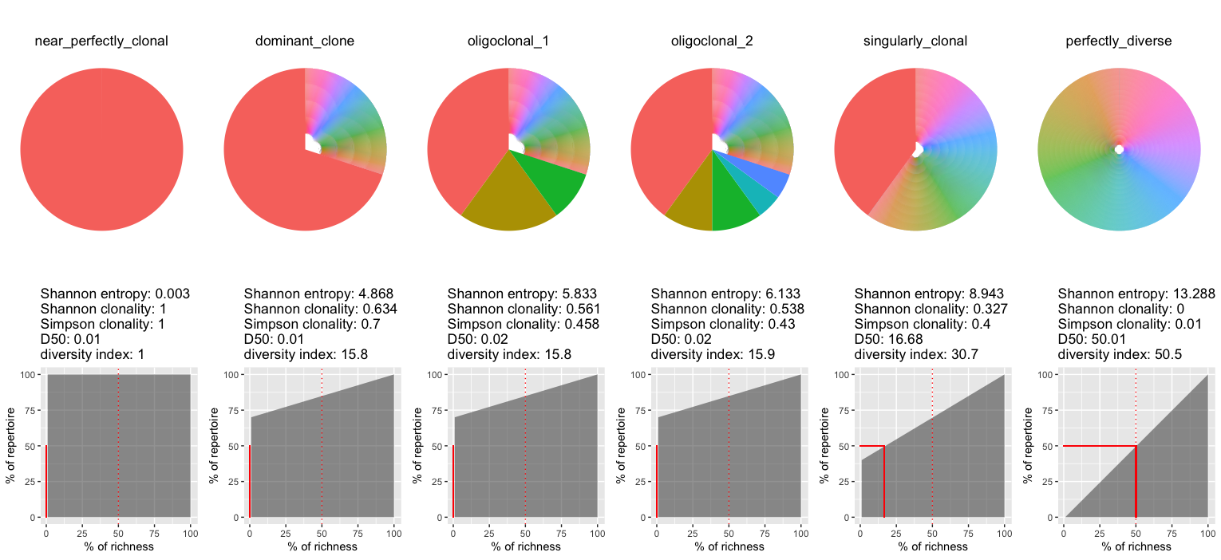
Simulated data: 10k clones; 100k total counts
Summary data

Slide 6
Summary
TCRseq overview
TCRseq can provide information of immune status in the TME and periphery
The associated between diversity metrics and response is context dependent
There are multiple approaches to summarize repertoire diversity
Information science approaches
Distribution analyses
Different approaches trend together
Each approach highlights a different aspect of diversity and must be evaluated separately

