Slide 1
SOFT2412 - Agile Software Development with Scrum and Agile Tools - Sprint 2
R18A Group 3 -
Chenglong Li
Yuben Fang
Xiaohan Li
Canwei Cai
Jiesheng Liang

Slide 2
Agenda
Functions updated
Product demo
Jacoco coverage report in Jenkins & Jira burndown chart
Plan for next sprint

Slide 3
Functions update
In this sprint we complete following functions:
Cancel function: The system would exit if no one is operating for 10 seconds
Complete the whole transaction by card: The user can checkout their items by card and the items number could be correctly updated.
Last 5 items: The user as well as anonymous can see the last 5 items he/she bought in the past.
Seller: The seller can modify items’ data and obtain two reports.

Slide 4
Product demo
Step 1: We would show you our system would exit if no one is operating for 10 seconds
Guideline:
The system would do no action in the main page, and it would automatically exit
Then we would set the cancel time to 2 mins for following demo.

Slide 5
Product demo
Step 2: We would show you the seller reports for current database items details.
Guideline:
The system would firstly log in as a seller with username “seller” and password “seller” which are initialize in the database.
Then, the seller would require for two reports separately in the seller interface.
Two reports “available_items_report.txt” and “get_summary_report.txt” can be found in the root content of the product which separately contains current available items with their details and current sold items with their code and name.

Slide 6
Product demo
Step 3: We would show you a whole transaction with card.
Guideline:
The system would firstly sign up as a customer with username “Basem” and password “soft2412” which would be stored in the database.
Then, Basem would have a look at shopping list and put several items in the shopping cart.
After that, Basem would checkout with card with card holder name “Charles” and card number “40691” which are the permitted form.

Slide 7
Product demo
Step 4: We would show you Basem last five items are fit the last transaction.
Guideline:
The system would firstly log in as a customer with username “Basem” and password “soft2412” which would be stored in the database.
Then, the last 5 items are typed on the user main page.

Slide 8
Product demo
Step 5: We would show you the updated number of available items and number of sold items by seller’s report. Also, the remain functions of seller would be performed, and updated data would be showed by reports.
Guideline:
The system would firstly log in as a seller with username “seller” and password “seller” which are initialize in the database.
Then, the seller would require for two reports separately in the seller interface.
After that, the seller would try to modify the items with several operations.
The previous report would be deleted when an updated report try to generate, and the data would be updated.

Slide 9
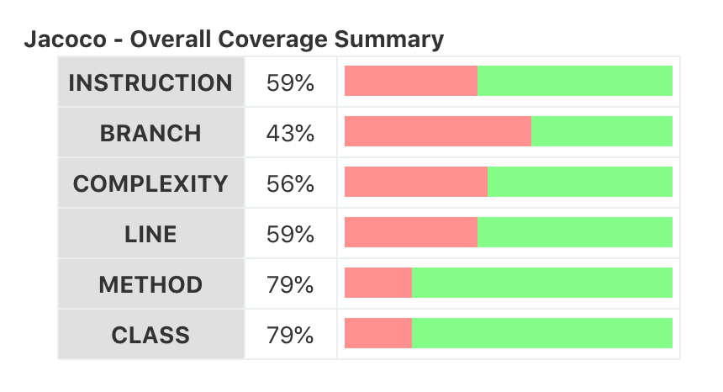
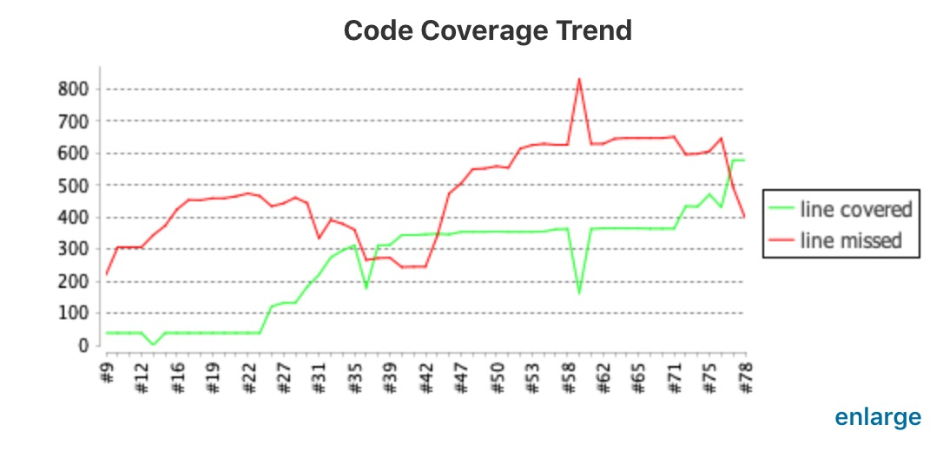
Jacoco coverage report in Jenkins

Slide 10
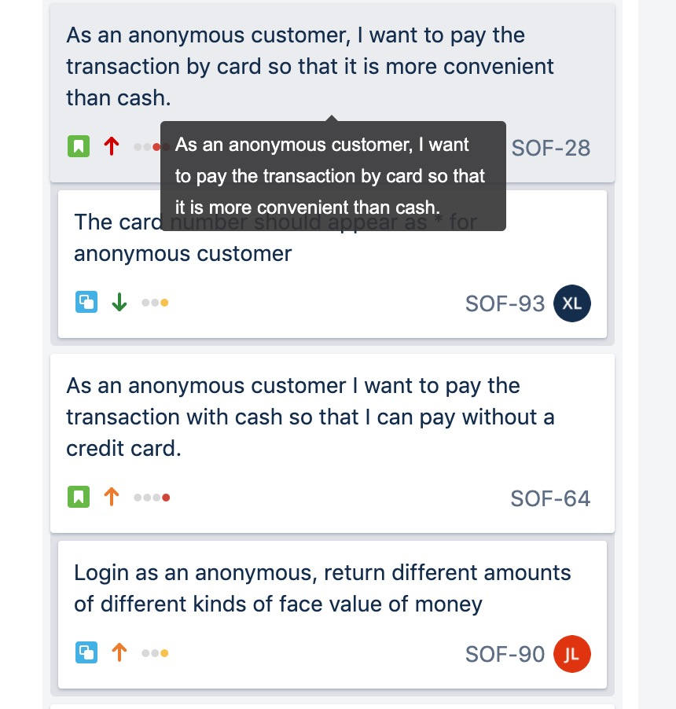
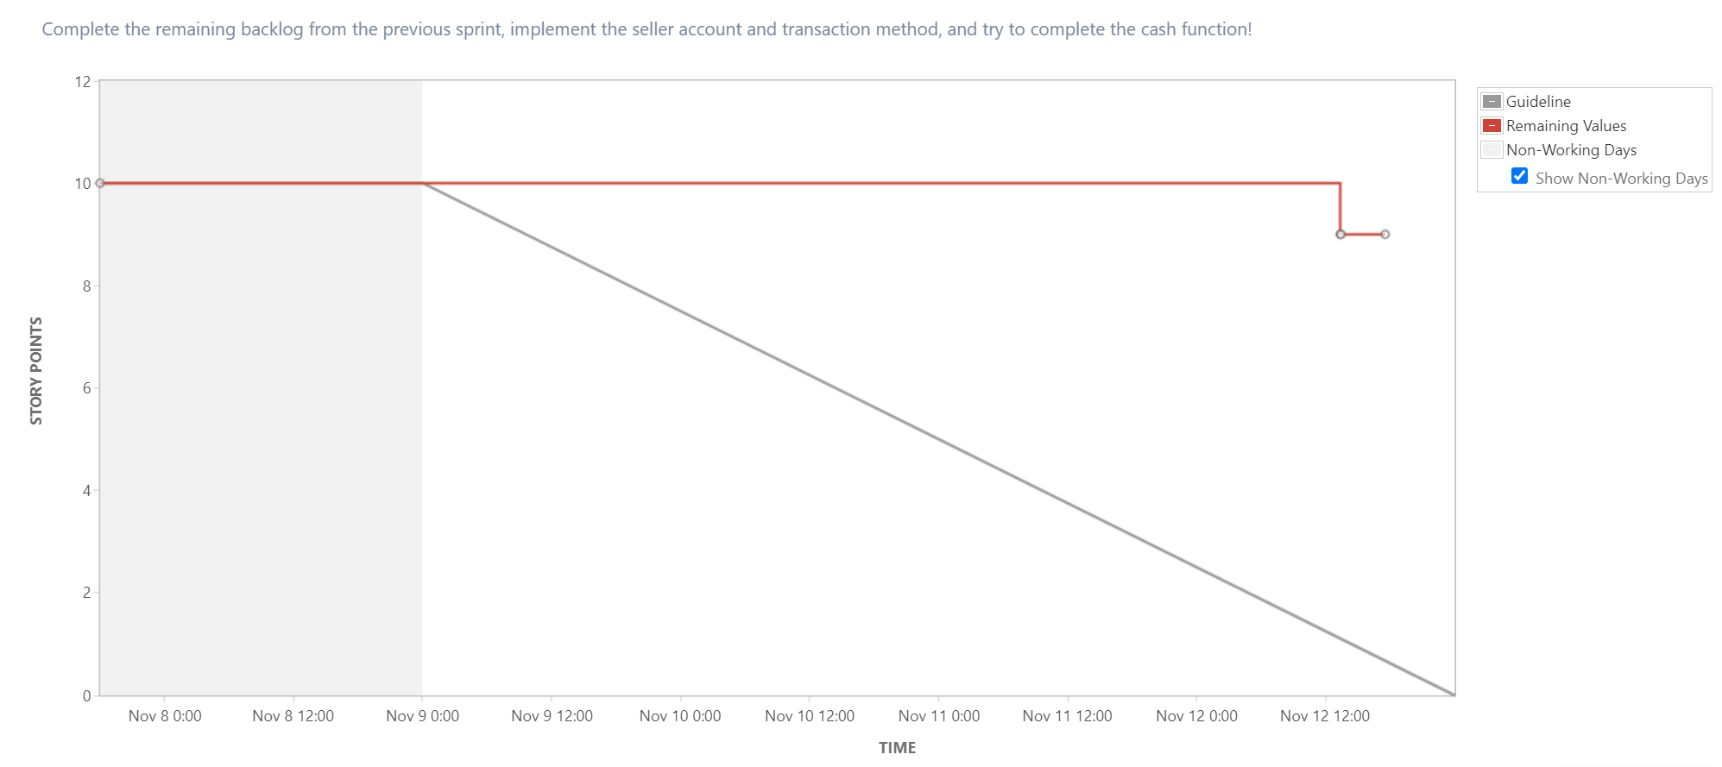
Jira burndown chart

Slide 11
Plan for next sprint
As so far, we successfully implement basic sign up/log in functions, shopping functions, pay by card functions, seller functions and database.
For next sprint:
Pay by cash functions
Cashier functions
Owner functions
Convert password to “*” function

Slide 12
Thanks for listening!

