Slide 1
SOFT2412 - Agile Software Development with Scrum and Agile Tools - Final Demonstration
R18A Group 3 -
Chenglong Li
Yuben Fang
Xiaohan Li
Canwei Cai
Jiesheng Liang

Slide 2
Agenda
Functions updated in this sprint
Application introduction
Product demo as scenarios
Jacoco coverage report in Jenkins
Jira burndown chart

Slide 3
Functions updated in this sprint
In this sprint we complete following functions to complete the whole project:
Pay by cash function: Now, the customer can complete the transaction by cash.
Cashier:
The cashier can fill/modify changes’ data.
The cashier can obtain a report including change information and a report including transaction information.
Owner:
The owner can complete all functions of Seller and Cashier.
Besides that, the owner can obtain a report including user information and a report including cancelled transaction information.

Slide 4
Application introduction
Our Vending Machine (Lite Snacks) Software contributes on profiting from selling different types of snacks with embedded requirements proposed by the client.
User Interface (UI): Command Line User Interface by Java class with independent layer
Functionalities: Implemented by Java class which separate from UI with independent laye
# Independent layer: Means any interface such as App, MainMenu, CashPay, CardPay, Seller, Cahier, Owner, etc.
# Each Independent layer has corresponding UI and functionalities
Database (DB): Local SQLite database
How to run: Use gradle run by terminal in the root folder

Slide 5
Before demonstration
The reports would be provided in the root folder.
We would firstly give you a summary of the initial database
Every face value is initial with the quantity of 5
# The quantity of Face value below 1$ is set to 0 for following demo
Every inventory is initial with the quantity of 7
There would be several initial users including two old users, one anonymous user, one seller, one cashier and one owner.
In the following demonstration, every group member would act as one role of user to show you most of functions.

Slide 6
Let’s start the demonstration

Slide 7
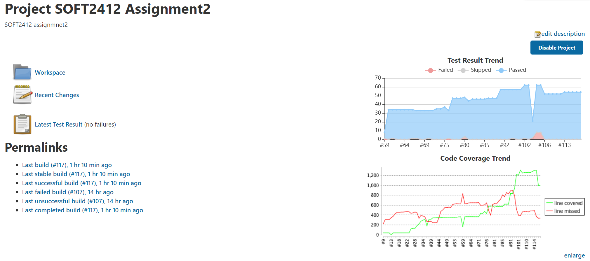
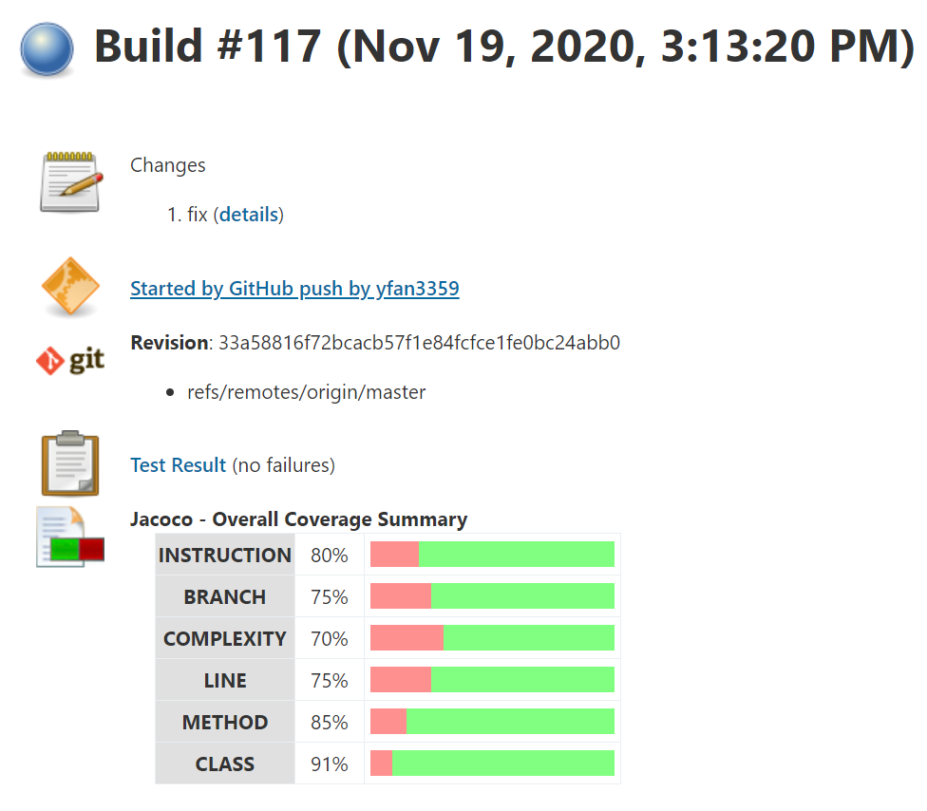
Jacoco coverage report in Jenkins

Slide 8
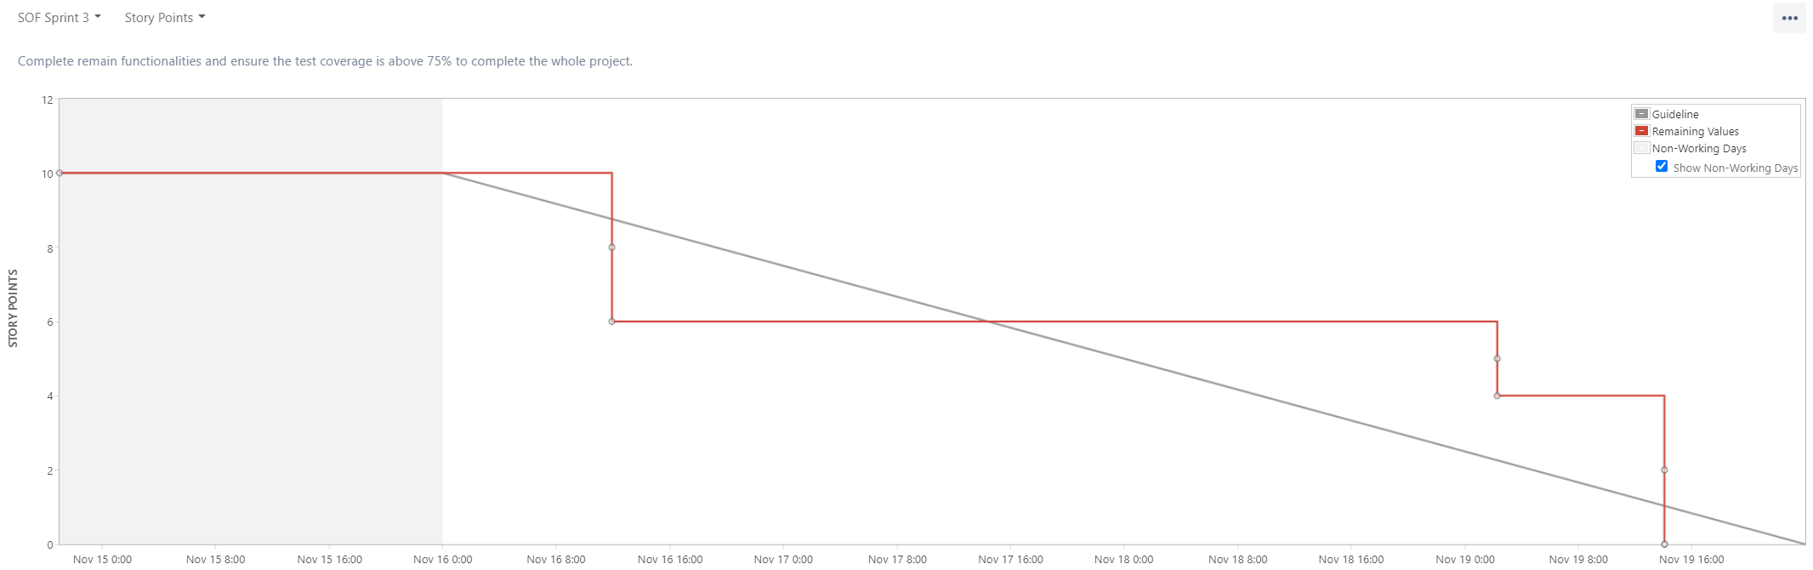
Jira burndown chart

Slide 9
Thanks for listening!

