Slide 1
SOFT2412 - Agile Software Development with Scrum and Agile Tools - Final Demonstration
R18A Group 3 -
Canwei Cai
Xiaohan Li
Chenglong Li
Yuben Fang
Jiesheng Liang

Slide 2
Agenda
Functions updated in this sprint
Application introduction
Product demo as scenarios
Jacoco coverage report in Jenkins
Jira burndown chart

Slide 3
Functions updated in this sprint
In this sprint we complete following functions to complete the whole project:
Pay by cash function: Now, the customer can complete the transaction by cash.
Cashier:
The cashier can fill/modify changes’ data.
The cashier can obtain a report including change information and a report including transaction information.
Owner:
The owner can complete all functions of Seller and Cashier.
Besides that, the owner can obtain a report including user information and a report including cancelled transaction information.

Slide 4
Application introduction
Our Vending Machine (Lite Snacks) Software contributes on profiting from selling different types of snacks with embedded requirements propose by the client.
User Interface (UI): Command Line User Interface by Java class with independent layer
Functionalities: Implemented by Java class which separate from UI with independent laye
# Independent layer: Means any interface such as App, MainMenu, CashPay, CardPay, Seller, Cahier, Owner, etc.
# Each Independent layer has corresponding UI and functionalities
Database (DB): Local SQLite database
How to run: Use gradle run by terminal in the root folder

Slide 5
Before scenarios
The reports would be provided in the root file.
We would firstly show you the initial database with available_change_report, available_items_report, usernames_summary
Every face value is initial with the quantity of 5
Every inventory is initial with the quantity of 7
There would be several initial users including two old users, one anonymous user, one seller, one cashier and one owner.
The following scenarios are coherent happens in one actual Vending Machine.
Also, they show most of functionalities as request.

Slide 6
New customer
(user sign up)Jacky is a new user to the vending machine. He wants to sign up with username “Jacky” and password “123”.
(pay no enough money)
After sign up, he wants to buy 6 Sprites and 5 Kettle for his team members. However, when he put these items in the shopping cart and see the total price is 45, he ties to put 40 dollars into the machine. When he finds he cannot process the transaction, he cancels it.
(pay cash successfully)Then, he logs in with his account and change the number of Kettles to 3. He processes the payment with the cash of input 34.5$ in total, including one 20$, one 10$, two 2$ and one 0.5$. Then the machine gives him change and goes back to the main menu.

Slide 7
Register customer
(pay with card and input card the information 1.first is the wrong 2.second is correct and save card information)
Few hours later, Jacky is back to the vending machine with his account and wants to buy 5 Sprites, 1 Mars, but the inventory of Sprite is not enough, so he buys one sprite instead and wants to check the inventory in the shopping cart. Then he process the transaction with the card. He wrongly types username “Deena” as “Dean” but with the right card number(95953). The machine finds out the invalid info and Jacky types in with the right information. Finally, he wants to save his card for next usage.

Slide 8
Cashier
(cashier modify the quantity of 2,1,0.5, 0.2,0.1)One day, the cashier needs some coins, so he takes the coins left in the machine except 5 cents.
(cashier want to see the report)Then he wants to see the current changes and current transaction reports.

Slide 9
Seller
(Seller want to see the report)Few hours later, the seller wants to see the current items and sold-out summary reports.
(Seller want to change the price and quantity of items Sprite)
He finds that the sales of Sprite are good, and the inventory is out of stock. As a result, he adds the number of Sprite to 10 and raises the price to 4 dollar.

Slide 10
Anonymous user
(Anonymous user fail to pay with cash)
After that, Jerry comes to the machine, but he wants to log in as anonymous. He wants to buy a mineralWater with 5 dollar. However, the coins in the machine is taken by the Cashier. So the transaction is cancelled as change not available.
(Anonymous user want to pay with card)
Then, Jerry wants to buy the water with his card. So he provides the card info with the name “Vincent” and password “59141”. He cannot save the card because he log in as anonymous, so the transaction is then done.

Slide 11
Anonymous user
(last 5 items)One day later, Lucius comes to the machine and wants to see the item bought by previous anonymous user. He log in as anonymous, then he sees previous other anonymous, which is only Jerry in fact, only buy a water..
(pay with cash)
He puts a Sour into the cart.
He tries to process the payment by cash with a total price of 8.85. He inserts 9 dollars, including one 5$ note and four 1$ coins.
Since the 5-cent coins are not taken by the cashier, the transaction is successfully processed, and three 5-cent coins should be changed instead of one 10-cent coin and one 5-cent coin.

Slide 12
Register customer with saved card
(last 5 items + pay by saved card)
Jacky comes to the machine as well since he found the chocolate he bought before is tasty, but he forgets its name. After log in, he sees the name of the chocolate in last-5-items.
As a result, he puts two Mars and three Sprite which is his favorite drink in the shopping cart and process the transaction with his saved card.

Slide 13
Owner
(Owner check all the report)
Jackson log in using the Owner account. He check the report of seller and cashier.
And he wants to see the user report and cancelled transaction report.
(Owner delete cashier)
There is a cancel transaction in cancelled transaction report. Owner want to delete the cashier account(account: cashier, password :cashier)
(Owner create new cashier)
and create a new cashier named cashier2 and the password is 123.

Slide 14
Owner
(Owner change price of item)He also realizes that the sales of Mentos is not good, so he also adjusts the price to the 6$. Finally, he wants to see the user report and cancelled transaction repot. He forgets to log out his account, but the system would automatically log out.

Slide 15
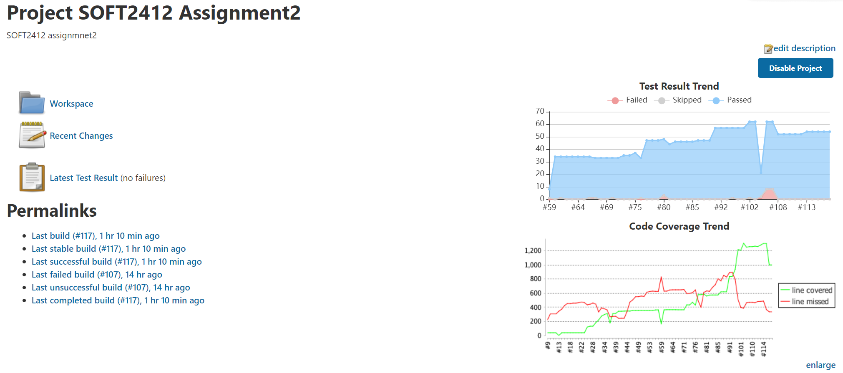
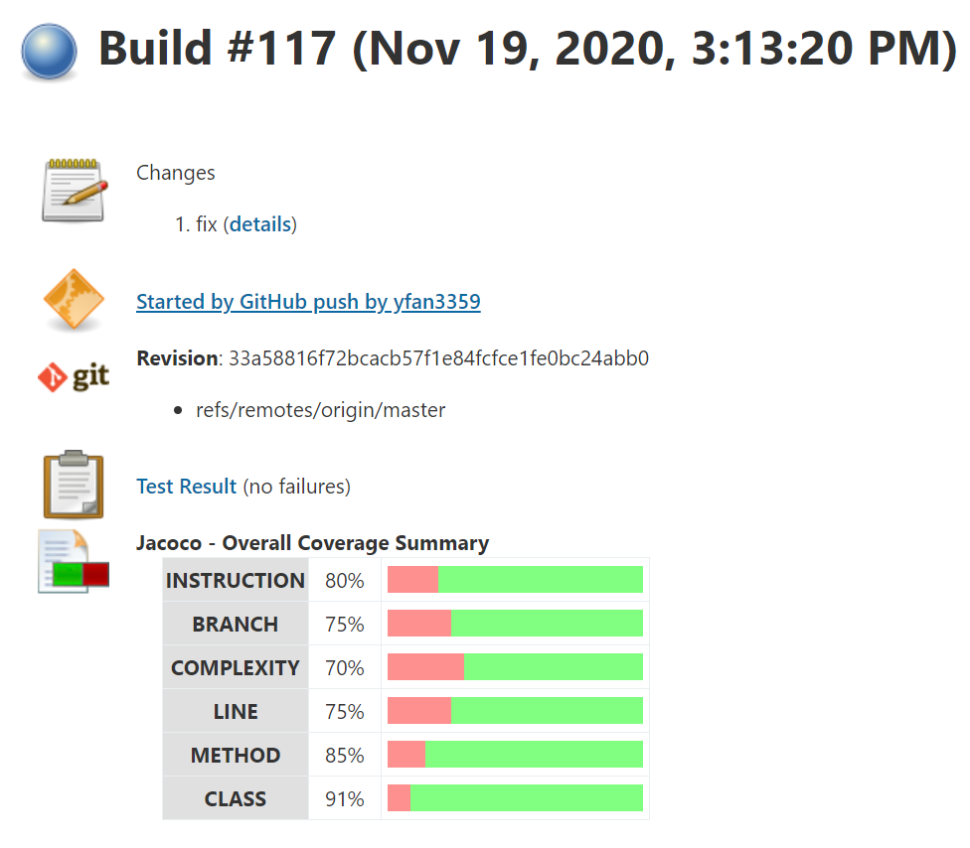
Jacoco coverage report in Jenkins

Slide 16
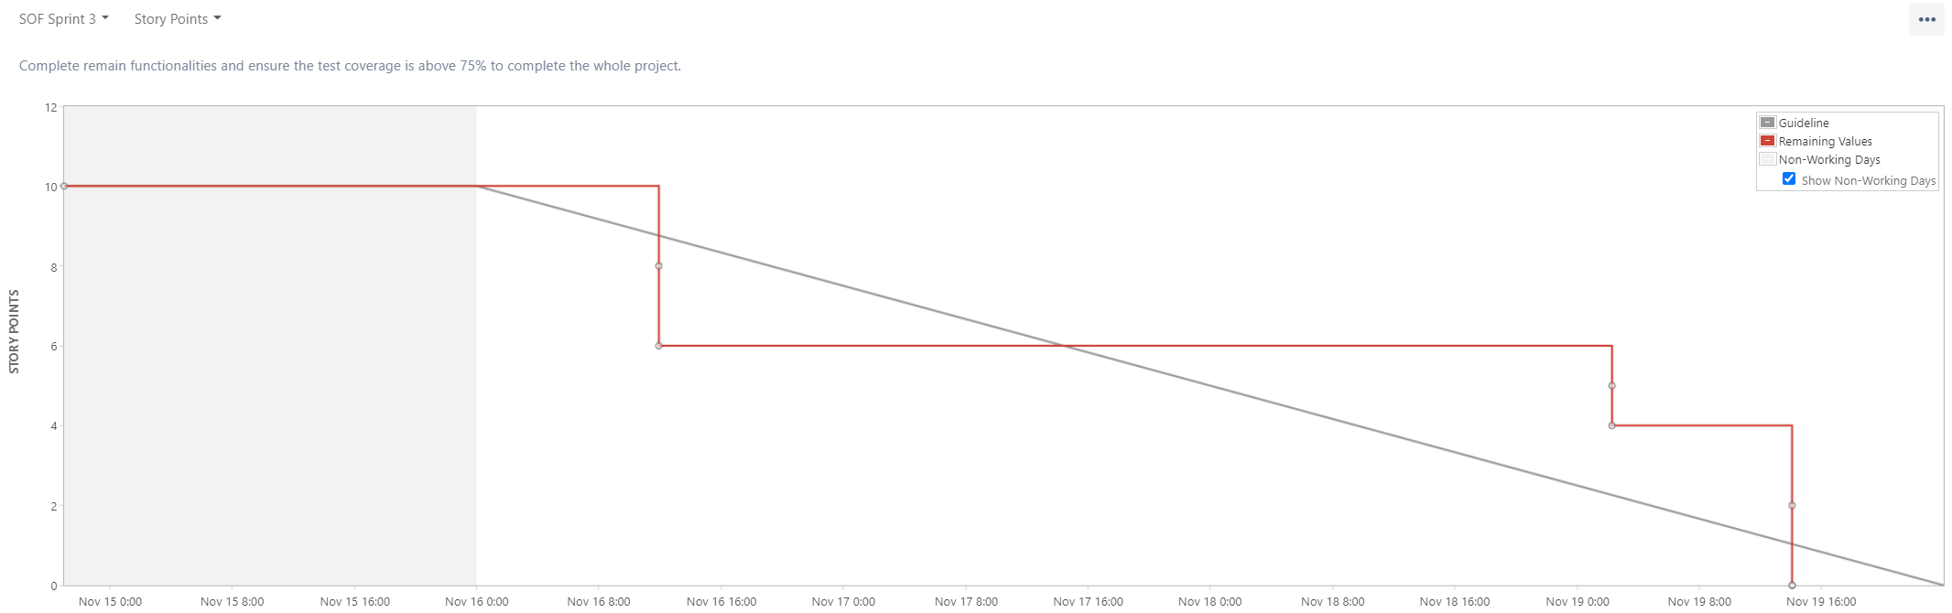
Jira burndown chart

Slide 17
Thanks for listening!

