Slide 1

2020 NLP Tasks in Sentiment Analysis
Presented by Ziyang Lin
Made by Ziyang Lin

Slide 2
Funniness Estimation for Edited News Headlines
Task one - Given one edited headline, design a regression model to predict how funny it is
Task two - Given the original headline and two manually edited versions, design a model to predict which edited version is the funnier of the two

Slide 3
Task One – Data Preprocessing
Convert original headlines into normal sentences (Remove ”<” and “/>” by applying RE)
Get the edited version of headlines by doing word substitution using RE
Do tokenization and lowercasing for each edited-original headlines pair

Slide 4
Task One – Models Choices & Design
Two Inputs FFNN
Two Inputs CNN
Two Inputs RNN
Two Inputs Concatenated RNN
Pre-trained LM + a regression layer (LMs applied: BERT, ALBERT, XLNet, ELECTRA)

Slide 5
Task One – Two Inputs FFNN
Old headline
(Headline vector)
Logit
Weighted Sum
New headline
Embeddings Layer
Averaging
3 Linear Layers

Slide 6
Task One – Two Inputs CNN, Two Inputs RNN (similar as the FFNN one)
Old headline
New headline
CNN
Logit
Weighted Sum
Old headline
New headline
RNN
Logit
Weighted Sum

Slide 7
Task One – “Pre-trained LM + a regression layer”
Data preprocessing for pre-trained LMs (BERT-liked LMs) :
Version 1 - Concatenate original headlines and new headlines
Version 2 - Concatenate new headlines and new words
Version 3 – Contain only new headlines

Slide 8
Task One – “Pre-trained LM + a regression layer”
Version 1 - Concatenate original headlines and new headlines
[CLS]
Old headline
[SEP]
New headline
[SEP]

Slide 9
Task One – “Pre-trained LM + a regression layer”
Version 2 - Concatenate new headlines and new words
[CLS]
New headline
[SEP]
new word
[SEP]

Slide 10
Task One – “Pre-trained LM + a regression layer”
Version 3 – Contain only new headlines
[CLS]
New headline
[SEP]

Slide 11
Task One – Optimizer & Learning Rate Scheduler
For FFNN, CNN, RNN:
The optimizer ‘AdamW’ and the scheduler ‘CosineAnnealingLR’ provided by pytorch
For pre-trained LMs (BERT-liked LMs) :
The optimizer ‘AdamW’ and the scheduler ‘get_linear_schedule_with_warmup’ from Huggingface transformers

Slide 12
Task One – Prime Hyperparameters
Learning Rate
Fine-tuning Rate
Adam Epsilon
Weight Decay
Warmup Ratio
Number of Steps

Slide 13

Task One – Loss Function
Root Mean Square Error
$$\sqrt{\frac{1}{N}\sum_{t=1}^{N}{{\left({\text{observe}\text{d}}_{t}−{\text{predicte}\text{d}}_{t}\right)}^{2}}}$$

Slide 14

Task One – Results
Best performance achieved by Two Inputs FFNN
EPOCHS | LRATE | EMBEDDING_DIM | HIDDEN_DIM_1 | HIDDEN_DIM_2 | HIDDEN_DIM_3
100 | 0.145 | 300 | 100 | 50 | 10

Slide 15
Task One – Results
Best performance achieved by Two Inputs CNN
EPOCHS | LRATE | EMBEDDING_DIM | FC_OUT_DIM | N_OUT_CHANNELS | WINDOW_SIZE | DROPOUT
500 | 5e-3 | 50 | 25 | 100 | 3 | 0.7

Slide 16

Task One – Results
Best performance achieved by Two Inputs RNN
EPOCHS | LRATE | EMBEDDING_DIM | HIDDEN_DIM | FC_OUTPUT_DIM | BIDIRECTIONAL | DROPOUT
30 | 1e-4 | 50 | 128 | 32 | Ture | 0.3

Slide 17
Task One – Results
Best performance achieved by Pre-trained LMs
Without Data Augmentation
Model: bert_base_uncased
Inputs structure: new headlines + new words
Test loss: 0.52937
With Data Augmentation (Add “funlines” training dataset)
Model: bert_base_uncased
Inputs structure: new headlines + new words
Test loss: 0.52054 (Best performance achieved among all trials)

Slide 18
Task Two – Data Preprocessing
There are 3 versions of data preprocessing:
The normal version
The headlines truncated version
The punctuation removal version

Slide 19
Task Two – Models Choices & Design
Pre-trained LM + a classification layer (LMs applied: BERT, ALBERT, XLNet, ELECTRA, ROBERTA)

Slide 20
Task Two – “Pre-trained LM + a classification layer”
Concatenate edited headline 1 and edited headline 2
Class Prediction
Linear Classifier
BERT-Liked Pre-trained LM
[CLS]
Edited headline 1
[SEP]
Edited headline 2
[SEP]

Slide 21
Task Two – Design of Training Processes
Version 1:
Training the model “Pre-trained LM + a classification layer” straightly for the real classification task.
Version 2 (Fake Task + Real Task) :
Firstly, training the model “Pre-trained LM + a regression layer” for a fake regression task on the training dataset.
After training well, get rid of the regression layer and add an initialized classification layer on top of the pre-trained LM.
Finally training the model for the real classification task.

Slide 22
The optimizer, the learning rate scheduler and the prime hyperparameters are the same as those for the task one models

Slide 23

Task Two – Loss Function
Cross-Entropy Loss
$$H\left(P,Q\right)=−\sum_{i}{P\left(y_{i}\right)\log{Q\left(y_{i}\right)}}$$

Slide 24
Task Two – Results
Version 1: Straightly training the model for the real task

Slide 25
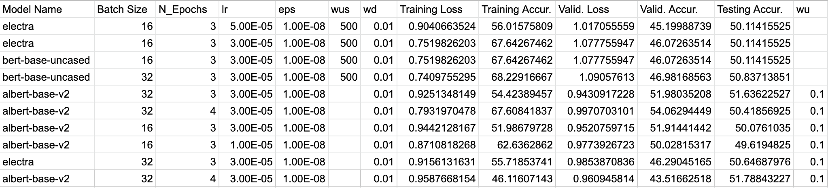
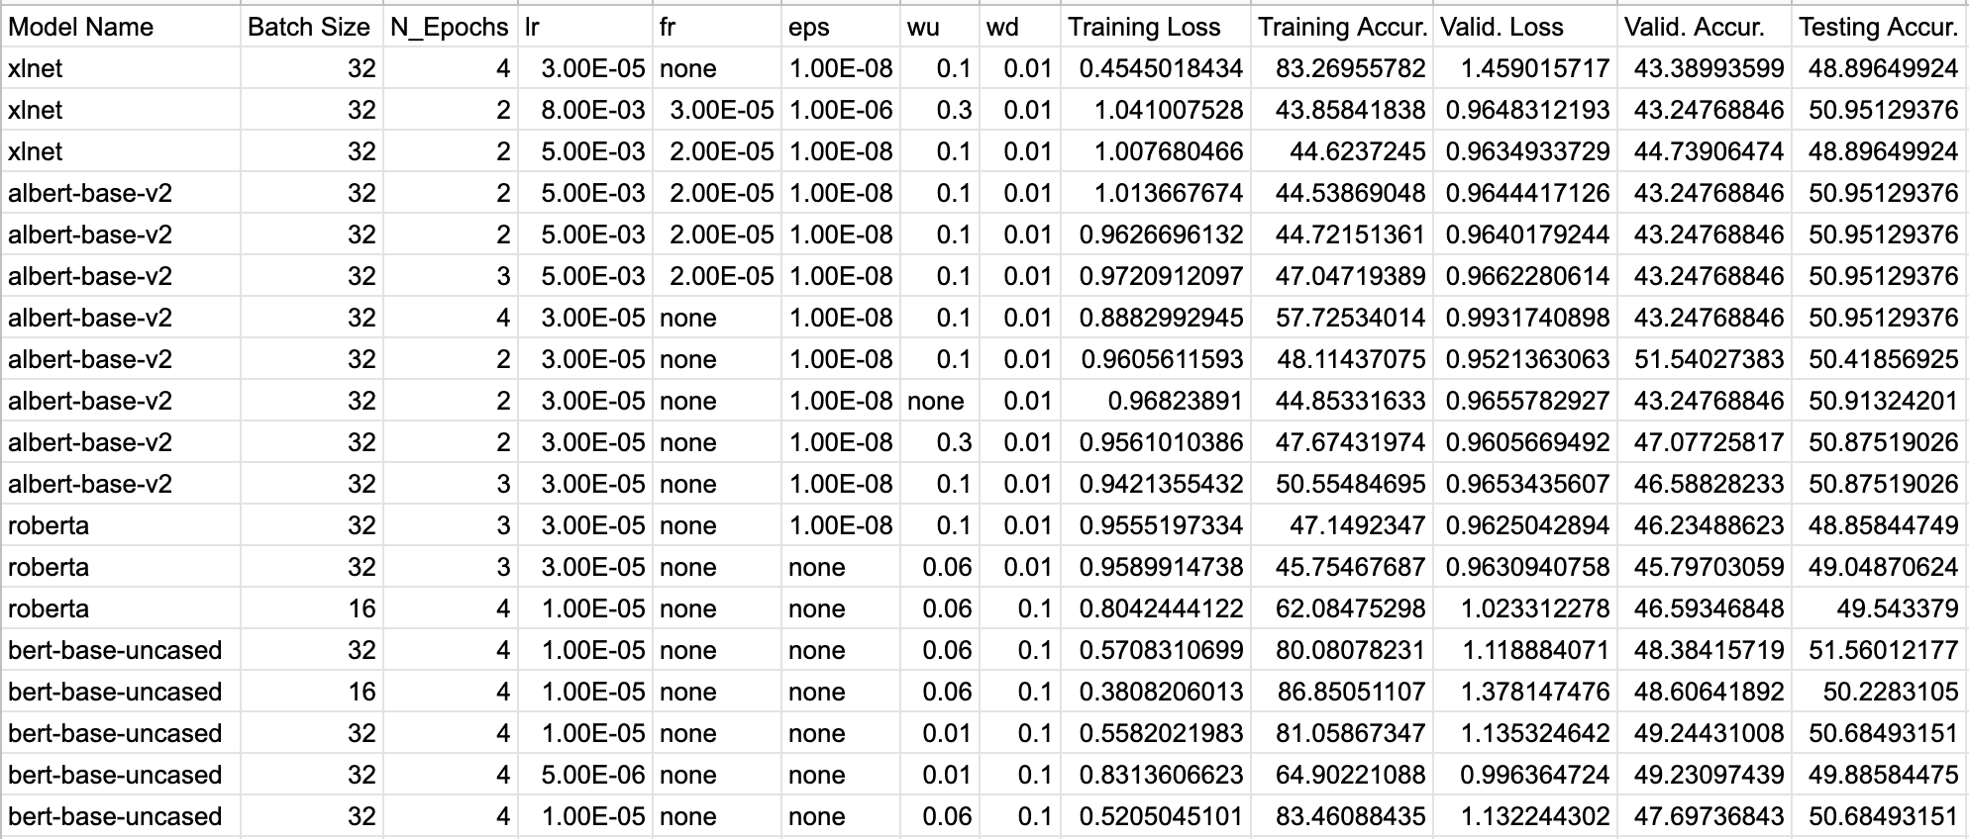
Log 1
Log 2

Slide 26
Task Two – Results
Version 2: Fake Task Training + Real Task Training

Slide 27
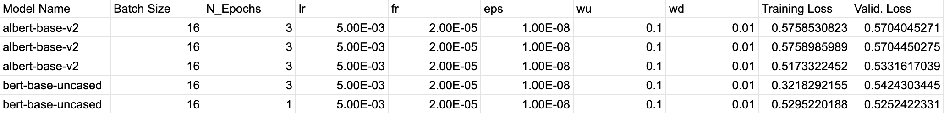
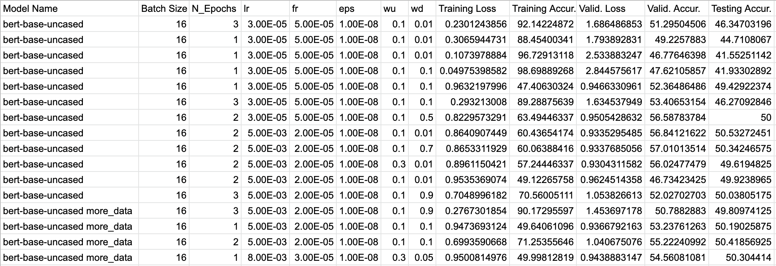
Fake Task Log
Real Task Log

Slide 28
Discussion
Task one
The performance of Two Inputs RNN is just slightly better compared with that of the Two Inputs FFNN (0.5759702196 vs. 0.5751694002) while the time complexity of the Two Inputs RNN is much higher than the Two Inputs FFNN, at some point the current version of Two Inputs RNN is resources-wasted
The Two Inputs CNN with a single window size performs worse than the Two Inputs FFNN and the Two Inputs RNN, and one of possible reasons is that it only looks at one size of n-gram and hence ignores the knowledge of n-grams with different lengths

Slide 29
Discussion
Task two
For different preprocessing methods, the headlines truncated version and the punctuation removal version have the same performance as the normal one except that truncating headlines will reduce the training time for a single epoch
The issue of overfitting on the training dataset is hard to overcome when applying BERT-liked pre-trained LMs (Although several methods, such as data augmentation, weight decay and dropout increase have been tried to mitigate this problem
Surprisingly, the fake task training for pre-trained LMs does not help to improve the performance of the model in real task even a little bit
With the same hyperparameters setting for the certain task, the performance of the newly proposed pre-trained LM is not necessarily the best

Slide 30
Prospective
Construct a pretrain LM to do a binary classification task in which the model learns to decide whether a word from the edited new headline is original or edited. Take the embeddings out of the pretrain model and use it to initialize the model for the real regression task. By doing so we expect the embeddings can be informed some knowledge about the relationship between original headlines and edited headlines.
Build up a pretrain LM to do a text translation task on the training dataset and use the embeddings of this model to initialize the model for the real regression task. (Aim to learn the semantics of funniness)
Intuitively thinking the performance of the Two Inputs CNN might be improved by increasing the number of the window sizes (different n-gram filters)
Applying the pre-trained LM Longformer rather than other BERT-liked models for the task two, in which the Longformer has the ‘global attention mask’ and it can probably better model the relationship between the edited word and the other words in a headline (e.g. How important is the edited word for the whole headline in order to make it funnier? / How does the edited word contribute to the meaning of the whole sentence)

