Slide 1
Tile LVPS Radiation from Monitors
Haleh Hadavand UTA
June 20, 2018

Slide 2
Monitor Positions
LBA15
LBC17
Mark provided an excel sheets with position of tile radiation monitors and dosing from 2012
Will refer to this data as ‘old’
Followed up to look for current radiation dosing from DCS
Will refer to this data as ’new’
Position of monitors are not know precisely
Will see this in next slides when investigating the TID and fluence numbers
LBA43
LBC42
EBA49
EBC49

Slide 3
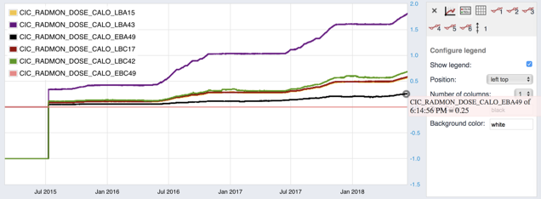
New Doses from DCS (2015-Present)
Barrel | Gy new
Finger LBA43 | 1.8
Finger LBA15 | 0.56
Finger LBC17 | 0.58
Finger LBC42 | 0.68

Slide 4
Old Doses (2012) and Dose/fb⁻¹
Notice that LBA43 and LBA15 have exactly the same dose
Also the A and C side dose is different by almost a factor of 3!

Slide 5
Old and new comparison, TID
 | Gy new | Gy old | rad/fb-1 old | rad/fb-1 new | 4000 fb-1 old | 4000 fb-1 new
Finger LBA43 | 1.80 | 0.37 | 1.25 | 1.55 | 50.13 | 62.07
Finger LBA15 | 0.56 | 0.37 | 1.25 | 0.48 | 50.13 | 19.31
Finger LBC17 | 0.58 | 0.14 | 0.46 | 0.50 | 18.38 | 20.00
Finger LBC42 | 0.68 | 0.16 | 0.50 | 0.59 | 20.05 | 23.45
Large Difference for LBA15 dose in old and new data ie for 4ab⁻¹ old is 50 Gy vs 19 Gy
Was LBA15 moved?
Also see the A/C side discrepancy in both old and new data but not for LBA15 comparison
A vs C side comparison
old | LBA15/LBC17 | 2.642857143
new | LBA15/LBC17 | 0.965517241
new | LBA43/LBC17 | 3.103448276

